Slide 1

Employees Compensation
Employers Liability for workplace injuries
Date

Slide 2

Section 01
Workmens/ Employees Compensation Act
An Act to provide for the payment by certain classes of employers to their workmen of compensation for injury by accident.
If personal injury is caused to a workman by accident arising out of and in the course of his employment, his employer shall be liable to pay compensation in accordance with the provisions of this Act
Date
Employees Compensation

Slide 3

Employees Compensation Act
Provisions
  The employer is not liable –
  in respect of any injury which does not result in the total or partial disablement of the workman for a period exceeding 3 [three] days;
  in respect of any injury, not resulting in death, caused by an accident which is directly attributable to —
  (i) the workman having been at the time thereof under the influence of drink or drugs, or
  (ii) the wilful disobedience of the workman to an order expressly given, or to a rule expressly framed, for the purpose of securing the safety of workmen, or
  (iii) the wilful removal or disregard by the workman of any safety guard or other device which he knew to have been provided for the purpose of securing the safety of workmen.
Date
Employees Compensation

Slide 4

Employees Compensation Act 2009 (Revised limits)
Provisions
  Amount of compensation.-
  Subject to the provisions of this Act, the amount of compensation shall be as follows, namely:--
  where death results an amount equal to fifty percent of the monthly wages of the deceased workman multiplied by the relevant factor; or an amount of One lac twenty thousand rupees, whichever is more;
  (b) Where permanent total disablement results, an amount equal to sixty percent cent. of the monthly wages of the injured workman multiplied by the relevant factor; or an amount of One lac forty thousand rupees, whichever is more;
  Explanation I.--For the purposes of clause (a) and clause (b), "relevant factor", in relation to a workman means the factor specified in the second column of Schedule IV against the entry in the first column of that Schedule specifying the number of years which are the same as the completed years of the age of the workman on his last birthday immediately preceding the date on which the compensation fell due;
Date
Employees Compensation

Slide 5
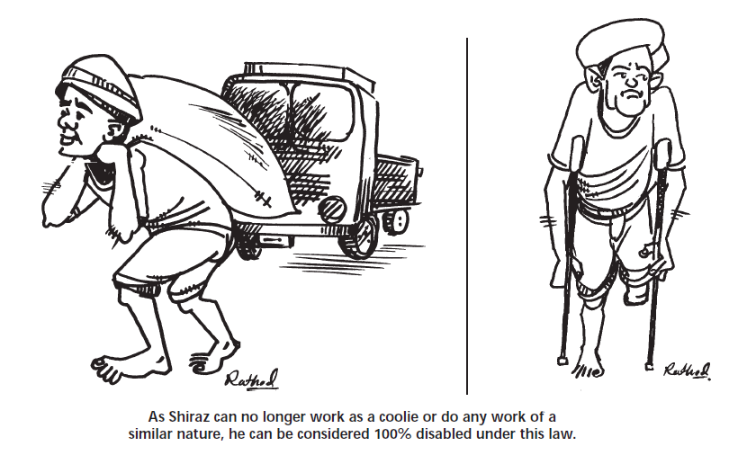
Employees Compensation Act 2009 (Revised limits)
Provisions
Date
Employees Compensation

Slide 6

Employees Compensation Act 2009 (Revised limits)
Provisions
  Amount of compensation.-
  Subject to the provisions of this Act, the amount of compensation shall be as follows, namely:--
  (c) Where permanent partial injury results,
  (1) such percentage of the compensation which would have been payable in the case of permanent total disablement as is specified therein as being the percentage of the loss of earning capacity caused by that injury, and
  (ii) in the case of an injury not specified in Schedule I, such percentage of the compensation payable in the case of permanent total disablement as is proportionate to the loss of earning capacity (as assessed by the qualified medical practitioner) permanently caused by the injury;
  Explanation I.--Where more injuries than one are caused by the same accident, the amount of compensation payable under this head shall be aggregated but not so in any case as to exceed the amount which would have been payable if permanent total disablement had resulted from the injuries;
  Explanation II.--In assessing the loss of earning capacity for the purposes of sub-clause (ii), the qualified medical practitioner shall have due regard to the percentages of loss of earning capacity in relation to different injuries specified in Schedule I
Date
Employees Compensation

Slide 7
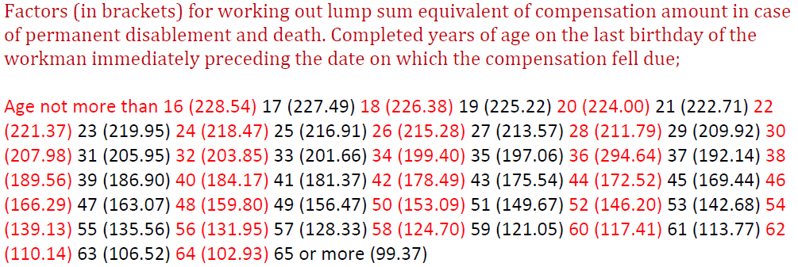

Employees Compensation Act 2009 (Revised limits)
Relevant Factors
Date
Employees Compensation

Slide 8

Employees Compensation Act 2009 (Revised limits)
Provisions
  Amount of compensation.-
  Subject to the provisions of this Act, the amount of compensation shall be as follows;
  (d) Where temporary disablement results
  a half-monthly payment of sum equivalent to twenty-five per cent. of monthly wages of the workman, to be paid in accordance with the provisions of sub- section 2.
  (2) The half-monthly payment shall be payable on the sixteenth day
  from the date of disablement where such disablement lasts for a period of twenty-eight days or more, or
  (ii) after the expiry of a waiting period of three days from the date of disablement where such disablement lasts for a period of less than twenty-eight days; and thereafter half-monthly during the disablement or during a period of five years, whichever period is shorter:
  Explanation.--Any payment or allowance which the workman has received from the employer towards his medical treatment shall not be deemed to be a payment or allowance received by him by way of compensation within the meaning of clause (a)
  On the ceasing of the disablement before the date on which any half-monthly payment falls due, there shall be payable in respect of that half-month a sum proportionate to the duration of the disablement in that half-month.
Date
Employees Compensation

Slide 9
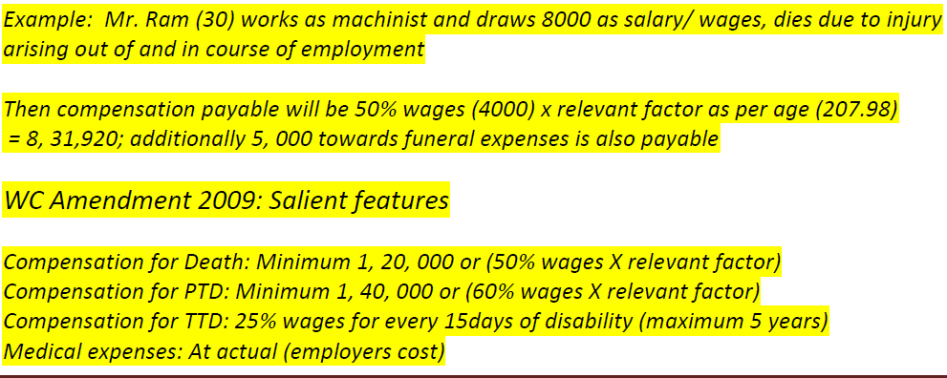

Employees Compensation Act 2009 (Revised limits)
Illustration – Claim Computation
Date
Employees Compensation

Slide 10

Employees Compensation Act 2009 (Revised limits)
Legal Bar
Time period within which the claim should be made (section 10)
All such claims have to be made within two years of the occurrence of the accident, or death of the worker. The commissioner can refuse to hear the matter if no notice was issued to the employer on the occurrence of the accident and no claim made to the commissioner within two years.
If there is a delay in making such a claim it is possible for the delay to be excused by the commissioner, but the worker should give sufficient reason. As the Act is a ‘Beneficial Act’, delays and technical short comings are not given importance unlike criminal and civil cases.
Bar against double remedies ( section 3 (5))
Once an injured worker, initiates action against, or reaches an agreement with, an employer the said worker cannot initiate a simultaneous proceeding in a civil court in respect of the same injury (but s/he can in a criminal court). Similarly if the worker institutes a suit for compensation, for injury sustained during the course of work, in a civil court, then s/he cannot then apply to the labour commissioner under this Act.
Therefore the worker can chose the type of remedy s/he wants i.e. either under the WCA, or civil court or Motor Vehicles Act ( incase of a motor accident), but s/he cannot apply for more than one remedy.
Date
Employees Compensation

Slide 11

Section 02
Workmens/ Employees Tariff/ Policy
Provisions
Date
Employees Compensation

Slide 12

Employees Compensation Policy
Policy coverage
If at any time during the Period of Insurance any Employee or Employees of the Insured shall
sustain Injury by accident arising out of and in the course of his employment in the Business,
for which the Insured is liable to pay compensation under any Law(s) specified in the Schedule, then the Company shall indemnify the Insured up to the Limit of Indemnity against all sums for which the Insured shall be so liable, including costs and expenses for defending any such claim incurred with the Company’s consent.
Law(s) applicable:
Workmen's compensation act (as amended)
Fatal accident act
Common law
PROVIDED ALWAYS that in the event of any change in the Law(s) or the substitution of other legislation therefor, this Policy shall remain in force but the liability of the Company shall be limited to such sum as the Company would have been liable to pay if the Law(s) had remained unaltered.
Date
Employees Compensation

Slide 13

Employees Compensation Policy
Policy Definitions
Wages means the remuneration payable to an Employee by the Insured for the employment in the Business and includes any privilege or benefit which is capable of being estimated in money other than a travelling allowance or the value of any travelling concession or a contribution paid by the employer of an employee towards any pension or provident fund or a sum paid to an employee to cover any special expenses entailed on him by the nature of his employment;
2. Employee or Employees means such person or persons in direct employment under the Insured in the
Business, but shall not include any person employed under a Contractor or Sub-Contractor of the Insured
unless specifically shown as covered in the Schedule and by an endorsement.
3. Injury means physical bodily injury including death resulting from such injury arising out of an accident but does not include any mental sickness, disease, Occupational Disease, unless caused by such physical bodily injury.
Date
Employees Compensation

Slide 14

Employees Compensation Policy
Policy Exclusions
This Policy shall not cover liability of the Insured:
a) For Injury caused to Employee by accident directly or indirectly caused by or arising from or in consequence
of or attributable to war, invasion, act of foreign enemy, hostilities (whether war be declared or not) civil war,
mutiny, insurrection, rebellion, revolution or military or usurped power, nuclear weapons material, ionising
radiations or contamination by radioactivity from any nuclear fuel or from any nuclear waste from the
combustion of nuclear fuel.
b) Accident occurring at any other place than the Place or Places of Employment specified in the Schedule, unless the Employee was at such other place whilst on duty for the purpose of the Business and on the directions of the Insured or any of its official authorized to exercise control and supervision over the Employee..
c) For Occupational Diseases contracted by an Employee
Date
Employees Compensation

Slide 15

Employees Compensation Policy
Policy Exclusions
This Policy shall not cover liability of the Insured:
d) For interest and/or penalty imposed on the Insured under any law or otherwise.
e) Under any Law for medical expenses in connection with treatment of any Injury sustained by an Employee
f) For persons employed in the Business under a Contractor or Sub-Contractor of the Insured unless specifically covered in the Schedule
g) For Injury sustained by person whilst in the employ of the Insured otherwise than in the Business and/or who has is not declared for insurance under this Policy.
h) Assumed by agreement which would not have attached in the absence of such agreement
For any sum which the Insured would have been entitled to recover from any party but for an agreement between the Insured and such party.
j) For any accident occurring whilst the Employee is under the influence of intoxicating liquor or drugs.
k) For any incapacity or death of an Employee resulting from his/her deliberate self-injury
Date
Employees Compensation

Slide 16

Employees Compensation Policy
Policy Conditions
1. The Contract: This Policy and the Schedule shall be read together as one contract and any word defined herein and shown in bold shall bear such specific meaning wherever it may appear in the Policy or the Schedule.
2. Due Observance: The due observance and fulfilment of the terms, conditions and endorsements of this Policy so far as they relate to anything to be done or not to be done by the Insured shall be condition precedent to any liability of the Company to make any payment under this Policy.
3. Mis-representation/Non-Disclosure: This Policy shall be void in the event of any mis-representation or non-disclosure in the Proposal and the Insured is deemed to warrant the truth and accuracy of the statements and answers in the Proposal which form the basis of this Policy.
4. Written Communication: Every notice or communication to be given or made under this Policy shall be delivered in writing to the Company.
5. Safeguards: The Insured shall take reasonable precautions to prevent accidents and disease and shall comply with all statutory obligations, manufacturer's recommendations and other safety regulations in conduct of the Business.
Date
Employees Compensation

Slide 17

Employees Compensation Policy
Policy Conditions
6. Claim Intimation: In the event of any occurrence which may give rise to a claim under this Policy the
Insured shall as soon as possible, and in any case within a period of thirty days of such occurrence, give notice thereof to the Company in writing with full particulars. Every letter claim writ summons and
process shall be notified to the Company immediately on receipt. Notice shall also be given to the Company immediately the Insured shall have knowledge of any impending prosecution inquest or fatal enquiry in connection with any such occurrence as aforesaid.
7. Company’s Rights After Loss: No admission offer promise or payment shall be made by or on behalf of the Insured without the consent of the Company which shall be entitled, without being obliged to do so, if it so desires to take over and conduct in his name the defence or settlement of any claim or to prosecute in his name for its own benefit any claim for indemnity or damages or otherwise and shall have full descretion in the conduct of any proceedings and in the settlement of any claim and the Insured shall give all such information and assistance as the Company may require.
8. Declaration of Employees and Wages: It is clearly agreed and Understood that the Insured shall be bound at all times to declare all Employees and Wages payable in respect of such Employees on the basis of which the Premium for this Policy is calculated. In case of increase in Employees or Wages subsequent to insurance, Insured shall keep the Company intimated and obtain Endorsement by payment of necessary additional premium. The Insured shall as and when require by the Company permit inspection of its records to verify the Wages and Employees and shall also provide duly authenticated copies thereof if so required the Company.
Date
Employees Compensation

Slide 18

Employees Compensation Policy
Policy Conditions
Average: Notwithstanding anything contained hereinabove,
(i) a) If the number of Employees (whether on duty or otherwise) employed by the Insured on the date of accident is higher than the number covered under this Policy, the Company shall indemnify Insured’s liability arising out of such accident, only in such proportion that the number of Employees covered bears to the Employees found employed on the date of accident.
b) If the amount of Wages declared for this insurance for all Employees is less than the actual Wages paid until date of accident, the Company shall be liable to indemnify on any claim only in proportion that the Wages declared bears to the Wages paid. For the purpose of this clause, the Wages declared shall be calculated proportionately for the period from commencement of Policy until date of accident for comparison with the actual wages paid during such period to determine applicability of this clause.
c) If the liability of the Insured for any claim by an Employee is determined on the basis of Wages higher than covered under this Policy, the Company shall be liable to indemnify only in proportion that the Wages covered under the Policy for the mployee/Employees bears to the Wages on the basis of which Insured is held liable. For the purpose of this clause, the Wages covered in respect of any Employee shall be deemed to be the average wage per Employee in the category under which the Employee falls as specified in the Schedule, unless actual Wages paid at the time of accident is substantiated by submission of documentary evidence to the Company.
(ii) If more than one of the above clauses is found applicable in respect of a claim, only such clause under which the liability of the Company is least shall be applied.
Date
Employees Compensation

Slide 19

Employees Compensation Policy
Policy Conditions
10. Maintenance of record of Employees/Wages: The Insured undertakes to maintain an accurate record of the Employees and Wages in respect of the Business throughout the Period of Insurance, in compliance with all statutory requirements or otherwise, and allow the Company to inspect such records during or upon expiry of this Policy.
11. Contribution: If at the time of the happening of an accident covered by this Policy there shall be any other insurance covering the same risk in respect of the Employee whether or not effected by the Insured, then the Company shall not be liable to contribute more than its rateable proportion of the amount that would otherwise be payable under this Policy.
12. Cancellation: The Company or the Insured may cancel this Policy by sending at least 15 days written notice to the other party at his last known address and in such event the premium shall be adjusted in accordance with Condition 8 above.
13. Forfeiture: In event of Fraud claim
14. Arbitration: For settlement of dispute regarding quantum of claim
15. Law & Jurisdiction: INDIA
Date
Employees Compensation

Slide 20
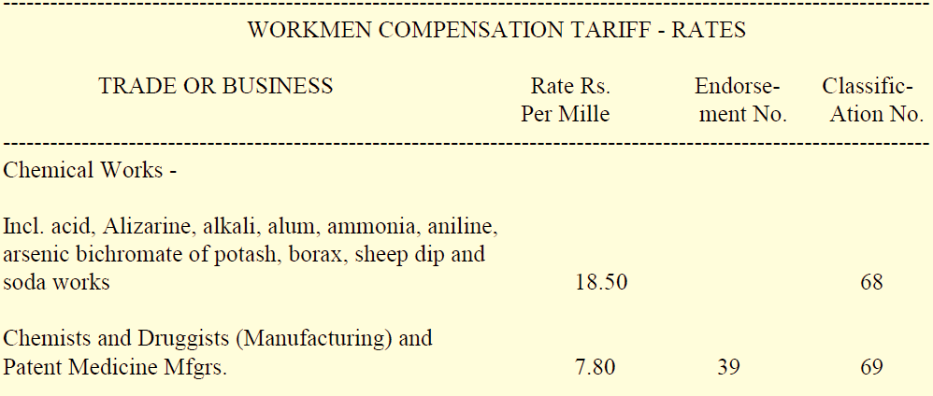

Employees Compensation Policy
Rates e.g.
Note: Rates as per tariff are applied to wages up to 8,000 and nominal rate of INR 2 / mille is applied to wages exceeding 8,000/ month
Date
Employees Compensation

Slide 21

Employees Compensation Policy
Claims Documents
Documents required for processing the Claim–
  Claim Form
  FIR in case of Death, PTD and PPD
  Death Certificate (original) in case of death claim
  Post mortem (Attested legible copy) in case of death claim
  PTD-Doctors certificate certifying permanency of disability.
  PPD-Doctors Certificate certifying permanency of disability.
  TTD-Doctors Certificate certifying period of disability.
  Detailed Note on incident from Site-In-charge
  Wages slips + Attendance particulars + Birth certificate or School leaving certificate.
  Original Medical Bills and Receipts
Date
Employees Compensation

Slide 22
Employees Compensation Policy
Claims Best Practices .
IN ORDER TO HAVE HASSEL FREE PROCESSING OF THE CLAIM:
Keep documentary proof of birth date of all employees in the records
Keep wage register and attendance register updated always.
Take insurance policy for all employees other than those covered under ESI scheme.
Declare the correct wages for insurance cover,
In case of increase in wages and/or number of employees during the tenure of policy, immediately inform the same to insurance company and get the policy amended and ensure that you are fully insured.
It is advisable to take adequate ‘Medical Expenses Extension’ under the Insurance policy as Medical expenses incurred for accidental injury to employee is a part of employer’s liability.
Date
Employees Compensation

Slide 23
Thanks
www.futuregenerali.in
Date

