Slide 1
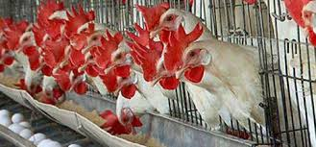
POULTRY INSURANCE

Slide 2
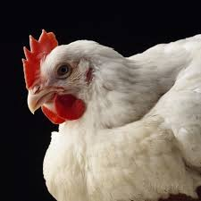
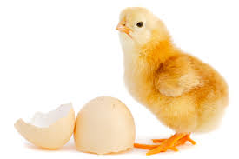
What Policy Covers?
Accident (including Fire, Lightning, Flood, Cyclone, Strike, Riot and Civil Commotion & Terrorism),
or
Diseases contracted or occurring during the period of insurance
Indemnity against death of birds due to
Coverage provided for:
Reared for Egg production purposes
‘Layers’ birds
Reared for Meat purposes
‘Broilers’ birds
Reared for breeding and Chicks production purpose
‘Hatchery’ Birds

Slide 3
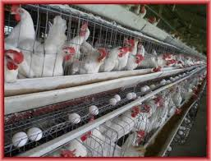
Underwriting Guidelines
All the birds in a farm should be covered.
All the birds should be covered on flock basis thus no identification is necessary. After issuing policy, if additional birds are introduced in the farm, immediate notice to be given to insurer. New birds being added into the batch should pass through the Veterinary examination.
All the birds proposed for insurance should be sound and healthy. A fitness certificate to this effect from Veterinarian is required
Insured is expected to keep all the essential records such as Flock record on day to day basis –
  Daily stock Register
  Mortality Record
  Culling (Removal of weak birds from the flock)
  Vaccination
  Feed consumption
  Production
  Incidence of diseases
  Purchases and Sales
Transfer of interest/ownerships is not allowed
Information about any epidemic of disease should be collected from the nearby veterinary hospitals
Depending upon the claims experience and risk features additional underwriting conditions may be implemented

Slide 4
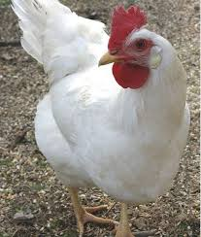
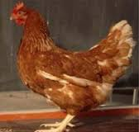
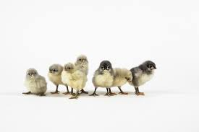
Underwriting Guidelines
Insurable Age
  Broilers: 1 day to 8 weeks
  Layers: 1 day to 72weeks
  Hatchery: 1 day
  to 72 weeks

Slide 5
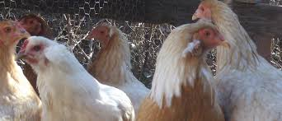
Sum Insured
Peak Value of the bird is taken as Sum Insured for premium calculations.
Presently it is as under, which is subject to change on the basis of change of Chick cost and feed cost.
Layers
Non-Scheme
Rs.111/- per bird
Broilers
Non-Scheme
Rs.85/- per bird
Hatchery
Negotiable
Minimum Rs.300/-

Slide 6
Indicative Premium Rates
Rs.5.00% on peak value per bird + Service Tax
Layers
Rs.1.50% on peak value per batch or Rs.6.00% per year + Service Tax
Broilers
Rs.5.00% on peak value + Service Tax
Hatchery
Full Premium to be collected at once before commencement of the policy
for the entire policy period

Slide 7

Major Exclusions
Loss / Death due to natural mortality, non-specified or unknown disease or reasons
Malicious/willful injury, neglect
Transit by any mode of transport
Improper management (including overcrowding) i.e. when the farm is not run on scientific Poultry Management Guidelines laid down by Poultry Corporations/Animal Husbandry Department in regard to housekeeping, watering, feeding, vaccinations, deworming, debeaking, lighting / heating, culling etc.
Undergrowth, cannibalism, action of predators like preying birds and carnivorous animals.
Theft and clandestine sale of birds.
Intentional slaughter of the birds except in cases where destruction is necessary to terminate incurable suffering on humane consideration and to protect remaining healthy flock to reduce additional losses on the basis of certificate issued by qualified veterinary surgeon or in cases where destruction is resorted to by order of lawfully constituted authority under intimation to Insurance Company.
Consequential loss, howsoever caused such as Loss of earning, loss of delays, loss of market or other consequential or indirect loss or damage of any kind or description whatsoever.
Loss of production i.e. the failure due to any reasons whatsoever to lay required number of eggs or small sized eggs in layers or to attain proper weight at a particular age in broilers

Slide 8

Major Exclusions
Permanent and Partial Disablement of any nature.
Malnutrition/shortage of water, death due to starvation because of non-supply of feed to farm due to any reason whatsoever.
Loss due to huddling and/or piling of birds
Marek’s disease, Ranikhet disease, Fowl Pox and Infectious Bronchitis. These diseases are covered if the birds are successfully inoculated against these diseases and the necessary veterinary certificate to that effect is submitted. Coccidiosis and other diseases are covered only if preventive and curative measures are taken from time to time.
Avian Leucosis complex (A.L.C.), Bird Flu.
War, invasion, acts of foreign enemies, hostilities (whether war be declared or not), civil war, commotion, unrest, rebellion, revolution, insurrection, military or usurped power or confiscation or nationalization or requisition of or damage by or under the order of any government or public local authority, riot, strike, or terrorist activities.
Ionising radiation or contamination by radioactivity from any nuclear fuel or from any nuclear waste or nuclear weapons material or from the combustion of nuclear fuel, or the radioactive toxic explosive or other hazardous properties of any explosive nuclear assembly or nuclear component thereof

Slide 9

Claims Procedure
In the event of death of birds, immediate intimation should be given to the company and the insurer should be supplied with the following documents required information.
  Duly filled claim form
  P.M. Report
  Daily records of mortality, feeding, Sales etc.
  Purchase invoices for the birds
  Any other proof to substantiate the loss like photographs, medical bills as and when required
In the case of alarming mortality, out-break of epidemic nature, immediate notice within 12 hours should be given to the Company and all birds should be segregated and produced to the representative of the Company or to any person authorized by the Company for inspection
Daily mortality details should be sent to the Company on fortnightly basis

