Slide 1
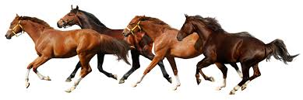
Horse Insurance

Slide 2
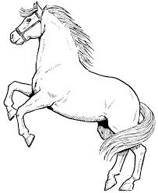
Horse Insurance
Features & Benefits
Underwriting Guidelines
Claims Process

Slide 3
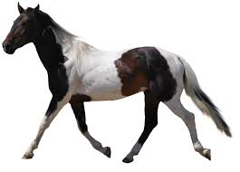
What is Horse Insurance Policy?
This policy is specifically designed to provide valuable financial protection to Horse Owners of Urban, Semi-urban and Rural areas
Death of Horse by disease or
accident
Coverage
Permanent Total Disability of the Horse due to accident, which results in that animal no longer being able to fulfill the purpose for which it was intended

Slide 4
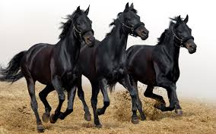
Premium
Premium Rate
For Death only cover
4.50%+ST
1.00%+ST
For PTD cover
Group Discount
No. of Horses
Rate of Discount
5-10
2.5 %
11-15
5 %
16-25
7.5 %
26-50
10 %
51-100
12.5 %
101-500
15 %

Slide 5

Underwriting Guidelines
Duly Filled Proposal Form
Age Limit 2 - 8 yrs. Higher or Lower age can be covered by charging extra premium on case to case basis
Proposed Horse should be sound and healthy in condition
Horse may be tagged with either eat tag or Microchip &/or Photographs be taken
Photographs of the Horse should clearly show ear tag, if applied and proper description of the Horse
Certificate of Fitness –cum –Valuation issued by a qualified Veterinary Doctor is required with Proposal
Purchase Receipt be collected if Horse is purchased
If proposal is for high value Horse than possibly certificate from 2 vets can be asked for
Information about any epidemic of disease should be collected from the nearby veterinary hospitals
Proposer’s Mobile No. and Phone No. to be collected for contact in case of any claim
Policy shall be subject to Contribution, Cancellation and Arbitration conditions

Slide 6

Major Exclusions
Malicious or willful injury or neglect, overloading, unskillful treatment.
Accidents and/or disease contracted prior to commencement of risk.
Glanders, South African Horse Sickness. However, Rinderpest, FMD, Anthrax, H.S., B.Q. are also excluded if the animal is not successfully inoculated (protected).
Theft or clandestine sale of the insured animal.
Disability Temporary or Permanent, Total or Partial. PTD can be covered if opted.
Death due to any disease contracted within 15 days from the date of commencement of the policy
Transport by air and sea. Transport beyond 25 kilometers from the place of stabling by Rail or Road and beyond 50 kilometers from the place of stabling in case of transit by foot.
Intentional slaughter of the animal except by the order of lawfully constituted authority.
Any Consequential Loss
War or War like situation, riot, strike, or terrorist activities.
Ionising radiation or contamination by radioactivity from any nuclear fuel.
Specific Exclusion:
Racing, Hunting, Blood stock Purposes

Slide 7

Claims Procedure
In the event of death of an animal, immediate intimation should be sent on Mobile No. and Phone No. mentioned in the policy followed by in writing and the following requirements should be furnished:
Duly completed claim form.
Death Certificate obtained from qualified Veterinarian.
Postmortem examination report as required by the Company.
Photograph of Dead animal
Ear Tag, if applied to the animal at the time of insurance should be surrendered.
Salvage:
Commercially realizable value of dead animal

Slide 8

Claims Procedure
In the event of Permanent Total Disablement : After immediate intimation following requirements should be furnished. Indemnity is limited to 80% of market value or sum insured whichever is less
A certificate from the qualified veterinarian to be obtained.
Company’s officer inspect the animal wherever it is possible and necessary.
Complete chart of treatment, medicines used, receipts, etc., should be collected. (Company may engage an independent qualified veterinarian or an investigator in special circumstances).
Admissibility of claim to be considered after two months of obtaining veterinary doctor / company doctor’s report

