Slide 1
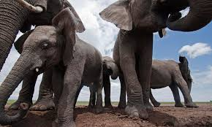
Elephant Insurance

Slide 2
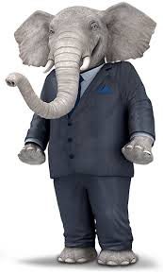
Elephant Insurance
Features & Benefits
Underwriting Guidelines
Claims Process

Slide 3
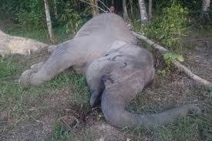
What is Elephant Insurance Policy?
This policy is specifically designed to provide valuable financial protection to Elephant Owners of Urban, Semi-urban and Rural areas
Coverage
Death of Elephant by Disease or Accident
Indemnity Limit
80% of Market Value or Sum Insured

Slide 4
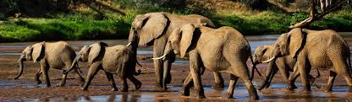
Premium
For Death only cover
Elephant used for commercial purpose
5.00%+ST
Elephant used for religious purpose
4.50%+ST
Group Discount
No. of Elephants
Rate of Discount
5-10
2.5 %
11-15
5 %
16-25
7.5 %
26-50
10 %
51-100
12.5 %
101-500
15 %

Slide 5

Underwriting Guidelines
Duly Filled Proposal Form
Age Limit 5-60 yrs. Higher or Lower age can be covered by charging extra premium on case to case basis
Proposed Elephant should be sound and healthy in condition
Elephant tagged with Microchip &/or Photographs be taken
Photographs should clearly show the proper identification marks of Elephant
Certificate of Fitness –cum –Valuation issued by a qualified Veterinary Doctor is required with proposal
If proposal is for high value Elephant than possibly certificate from 2 vets can be asked for
Proposer’s Mobile No. and Phone No. to be collected for contact in case of any claim
Policy shall be subject to Contribution, Cancellation and Arbitration conditions

Slide 6

Major Exclusions
Malicious or willful injury or neglect, overloading, unskillful treatment.
Accidents occurred and/or diseases contracted prior to commencement of risk.
Tuberculosis, Salmonellosis, Hemorrhagic Septicemia, Anthrax, Foot & Mouth Disease, Impaction Of Colon, Tetanus, Rabies and Parasitic Infection. However those diseases are covered provided inoculated.
Theft or clandestine sale of insured animal.
Disability of any type, whether Permanent or Temporary.
Death due to any disease within 15 days from the date of commencement of the policy.
Transport by air and sea. Transport beyond 25 kilometers from the place of stabling by rail/road and beyond 50 kilometers from the place of stabling in case of transit by foot.
Intentional slaughter of the animal except in cases where destruction is necessary to terminate incurable suffering.
Any consequential loss, howsoever arising.
War or War like situation, riot, strike, or terrorist activities.
Ionising radiation or contamination by radioactivity from any nuclear fuel.
Special Exclusions:
Breeding and Calving Risk
Loss or Damage of Tusks

Slide 7

Claims Process
In the event of death of an animal, immediate intimation should be sent on Phone No. mentioned in the policy followed by in writing. Company will depute its representative for physical verification of carcass ( Dead animal).Following requirements should be furnished:
Duly completed claim form.
Death Certificate obtained from qualified Veterinarian.
Postmortem examination report as required by the Company.
Treatment Records, if any.
Photograph of Dead animal
Salvage:
Commercially realizable value of Dead animal

