Slide 1
Cattle & Livestock Insurance

Slide 2
Cattle Insurance- An Introduction
The word “Cattle” for insurance coverage refers to ‘Milch Cow’ or ‘Milch Buffaloe’ means animal used primarily for milk production, Bulls, Bullocks, Calves, Heifers, Male Buffaloe.
Indigenous
These are domestic breeds. Normally these breeds are strong and more resistant to diseases, but the milk production is less.
Crossbred
These are animals whose one of the parents is of foreign breed. These are high milk yielder and are hardier than pure exotic breeds.
Exotic
These are animals, who’s both parents are of foreign breed. They yield more milk but prone to diseases. These are of high value and very carefully groomed.

Slide 3
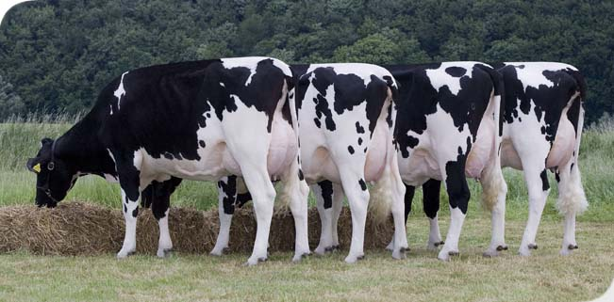
Insurance Coverage
Cattle insurance would indemnify the Insured against Financial loss suffered as a result of Death or Permanent Total Disablement due to diseases and accidents occurring during the period of insurance.
Accidents:
Fire, Electrocution, Snake Bite, Wild Life attack, Strangulation, Vehicular Accident, Drowning in river, lake, pond, sea and other water bodies, Poisoning, Riot, Strike, Act of God Perils etc.

Slide 4
Age of Animal For Eligibility of Insurance
Age of Animals in years shown below shall be accepted for Insurance
I | a) | Milch cows (Indigenous / Cross-bred / Exotic) | 2 to 10 years.
 | b) | Milch Buffaloes | 3 to 12 years.
 | c) | Stud Bulls (Cow / Buffalo species) | 3 to 8 years
 | d) | Bullock (castrated bulls and castrated male buffaloes) | 3 to 12 years.
II | Indigenous, cross-bred and exotic female calves / heifers. |  | 4months to age as in (I) (a) and (b)
III | Sheep and Goat |  | 6 months to 6 years
Note: At the time of acceptance, the maximum age should not exceed the prescribed age limit.

Slide 5
VALUATION AND SUM INSURED
1.The Market value of cattle varies from breed to breed, from area to area and from time to time. The examining Veterinarians’ recommendations shall be considered as the proper guide for acceptance of insurance as well as for settlement of claims. Wherever possible, high valued animals may be inspected by two veterinarians and if required by Company’s representative.
2. Sum Insured will not exceed 100% of Market Value.

Slide 6
Indicative Premium Rates
For Milch Cows /Buffaloes / Female Calves / Heifers / Stud Bulls / Bullocks
 | SPECIES | COVERS
 |  | Death | PTD Extra
1 | Indigenous /cross–bred | 5.00% | 1.00%
2 | Exotic Animals | 6.00% | 1.00%
Service Tax Extra

Slide 7
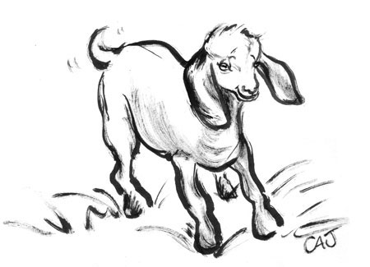
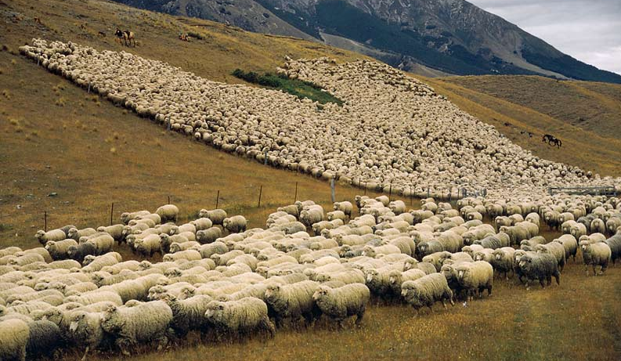
PREMIUM RATES
For Sheep & Goats
A) For Indigenous Animals-4% gross per annum
B) For Crossbred Animals - 5% gross per annum
C) For Exotic Animals - 6% gross per annum
(Note: Premium Rate for Scheme animals is 2.75% net)

Slide 8
Group Discount
No. of Animals | Rate of Discount
5-10 | 2.50%
11-15 | 5.00%
16-25 | 7.50%
26-50 | 10.00%
51-100 | 12.50%
101-500 | 15.00%
More than 500 | Not More than 20.00%

Slide 9
Schedule of Fees Payable by Company:
For Examination and Tagging charges for large animals (Cows, Buffaloes etc)- Min. Rs.25/-per animal.
For Examination and Tagging charges for small animals (Sheep and goats) – Rs.5/-per animal.
For Photographs 15/- per animal.
For conducting post-mortem examination and preparing Report Rs.200/-(If organized by Co.)
No Fees to be paid for scheme animals.

Slide 10
Process
Proposal Form
Proposal form will be filled up by or on behalf of the cattle owner.
Determination of Sum Insured of the animal:
The market price of the animal will be as per Veterinary Doctor’s Health-cum-Valuation Certificate. Such market price shall be Maximum Sum Insured.
Health Certificate:
Veterinary doctor of the area to be contacted for Health-cum-Valuation certificate of the animal to be insured confirming the description of animal (including ear tag number), its value and soundness.
Vaccination Certificate:
The following diseases will be covered under this policy only when a satisfactory vaccination certificate is furnished at the inception of the policy:Haemorrhagic Septicemia, Black Quarter, Anthrax, Rabies, Foot & Mouth Disease

Slide 11
Process
Identification of animals:
  Identification of individual cattle would be done using Polyurethane eartags
  with unique identification numbers embossed on them. FG company
  representative shall arrange ear tagging with the cooperation of Veterinary
  doctors.
Premium Collection:
Premium will be charged on the sum insured of the cattle. The collected premium shall be deposited along with the proposal and corresponding Health Certificate
Cover note Issuance:
On the receipt of proposal forms, Health Certificate and corresponding premium FG would provide ear tags. On confirmation of tagging done and submitting the photographs of tagged cattle, the cover note would be issued by FG.
Policy Issuance:
On receipt of Copies of Cover notes booking shall be done and policy shall be released by operations.

Slide 12
Exclusions
The Company shall not be liable under this Policy for compensating the Insured for any loss or damage in the following events:
Malicious or willful injury or neglect, overloading, unskillful treatment or use of animal for purpose other than stated in the policy.
Accidents/Disease prior to commencement of risk.
Pleuropneumonia. H.S., FMD, BQ, Anthrax & Rabies. These diseases are covered if the animal is inoculated and Certificates are supplied to the company.
Any claim arising due to disease within 15 days from commencement date of the policy.

Slide 13
Exclusions
Theft and Clandestine sale of the insured animal.
Partial and Total disability of any type, whether permanent or temporary. Permanent Total disability (PTD) exclusion is deleted if PTD is opted by paying extra premium.
Any loss or damage caused willfully or knowingly by the Insured, or any loss or damage in which the Insured or any person acting on his behalf is involved or implicated.
Transported by air or sea. Transport beyond 25 Kms from the place of Stabling by either road or rail and transit beyond 50 Kms on foot.

Slide 14
Exclusions
Intentional slaughter of the animal except in cases where destruction is necessary to terminate incurable suffering on humane consideration on the basis of certificate issued by qualified Veterinarian or in cases where destruction is resorted to by the order of lawfully/statutorily constituted authority.
Any Consequential Loss, Howsoever arising.
War or War like situation
Ionising Radiation or Contamination from Nuclear fuel or waste.

Slide 15
CLAIM PROCEDURE
In the event of death of an animal, immediate intimation should be sent on
Phone No. mentioned in the policy followed by in writing. Company will depute
its representative to physically verify the carcass (Dead animal). Following
requirements be furnished:
Duly completed claim form.
Death Certificate obtained from qualified Veterinarian.
Postmortem Examination Report. Insured has to get PM done by a qualified Veterinary doctor.
Ear Tag, which applied to the animal should be surrendered. The principle of ‘ No Tag- No claim’ shall be followed.
Value of the animal at the time of Loss.
Photograph of dead cattle.

Slide 16
CLAIM PROCEDURE
In the event of PTD Claim, immediate intimation should be sent on Phone No. mentioned in the policy followed by in writing:
Certificate from the qualified Veterinarian to be obtained stating the nature and Extent of Disability.
Complete chart of treatment, medicines used, receipts, etc., should be collected. (Company may engage an independent qualified Veterinarian or another investigator in special circumstances).
Admissibility of claim to be considered after two months of obtaining Veterinary Doctor / Company Doctor’s report. The Company’s authorised Veterinarian should examine the animal and confirm PTD, before settlement of the claim.
The indemnity is limited to 50 % or 75% of Sum Insured as per the type of animal.

