Slide 1
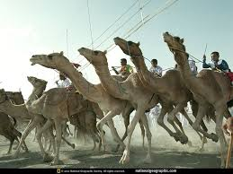
Camel Insurance

Slide 2

Camel Insurance
Features and benefits of Camel Insurance Policy
Underwriting Guidelines
Claims Process

Slide 3

Coverages
This policy is specifically designed to provide valuable financial protection to Camel Owners of Urban, Semi-urban and Rural
Death of Camel by
disease or accident
Coverage
Permanent Total Disability of the Camel due to accident, which results in that animal no longer being able to fulfill the purpose for which it was intended

Slide 4
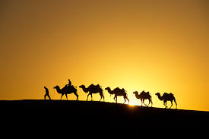
Premium
Premium Rate
For Death only cover
4.50%+ST
1.00%+ST
For PTD cover
Group Discount
No. of Camels
Rate of Discount
5-10
2.5 %
11-15
5 %
16-25
7.5 %
26-50
10 %
51-100
12.5 %
101-500
15 %

Slide 5

Underwriting Guidelines
Duly Filled Proposal Form
Age Limit 3-10 yrs. Higher or Lower age can be covered by charging extra premium on case to case basis
Proposed Camel should be sound and healthy in condition
Camel tagged with either eat tag or Microchip &/or Photographs be taken
Photographs of the Camel should clearly show eartag, if applied and proper description of the Camel
Certificate of Fitness –cum –Valuation issued by a qualified Veterinary Doctor is required with proposal
Purchase Receipt be collected if camel is purchased
If proposal is for high value Camel than possibly certificate from 2 vets can be asked for
Information about any epidemic of disease should be collected from the nearby veterinary hospitals
Proposer’s Mobile No. and Phone No. to be collected for contact in case of any claim
Policy shall be subject to Contribution, Cancellation and Arbitration conditions

Slide 6
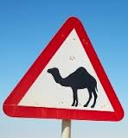
Major Exclusions
Malicious or willful injury or neglect, overloading, unskillful treatment.
Accidents and/or disease contracted prior to commencement of risk.
Rinderpest, FMD, Anthrax, H.S., B.Q. if the animal is not successfully inoculated (protected).
Theft or clandestine sale of the insured animal
Disability Temporary or Permanent, Total or Partial. PTD can be covered if opted.
Death due to any disease contracted within 15 days from the date of commencement of the policy
Transport by air and sea. Transport beyond 25 kilometers from the place of stabling by Rail or Road and beyond 50 kilometers from the place of stabling in case of transit by foot.
Intentional slaughter of the animal except in cases where the destruction is resorted to by the order of lawfully constituted authority.
War or War like situation, riot, strike, or terrorist activities.
Ionising radiation or contamination by radioactivity from any nuclear fuel
Specific Exclusion:
Death of a Camel due to Surra

Slide 7
Claims Procedure
In the event of death of an animal, immediate intimation should be sent on Phone No. mentioned in the policy followed by in writing. Company will depute its representative for physical verification of carcass ( Dead animal). Following requirements should be furnished
Duly completed claim form.
Death Certificate obtained from qualified Veterinarian.
Postmortem examination report as required by the Company.
Treatment chart, if treated.
Photographs of Dead animal
Ear Tag, if applied to the animal at the time of insurance should be surrendered
Salvage:
Commercially realizable value of dead animal

Slide 8
Claims Procedure
In the event of Permanent Total Disablement : After immediate intimation following
requirements should be furnished. Indemnity is limited to 70% of market value or
sum insured whichever is less
A certificate from the qualified veterinarian to be obtained.
Company’s officer inspect the animal wherever is possible and necessary.
Complete chart of treatment, medicines used, receipts, etc., should be collected. (Company may engage an independent qualified veterinarian or an investigator in special circumstances).
Admissibility of claim to be considered after two months of obtaining veterinary doctor / company doctor’s report

