Slide 1


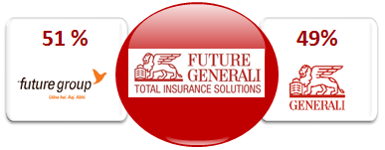
Future Generali India Insurance Company – 11 successful years
Future Group- Pioneers in retail
Global expertise– Generali group since 1831
Global Health Insurance expertise- GEB
125 offices with multi channel teams
In-house, de-centralized Motor/ Non Motor Claim servicing
In-house Health Claim servicing since Nov 2010- Future Generali Health
5532 Hospitals in Network across 577 cities
2591 Crore premium income in FY 18-19
Global premium income of 66,691 mln Euros, Net profit of 2,309 mln Euros and Assets under management of 488 bln Euros in 2018
Established in 1966, Generali Employee Benefit is now the world’s leading employee benefits network, serving multinational companies in over 100 countries.
Proud winner of ET Now Sales Champion Award 2018! Retail Sales team
Proud winner of Stevie Awards for Sales and Customer Service 2019! We won this global recognition in 2018 as well

Slide 2
ALPO BIMA
PED related claim payable
Maternity related claim payable
Accident & Critical cover for Primary member
Double/ Daily benefit x2 payable for ICU admission
New members may be added to the cover
Convalesce-nce Benefit for long Hosp’n/ 10+ days
Group cover
4 plan/ 6 benefit period options
Floater option for Hospicash section
Hospicash + Accident + Critical Illness cover
For Both Employer- Employee and Non Employer- Employee groups as per IRDA guidelines
Covered Critical Illness
Cancer
Kidney Failure (requiring reg Dialysis)
Multiple Sclerosis
Major Organ Transplant
Open Chest CABG
Stroke
Myocardial Infarction (1st Heart Attack)
Heart Valve Surgery
Permanent Paralysis of limbs
Covered Accidental Losses
Accidental Death
Accidental Permanent Total Disability
Accidental Permanent Partial disability
90 day waiting for Critical Illness
Survival period of only 28 days for CI claims
9 Critical Illnesses covered

Slide 3
ALPO BIMA
Features
Entry Age eligibility – 6 months to 65 years
Minimum Group Size – 7
Policy Tenure – 1 year.
Renewal – Renewability subject to continuous renewal of the group policy
Hospi-cash will be offered on individual Sum Insured basis or on family floater basis, covering Self, Spouse and up to a maximum of three dependent children (up to 25 years).
Cover should be uniform across the group
Critical Illness cover and Personal Accident Cover will be available for primary member of the group only, on Individual basis
Portability will be granted to policyholders as per portability guidelines of the IRDAI
Medical test is not required
Waiting Period – 90 days for Critical Illness cover
Target customers – The product would be sold to the Non-employer-employee groups which meet group guidelines as per IRDAI.

Slide 4
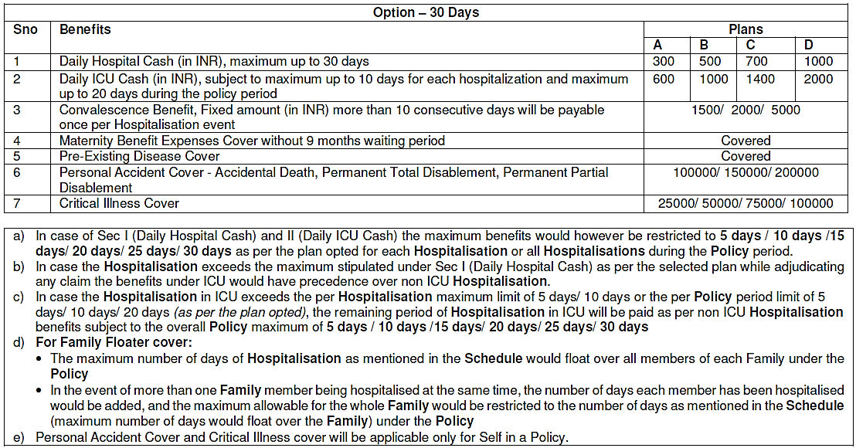
ALPO BIMA - SCHEDULE OF BENEFITS
Plans A, B, C, D can be offered for different options 5 days/ 10 days/ 15 days/ 20 days/ 25 days/ 30 days
Note: Convalescence benefit is not available in 5 days / 10 days option.

Slide 5
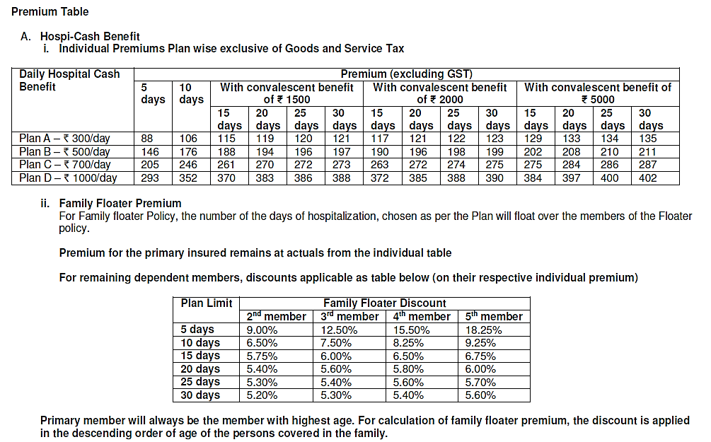
Premium and floater discount

Slide 6
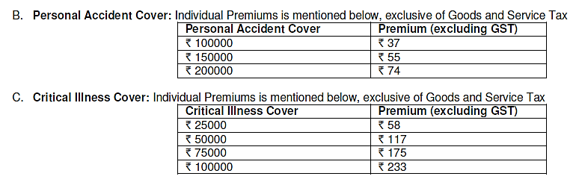
Premium
Add 18% towards Goods and Services Tax

Slide 7
Process
• Master policy would be issued for one year
• Annual premium will be charged & each member will be covered for one year only, within the same Master policy.
• List of all new Members needs to be provided to us on monthly basis
• Adequate float balance to be maintained to take care of monthly addition of new members
• In any case of unavailability of float, we will not be able to cover selected number of
members.
• Individual nominee names to be collected and claims payable to nominee only.
• Once the endorsement is issued, System generated individual certificate can be
downloaded by local operations team and same should be shared with the client.
• Individual certificates will be issued mentioning individual details and premium.
• Complete enrolment form mentioning nominee details needs to be collected from each
individual.
• Group Proposal Form to be signed by the Group Manager

Slide 8
General Exclusions
• War, Invasion, Act of Foreign Enemy, War like operations.
• Circumcision unless necessary for treatment of a disease or as may be necessitated due to an Accident.
• Cosmetic treatments, Plastic Surgery
• Dental Treatment/ Surgery unless requiring Hospitalisation as a result of Injury.
• Treatment of obesity (including morbid obesity).
• Abuse of alcohol, substance or drugs.
• Sexually transmitted disease, intentional self-Injury.
• Hospitalisation for Invitro fertilization (IVF), Gamete intrafallopian transfer (GIFT)
procedures, and zygote intrafallopian transfer (ZIFT) procedures, voluntary medical
termination of pregnancy; any treatment related to infertility and sterilization.
• Congenital external Illness/disease/defect anomaly.
• Hospitalisation primarily for diagnostic, X-ray or laboratory examinations.
• Injury or Disease directly or indirectly caused by or contributed to by nuclear
weapons/materials.
• Alternative treatments other than Allopathy.
• Hormone replacement therapy, sex change or treatment.
• Surgery to remove organs from the donor in case of a transplant surgery.
• Any Hospitalisation received out of India.
* Please read policy documents for complete list of exclusions.

Slide 9
Exclusions applicable to Critical illness
• Any Pre- Existing conditions or related condition(s).
• Any medical procedure or treatment, which is not medically necessary or not performed by a Doctor.
• Any treatment relating to birth defects and external or internal congenital Illnesses.
• Birth control procedures and hormone replacement therapy.
• Any treatment/surgery for change of sex or any cosmetic surgery or treatment/surgery
/complications/illness arising as a consequence thereof.
• Treatment by a family member and self-medication or any treatment that is NOT
scientifically recognized.
• Ayurvedic, Homeopathy, Unani, naturopathy, reflexology, acupuncture, bone-setting,
herbalist treatment, hypnotism, rolfing, massage therapy, aroma therapy or any other
treatments including Alternative treatments other than Allopathy / western medicines.
• Being under the influence of drugs, alcohol, or other intoxicants or hallucinogens unless properly prescribed by a Physician and taken as prescribed.
• Diagnosis outside India; unless reaffirmed by Physician in India and subject to
presentation of all Claim documents in English.
* Please read policy documents for scope of cover and complete list of exclusions.

Slide 10
Exclusions applicable to Personal Accident
• Actual or attempted felony, riot, crime, misdemeanor or civil commotion.
• Illegal act or any violation or attempted violation of the law or his resistance to arrest.
• Engaging in Aviation or Ballooning other than as passenger (fare paying or otherwise).
• Participating in motor racing or trial run as a driver, co-driver or passenger
• Pregnancy and childbirth, miscarriage, abortion or complications arising out of any of
these
• War, invasion, acts of foreign enemies, hostilities
• Nuclear energy, radiation
• Any existing disablement prior to the inception of the Policy
• Whilst engaging in Adventure sports, hazardous activity
• Any claim caused by osteoporosis or pathological fracture
• Bodily Injury caused by or arising from terrorism, except in case where the policy holder is a victim of terrorist act and not abetting terrorism
* Please read policy documents for scope of cover and complete list of exclusions.

Slide 11
Claims Service
The claims would be serviced through In-House Health Administrator, Future Generali Health (FGH) Team. The claim documents can be submitted directly to the below mentioned address.
It is mandatory to intimate the claim to Future Generali through: Email ID - fgh@futuregenerali.in
Claims Department: Future Generali Health (FGH),
Future Generali India Insurance Co. Ltd.
Office No. 3, 3rd Floor, “A” Building, G - O - Square
S. No. 249 & 250, Aundh Hinjewadi Link Road, Wakad,
Pune - 411 057.
Toll free number - 1800 209 1016/ 1800 103 8889
Toll free Fax - 1800 209 1017/ 1800 103 9998
Email: fgh@futuregenerali.in
In case of claims, You or someone claiming on Your behalf must inform Us in writing immediately, and in any event within 48 hours of the aforesaid Illness or Bodily Injury. You must immediately consult a Medical Practitioner and follow the Medical Advice and treatment that he recommends.

Slide 12
Thanks

