Slide 1

LAUNCHING

Slide 2
What is Personal Accident
personal
adjective
1.
belonging to or affecting a particular person rather than anyone else
accident
noun
1.
means sudden, unforeseen and involuntary event caused by external, visible and violent means.
.
Other synonyms
mishap, misfortune, misadventure, mischance, unfortunate incident,
injury, disaster, tragedy, catastrophe, quarrels, calamity, blow, trouble, problem, difficulty. technical casualty

Slide 3
What is Personal Accident Insurance
Personal Accident is a benefit* insurance policy designed to provide financial assistance to sufferers of Accidental bodily injury leading to death/ disability and or expenses.
Such policies are issued basis financial underwriting i.e. present earning of the individual and generally** not issued to non earners.
Unique feature of this product vis-à-vis Health Insurance is that Premium rates are determined according to the occupation of Insured and not according to the Age band, and hence the premiums do not change with Age.
* In contrast to Indemnity based policies, multiple policies can trigger and pay subject to overall income commensuration
** Limited cover is available for dependent spouse, children and non earners.
Notes:
* Benefit –In contrast to Indemnity based policies, multiple policies can trigger and pay subject to overall income commensuration
** generally – limited cover is available to dependent spouse, children and non earners

Slide 4
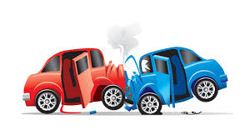
Why is Personal Accident insurance needed
1 serious road accident occurs in India every minute
16 people die on Indian roads every hour
1214 road crashes occur every day in India
377 people die everyday, equivalent to a jumbo jet crashing
Two-wheelers account for 25% of total road crash deaths
Top 10 cities with highest number of Road crash deaths are
Delhi 6. Kanpur
Chennai 7. Lucknow
Jaipur 8. Agra
Bengaluru 9. Hyderabad
Mumbai 10. Pune
Source : Ministry of Road Transport & Highway
Are road traffic accidents, the only reason for accidental death, disability and or expenses?
The answer is a BIG NO.
Fall injuries
Burns
Attempts on Life
Natural calamities
Drowning
Animal attacks
Terrorist attacks
And more such events are covered.

Slide 5

What is Personal Accident Insurance
A. Primary covers:
1. Accidental Death
2. Permanent Total Disablement
3. Permanent Partial Disablement
4. Temporary Total Disablement
B. Inbuilt Cover:
Repatriation and Funeral Benefit
Cumulative Bonus
C. Additional covers:
On payment of additional premium, following covers may be opted
1. Child Education Support
2. Life Support Benefit
3. Accidental Medical Expenses
4. Accidental Hospitalisation
5. Hospital Cash Allowance
6. Loan Protector
7. Adaptation Allowance
8. Family Transportation Allowance
9. Broken Bones
10. Road Ambulance Cover
11. Air Ambulance Cover
12. Adventure Sports Benefit
13. Chauffeur Plan Benefit
New Age features

Slide 6
A Few Definitions and feature descriptions
Accidental Death
If during the Policy Year, the Insured Person sustains Injury which directly and independently of all other causes results in death of the Insured Person within twelve (12) months from the date of Accident, then We will pay the Sum Insured.
Special Condition:
a) Disappearance
In the event of the disappearance of the Insured Person, following a forced landing, stranding, sinking or wrecking of a civilian aircraft in which such Insured Person was known to have been travelling as an occupant or passenger, or as a result of any Act of God, it shall be deemed after twelve (12) months, that such Insured Person shall have died as a result of an Accident. If, at any time, after the payment of the Accidental Death benefit, it is discovered that the Insured Person is still alive, all payments shall be reimbursed in full to the Insurer.
b) Drowning
In the event the body of the Insured Person is not found on account of Drowning, it shall be deemed as per the provisions of Indian Law that such Insured Person is dead as a result of an Accident.
Note: AD benefit is 100% of Sum Insured

Slide 7
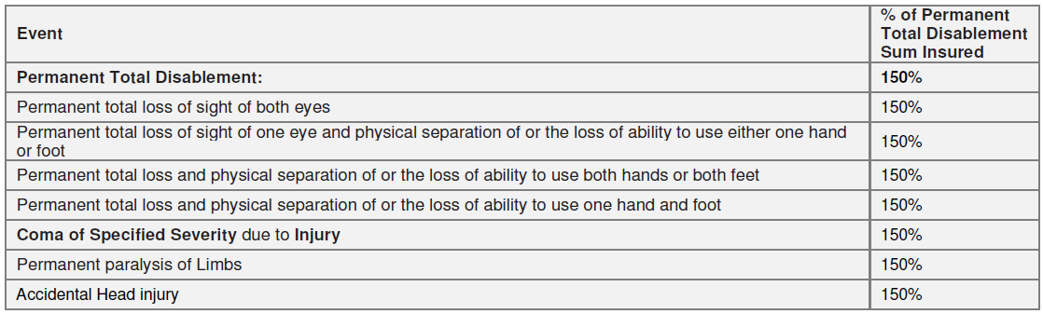
A Few Definitions and feature descriptions
Permanent Total Disablement means a bodily Injury caused by accidental, external, violent and visible means, which as a direct consequence thereof totally disables and prevents the Insured Person from attending to any business or Occupation of any and every kind or if he/she has no business or Occupation, from attending to his/her usual and normal duties that last for a continuous period of twelve calendar months from the date of the Accident, with no hopes of improvement at the end of that period.
Note: PTD benefit is 150% of Sum Insured
Notes:
Special Conditions -
a) Coma of Specified Severity
i. If an Insured Person sustains Injury which directly results in the Insured Person being in an Intensive Care Unit of a Hospital in a state of
Coma of Specified Severity, within 30 days of the date of Accident, then We will pay to the Insured Person the Sum Insured stated in the
Permanent Total Disablement section of the Schedule.
ii. The Coma of Specified Severity should be for a minimum continuous period of 180 days or more for any benefits to be payable.
b) Permanent Paralysis of Limbs
Permanent Paralysis of Limbs arising out of accident should be for a minimum continuous period of 12 months or more for any benefits to be
payable. And should be confirmed by specialist medical practitioner.
c) Accidental Head injury
The Accidental Head injury must result in an inability to perform at least four (4) of the following Activities of Daily Living either with or without
the use of mechanical equipment, special devices or other aids and adaptations in use for disabled persons. For the purpose of this benefit,
the word “permanent” shall mean beyond the scope of recovery with current medical knowledge and technology.
The Activities of Daily Living are:
i. Washing: the ability to wash in the bath or shower (including getting into and out of the bath or shower) or wash satisfactorily by other means;
ii. Dressing: the ability to put on, take off, secure and unfasten all garments and, as appropriate, any braces, artificial limbs or other surgical
appliances;
iii. Transferring: the ability to move from a bed to an upright chair or wheelchair and vice versa;
iv. Mobility: the ability to move indoors from room to room on level surfaces;
v. Toileting: the ability to use the lavatory or otherwise manage bowel and bladder functions so as to maintain a satisfactory level of personal
hygiene;
vi. Feeding: the ability to feed oneself once food has been prepared and made available.

Slide 8
A Few Definitions and feature descriptions
Permanent Total Disablement (Special Condition)
a) Coma of Specified Severity
i. If an Insured Person sustains Injury which directly results in the Insured Person being in an Intensive Care Unit of a Hospital in a state of Coma of Specified Severity, within 30 days of the date of Accident, then We will pay to the Insured Person the Sum Insured stated in the Permanent Total Disablement section of the Schedule.
ii. The Coma of Specified Severity should be for a minimum continuous period of 180 days or more for any benefits to be payable.
b) Permanent Paralysis of Limbs arising out of accident should be for a minimum continuous period of 12 months or more for any benefits to be payable. And should be confirmed by specialist medical practitioner.
c) Accidental Head injury must result in an inability to perform at least four (4) of the following Activities of Daily Living either with or without the use of mechanical equipment, special devices or other aids and adaptations in use for disabled persons. For the purpose of this benefit, the word “permanent” shall mean beyond the scope of recovery with current medical knowledge and technology.
The Activities of Daily Living are:
i. Washing: the ability to wash in the bath or shower (including getting into and out of the bath or shower) or wash satisfactorily by other means;
ii. Dressing: the ability to put on, take off, secure and unfasten all garments and, as appropriate, any braces, artificial limbs or other surgical appliances;
iii. Transferring: the ability to move from a bed to an upright chair or wheelchair and vice versa;
iv. Mobility: the ability to move indoors from room to room on level surfaces;
v. Toileting: the ability to use the lavatory or otherwise manage bowel and bladder functions so as to maintain a satisfactory level of personal hygiene;
vi. Feeding: the ability to feed oneself once food has been prepared and made available.

Slide 9
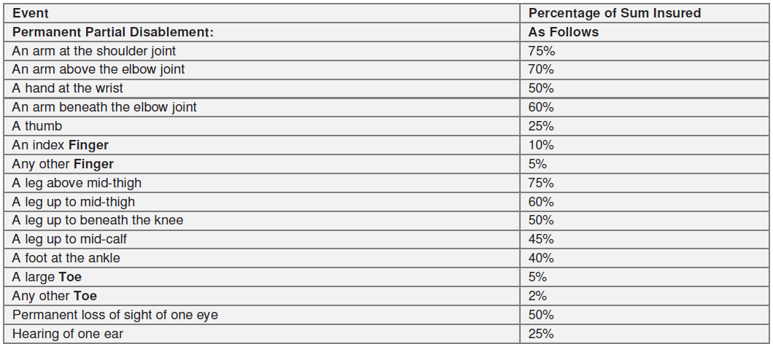
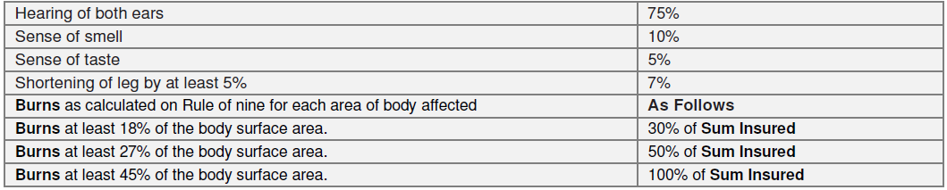
A Few Definitions and feature descriptions
Permanent Partial Disablement means a bodily Injury caused by accidental, external, violent and visible means, which as a direct consequence thereof, disables any part of the Limbs or organs of the body of the Insured Person
Notes:
Special Conditions
a) Burns
If during the Policy Year, the Insured Person sustains Injury which results in Second Degree Burns or Third Degree Burns, then We agree to pay
the percentage of the Sum Insured shown in the Table of Events below and as specified in the Schedule.
i. Rule of nine - A system used by Medical Practitioners for assessing the percentage of the body surface affected by Burns. In this system, the
head and each arm cover 9% of the body; the front of the body and the back of the body and each leg covers 18% of the body. The groin
covers the remaining 1%.
ii. Second Degree Burns - Burns which penetrate beyond the epidermis, causing formation of blisters.
iii. Third Degree Burns – There must be third-degree burns with scarring that cover, at least 20% of the body’s surface area. The diagnosis must
confirm the total area involved using standardized, clinically accepted, body surface area charts covering 20% of the body surface area.

Slide 10
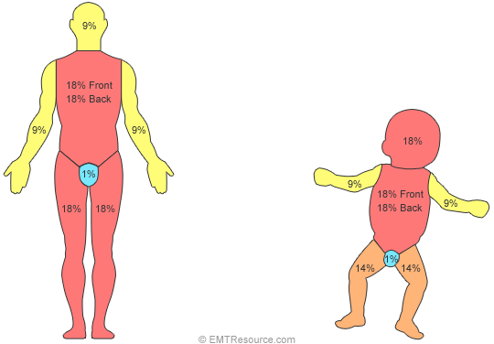
A Few Definitions and feature descriptions
Burns (Permanent Partial Disablement )
If during the Policy Year, the Insured Person sustains Injury which results in Second Degree Burns or Third Degree Burns, then We agree to pay the percentage of the Sum Insured shown in the Table of Events below and as specified in the Schedule.
Rule of 9
to estimate
Burn area
Notes:
Second Degree Burns - Burns which penetrate beyond the epidermis, causing formation of blisters.
Third Degree Burns – There must be third-degree burns with scarring that cover, at least 20% of the body’s surface area.

Slide 11
A Few Definitions and feature descriptions
Temporary Total Disablement means disablement which temporarily and totally prevents the Insured Person from attending to the duties of his usual business or Occupation and shall be payable for a maximum period of 100 weeks during such disablement from the
date on which the Insured Person first became disabled.
Temporary Total Disablement
If during the Policy Year, the Insured Person sustains Injury which directly results in Temporary Total Disablement which completely prevents the Insured Person from performing each and every duty pertaining to employment or Occupation, then We will pay a weekly benefit, provided that:
i. The Temporary Total Disablement is certified by a Medical Practitioner, and
ii. Our liability to make payment will be limited to an amount payable weekly for each week during the period of Temporary Total Disablement for a period not exceeding 100 weeks from the date of the Accident and if the Insured Person is disabled for a part of a week, then only a proportionate part of the weekly benefit will be payable.
Note: Weekly benefit (1% of SI) or as mentioned in the Schedule

Slide 12

Specific conditions applicable to Primary Covers section
a. If a claim has already been settled for any of the Primary Covers the amount payable for the subsequent claims/s under the Primary Covers shall be reduced by this amount/s already paid. Regardless of one or more claims made during the Policy Year, the maximum
amount payable towards the Primary Cover shall be restricted to the Principal Sum Insured.
b. If more than one loss results from any Accident, only one amount, the largest, will be paid.
c. This Policy shall not be further renewed for the particular Insured Person on payment of a claim for Accidental Death or Permanent Total Disablement. In case of long term policies with single premium payment option, in the event of claim for Accidental Death or Permanent Total Disablement of that insured person, in a particular policy year, the premium for the subsequent (unutilized) Policy Year(s), if any, shall be refunded.

Slide 13
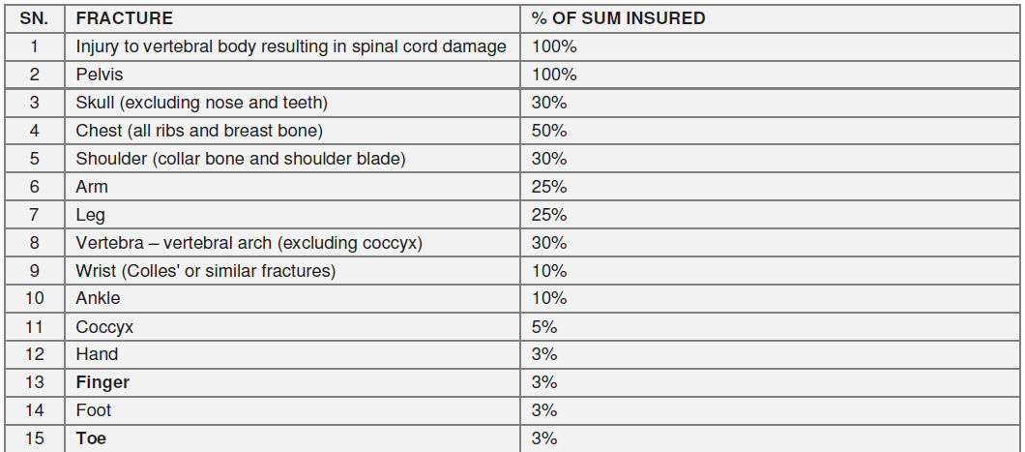
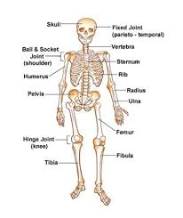
A Few Definitions and feature descriptions
Broken Bones
If an Accident causes an Insured Person to suffer a fracture (a break in the continuity of a bone) and this is certified by a Specialist Medical Practitioner and also confirmed by imaging investigations such as by X-ray, then We will pay the percentage of the Sum Insured specified in the table below.

Slide 14
A Few Definitions and feature descriptions
Accidental Hospitalisation
If the Insured Person suffers an Injury during the Policy Year that requires the Insured Person’s Hospitalisation for Inpatient Care then we will reimburse the charges.
Special exclusion for this section
i. Pre-hospitalization Medical Expenses and Post-hospitalisation Medical Expenses are not covered.
ii. AYUSH are not covered.
Accidental Medical Expenses
In the event of a valid claim under this Policy for any of the following covers: Accidental Death, Permanent Total Disablement, Permanent Partial Disablement, or Temporary Total Disablement, We will reimburse the Reasonable and Customary Charges, for
medical treatment or Surgery for the Injury sustained, provided the treatment is during the Policy Year and availed in a Hospital or Day Care Centre in India including OPD treatment/ Day Care Treatment. The maximum amount payable shall be 40% of the valid personal Accident claim amount or 20% of the relevant Sum Insured, whichever is less subject to maximum of Rupees Ten lakhs only.
Notes:
Note:
Relevant Sum Insured refers to the Sum Insured of the primary covers, under which the claim is payable. Primary covers include
Accidental Death/ Permanent Total Disablement/ Permanent Partial Disablement/ Temporary Total Disablement
Valid claim refers to the claim payable under primary covers i.e. Accidental Death/ Permanent Total Disablement/ Permanent Partial
Disablement/ Temporary Total Disablement

Slide 15
A Few Definitions and feature descriptions
Hospital Cash Allowance
If the Insured Person suffers an Injury during the Policy Year that requires that Insured Person’s Hospitalisation for Inpatient Care, then We will
make payment of the sum mentioned in the Schedule for each completed day of Hospitalisation in India, for a maximum period of 30 days per Policy Year mentioned in the Schedule provided that the hospitalisation commences within the same policy year.
Special exclusion for this section
AYUSH are not covered
Daily Benefit amount for Class 1 is 2000 and for Class 2 insured is 1500

Slide 16
A Few Definitions and feature descriptions
Loan Protector
i. In the event of Us making a payment for Accidental Death or Permanent Total Disablement, We will also pay the sum mentioned in the Schedule against this benefit per month for the maximum period mentioned in the Schedule.
ii. We will also make payment towards this benefit for each completed month of Hospitalisation within India in the event of the Insured Person meeting with an Accident and getting hospitalized. The maximum period for payment during the Policy Period shall be the number of months mentioned in the Schedule.
However, We reserve the right to pay the claim under this benefit as lump sum benefit.
Relevant question on the proposal form must be answered before this cover is extended.

Slide 17
A Few Definitions and feature descriptions
Child Education Support
In the event of We making payment for a claim for Accidental Death or Permanent Total Disablement, We will also make payment towards the education support of the Insured Person's Dependent Child */ Children, which will be an amount mentioned against this benefit per month for the maximum period as stated in the Schedule. This benefit shall be limited to the maximum as stated in the Schedule irrespective of the number of Dependent Children.
However, We reserve the right to pay the claim under this benefit as lump sum benefit..
Dependent Child * refers to a child (natural or legally adopted), who is up to 25 years of age, financially dependent on the primary Insured Person or proposer and does not have his/ her independent sources of income.

Slide 18
A Few Definitions and feature descriptions
Inbuilt Covers / Free Benefits
1. Repatriation of remains and Funeral Benefit
In the event of We making payment for a claim for Accidental Death, We will also make payment towards
a. Expenses for burial or cremation and transportation of Insured Person’s body to his/her city of residence.
b. Insured person’s funeral expenses.
The benefit payable towards a & b together shall be limited to 1% of the Principal Sum Insured subject to maximum of Rs 12500/-.
2. Cumulative Bonus
5% increase in the Base Sum Insured for every continuous and claim free Policy
Year, subject to a maximum of 25% of the Base Sum Insured including if policy
is ported to Us.
In case a claim is made during a Policy Year, the Cumulative Bonus would reduce
by 5% in the following year. However the Base Sum Insured will be maintained at all
times.

Slide 19
A Few Definitions and feature descriptions
Adaptation Allowance
If the Insured Person is required to modify his/her vehicle or make some changes in his/her house as necessitated by a Permanent Total Disablement which resulted from an Accident covered under this Policy, We shall reimburse such expenses up to a limit of 10% of the Permanent Total Disablement Sum Insured or as mentioned in the policy schedule, whichever is less, subject to a maximum of Rs. 50,000 provided We have paid the claim towards Permanent Total Disablement.
Life Support Benefit
In the event of We making payment for a claim for Permanent Total Disablement, We will also make payment towards life support of the Insured Person which will be an amount mentioned against this benefit per month for the number of months mentioned in the Schedule.
However, We reserve the right to pay the claim under this benefit as lump sum benefit.

Slide 20
A Few Definitions and feature descriptions
Adventure sports are activities having high level of inherent danger. These activities often involve speed, height, a high level of physical exertion, and highly specialized gear such as racing on wheels or horseback, big game hunting, mountaineering, winter sports, skydiving,
parachuting, scuba diving, riding or driving in races or rallies, mountain climbing, hunting or equestrian activities, rock climbing, pot holing, bungee jumping, skiing, ice hockey, aviation activities, ballooning, hand gliding, diving or under-water activity, river rafting, canoeing involving rapid waters, polo, yachting or boating.
Adventure Sports Benefit
In case of Injury which causes Accidental Death or Permanent Total Disablement whilst engaged in Adventure sports in a nonprofessional capacity and under the supervision of a trained professional, during leisure trip, We will pay the Sum Insured as given in the Schedule under this benefit.
However, the Sum Insured for this cover shall be limited to 50% of Sum Insured under Accidental Death benefit to a maximum of ₹ 50,00,000/-.

Slide 21
A Few Definitions and feature descriptions
Family Transportation Allowance
Following an Injury which results in Accidental Death, Permanent Total or Permanent Partial Disablement benefit payable under this Policy, if the Insured Person is confined in a Hospital outside 100 kms of his normal place of residence and the attending Medical
Practitioner recommends the personal attendance of Family member, We shall reimburse the expenses incurred for the immediate Family member for transportation by the most direct route by a licensed common carrier to the place of Hospitalization of the Insured Person.
The maximum amount payable for this cover shall be limited to 10% of the Principal Sum Insured or as mentioned in the policy schedule, whichever is less, subject to maximum Rs 50,000/.

Slide 22
A Few Definitions and feature descriptions
Road Ambulance Cover
If the Insured Person suffers an Injury in India during the Policy Year and it is necessary to immediately transfer such person from the site of Accident to the nearest Hospital/ Day Care Centre/ Nursing Home by road in an ambulance offered by a healthcare or an ambulance service provider, then We shall reimburse the actual expenses of the transfer to the nearest Hospital or up to a maximum amount as mentioned in the Schedule, subject to a valid claim being admissible under the Primary Cover(s) of the Policy.
Specific Conditions
a. Expenses for road ambulance transportation are restricted within India only.
b. Return transportation to the Insured Person’s home by ambulance is excluded.

Slide 23
A Few Definitions and feature descriptions
Air Ambulance Cover
If the Insured Person suffers an Injury which causes emergency life threatening conditions during the Policy Year and it is necessary to immediately transfer such person from the site of Accident to the nearest Hospital/ Day Care Centre/ Nursing Home, then we will pay the
expenses incurred for ambulance transportation in an airplane or helicopter for rapid ambulance transportation as set out in the Schedule.
Specific Conditions
i. Expenses for air ambulance transportation are restricted within India.
ii. Return transportation to the Insured Person’s home by ambulance is excluded.
iii. Insured needs to make an intimation before availing the benefit under Air Ambulance Cover.

Slide 24
A Few Definitions and feature descriptions
Chauffeur Plan Benefit
If during the Policy Year, the Insured Person sustains an Injury and in the event of We making payment for a claim under Permanent Partial Disablement or Temporary Total Disablement, then We will pay the daily amount up to the Sum Insured up to a maximum of 30 days mentioned in the Schedule, for the hire of a taxi or chauffeur driven car or other necessarily incurred extra costs to maintain the Insured Person's mobility to meet his/her work/Occupational commitments.

Slide 25
Eligibility
Age : 18 yrs – 70 yrs for Individual
3 yrs – 25 yrs as dependent child
Renewal : Up to 70 years for break-free policy
Profession: Working / self employed
Period of cover: One/ Two and Three year
Nationality: Should be citizen of India, living in India
Coverage : Depends on Monthly Income and Risk Class

Slide 26
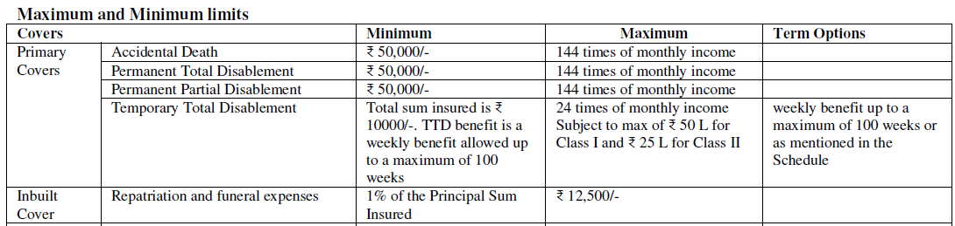
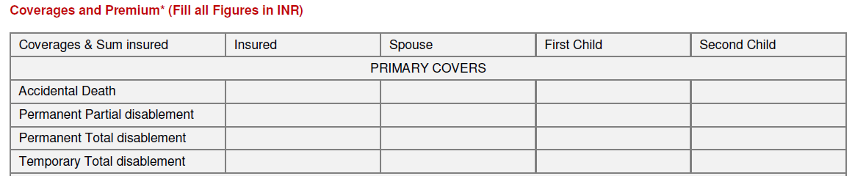
Minima Maxima

Slide 27
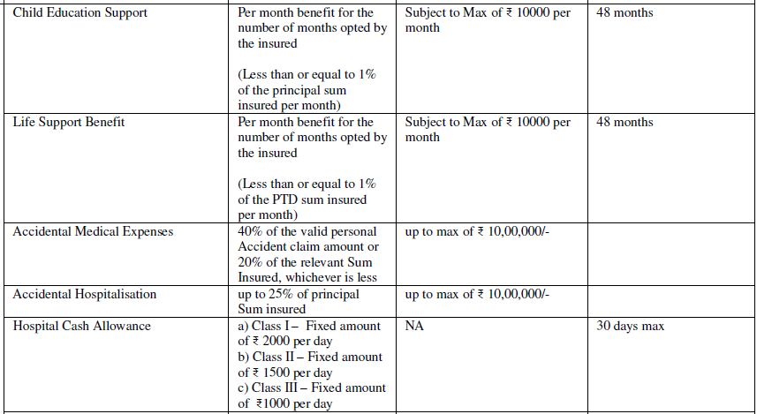
Minima Maxima

Slide 28
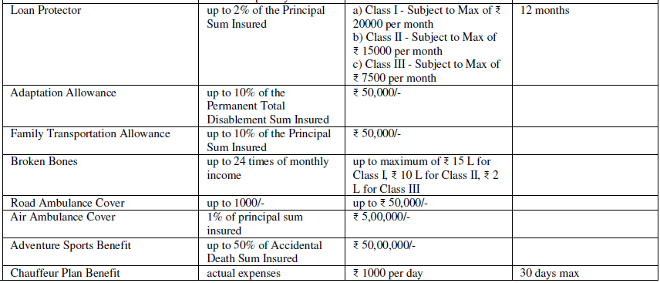
Minima Maxima

Slide 29
Rate of Premium per 1000 sum insured (GST extra)
Cover for | Risk Class 1 | Risk Class 2 | Risk Class 3
Accidental Death (Primary Sum Insured) | 0.4 | 0.6 | 0.9
Permanent Total Disability | 0.1 | 0.2 | 0.35
Permanent Partial Disability | 0.25 | 0.45 | 0.75
Temporary Total Disablement | 0.5 | 0.75 | Not Applicable
Additional Benefits
Hospital Cash Allowance (Max 30 days) | 25 per 100/ day | 30 per 100/ day | 40 per 100/ day
Child Education Support (Trigger AD / PTD) | 0.5 | 0.8 | 1.25
Loan Protector (Trigger AD/PTD/AH) | 2 | 2.80 | 4.25
Accidental Hospitalization (Independent cover) | 1.5 | 2 | 3
Accidental Medical Hospitalization | 20% loading on total premium of primary covers

Slide 30
Rate of Premium per 1000 sum insured (GST extra)
Cover for | Risk Class 1 | Risk Class 2 | Risk Class 3
Life Support Benefit (Trigger PTD) | 0.1 | 0.2 | 0.35
Adaptation Allowance (Trigger PTD) | 0.7 | 0.75 | 0.80
Family Transportation (Trigger AD/PTD/PPD) | 0.3
Broken Bones | 2.89
Road Ambulance cover | 2.174
Air Ambulance cover |  | 0.127
Adventure Sports benefit (AD/ PTD) | 0.75 | 1.20 | 1.88
Chauffeur Plan benefit (PPD/ TTD) | Flat Rs. 119.5
Change of Occupation
If at the time a claim arises under this Policy the Insured Person has changed his Occupation without Us being notified (within 30 days of such change), then Our maximum liability will be limited to the amount that would have been payable for the premium paid and the new Occupation.

Slide 31
Guidelines for Sum Insured
1. For deciding the Sum Insured the gainful Income should be multiplied by the number of times (maximum multiplying factor ) as specified in the table
2. TTD – Maximum sum insured restricted to ₹ 50 Lakhs for Class 1, ₹ 25 Lakhs for Class
3. Broken Bones – Up to a maximum of ₹ 15 L sum insured for Class 1, ₹ 10 L sum insured for Class 2 and 2 L sum insured for Class 3.
The maximum sum insured will be up to 24 times of the monthly income for Class 1 and Class 2.
4. Non working spouse-50% of sum insured of the primary insured subject to maximum ₹ 10 lacs with TTD Sum Insured max ₹ 1 lakh (i.e. limited to ₹ 1000/- per week for 100 weeks)
5. Dependent Children from 3 years up to 25 years of Age - 25% of sum insured of the primary insured subject to maximum ₹ 5 lakhs without TTD
6. Unemployed/ Students – AD, PTD, PPD can be given up to maximum of ₹ 10 Lakhs, without TTD
7. No TTD for Professional Sports Persons and other covers allowed with 100% loading

Slide 32
Risk Classification
Class I:
Accountants, Doctors, Lawyers, Architects, Consulting Engineers, Teachers, Bankers, Persons engaged in administrative functions, Persons primarily engaged in occupations of similar hazard.
Class II:
Builders, Contractors, Sales executives and Engineers engaged in superintending functions only. Veterinary Doctors, paid drivers of motor cars and light motor vehicles and persons engaged in occupations of similar hazard and not engaged in manual labor.
All persons engaged in manual labor (Except those falling under Group III) Cash Carrying Employees, Garage and Motor Mechanics, Machine Operators, Drivers of trucks or lorries and other heavy vehicles, Professional Athletes and Sportsmen, Woodworking Machinists and persons engaged in occupations of similar hazard.
Class III: Referral
Persons Working in underground mines, explosives, magazines, workers involved in electrical installation with high tension supply, Jockeys, Circus personnel, Persons engaged in activities like racing on wheels or horseback, big game hunting, mountaineering, winter sports, skiing, ice hockey, ballooning, hand gliding, river rafting, polo and persons engaged in occupations/activities of similar hazard

Slide 33
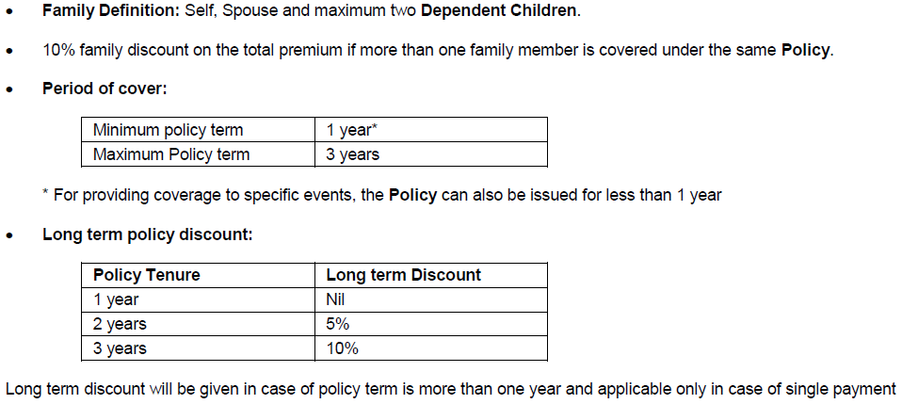
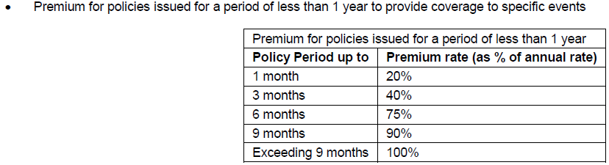
Guidelines for Issuance
Approval Req.

Slide 34
Underwriting Documents
a) Duly signed and filled Proposal Form.
b) Clean proposals (without any health declaration/ deformity) with sum insured up to 30 lakhs can be processed locally as per the income declaration and commensuration without any income proofs
c) Unclean Proposals with any health declaration should be referred to Retail Health Underwriters
d) Sum insured of above 30 lakhs should be referred to Retail Health Underwriters along with following documents:
i. Latest IT Returns / Salary slip in case of salaried person for sum insured above ₹ 30 lakhs
ii. Above ₹ 50 lakhs - last 3 years IT returns / last 3 months salary slip in case of salaried employee is required
Zonal Heads Approval required for sum Insured 1 Crore and above
Change in Sum Insured
1. For all proposals, where the sum insured does not exceed 30 lakhs, will be done at respective branch, subject to income commensuration, clean proposals, no change in occupation and nil claims in the expiring policy
2. The proposals wherein change in sum insured exceeds 30 lakhs, or there is any adverse declaration or change in occupation, need to be referred to Retail Health Underwriters.
3. Fresh proposal form to be filled in case of change of sum insured or plan.
4. No increase/decrease in Sum Insured or change in plan is allowed during the currency of the policy.
Notes:
Please Note:
The Insured Person must disclose all Pre-Existing Disease/s, injury/ disability before taking the Policy. Non-disclosure may result in claim not being paid.
The Insured Person must disclose any change in material information during the Policy Period.

Slide 35
Underwriting Guidelines
A) The following risks are on the referral list:
1. Persons mentioned under risk class III
2. Persons working as miners.
3. Persons engaged in explosives manufacturing or trade
4. Aviation crew and pilots covered under aviation P.A. policies.
5. Persons who have had more than one claim in the last three years.
6. Film stars (except for death covers.)
7. Persons who engage in hazardous sports like rafting, mountaineering, underwater diving, deep sea diving, rafting, canoeing,
bungee jumping, parachuting, sky diving or any other dangerous sport or activity.
8. Physically challenged individuals.
9. Security Guards
B) Decline list:
i. Military, para- military and police personnel
ii. Alcoholics, persons habitually under the influence of drugs.
iii. Political activists in violence prone areas.
iv. Proposals from politically disturbed areas where enforcement law and order is lax.
v. Persons undergoing treatment for epilepsy or mental illness/ psychiatry
vi. Children below the age of three.

Slide 36
General Exclusions
a. Intentional self-Injury (including but not limited to the use or misuse of any intoxicating drugs or alcohol).
b. Mental or nervous disorder, anxiety, stress or depression.
c. Accident while under the influence of alcohol or drugs.
d. Participation in an actual or attempted felony, riot, crime, misdemeanor or civil commotion.
e. Any Accident of which a contributing cause was the Insured Person’s actual or attempted commission of, or willful participation in, an illegal act or any violation or attempted violation of the law or his resistance to arrest.
f. Whilst engaging in aviation or whilst mounting in to, dismounting from or traveling in any aircraft other than as passenger (fare paying or otherwise) in any duly licensed standard type of aircraft.
g. Participating in motor racing or trial run as a driver, co-driver or passenger.
h. Curative treatments or interventions that the Insured Person carries out or have carried out on his body.
i. Pregnancy and childbirth, miscarriage, abortion or complications arising out of any of these.
j. War, invasion, acts of foreign enemies, hostilities (whether war be declared or not), civil war, commotion unrest, rebellion, revolution, insurrection, military or usurped power or confiscation or nationalization or requisition of or damage or under the order of any government or public authority.
k. Nuclear energy, radiation.
l. Any existing disablement prior to the inception of the Policy.
m. Whilst engaging in Adventure sports. (waived if additional cover opted)
n. Whilst engaging in hazardous activity.
.

Slide 37
General Exclusions
o. Venereal or sexually transmitted diseases, HIV (Human Immunodeficiency Virus) or HIV related Illness including AIDS (Acquired Immune Deficiency Syndrome) and / or mutant derivatives or variations however caused.
p. Any Medical Expenses, services, supplies or treatment or Hospital stay which were not recommended or approved as Medically Necessary Treatment by a Medical Practitioner.
q. Any expense incurred which is not exclusively medical in nature/ Unproven/ Experimental treatment of any description
r. Expenses incurred for emergency medical evacuation (unless specifically insured).
s. Any claim caused by osteoporosis (porosity and brittleness of the bones due to loss of protein from the bones matrix) or pathological fracture (any fracture in an area where Pre-Existing Disease has caused the weakening of the bone) or chronic degenerative diseases if osteoporosis or bone disease or chronic degenerative diseases diagnosed prior to the commencement date of the Policy.
t. Expenses incurred on neck belts, wrist bandages, walking sticks, abdomen belts, CPAP and any other similar external aid /devices, the use of which has been necessitated following an accident.
u. Bodily Injury caused by or arising from terrorism, except in case where the policy holder is a victim of terrorist act and not abetting terrorism
v. Standard list of excluded items as mentioned in our website https://general.futuregenerali.in.
w. Treatment taken in any hospital or by any Provider that We have blacklisted, as mentioned in our website https://general.futuregenerali.in/general-insurance/network-hospitals.

Slide 38
Standard Conditions
Applicable only to indemnity sections under the Policy.
The insured can choose the policies to claim from and the insurer is obliged to pay as per policy terms.
The insured may claim amount disallowed, deducted in one policy due to deductibles or co payment or when the sum insured is exhausted the balance amount from Other policy.
Multiple Policies
In case of a Renewal, a Grace Period of 30 days is permissible. Any claim incurred as a result of an Accident during the Grace Period will not be admissible under the Policy.
Grace Period
Policy shall be Renewable till the Insured Person attains up to 70 years of age.
Renewal
The insured will be allowed a period of at least 15 days from the date of receipt of the policy to review the terms and conditions of the policy and to return the same if not acceptable. A refund of premium less certain charges like stamp duty, proportionate risk premium for the period on cover shall be deducted.
Free Look Period

Slide 39
Illustrations
Proposer Name | Vishal | SELF |  |  |  | Yes
 |  | Occupation |  | Service
 |  | Annual Income |  | 100000 |  | 1
Main-Covers |  | Sum Insured / Benefits Amt to be entered |  | Maximum Sum Insured / Benefit |  | Premium
Accidental Death |  | 10,00,000 |  | 10,00,000 |  | 400.00
Permanent Partial Disability |  | 10,00,000 |  | 10,00,000 |  | 250.00
Permanent Total Disability |  | 10,00,000 |  | 10,00,000 |  | 100.00
Temporary Total Disability |  | 2,00,000 |  | 2,00,000 | 100 | 100.00
Additional-Covers |  | Benefit Amount |  | Benefit Amount | Months / Days
Child Education Support |  | 10,000 |  | 10,000 | 48 | 240.00
Life Support Benefit |  |  |  | - | 48 | -
Accidental Medical Expenses |  |  |  |  |  | -
Accidental Hospitalisation |  | 2,50,000 |  | 2,50,000 |  | 375
Hospital Cash Allowance |  | Yes |  | 2,000 | 30 | 500.00
Loan Protector |  | 20,000 |  | 20,000 | 12 | 480.00
Adaptation Allowance |  |  |  | - |  | -
Family Transportation Allowance |  |  |  | - |  | -
Repatriation and Funeral Expenses are inbuilt cover |  |  |  | 10,000 |  | -
Broken Bones |  | 2,00,000 |  | 200000 |  | 578.00
Road Ambulance Cover |  |  |  | - |  | -
Air Ambulance Cover |  |  |  | 0 |  | -
Adventure Sports Benefit |  |  |  | 0 |  | -
Chauffeur Plan Benefit |  |  |  | - | 30.00 | -
Self Premium (exclusive of GST) |  |  |  |  |  | 3,023.00

Slide 40
Claims Procedure
If the Insured Person meets with an Injury that may result in a claim, then
a. The Insured Person must immediately consult a Medical Practitioner and follow the Medical Advice and treatment that he recommends.
b. The Insured Person or someone claiming on his/her behalf must inform Us in writing immediately and in any event within 15 days.
c. The Insured Person must take reasonable steps immediately or at the earliest possible to lessen the consequences of his/her Injury.
d. The Insured Person or someone claiming on his/her behalf must promptly give Us the documentation and other information We ask for to investigate the claim for Our obligation to make payment for it.
e. The Insured Person must submit to examination by Our medical advisors if We ask, the cost for which will be borne by Us.
f. In case of the Insured Person’s death, the Nominee must inform Us in writing immediately and send Us a copy of the postmortem report, FIR or any other document that We ask for within 15 days.
g. We will make claim payment to the Insured Person or his/her Nominee, as the case may be. Any payment We make in good faith in this way will be a complete and final discharge of Our liability to make payment for the claim.

Slide 41
Claims Settlement
a. We will scrutinize the claims and flag the claim as Settled/ Rejected/ Pending within the period of 30 days of the receipt of the last `necessary' documents.
b. Pending claims will be asked for submission of incomplete documents.
c. Rejected claims will be informed to the Insured Person in writing with reason for rejection.
d. We will make claim payment to You or the Insured Person who met with the Accident.
e. Any payment We make in good faith in this way will be a complete and final discharge of Our liability to make payment for the claim.
f. We will make payment of the amount due within 30 days from the date of receipt of last ‘necessary’ document. However, in the circumstances where a claim warrant an investigation in Our opinion, We shall initiate and complete such investigation at the earliest, in any case not later than 30 days from the date of receipt of last ‘necessary’ document. In such cases, We shall settle the claim within 45 days from the date of receipt of last ‘necessary’ document.
g. In the cases of delay in the payment of claim, We shall be liable to pay interest from the date of receipt of last necessary document to the date of payment of claim at a rate 2% above the bank rate
h. We will make all claim payments in Indian rupees within India only.

Slide 42
Claims Settlement – Hospitalization
If Insured Person meets with any Injury that may result in a claim, then as a Condition Precedent to Our liability, the Insured Person must comply with the following:
a. Insured Person must give Notification of Claim in writing immediately, and in any event within 48 hours of the aforesaid Injury.
Insured Person must immediately consult a Medical Practitioner and follow the advice and treatment that he recommends.
b. Insured Person must promptly and in any event within 30 days of discharge from a Hospital give Us the documentation (written details of the quantum of any claim along with all original supporting documentation, including but not limited to first consultation letter,
original vouchers, bills and receipts, birth/ death certificate (as applicable)) and other information We ask for to investigate the claim or in relation to Our obligation to make payment for it.
c. The periods for intimation or submission of any documents as stipulated under (a), and (b) will be waived in case of any hardships being faced by the Insured Person or his representative which is supported by some documentation.

Slide 43







Claim Procedure
Preliminary scrutiny of claim
- Policy Benefit
- Date of Loss
- Mandatory Documents
Claim documents received
from Insured member
Deficient
(Some Document required
For Admissibility)
Repudiated
(Not falling with policy conditions)
Approved
(Admissible under policy)
Intimation of the
Deficiency
is sent to the client
Repudiation letter
sent to client
Payment cheque
sent to client
Reply received along
with all
deficient documents
Reply not
received
Subsequent reminders
sent at fixed intervals
Documents
not received
Reimbursement
Claims Process
Claim closed
without payment

Slide 44
FAQs
What has changed in this product ?
More clarity in contract terms, existing covers enhanced and new covers added.
Please specify
Special conditions are added to define and include instances s/as accidental drowning under Death and Coma under PTD.
Benefit under PTD is now 150% of Sum Insured without increase in rate of premium similarly Hospital cash cover is enhanced
New covers like Broken Bones, Road Ambulance, Air Ambulance and Adventure Sports etc. cover added

Slide 45
FAQs
Will Both Broken bones and Temporary Total Disability trigger if Insured suffers a Fracture in Leg resulting in admissible TTD claim for 1 month?
YES, both covers will trigger in given instance
16 types of fractures are listed in your prospectus but human body has 206 bones, what about the rest?
Claim is admissible for fractures to all bones and percentage will be decided based on assessment of Registered Medical Practitioner

Slide 46
FAQs
Is treatment taken on Inpatient, Day care or even Out Patient basis covered under this product? Is cashless facility available?
YES, If insured has opted for Accidental Medical Expenses cover subject to scope of cover.
However only treatment taken on Inpatient basis is covered If insured has opted for Accidental Hospitalization cover
Cashless facility is currently not available under this product

Slide 47
FAQs
Any changes in guidelines?
YES, dependent child can be covered from 3 years till 25 years, earlier minimum age was 5 years and above.
Major change has taken place in;
Income commensuration criteria which is 144 x monthly income for AD, PTD and PPD and 24 x monthly income for TTD cover.
TTD cover is now available for up to 50000 per week for Class 1 and up to 25000 per week for Class 2 customers.

Slide 48
Thanks

