Slide 1
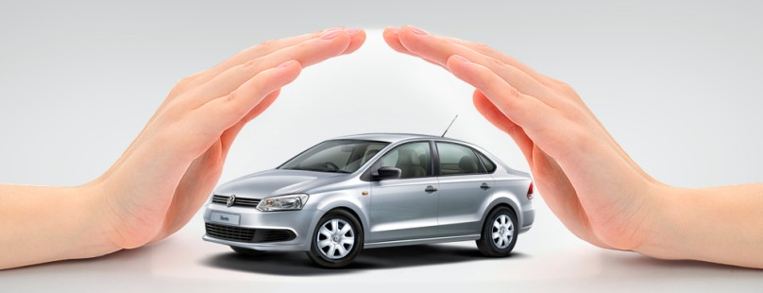
Motor Insurance

Slide 2
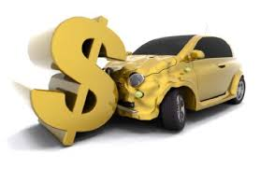

What Is Motor Insurance
Motor Insurance is a contract by which the insurer assumes the risk of any loss the owner or operator of a motor vehicle may incur through damage to property or persons as the result of an uncertain event like an accident.

Slide 3

Why Motor Insurance
Increase in number of Vehicles and Road Accidents
Protects the Financial Value of Motor vehicle against accident
Protects the Financial Value of Motor vehicle against damage
Protection against Third Party Property Damage
Protection against Third Party Life Damage
Passing the burden to the Insurance company
Mandatory coverage as per Law-Third Party Liability

Slide 4
Motor Insurance
History
1939
First motor Vehicle Act was passed to make T.P insurance compulsory. M.V Act 1939
1988
M.V Act of 1988 replaced the 1939 Act and came into force from 1.7.1989
2007
Motor insurance in India was governed by the India Motor Tariff till 31.12.2006

Slide 5


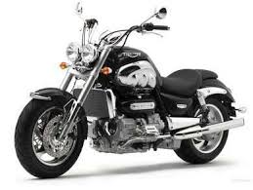



Motor Insurance
Private Car
Scooter / Motor Cycle
Commercial Vehicle
Goods Carrying
Misc. Type Vehicles
Passenger Carrying

Slide 6
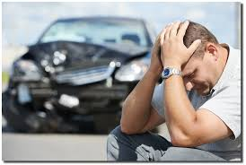
Types Of Coverage
Own Damage
Accidental External Means
Burglary/ house-breaking/ theft
Riot/ Strike
Malicious Act
Terrorism
In transit
Rock slide/ Land slide
Fire/ explosion/ self ignition/ lightning
Earthquake/ Act of God perils

Slide 7
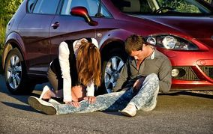
Types Of Coverage
Third Party Liability
Third Party Life- Unlimited Liability
Third Party Property- 7.5 lacs for Pvt Car & C.V. 1 lac for two wheelers
All legal expenses incurred for defending T.P claims

Slide 8
Other Covers
Personal Accident Cover for Owner Driver is compulsory if vehicle is owned by an individual.
  Pvt Car & C.V – Rs. 1500000 /-. Premium Rs.330/-
  2-wheeler – Rs. 1500000 /-. Premium Rs.330/-
Personal Accident Cover for occupants.
  Upto Rs.200000 /- for each passenger
  Premium : Pvt. Car-Rs.5/per10K, 2-wheeler-Rs.7/per10K, C.V-Rs6 per10K
Legal liability to paid driver (As per WC Act.)-Premium Rs. 50/-
Liability to employees-Pvt. Car-Rs.50, 2-wheeler-Rs.60, C.V-Rs.75/125

Slide 9

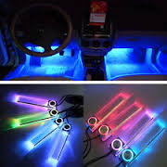
Other Covers
Loss of Accessories
Coverage | Premium 2Wheelers | Premium Private Car | Premium Comm. Vehicles
Electronic Accessories | 3%, min Rs 50/- | 4% | 4%
CNG / LPG Kit | NA | 4% plus Rs 60/- (5% on OD if inbuilt) | 4% plus Rs. 60/- (5% on OD if inbuilt)
Fiber Glass fuel tank | NA | Rs. 50/- | Rs. 50/-
Imported Vehicle without customs duty | NA | 30% of OD Premium | 30% of OD Premium
Cover for Mudguard etc (IMT 23) | NA | NA | 15% of OD Premium

Slide 10
Compulsory Excess
  Car
  Vehicle upto
  Vehicle above
  Motorized Two Wheelers
1500 CC
Excess
Rs.1000
1500 CC
Excess
Rs.2000
Excess
Rs.100

Slide 11

Depreciation
Rates For
All rubber nylon/ plastic parts, tyres and tubes, batteries and air bags - 50%
All fibre glass components - 30%
All parts made of glass- Nil
All other parts including wooden parts is to be as per the following schedule
AGE OF THE VEHICLE
% OF DEPRECIATION
Not exceeding 6 months
Nil
Exceeding 6 months but not exceeding 1 year
5%
Exceeding 1 year but not exceeding 2 years
10%
Exceeding 2 years but not exceeding 3 years
15%
Exceeding 3 years but not exceeding 4 years
25%
Exceeding 4 years but not exceeding 5 years
35%
Exceeding 5 years but not exceeding 10 years
40%
Exceeding 10 years
50%

Slide 12

Rating Factors
Pvt. Car, 2-wheeler, C.V :
Insured’s Declared Value (IDV)
Cubic Capacity :
  For Pvt. Car & 2-wheeler – Cubic capacity
  For Commercial Vehicle :
    Goods Carrying vehicle - Gross Vehicle Weight (GVW)
    Passenger Caring Vehicle – Licensed Carrying Capacity
Geographical Zones
4. Age of the Vehicle

Slide 13
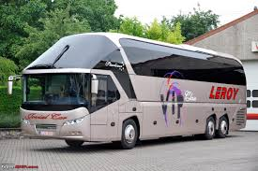
Rating Factors – Commercial Vehicles
C.Vs are classified into following categories for rating :
CLASS CATEGORY
Goods Carrying
A1, A2, A3, A4
Trailers
B
Passenger Carrying
C
Misc. & special type
D
Motor Trade
E, F, G

Slide 14
Insured Declared Value - IDV
Fixed on manufacturer's selling price.
( Invoice Value + Sales Tax, Excluding Registration & Insurance Charges)
Age of vehicle Depreciation
Not exceeding 6 months
5 %
6 months to 1 year
15 %
1 year to 2 years
20 %
2 years to 3 years
30 %
3 years to 4 years
40 %
4 years to 5 years
50 %

Slide 15
Geographical Zones
  For Private Cars and 2 Wheelers-
  For Commercial Vehicles-
Mumbai,Delhi,Kolkata,Chennai, Hyderabad,Bangalore,Pune, Ahmedabad
Zone A
Zone B
Rest Of India
Zone A
Mumbai,Delhi,Kolkata,Chennai
Zone B
All other State capitals
Zone C
Rest Of India
Geographical zone is where vehicle is registered

Slide 16
Premium For Liability Cover
Liability premium is based on cubic capacity/GVW/passenger carrying capacity.
No mid term changes allowed.
THIRD PARTY PROPERTY DAMAGE LIMITS
LIMITS
Vehicle type | Limits as per Act | Optional limit | Discount
Private Cars | 750,000 | 6,000 | 100
2 wheelers | 100,000 | 6,000 | 50
Commercial Vehicles
2 wheelers | 100,000 | 6,000 | 50
3w/taxis | 750,000 | 6,000 | 150
Other CV's | 750,000 | 6,000 | 200
Misc Vehicles | 750,000 | 6,000 | 200

Slide 17
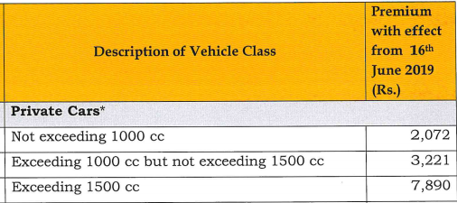
PREMIUM RATES – Private Car
ZONE A | Age Of Vehicle | Not Exceeding 1000 CC | Exceeding 1000 CC but not 1500 CC | Exceeding 1500 CC
 | Not Exceeding 5 years | 3.127% | 3.283% | 3.440%
 | Exceeding 5 years but not 10 years | 3.283% | 3.447% | 3.612%
 | Exceeding 10 years | 3.362% | 3.529% | 3.698%
Own Damage Rates
ZONE B | AGE OF VEHIVLE | Not Exceeding 1000 CC | Exceeding 1000 CC but not 1500 CC | Exceeding 1500 CC
 | Not Exceeding 5 years | 3.039% | 3.191% | 3.343%
 | Exceeding 5 years but not 10 years | 3.191% | 3.351% | 3.510%
 | Exceeding 10 years | 3.267% | 3.430% | 3.594%
Third Party Rates

Slide 18
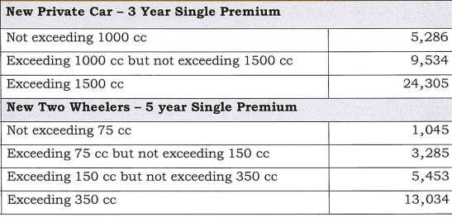
PREMIUM RATES – Private Car
Third Party Rates- long term covers

Slide 19
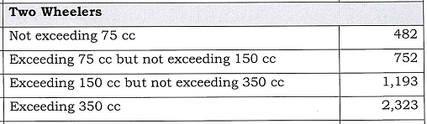
PREMIUM RATES – Two Wheelers
ZONE A | AGE OF VEHICLE | Not Exceeding 150 CC | Exceeding 150 CC but not 350CC | Exceeding 350 CC
 | Not Exceeding 5 years | 1.676% | 1.760% | 1.844%
 | Exceeding 5 years but not 10 years | 1.760% | 1.848% | 1.936%
 | Exceeding 10 years | 1.802% | 1.892% | 1.982%
Own Damage Rates
ZONE B | AGE OF VEHIVLE | Not Exceeding 1000 CC | Exceeding 1000 CC but not 1500 CC | Exceeding 1500 CC
 | Not Exceeding 5 years | 1.708% | 1.798% | 1.879%
 | Exceeding 5 years but not 10 years | 1.793% | 1.883% | 1.973%
 | Exceeding 10 years | 1.836% | 1.928% | 2.020%
Third Party Rates

Slide 20

Discounts
No Claim Bonus.
Voluntary Deductibles.
Automobile Association Membership.
Anti theft devices (Approved by Automobile Research Association of India).
Vehicle is designed for Handicap Person (Same needs to be mentioned in the RC copy).

Slide 21
No Claim Bonus
Discount on O.D Premium
All types of Vehicles
No Claims made/pending in preceding :
1 Year
Discount
20%
2 Years
Discount
25%
3 Years
Discount
35%
4 Years
Discount
45%
5 Years
Discount
50%

Slide 22
Voluntary Deductible
Private Cars
Opted as Voluntary deductible max Rs.750
Opted as Voluntary deductible max Rs.1500
Opted as Voluntary deductible max Rs.2000
Opted as Voluntary deductible max Rs.2500
Rs.2500
20%
Rs.5000
25%
Rs.7500
30%
Rs.15000
35%
Discount on O.D Premium

Slide 23

Premium Calculation - Steps
Own Damage
1. Find out the IDV
A. Vehicle Own Damage
B. Accessories
C. CNG / LPG Kit
Apply Premium Rate to the IDV
A. Age
B. Zone
C. Cubic Capacity
3. Calculate Own Damage Premium (IDV * Rate)
Deduct Discounts
1. Voluntary Deductible
2. No Claim Bonus
3.Tariff / OD Discount
Liability
A. Third Party
B. Owner Driver PA cover
Passenger PA
Paid Driver
Employee Liability
C. Any Other Additional Cover
Final Premium
Own Damage
+
Add on
+
Liability
+
GST 18%

Slide 24
Important Guidelines
No cover notes to be issued for stand alone TP proposals
No Cover notes shall be issued on Short Period Basis.
In case of any doubt on rates/discounts/loading etc. please approach the office head / ZU / HO.

Slide 25
Business Process
Fresh Cases – New Car
Break In Insurance Cases
Roll Over Cases
Transfer Cases

Slide 26

Business Process
New Cases
Break in Insurance Cases
  IDV @ 95% of SP
  Proposal Form :Completely Filled & Signed
  Invoice / RC Copy
  NCB Reserving Letter (ORIGINAL) if nay
  Cover-note
  Proposal Form :Completely Filled & Signed
  Previous Insurance Policy
  Inspection Report
  Copy of RC
  Cover-note

Slide 27
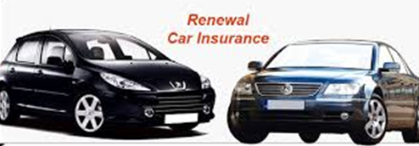
Business Process
Roll Over Cases
Transfer Cases – Fresh Policy
  Proposal Form – Completely Filled & Signed
  Previous Years Policy
  Cover-note
  Proposal Form – Completely Filled & Signed
  Previous Insurance Policy
  Proof of sales of the vehicle – Transferred RC or Copy of Form 29 & 30
  Inspection Report
  Cover-note

Slide 28

Business Process
Endorsement for Transfer
  Proposal Form – Completely Filled & Signed
  Inspection Report
  Written Request for transfer of the policy from original policy holder
  Transfer Fee of Rs. 50/-
  NCB Recovery, if any, on pro rata basis
  Original Policy
  Proof of sales of the vehicle – Transferred RC or Copy of Form 29 & 30

Slide 29


General Exclusions
Consequential Losses due to accident.
Damage to tyres & tubes without the vehicle being damaged.
Driver being under the influence of liquor and drugs at the time of accident.
Damage to insured own property.
Intentional self injury or attempted suicide.
Accident occurring out side geographical area of operation covered by the policy.
Contractual Liability of any kind.
Vehicle Used otherwise than limitations as to use
Driven by any one other than a licensed driver
Losses due to Ionizing radiation or contamination by radioactivity
Losses caused due to Nuclear weapons material
Losses caused due to War and war like situation.

Slide 30
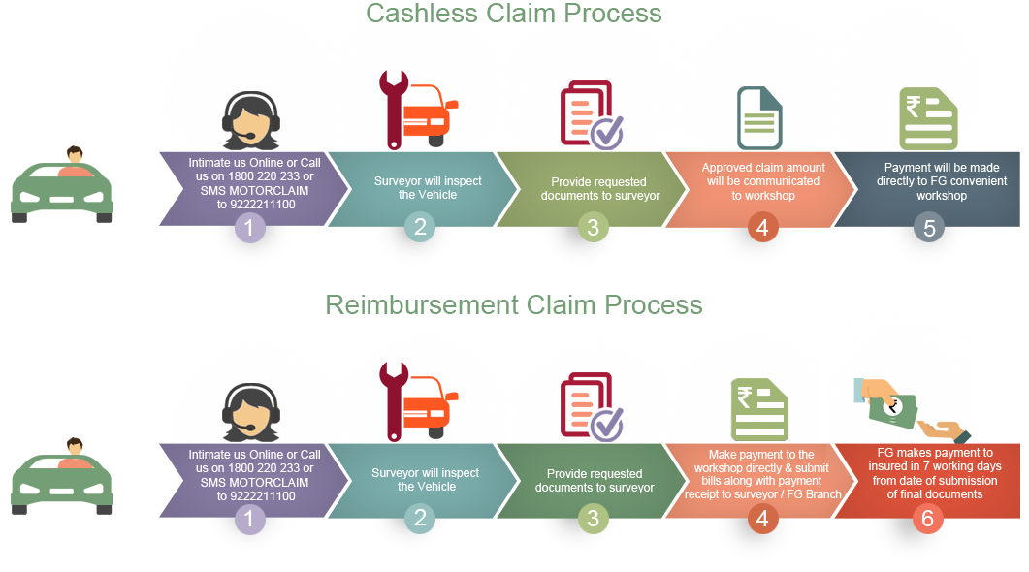
Claim Process

Slide 31
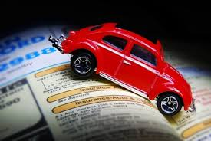
Claim Documentation
Hand over the following documents to surveyor / Garage
Copy of permit, load challan for G.C.V
Filled claim form
Copy of Ins. Policy or C/N
Copy of Reg. certf, sales invoice, tax receipt
Copy of fitness certificate for C.V
Documents
Copy of D/L of person driving at time of accident
Estimate of repair from repairer
FIR/ police panchnama

Slide 32
Thanks

