Slide 1
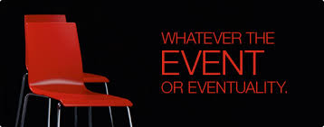
Future Events Insurance

Slide 2
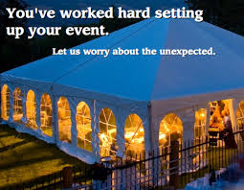
Scope of Cover
Sections
EVENT CANCELLATION (Compulsory Section)
PROPS, SET, STAGE and EQUIPMENTS
PUBLIC LIABILITY
PERSONAL ACCIDENT – DEATH & DISABILITY
CASH IN TRANSIT & SAFE

Slide 3
EVENT CANCELLATION
Section 01
Insuring clause
This Insurance is to indemnify the Insured for their Ascertained Net Loss should any Insured Event(s) be necessarily Cancelled due to
1. Loss or Damage to the venue due to Fire & Allied Perils and Earthquake, Flood, Cyclone. (Resulting in cancellation of the event)
2. Death of current Prime Minister, President of republic of India, Chief Minister of the state in which the event is being held, due to which National / State mourning is declared or any other prominent personality.
Warranty:
1 It is warranted that the insured has all the required permissions from the local authorities / government approvals etc. in place before the start of the event.
2 Alternate, appropriate and necessary arrangement is made to the venue so as to continue the event during seasonal climatic changes
Notes:
“Ascertained Net Loss” means such amount in excess of any deductible stated in the Schedule as represents expenses which have been irrevocably expended in connection with the Insured Event(s) which have been necessarily Cancelled, Abandoned, Postponed, Interrupted, Curtailed or Relocated, less
such part of the Gross Revenue retained less any savings the Assured is able to effect to mitigate such loss

Slide 4
EVENT CANCELLATION
Section 01
Exclusions to Section 1
Cancellation of the event due to Non – Appearance of the insured artist / performers as a result of cancellation, postponement of transport arrangements.
Cancellation of the event due to rains, storm; Hail storm; Sand storm; High Winds; Gales; tempest etc.
Contractual disputes if any between the Insured and the insured artist / performer.
Non– Appearance of the insured artist/ performer due to legal, government cases, litigations, summons etc.
The failure of the insured to carry on the event, commence & complete the event in the scheduled time due to the insured’s inability to make the necessary arrangements, to take the required permissions, due to financial incapacity, lack of funds, defaults,
Due to insufficient crowd and non – appearance of key performer’s/ artist/ speakers/ anchors insured in the said policy due to government warrants, duty’s, court verdicts, summons and other government requirements and summons.
Refer policy wordings for complete list of exclusions

Slide 5
PROPS, SET, STAGE and EQUIPMENTS
Section 02
Insuring clause
The Company agrees to indemnify the Insured against loss of or damage to the props, set, stage, equipments as declared in the insured production against the following coverages:
Standard Fire and Special Perils
Earthquake
Burglary
Accidental external damage (direct physical loss or damage to the property from any external cause) whilst stored and or lying in the premises or whilst stored and or lying and/or erected at the site of event.
Warrantee :
Proper fire fighting equipments, systems are installed at the venue, the local and nearest fire station is informed about the event and is on call, Escape exits are provided for at the venue, All pyrotechnics event (if any) are carried out by trained professionals only.

Slide 6
PROPS, SET, STAGE and EQUIPMENTS
Section 02
Exclusions to Section 2
Loss of or damage to articles of consumable nature other than those for sale.
Loss of or damage to Valuables, livestock, motor vehicles and pedal cycles. Coverage under this section however does not exclude petty cash in the premises up to a limit of Rs.2,500/- provided the same is specifically insured.
Other standard exclusions under Standard Fire Policy
Refer policy wordings for complete list of exclusions
Special conditions
Condition of Average is applicable
Provided, however, that if the Sum Insured hereby on the property Insured shall at the event of such fire or at the commencement of such destruction or damage be not less than 85% of the collective value of the property insured, this condition shall be of no purpose and effect.

Slide 7
PUBLIC LIABILITY
Section 03
Insuring clause
The Company will indemnify the Insured against its legal liability (including Defence Costs) to pay Damages for third party civil claims arising out of Bodily Injury or Property Damage caused in the course of the Event by an Accident in the Premises where it is held and during the Policy Period if notified during the Policy Period in accordance with the terms of this Policy.
Warrantee: It is warranted that proper care is taken in installing the sets props and other infrastructure at the venue of the event and is carried out by trained professionals, as per approved plans of the local authorities.

Slide 8
PUBLIC LIABILITY
Section 03
Special conditions
1. Insured to notify within 7 days, any claim made against the Insured during the Policy
Period; and/or
2. Insured to notify within 7 days, any circumstance occurring during the Policy Period
which might reasonably be expected to give rise to a claim. Any circumstance notified under this clause and any subsequent claim arising out of the circumstance so notified shall be deemed to have been made during the Policy Period, and
3. Right to defend
4. If, in the case of continual and continuous inhalation, ingestion or application of any substance resulting from an insured event, the Insured and the Company should disagree as to when the Bodily Injury or the Property Damage happened
4a. The Bodily Injury shall be deemed to have occurred when the claimant first consulted a qualified medical practitioner in respect of the same;
4b. Property Damage shall be deemed to have occurred when it first became physically evident

Slide 9
PUBLIC LIABILITY
Section 03
Exclusions to Section 3
Any agreed assumption of risk by the Insured, save to the extent that liability would have attached in the absence of such agreement;
Any accident arising out of the deliberate, willful or intentional non-compliance with any statutory provision;
Any bodily injury of any person under a contract of employment or apprenticeship with the Insured, or the Insured's contractors or sub-contractors, if such bodily injury was contracted and/or arose out of and in the course of his employment;
The Insured’s consequential losses of any kind, be they by way of loss of profit, loss of opportunity, business interruption, market loss or otherwise, or any claims arising out of loss of a pure financial nature such as loss of goodwill;
The infringement of plans, copyrights, patents, trade names, trade marks or registered designs;
Libel, slander, false arrest, wrongful eviction, wrongful detention, defamation including mental injury, anguish or shock resulting there from;

Slide 10
PUBLIC LIABILITY
Section 03
Exclusions to Section 3
The ownership possession or use by or on behalf of the Insured of any motor vehicle or trailer (or tools attached) for which compulsory insurance is required by legislation.
The transportation of materials and/or hazardous or dangerous substances outside the Insured's Premises;
Damage to property belonging to third parties that is rented, leased or hired or under hire purchase or on loan to the Insured. An indemnity shall however be provided for Claims arising out of accidental damage to the Insured Premises or the Contents thereof, that are temporarily occupied by the Insured for working thereon, but only to the extent the Insured is held legally liable for the same independently of any specific agreement relating to the use of the same;
Damage to property belonging to third parties handled by the Insured by way of his trade or worked upon by or in the care, custody or control of the Insured or any person employed by or working for the Insured. An indemnity shall however be provided for claims arising out of damage to employees’ and visitors clothing or personal effects brought onto the Insured's Premises with the Insured’s consent;
Refer policy wordings for complete list of exclusions

Slide 11
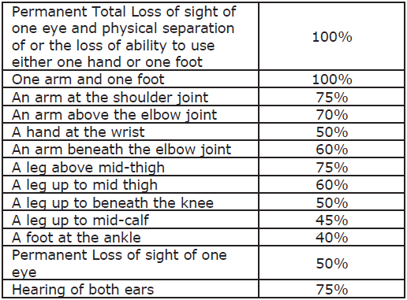
Personal Accident
Section 04
Insuring clause
We shall indemnify the Assured to the Limit of the Sum Assured or the percentage of the Sum Assured as specified in the Policy Schedule, if Assured will sustain Accidental
Bodily Injury during the Policy Period, which results in one of the losses shown in the Table of losses below. The loss must occur within 12 months from the date of Accident, which caused the Injury.

Slide 12
Personal Accident
Section 04
Exclusions to Section 4
Intentional self injury (including but not limited to the use or misuse of any intoxicating drugs or alcohol).
Accident while under the influence of alcohol or drugs.
Participation in breach of law with or without criminal intent.
War, Nuclear risks exclusions
Any existing disablement prior to the inception of the policy.
Accidents due to mental disorders or disturbances of consciousness strokes fits or convulsions which affect the entire body and any pathological disturbances caused by the mental reaction to the same.
Any claim arising directly or indirectly, wholly or partly by bacterial infections (except pyogenic infections which shall occur through an Accidental cut or wound).
Losses arising from Accidents as a driver on motorized vehicles unless at the time of the Accident You are in possession of a current full national driving license and while riding a two wheeler the driver is wearing a safety crash helmet.
Refer policy wordings for complete list of exclusions

Slide 13
CASH IN TRANSIT & SAFE
Section 05
Insuring clause
The Company will indemnify the Insured for
1. the loss In Transit of money whilst carried by the Insured or its Employee, caused during the Policy Period by Robbery, theft or any other fortuitous event.
2. the loss of Money from a Safe and/or Strong Room in the premises mentioned in the Schedule caused by Burglary and/or Robbery and/or theft
Warranty:
1. It is warranted that Key (Duplicate /original ) should not be kept on the same premises where strong room/safe is located.
2. It is warranted that the Key(s) should be with nominated Named person (max two) only
3. It is warranted that the premises should have security gaurd 24 Hrs, preferably armed guard

Slide 14
CASH IN TRANSIT & SAFE
Section 05
Definitions
1. "Theft” means the dishonest misappropriation of Money with the intention of permanently depriving the Insured of that Money.
2. "Robbery” means the Theft of Money using unforeseen, aggressive and violent means against the Insured's Employees.
3. "In Transit” means:
3.1 Any mode of transportation of Money for the payment of wages, salaries and other earnings or for petty cash directly between a bank, the Insured Premises or a Point in Transit (if specified) by the Insured or an Authorised Employee from the time Money is received at the bank, the Insured Premises or a Point in Transit by the Insured or an Authorised Employee until delivered to the bank, the Insured Premises or a Point
in Transit by the Insured or an Authorised Employee and whilst at the Insured Premises until disbursed provided that out of business hours such Money shall be secured in a locked Safe or locked Strong Room. Cheques drawn by the Insured to provide for such
Money are covered In Transit from the Insured Premises to the Bank only.
3.2 Any mode of transportation of Money in the personal custody of the Insured or an Authorised Employee directly between a bank and the Insured Premises or a Point in Transit (if specified) from the time Money is received at the bank or the Insured Premises by the Insured or an Authorised Employee until delivered to the bank or the Insured Premises or a Point in Transit by the Insured or an Authorised Employee within 72 hours of the time of collection.

Slide 15
CASH IN TRANSIT & SAFE
Section 05
Exclusions to Section 5
1. any consequential losses of any kind, be they by way of loss of profit, or otherwise and any other legal liability of any kind.
2. loss of money carried by anyone other than the Insured or an Employee.
3. loss of money where the Insured or an Employee is or is alleged to be involved as a principal or accessory or is alleged to be in anyway concerned or implicated.
4. money carried under contract of affreightment.
5. loss of money from an unattended vehicle.
6. Loss of money from a Safe or Strong Room following the use of a key belonging to the Insured and/or combination and/or code to gain access, unless this has been obtained by threat or violence against Employees.
7. Loss or damage whether direct or indirect arising from war, riot, strike or any terrorist activity.
8. Loss caused by any earthquake, flood, storm, cyclone or other convulsions of nature or atmospheric disturbances.
9. any loss not discovered within a period of 72 hours after its occurrence.
10. Refer policy wordings for complete list of exclusions

Slide 16
General Exclusions
Section 06
No liability for any loss resulting from …
the Assured's lack of care, diligence or prudent behaviour, the result of which would Increase the risk, and/ or likelihood of a loss, hereunder.
any contractual dispute or breach by the Insured or any Participant.
alterations or variance of Insured Event(s) without the prior written approval of the Company.
adverse weather in respect of any Insured Event(s) in the open or under canvas or in temporary structures unless agreed by the Company in writing and stated in the Schedule.
any work being carried out by builders or other contractors which renders the Venue or its facilities unusable in whole or in part, unless such work is unknown to the Assured at the inception of this Insurance or at the time of making the booking whichever is the later.
expenses and Gross Revenue which have not been declared to and agreed by the Company.
any reduction in attendance that is not specifically attributable to the necessary Cancellation, Abandonment, Postponement, Interruption, Curtailment or Relocation of the Insured Event(s).
Refer policy wordings for complete list of exclusions

Slide 17
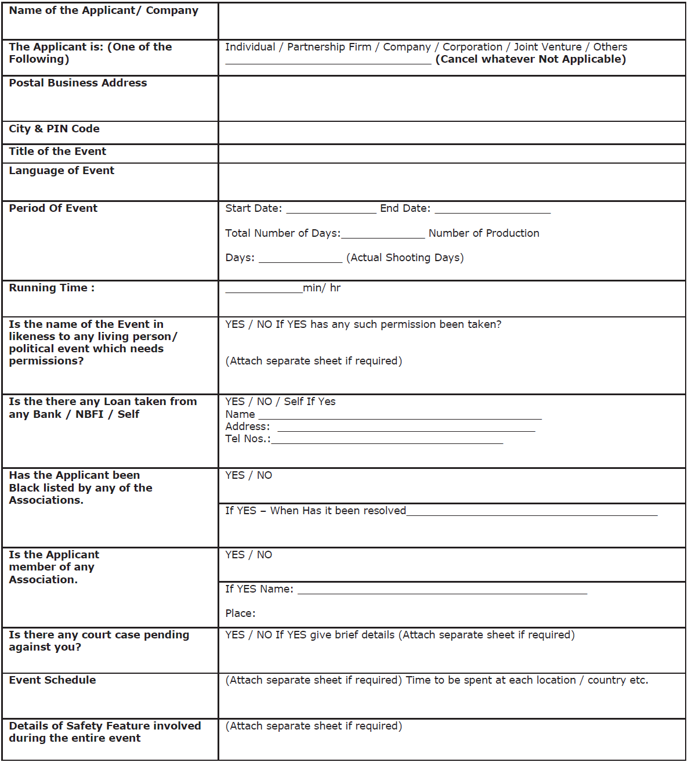
Proposal Form
Section 07

Slide 18
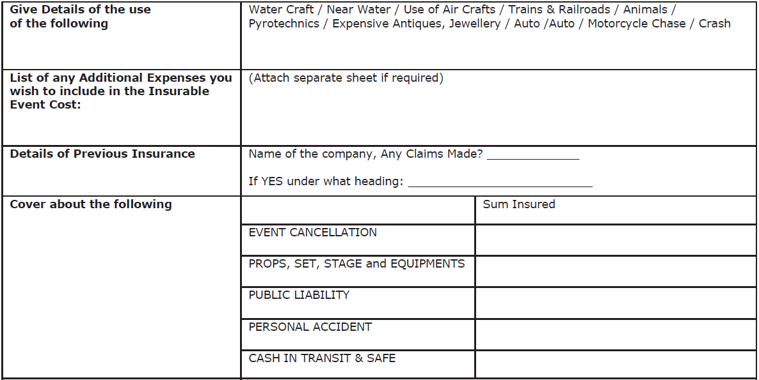
Proposal Form
Section 07

Slide 19
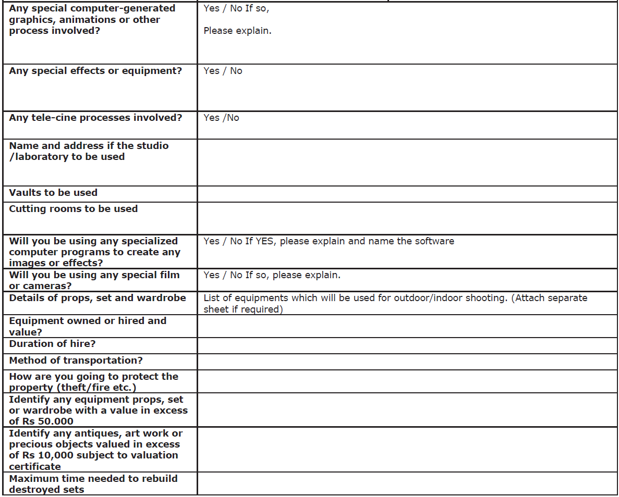
Proposal Form
Section 07

Slide 20
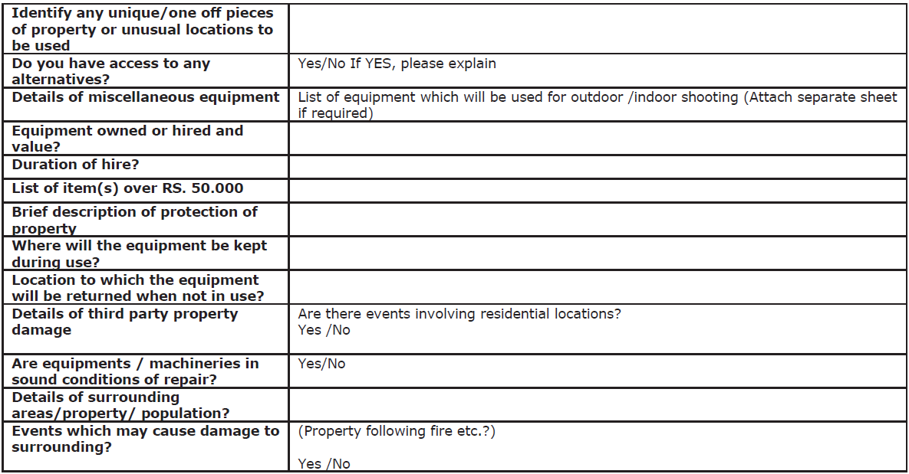
Proposal Form
Section 07

Slide 21
www.futuregenerali.in

