Slide 1

Burglary Insurance

Slide 2
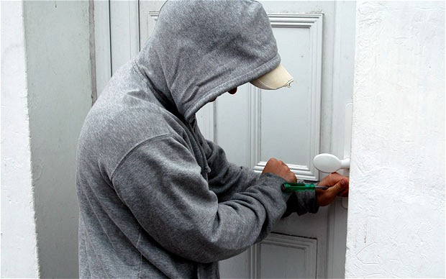
Burglary & Housebreaking
Every successful business be it a small or medium enterprise or a retail store, needs complete protection against various risks.
Occurrences like burglary, housebreaking etc. can cause a severe financial strain on your business.
Although you cannot completely safeguard your business from such occurrences, you can still take necessary precautions against them.
Burglary Insurance can assist in safeguarding your assets that you value the most.

Slide 3

What’s Covered
Covers property contained in your premises.
It also covers cash, valuables, securities kept in a locked safe or cash box in locked steel cupboard on specific request.
The Policy pays actual loss/damage subject to the limit of Sum Insured. If Sum Insured is not adequate, Policy pays only proportionate loss.
There is also a provision in the Policy to cover bulk items on ‘first loss’ basis wherein a percentage of total stock stored can be taken as that exposed to the risk of burglary and housebreaking. The premium is charged on this percentage selected only.

Slide 4

Additional covers
Costs for changing locks
Cost for repair of damage to your premises
Riot, Strike, Malicious Damage cover
on payment of additional premium

Slide 5

What's Not Covered
Destruction damage or loss if the premises have been unoccupied for longer than 7 continuous days
Nuclear activity, weapons, waste
War, invasion, act of foreign enemy
Confiscation, nationalisation by government authority
Consequential loss of any type.
Riots strikes civil commotion

Slide 6
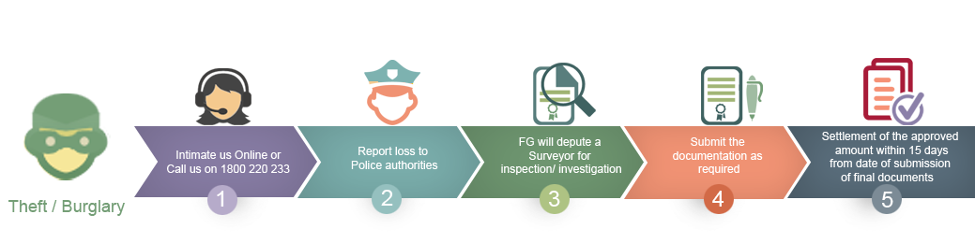

Claim Notification and Proof of Loss

Slide 7
Document Checklist for Claims
Duly completed claim form
Copy of the complaint lodged duly acknowledged by the police
FIR
Final investigation report from Police
Non traceable certificate issued by the police authority
Estimate of loss.
Copy of all invoices, price list, based on which quantum of loss is arrived & supporting bills.
Letter of indemnity and subrogation form from insured
Stock statement a day before the date of loss.
The list is indicative and where the circumstances of loss necessitate submission of any further documents, the Insurer/surveyor shall advise the insured of the same within 7 days of being informed of the loss.

