Slide 1
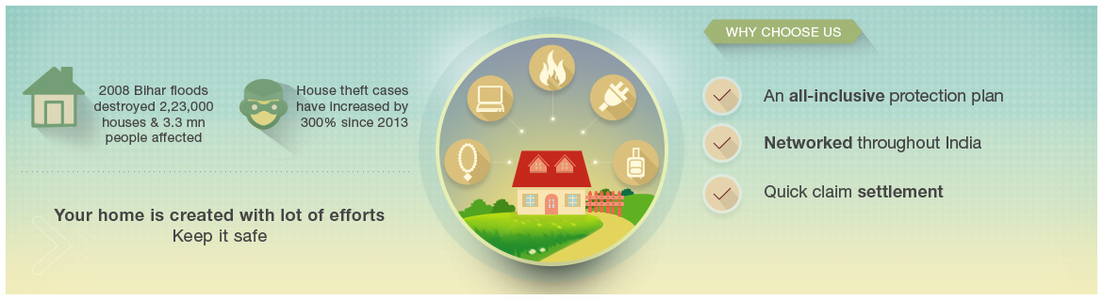
Home Secure
Protect what protects you
Insure your home and everything in it.

Slide 2
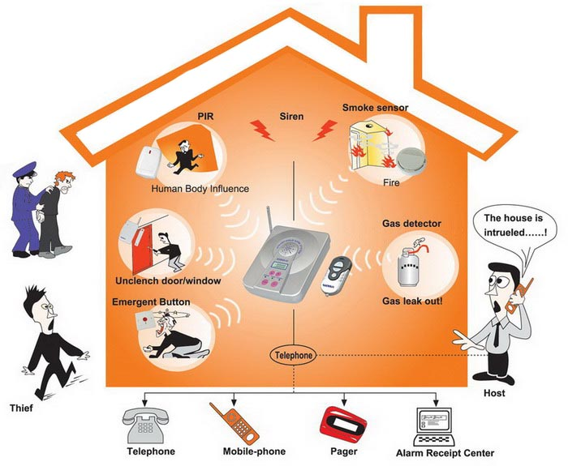
Future Generali's Home Secure protects your Home worries when:
Home gets burgled
Gas cylinder explodes
Jewellery gets stolen
The costly plate glass fixed on the balcony breaks accidentally
The computer accidentally falls down damaging the monitor
Breakdown of electronic equipment / home appliances
Baggage containing costly clothing gets stolen during the holiday trip
Some one sues against you for your liability towards a third party
This insurance policy is tailored to take care of the various unfortunate events of daily life.

Slide 3

Home Secure

Slide 4

Product Details

Slide 5


Protection of your Assets- Standard Fire & Special Perils
Buildings
Contents (excluding Valuables)

Slide 6
Perils Covered
Fire
Lightening
Explosion/Implosion
Aircraft Damage
Riot, Strike and Malicious Damage
Storm, Cyclone, Typhoon, Tempest, Hurricane, Tornado, Flood and Inundation
Impact Damage
Subsidence and Landslide including Rock Sildes
Bursting and or Overflowing of water tanks
Missile Testing Operations
Leakage from Automatic Sprinkler Installations
Bush Fire
Earthquake
Terrorism (if opted)

Slide 7
Cost of alternative accommodation
If the home is damaged and You cannot live there, We will pay You reasonable accommodation expenses, up to the limit, until the home is fit to live in.
Loss of rent
If the home is damaged and You cannot live there, We will pay You loss of rent, up to the limit, until the home is fit to live in.
Purchase Protection
We will indemnify you in respect of additional purchase made up to 90 days from the date of purchase.

Slide 8
Deeds
We will pay the cost of preparing new title deeds to the home if they are lost or damaged
Emergency Storage of Contents (Household Removal)
We will provide cover for loss of or damage to contents while being moved by professional furniture removers from the home to Insured’s new permanent home (including temporary storage in a furniture depository for up to seven days in a row)
Enhanced cover during family event
We will increase the sum insured for contents section for losses during any month in which insured celebrate a religious festival to cover gifts and food bought for the occasion.

Slide 9


Exclusions
Stocks in cold storage
Bullions, precious stones, curios, drawings, manuscripts, securities, coins, cheques, books of accounts
Loss to electrical machines arising by Over running, excessive pressure, short circuiting, self heating or leakage of electricity shall apply to the particular electrical machine and not to other machines
Loss of earnings, consequential loss
Spoilage as a result of the perils covered
Loss by theft under riots, strike and malicious damage
Volcanic eruptions
Temporarily removed for cleaning, repairs, not exceeding 60 days
5% for claim amount subject to minimum of Rs.10,000 for claims on AOG perils
Rs.10,000 for claims other than AOG perils

Slide 10
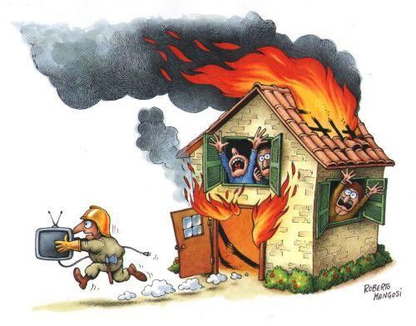
Basis for loss settlements
Partial Loss
Cost required for reinstating or repairing the items to their previous state before the loss.
No depreciation shall be applicable
Total Loss
Cost required for replacing or reinstating the affected items
If the loss is more than 110% then the rateable proportion will be borne by the insurer

Slide 11

Burglary and Theft
Contents ( excluding money and valuables)
Purchase Protection
Enhanced Cover during family events
Deeds

Slide 12
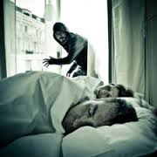
Exclusion
Burglary/Theft by family members
Livestock, Motor vehicle and Pedal cycles
Jewelry and precious stones
Deductible of 5% of claim subject to minimum of Rs. 5000
Not registered immediately as police complaint

Slide 13

Basis of Loss
Repaired or reinstated at a cost less than the replacement cost
For total loss, we will restoration or replacement costs

Slide 14
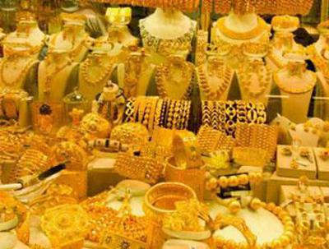
Protection of Your Valuables
Jewellery & Precious Items - All Risks
Accidental loss of or damage to Jewellery and/or Precious Items anywhere in India.

Slide 15
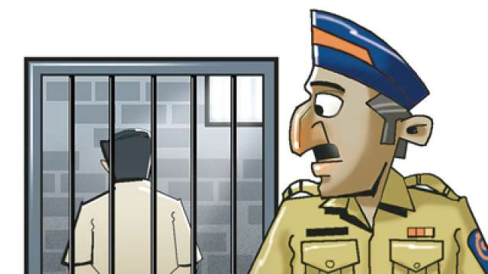
Exclusions
Loss or damage due to
cracking, scratching or Breakage
caused by any process of cleaning, dyeing, repairing or restoring
caused by moth or vermin
being conveyed by any carrier under a contract of affreightment
No one or pair of articles is deemed to be worth more than 10% of the Sum Assured unless its value is specifically and separately stated in the Schedule

Slide 16
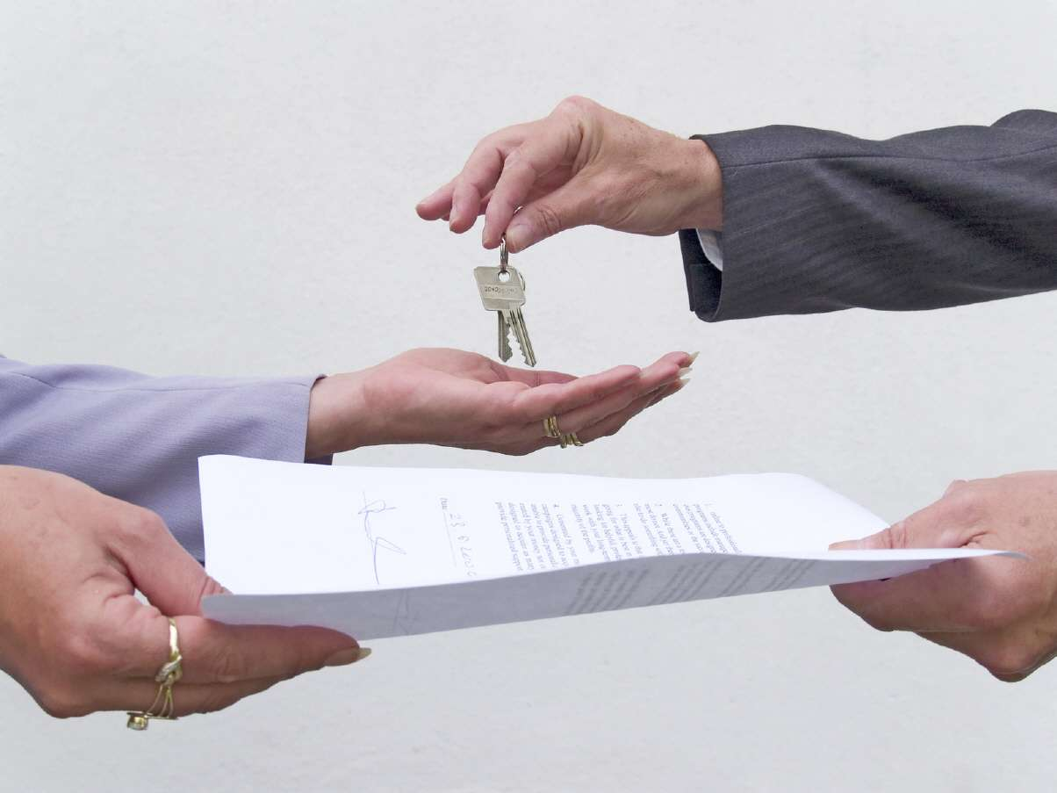
Contents of Safe Deposit Box in bank - All Risks
Valuable items / contents kept in Safe deposit box in bank excluding cash, so lost, destroyed or damaged, by Fire, Riot and Strike, Theft or Accident, from any fortuitous cause.

Slide 17
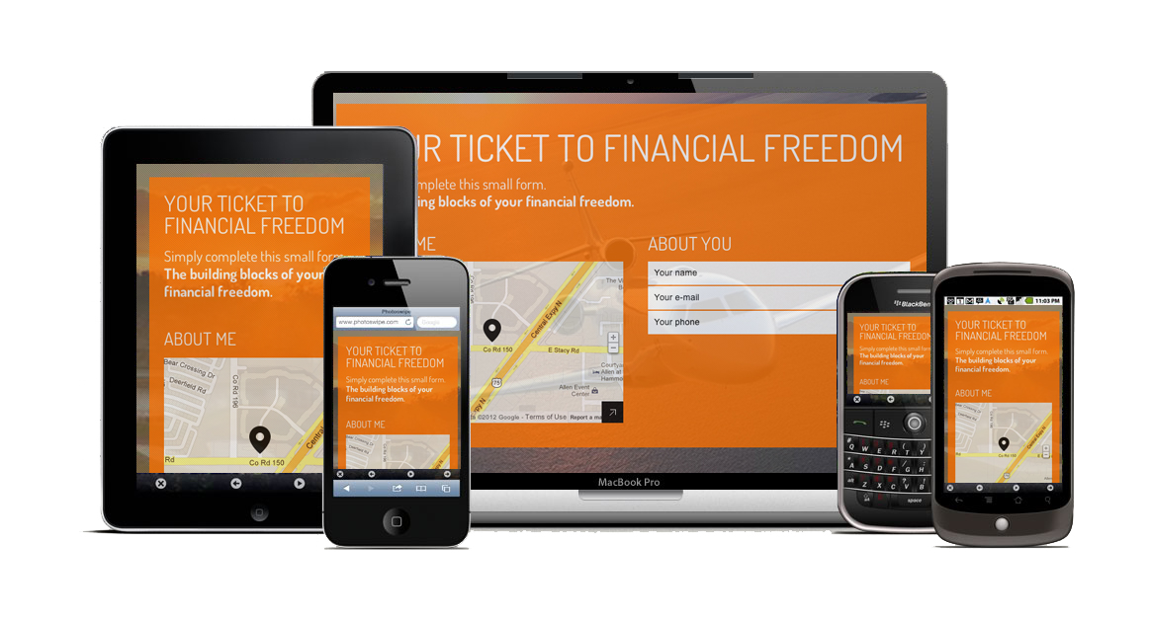
Portable Computer – All Risk excluding Breakdown
Value of portable computers anywhere in the World, so lost, destroyed or damaged, by Fire, Riot and Strike, Theft or Accident, from any fortuitous cause.
A computer includes any computer, data processing equipment, microchip, integrated circuit or similar device or any computer software tools operating system or any
computer hardware or peripherals and the information or data stored in or on any of the above.

Slide 18
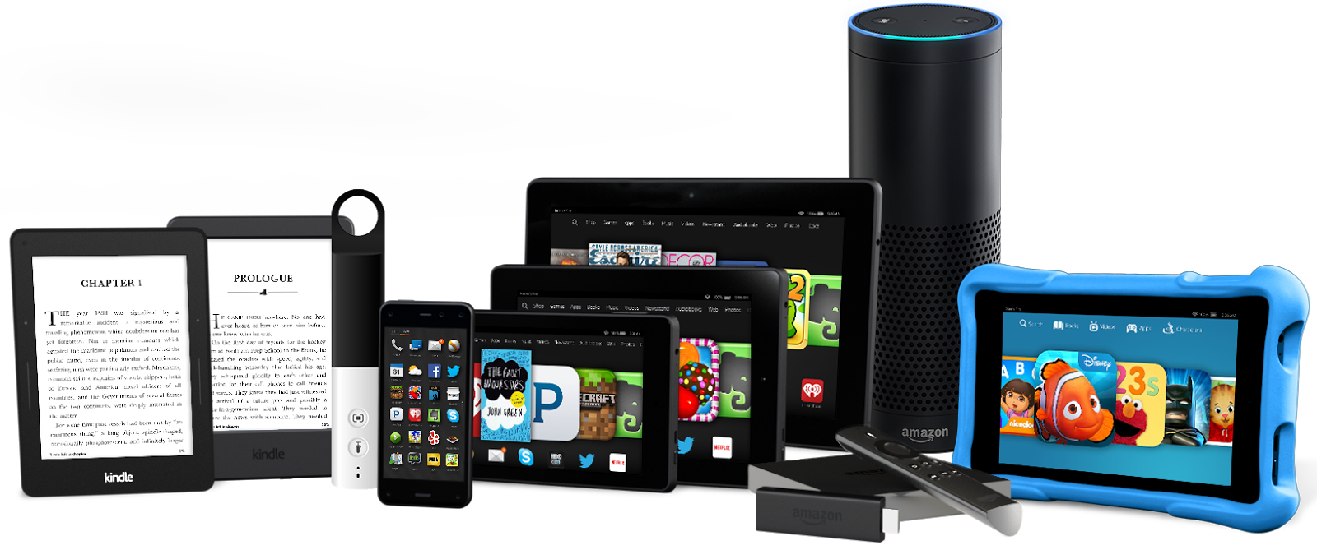
Exclusions
Cleaning, repairing or renovation
Breakage of glass, cameras, lenses, musical instruments
Over winding, denting or internal damage
Theft from Car (except securely locked in car)
Legal Liability
Confiscation by Customs
Consequential Loss

Slide 19
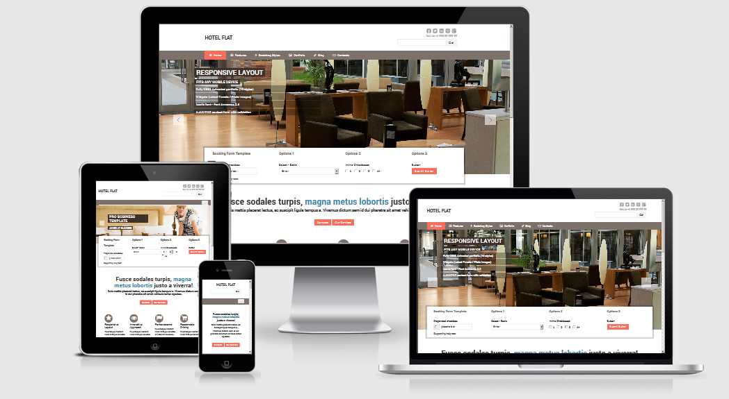
Protection of Your Electronic Equipments
Audio Visual Equipments (Electronic Equipments) – All Risk
Computers (Electronic Equipments) – All Risk

Slide 20

Exclusion
Any fault or defect before the policy
Manufacture or supplier is responsible
Natural wear and tear
Maintenance operations
Willful act
Consequential loss
Portable items
Pressure waves by aircraft
Deductible as stated in the policy
Bulbs, valves, tubes, belts, wires
Aesthetic defects

Slide 21

Basis of Loss
Value of System Software is also included
In case of repair, the cost necessary to restore to the previous serviceability plus the cost for dismantling and re-erection.
If the item is destroyed, then the actual value is calculated by deducting the depreciation from the replacement value.
In total loss, replace the lost with a similar type of similar configuration

Slide 22
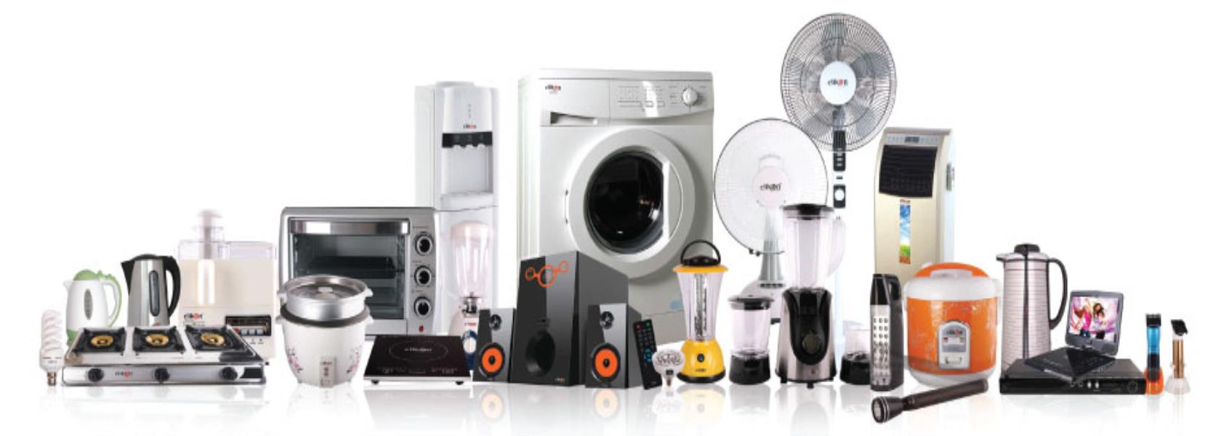
Protection of Your Household Mechanical / Electrical Equipments
Household Appliances – Breakdown

Slide 23


Protection for You and your Family
Accidental Compensation (Personal Accident)
Accidental Death
Permanent Total Disability
Permanent Partial Disability

Slide 24
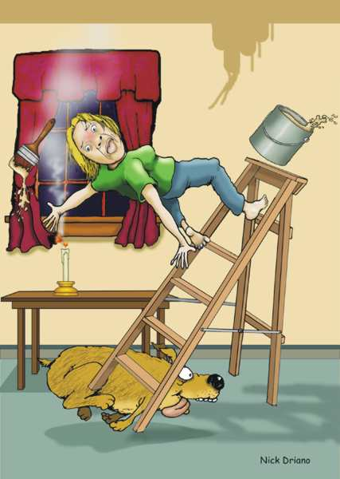
Exclusion
Intentional Injury
Accidents under alcohol and drug influence
Riot, crime
Willful violation of law
Motor racing
War, invasion, civil war, rebellion, revolution
Nuclear energy, radiation

Slide 25
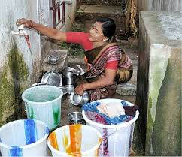
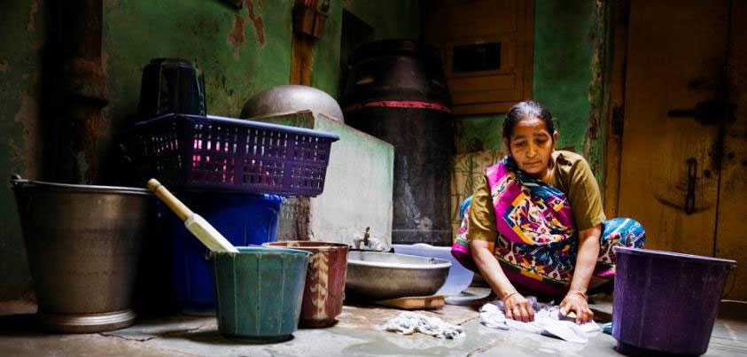
Domestic Workers Compensation
legal liability to pay compensation under the Fatal Accidents Act 1855, the Workmen’s
Compensation Act 1923 or any amendment thereto or under common law in respect of
personal injury by accident or disease sustained by domestic workers

Slide 26

Public Liability
legal liability to pay Damages for civil claims of Bodily Injury or Property Damage arising out of Your use, ownership or occupation of the Insured Premises for solely domestic purposes
caused by the negligent act, error or omission of You, Your Family or Your Household Staff
For any liability that may be incurred under the Public Liability Insurance Act 1991 or any other law base
As the keeper and owner of domestic pets.

Slide 27
Enhanced Protection covers (Other Covers )
Baggage – All Risk
Plate Glass – All Risk
Pedal Cycle
ATM Cash Withdrawal – All Risk
Credit Card/ Debit Card ( Loss or Theft) – Fraudulent Use
Veterinary Cost – Road Accident

Slide 28

Baggage – All Risk
Accidental loss or damage to personal baggage while travelling anywhere in India beyond 25 kms of the insured premises

Slide 29

Exclusions
Any electrical machines
Theft from Car ( other than properly secured)
Under contract of affreightment in a carrier
Jewellery, valuables, Cash, Cheques
Mobiles, Laptops
Loose articles like umbrella, handbags

Slide 30
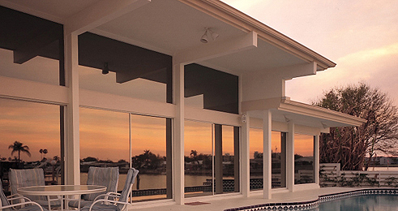
Plate Glass
Accidental Loss or damage to Plate Glass
Reasonable cost for erecting any temporary boarding subject to maximum of Rs.5000
Deductible of 5% of claim amount or Rs.2500 is applicable

Slide 31
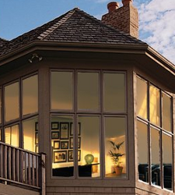
Exclusion
Alteration, removal or repair of plate glass
Breakage of lettering unaccompanied by breaking of plate glass
Consequential damage

Slide 32


Pedal Cycle
Repair or replacement cost for Pedal Cycle
Legal liability to pay for litigation expenses, compensation for accidental damage to property, bodily injury or death other than the family, upto a limit of Rs.30,000

Slide 33
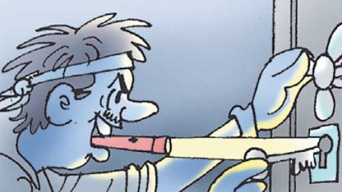
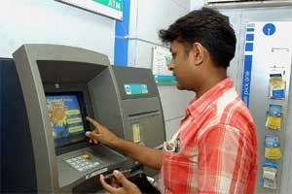
ATM Cash Withdrawal – All Risk
The loss In Transit of Money whilst carried by You after withdrawal from ATM machine, caused by Robbery, Theft or hold up during your journey from the ATM to your residence or office or bank or any other destination where you are traveling to.

Slide 34
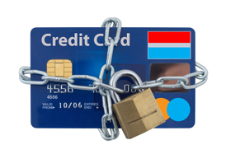
Credit Card/ Debit Card ( Loss or Theft) – Fraudulent Use
Loss of credit card or debit card if they are used by someone without Your permission following a loss or theft.
Cover is provided for credit and debit cards held for domestic purposes up to the limit shown in the schedule.
Policy will not cover for:-
Loss caused by mistakes.
Loss not reported to police

Slide 35

Veterinary Cost – Road Accident
We will reimburse you the necessary cost of Veterinary doctors due an unforeseen accident caused to your pet dog up to limit specified in the schedule

Slide 36
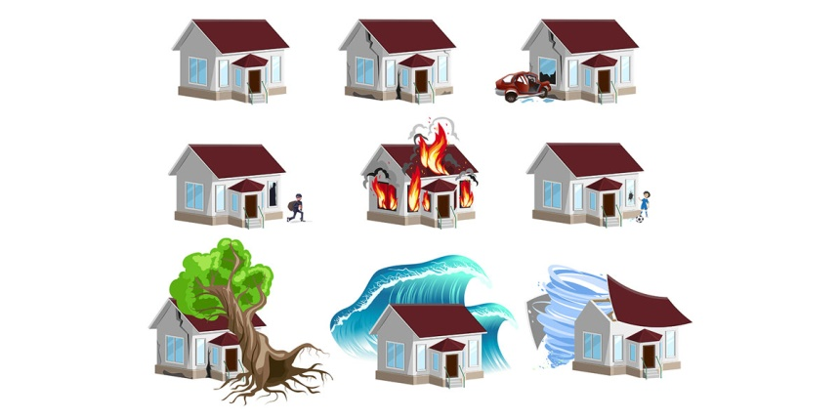
Exclusions applicable to all sections
Direct or indirect arising from War, Warlike operations, Act of Foreign Enemy, Hostilities (whether war be declared or not), Civil war, rebellion, Insurrection, Civil Commotion, Military or Usurped Power, Seizure, Capture, confiscation, Arrests Restraints and Detainment by the order of any Government or any other authority.
Loss or damage caused by depreciation or wear and tear.
Consequential loss of any kind or description.
nuclear weapons or ionising radiation or contamination by radioactivity

Slide 37

Terrorism Damage Exclusion Warranty
Notwithstanding any provision to the contrary within this insurance it is agreed that
this insurance excludes loss, damage cost or expense of whatsoever nature directly or indirectly caused by, resulting from or in connection with any act of terrorism regardless of
any other cause or event contributing concurrently or in any other sequence to the loss.

Slide 38



Slide 39
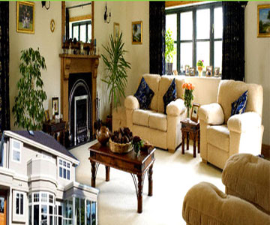
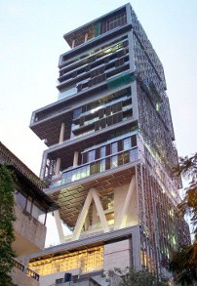
Eligibility
Home owned by you
Home not owned by you

Slide 40
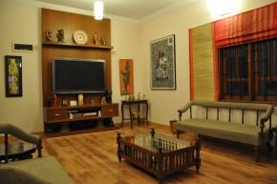
What’s Covered
Fire
Burglary / Housebreaking and natural calamities
Coverage for Baggage, Plate Glass, Pedal Cycle, ATM Cash Withdrawal, Misuse of Credit Card, Veterinary Costs
Losses or damages to domestic & electronic appliances, portable equipments like lap tops etc.
Liabilities like tenants legal liability, Domestic Workmen compensation and Public liability

Slide 41
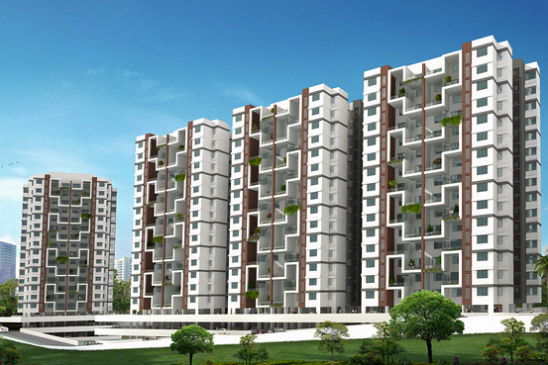
Exclusions
Consequential Loss of any Kind or Description
Loss or Damage Caused by Depreciation or Wear and Tear
Damage to Contents of a Consumable Nature
Loss or Damage to Mobile Phones or Similar Communication Devices

Slide 42

Top reasons why this is ideal for you
1 Protection under a single policy
Complete protection for property, contents, along with the interests of yourself and your family members under a single policy.
2 Affordable premium
Affordable and attractive premium rates.
3 In-house claims unit
State of the art, In-house claims servicing unit for hassle-free claims process.
4 All-inclusive Home Insurance
All Risk Insurance for jewellery, ornaments or high value items. Portable equipments such as laptops are also covered.

Slide 43

Underwriting Guidelines

Slide 44
Home Valuation
Value of House Structure
The most accurate way to determine the replacement / reinstatement cost of your house is to hire a building contractor or other building professional to produce a detailed estimate.
Only the cost of the property’s structure and its associated systems, fixtures, and finishes will be included in the estimate.
Land value is not included in the amount of insurance you buy.
Value of Home Contents
The best way to work out the value of your contents is to systematically go through every room and make an inventory.
Don't leave anything out, whether it's a sofa set or a pair of curtains - they'd all need to be replaced if, say, there was a fire in your house.
Don't simply guess the value of your contents: research shows that one in five households does not have enough insurance.
Just like the house structure, the contents should also be insured for replacement costs.

Slide 45
The basic criteria for acceptance are
1. The construction type of shop should be Class A (Brick wall in RCC framework) and no kutcha
construction is allowed.
2. This policy is designed mainly for shops covering building and /or Contents of shop only. Any
separate storage not in the premises of shop but belonging to shop owner / Proposer to be
referred to local / zonal underwriter for approval.
3. Shop should not be situated in basement.
4. No manufacturing / Repair work should be carried out in the shop premises.
5. Shop should not be silent (closed) in nature.
6. Shop should not be situated in low laying area and having past flood loss history.
7. Proposal form with clear and complete details such as coverage, sum insured limits and duly
signed by Proposer / Shopkeeper.
8. Burglary sum insured should be identical to total sum insured of content under section I and
first loss limit to be clearly mentioned in customized proposals.
9. Minimum 3 sections to be opted and out of that Fire and Burglary section is compulsory.
10.No short period policy proposals shall be accepted.
11.Equipment age under Electrical and Mechanical appliance and electronic appliances section
shall not be more than 7 years.

Slide 46
Cover Limits
Section | Covers | Limits
I | Fire and Special Perils
 | Building and Contents | Up to 3 Crs.
 |  | (Building and Contents value shall be shown separately and both put together should not exceed Rs. 3 Crs. Home Contents sum insured can be up to Rs. 3 Crs if building cover is not opted if it is leased / hired premises. Sum insured value of building; FFF, home Contents/ Equipments should be on reinstatement basis. Adequacy of sum insured of Building and Contents to be ensured to avoid underinsurance. If the Building and/or Contents sum insured exceed 3 Crs, then refer the proposal to Local / Zonal Underwriter.
 | Rent for alternate accommodation / Loss of Rent | Max up to 100,000 (IP 3 Months)
II | Burglary and / or Housekeeping | Up to 3 Crs. Burglary sum insured should be either equal to sum insured of contents under section I of policy or first loss limit (25% or 40%). Basis of valuation is on Market Value basis for contents
III | Jewellery & Precious Items / in Bank Lockers (excluding Cash) | Up to 10 Lacs with valuation report
 | Portable Computer | Up to 1 Lac, Serial No is required at the time of issue of policy. Geographical Limit: India.

Slide 47
Cover Limits
Section | Covers | Limits
IV | Electronic Equipment (Audio / Visual / Computer) | Up to 25% of sum insured of contents under section I. Per Equipment sum insured max limit to 200,000. Each equipment age should not be more than 7 years. Insured should be on Reinstatement Basis.
V | Household Electrical and Mechanical Appliances ( Machinery Breakdown) | 25% of sum insured of contents under section I. Per Equipment sum insured max limit to 2,00,000. Each equipment age should not be more than 5 years. Sum Insured should be on Reinstatement Basis.
VI | Accidental Compensation (Personal Accident) – Death / PTD / PPD / Hospital Expenses | Up to 10 Lacs.
VII | Tenant fire legal liability | Max up to 10% of sum insured of building premises.
 | Workman’s Compensation – Domestic Employees | Total no of employees up to 5 having wages not exceeding Rs. 4000.
 | Public Liability | Max limit up to 25 Lacs.

Slide 48
Cover Limits
Section | Covers | Limits
VIII –A | Baggage | Max Limit up to 20,000.
VIII –B | Fixed Plate Glass | Max Limit of total sum insured 2 Lacs
VIII –C | Pedal Cycle | Max Limit per cycle is Rs. 10,000.
VIII –D | ATM cash Withdrawal | Max Limit up to Rs. 10,000.
VIII –E | Credit Card (Loss or Theft)- Misuse | Max up to Rs. 25,000.
XIII –C | Veterinary Cost | Max up to Rs. 10,000.

Slide 49
Excess
Section | Covers | Excess
I | Fire and Special Perils | NIL
 |  | Terrorism: 0.5% of total sum insured subject to min of Rs. 10,000.
 | Rent for alternate accommodation | NIL
II | Burglary and / or Housekeeping | NIL
III | Jewellery & Precious Items | NIL
 | Portable Computer | 5% of claim amount subject to min of Rs. 2500.
IV | Electronic Equipment (Audio / Visual / Computer) | Computers: 5% of claim amount subject to min of Rs. 2500. For all other equipments: 5% of claim amount subject to min of Rs. 500
V | Household Electrical and Mechanical Appliances ( Machinery Breakdown) | 1% of sum insured subject to min of Rs. 250
VI | Accidental Compensation (Personal Accident) – Death / PTD / PPD | NIL

Slide 50
Discounts
Sectional Discounts
Section I and II is compulsory.
Discounts shall be allowed for opting higher section as under,
  More than 2 and Up to 5 Section 10%
  More than 5 section 20%

Slide 51
Details Required for Premium Quote
Section | Interest Insured |  |  |  | Sum Insured
Fire | Building |  |  |  | -
 | Contents
 | Terrorism |  |  | No
 | Additional Cost for Temporary Accommodation
 | Loss of Rent
 | Purchase Protection - Upto 90 Days |  |  |  | No
 | Cash in House |  |  |  | -
Total
Burglary | Contents |  |  | Yes | -
 | First Loss Percentage
Total
All Risk | Jewellery & Valuables |  |  |  | -
 | Contents of Safe Deposit Box in Bank (Excluding Cash)
 | Portable Computer
Total
Electronic Equipments | Audio Visual Equipments
 | Computers
Total
Breakdown | Home Appliances
 | Air Conditioner |  |  |  | -
Total
Personal Accident Death / PTD | Self |  | No
 | Spouse |  | No | Working
 | Kid One (Upto Age 21Yrs) |  |  | No
 | Kid Two (Upto Age 21 Yrs) |  |  | No
Cost of Hospitalisation | Cover Opted |  |  | No
Total
Legal Liability | Tenant Liability - Fire Damage |  |  |  | -
 | Domestic W C |  | 1 | 0 | -
 | Public Liability
Total
Misc Covers | Baggage |  |  |  | -
 | Plate Glass
 | Pedal Cycle
 | ATM Cash Withdrawal
 | Credit Card Cover |  |  |  | -
 | Veterinary Costs

Slide 52


Slide 53

Making a claim
Our in-house claim settlement team processes your claims within 7 working days from the time we receive your claim intimation form along with required documentation.
In-house team of professionals who can give specialised advice.
Claim form – You can intimate your claim online or submit the form to your nearest branch or alternatively email it to us.
Complaint/feedback form – Should you have any complaints/feedback, you can fill in the form and submit it to the nearest branch or email us.
Grievance Redressal - procedure along with list of ombudsman addresses. In case you are not satisfied with the resolution to the complaint as provided by us, you may approach the Insurance Ombudsman for review.

Slide 54

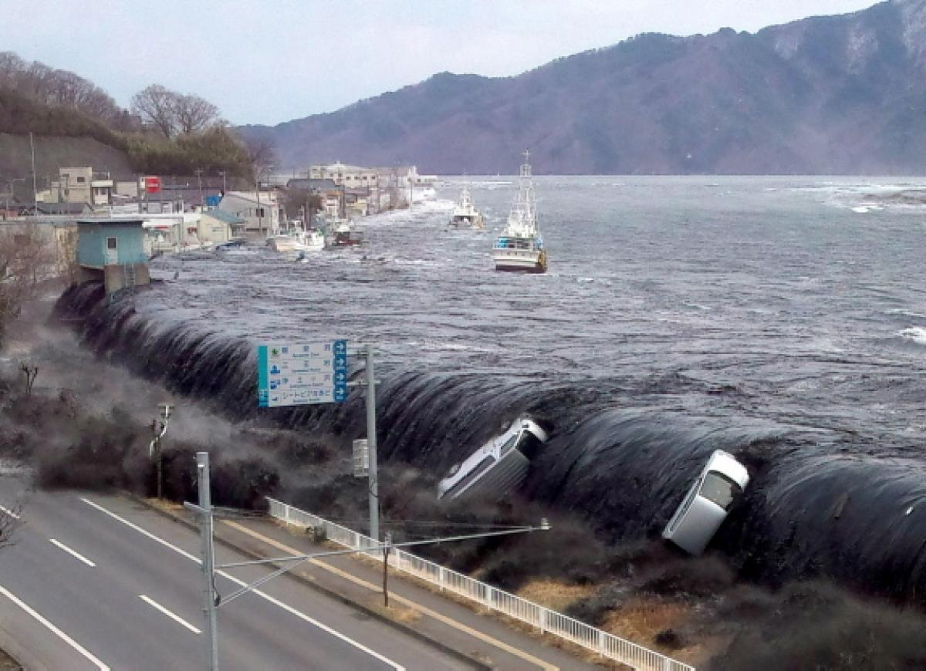
Contact our Helpline
Call us on:
1800-220-233
1860-500-3333
022-67837800
Registered & Corporate Office
Future Generali India Insurance Co Ltd.,
Indiabulls Finance Centre, Tower 3, 6th Floor,
Senapati Bapat Marg, Elphinstone (W),
Mumbai - 400 013.

Slide 55
Future Generali Home Plans

Slide 56
Future Generali Home Plans
Plan Name |  | Gold-I
Section |  | Sum Insured | Premium
Fire | Contents | 200,000 | 330
Burglary | Contents | 200,000 | 300
Personal Accident | Self | 200,000 | 120
Cost of Hospitalisation | Self | 25,000 | 38
Misc | Credit Card Cover | - | -
 | ATM Cash Withdrawl | 5,000 | 25
Liability | Public Liability | 100,000 | 40
 | WC - Max salary Rs.4000/- | 48,000 | 280
All Risk | Laptop | - | -
 | Jewellary | - | -
Gross Premium |  |  | 1,133
Add Service Tax @ 14.50% |  |  | 165
Total Premium Payable |  |  | 1,298

Slide 57
Future Generali Home Plans
Plan Name |  | Gold-II
Section |  | Sum Insured | Premium
Fire | Contents | 300,000 | 714
Burglary | Contents | 300,000 | 450
Personal Accident | Self | 300,000 | 180
Cost of Hospitalisation | Self | 50,000 | 75
Misc | Credit Card Cover | 10,000 | 50
 | ATM Cash Withdrawl | 10,000 | 50
Liability | Public Liability | 200,000 | 80
 | WC - Max salary Rs.4000/- | 48,000 | 280
All Risk | Laptop | 50,000 | 750
 | Jewellary | - | -
Gross Premium |  |  | 2,629
Add Service Tax @ 14.50% |  |  | 382
Total Premium Payable |  |  | 3,011

Slide 58
Future Generali Home Plans
Plan Name |  | Gold-III
Section |  | Sum Insured | Premium
Fire | Contents | 500,000 | 1,139
Burglary | Contents | 500,000 | 750
Personal Accident | Self | 500,000 | 300
Cost of Hospitalisation | Self | 75,000 | 113
Misc | Credit Card Cover | 15,000 | 75
 | ATM Cash Withdrawl | 20,000 | 100
Liability | Public Liability | 300,000 | 120
 | WC - Max salary Rs.4000/- | 96,000 | 561
All Risk | Laptop | 50,000 | 750
 | Jewellary | 50,000 | 625
Gross Premium |  |  | 4,533
Add Service Tax @ 14.50% |  |  | 658
Total Premium Payable |  |  | 5,191

Slide 59
Future Generali Home Plans
Plan Name |  | Standard-I
Section |  | Sum Insured | Premium
Fire | Contents | 200,000 | 332
Burglary | Contents | 200,000 | 300
Personal Accident | Self | 200,000 | 120
Cost of Hospitalisation | Self | 25,000 | 38
Misc | Credit Card Cover | - | -
 | ATM Cash Withdrawl | 5,000 | 25
Liability | Public Liability | - | -
 | WC - Max salary Rs.4000/- | - | -
All Risk | Laptop | - | -
 | Jewellary | - | -
Gross Premium |  |  | 815
Add Service Tax @ 14.50% |  |  | 119
Total Premium Payable |  |  | 934

Slide 60
Future Generali Home Plans
Plan Name |  | Standard-II
Section |  | Sum Insured | Premium
Fire | Contents | 300,000 | 600
Burglary | Contents | 300,000 | 450
Personal Accident | Self | 300,000 | 180
Cost of Hospitalisation | Self | 50,000 | 75
Misc | Credit Card Cover | 10,000 | 50
 | ATM Cash Withdrawl | 10,000 | 50
Liability | Public Liability | - | -
 | WC - Max salary Rs.4000/- | - | -
All Risk | Laptop | - | -
 | Jewellary | - | -
Gross Premium |  |  | 1,405
Add Service Tax @ 14.50% |  |  | 204
Total Premium Payable |  |  | 1,609

Slide 61
Future Generali Home Plans
Plan Name |  | Standard-III
Section |  | Sum Insured | Premium
Fire | Contents | 500,000 | 1,745
Burglary | Contents | 500,000 | 750
Personal Accident | Self | 500,000 | 300
Cost of Hospitalisation | Self | 75,000 | 113
Misc | Credit Card Cover | 15,000 | 75
 | ATM Cash Withdrawl | 20,000 | 100
Liability | Public Liability | - | -
 | WC - Max salary Rs.4000/- | - | -
All Risk | Laptop | - | -
 | Jewellary | - | -
aGross Premium |  |  | 3,083
Add Service Tax @ 14.50% |  |  | 448
Total Premium Payable |  |  | 3,531

