Slide 1

Business Suraksha for Shopkeeper
Protect your shop and yourself with just one plan.
Version: June 2016

Slide 2
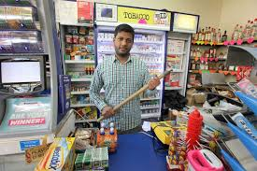

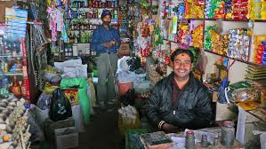
The keeper’s keeper
The keeper’s keeper, customers and consumer goods, sales and store timings, profit and loss; with so many things to look after, it’s easy to forget what matters the most - you.
With Future Generali's "Business Suraksha for Shopkeeper" you not only protect your shop and everything in it, you also protect yourself.
Here's to business without worries.

Slide 3

Product Details

Slide 4

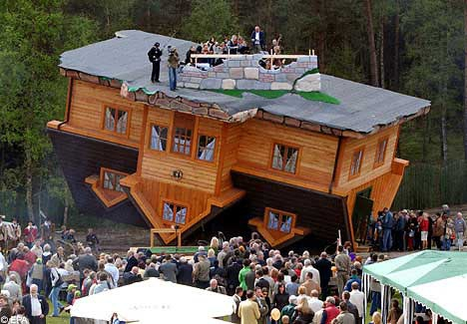
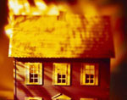
Protection of your Assets- Standard Fire & Special Perils
Buildings
Contents (excluding Valuables)

Slide 5
Perils Covered
Fire
Lightening
Explosion/Implosion
Aircraft Damage
Riot, Strike and Malicious Damage
Storm, Cyclone, Typhoon, Tempest, Hurricane, Tornado, Flood and Inundation
Impact Damage
Subsidence and Landslide including Rock Sildes
Bursting and or Overflowing of water tanks
Missile Testing Operations
Leakage from Automatic Sprinkler Installations
Bush Fire
Earthquake
Terrorism (if opted)

Slide 6


Exclusions
Stocks in cold storage
Bullions, precious stones, curios, drawings, manuscripts, securities, coins, cheques, books of accounts
Loss to electrical machines arising by Over running, excessive pressure, short circuiting, self heating or leakage of electricity shall apply to the particular electrical machine and not to other machines
Loss of earnings, consequential loss
Spoilage as a result of the perils covered
Loss by theft under riots, strike and malicious damage
Volcanic eruptions
Temporarily removed for cleaning, repairs, not exceeding 60 days
5% for claim amount subject to minimum of Rs.10,000 for claims on AOG perils
Rs.10,000 for claims other than AOG perils

Slide 7
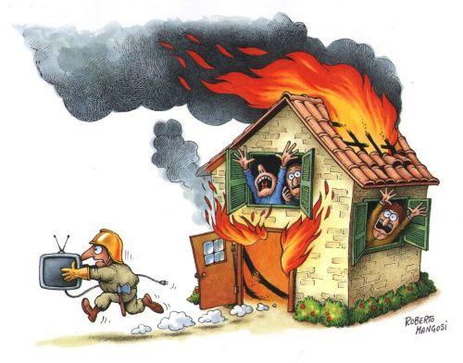
Basis for loss settlements
Partial Loss
Cost required for reinstating or repairing the items to their previous state before the loss.
No depreciation shall be applicable
Total Loss
Cost required for replacing or reinstating the affected items
If the loss is more than 110% then the rateable proportion will be borne by the insurer

Slide 8
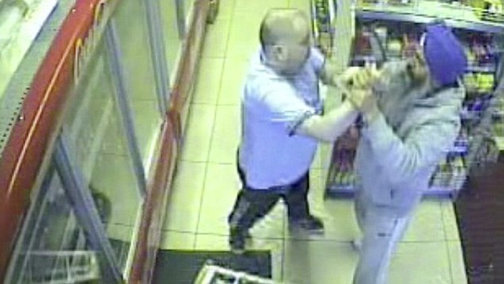
Burglary and Theft
Contents ( excluding money and valuables)

Slide 9
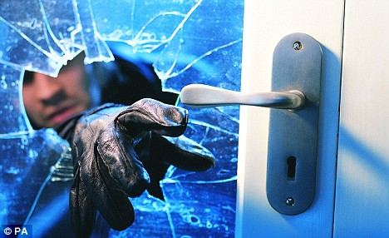
Exclusion
Burglary/Theft by family members
Livestock, Motor vehicle and Pedal cycles
Jewelry and precious stones
Deductible of 5% of claim subject to minimum of Rs. 5000
Not registered immediately as police complaint

Slide 10

Basis of Loss
Repaired or reinstated at a cost less than the replacement cost
For total loss, we will restoration or replacement costs

Slide 11
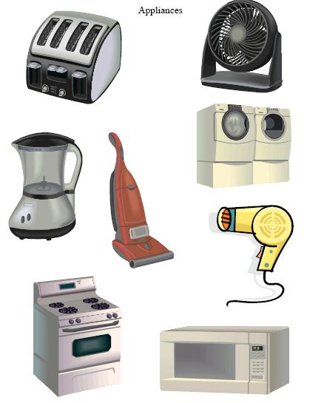
Protection of Machinery Breakdown
Unexpected mechanical or electrical breakdown of machineries

Slide 12
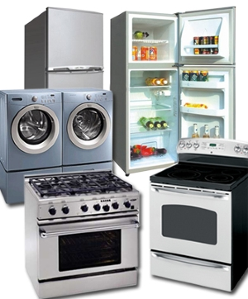
Exclusion
Overload or abnormal conditions
Natural wear and tear
Willful act or gross negligence
Consequential loss
Items covered by the law or contract of the manufactures
Deductible as per the schedule

Slide 13
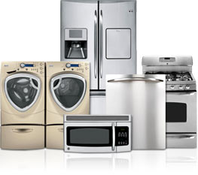
Basis of Loss settlement
In case of repair, the cost necessary to restore to the previous serviceability plus the cost for dismantling and re-erection.
If the item is destroyed, then the actual value is calculated by deducting the depreciation from the replacement value.

Slide 14
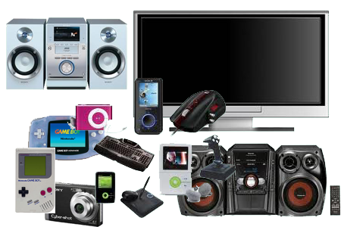
Protection for Electronic Equipment
The repair or the replacement costs of any electronic equipment caused by any unforeseen and sudden physical loss.

Slide 15
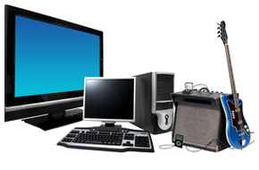
Exclusion
Any fault or defect before the policy
Manufacture or supplier is responsible
Natural wear and tear
Maintenance operations
Willful act
Consequential loss
Portable items
Pressure waves by aircraft
Deductible as stated in the policy
Bulbs, valves, tubes, belts, wires
Aesthetic defects

Slide 16

Basis of Loss
Value of System Software is also included
In case of repair, the cost necessary to restore to the previous serviceability plus the cost for dismantling and re-erection.
If the item is destroyed, then the actual value is calculated by deducting the depreciation from the replacement value.
In total loss, replace the lost with a similar type of similar configuration

Slide 17

Portable Computer/ Mobiles – All Risk
Loss or damage to portable computer/ Mobiles anywhere in India by
Fire
Riot and Strike
Theft or Accident

Slide 18
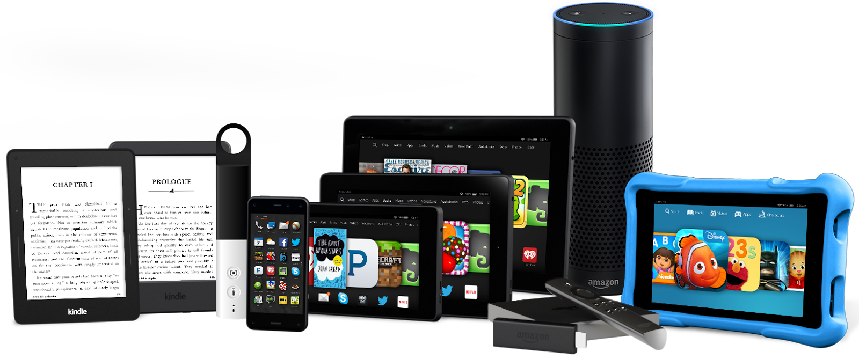
Exclusions
Cleaning, repairing or renovation
Breakage of glass, cameras, lenses, musical instruments
Over winding, denting or internal damage
Theft from Car (except securely locked in car)
Legal Liability
Confiscation by Customs
Consequential Loss

Slide 19
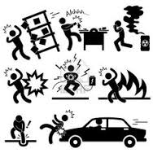
Protection for you and your employees
Accidental Compensation for
Accidental Death
Permanent Total Disability
Permanent Partial Disability

Slide 20
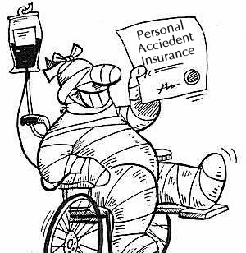
Exclusion
Intentional Injury
Accidents under alcohol and drug influence
Riot, crime
Willful violation of law
Motor racing
War, invasion, civil war, rebellion, revolution
Nuclear energy, radiation

Slide 21
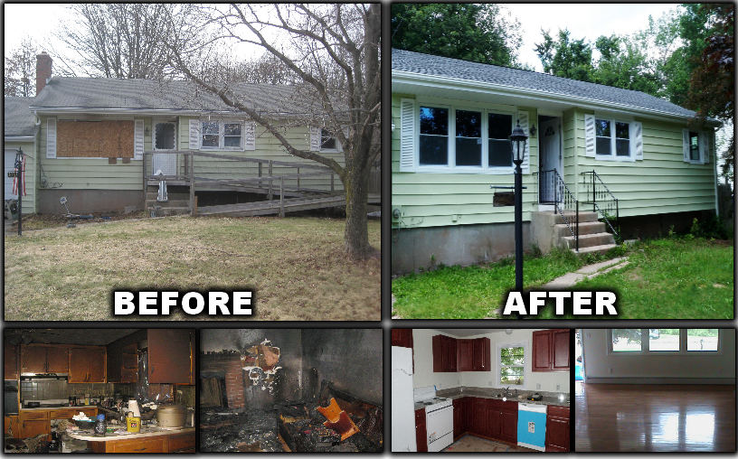
Your Legal Liability as a Tenant
Legal responsible as a tenant for
Loss or damage to the insured premises other than AOG
Accidentally broken fixed glass and their fixtures, fittings
Accidental damage to cables, underground pipes, drains and tanks

Slide 22
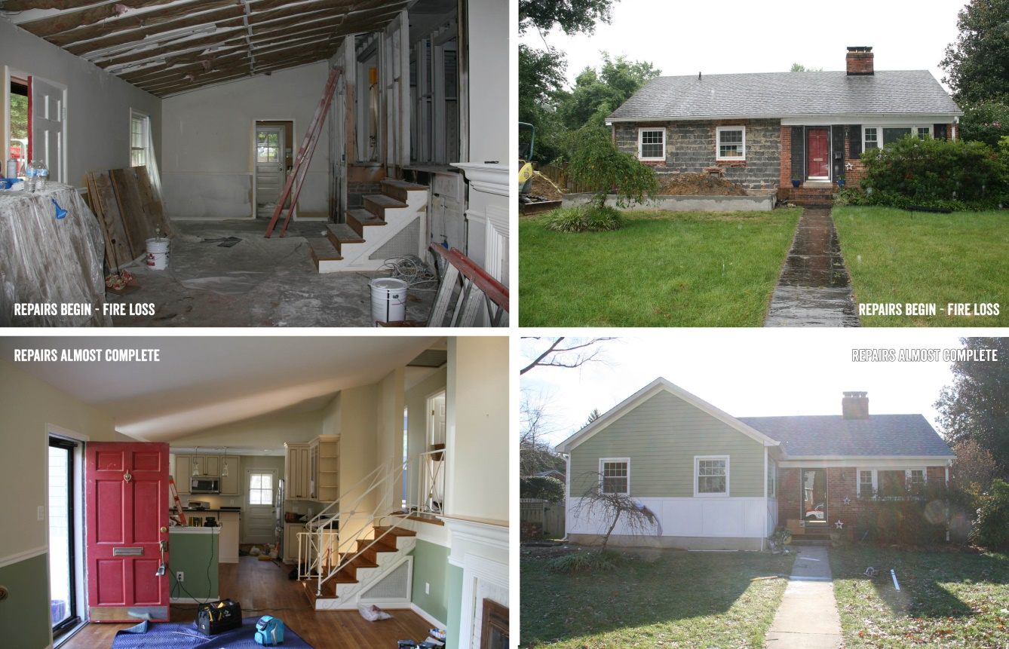
Exclusion
Natural wear and tear
Faulty materials and workmanship
Vermin, insects, fungus
Building works which involves alterations, renovation, extensions

Slide 23


Workers Compensation
Legal Liability against
Fatal Accidental Act
Workmen’s Compensation Act 1923 and amendments

Slide 24


Public Liability
Legal Liability for Civil Claims to
Bodily injury
Property Damage
Caused by the negligent act error or omission
Under the Public Liability Act 1991

Slide 25
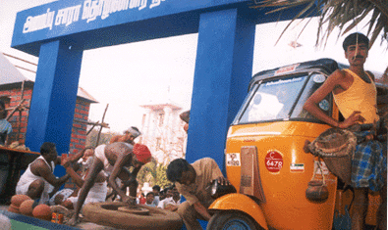
Exclusion
Deliberate, willful or intentional act, error or omission
Liability arising out of Motor vehicle
Liability arising our of Workmen’s Compensation Act 1993
Transmission of occupational diseases
Occupation, business or trade

Slide 26

Accompanied Baggage
Accidental loss or damage to personal baggage while travelling anywhere in India beyond 25 kms of the insured premises

Slide 27

Exclusions
Any electrical machines
Theft from Car ( other than properly secured)
Under contract of affreightment in a carrier
Jewellery, valuables, Cash, Cheques
Mobiles, Laptops
Loose articles like umbrella, handbags

Slide 28
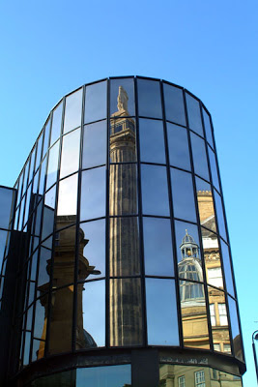
Plate Glass
Accidental Loss or damage to Plate Glass
Reasonable cost for erecting any temporary boarding subject to maximum of Rs.5000
Deductible of 5% of claim amount or Rs.2500 is applicable

Slide 29
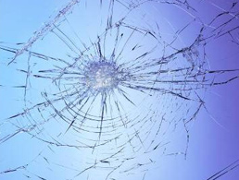
Exclusion
Alteration, removal or repair of plate glass
Breakage of lettering unaccompanied by breaking of plate glass
Consequential damage

Slide 30
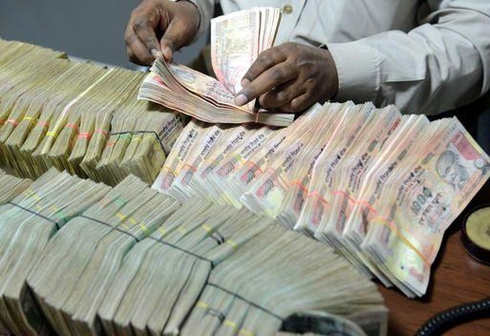
Money Insurance
Transit between the premises and back(including ATMs) and vice versa
Burglary/house breaking of money in Safe, steel cubboards, Cash box (lock & Key)
Loss of money in the Cashier’s till during business hours under assault or violence

Slide 31

Fidelity Guarantee
Loss due to fraud / dishonesty / fraudulence caused by Permanent salaried employees in the premise and discovered within 3 months of the dismissal, expiry of the policy.

Slide 32
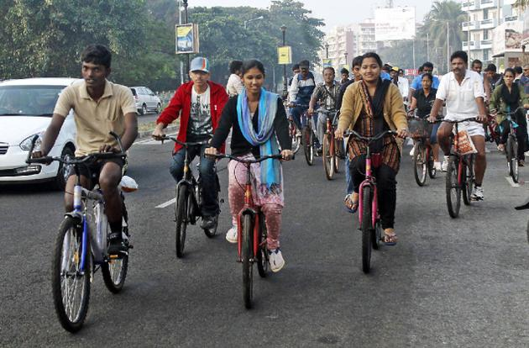
Pedal Cycle
Repair or replacement cost for Pedal Cycle
Legal liability to pay for litigation expenses, compensation for accidental damage to property, bodily injury or death other than the family, upto a limit of Rs.30,000

Slide 33

Neon Sign / Glow sign
Loss or damage to Neon/ Glow sign by
Accidental external means
Fire, Lightening, External Explosion, theft
Riot, Strike, Malicious Act or Terrorism
Flood, Inundation, storm, tempest, typhoon, hurricane, tornado or cyclone
Deductible of Rs.1000 applies during claims

Slide 34


Slide 35
What’s Covered
Fire and special perils: Building and contents - Covers the loss or damage to the building and/or contents caused by the risks of fire, lightning, explosion/implosion, aircraft damage, riot, strike and malicious damage, storm, cyclone, typhoon, tempest, hurricane, tornado, flood And inundation, impact damage, subsidence and landslide including rock slide, bursting and/ or overflowing of water tanks, apparatus and pipes, missile testing operations, leakage from automatic sprinkler installations, bush fire, earthquake, terrorism (optional).
Burglary and Housebreaking: Provides protection against the loss or damage to the building and/or contents due to the risks of burglary and/or housebreaking.
Business interruption (fire loss of profit): Provides cover against the loss of income following the loss or damage by standard fire and special perils.
Electrical and mechanical appliances: Protects electrical and mechanical appliances in the Shop premises against any accidental mechanical or electrical breakdown of such appliances.
Electronic Equipments: Protects electronic equipment’s in the Shop premises against any losses or damages caused by any unforeseen and sudden physical events.

Slide 36
What’s Covered
Portable equipment: Covers the loss or damage to portable equipment’s like laptops by fire, riot and strike, theft or any accidental external means or from any fortuitous causes.
Money (money in transit /money in safe / money in counter): In business, transferring the money from one place to another often causes anxiety for everyone. Losses during-money in transit between the insured premises and specified bank and vice versa, money in safe, money in counter are covered.
Public liability: Any claims arising out of the third parties bodily injury or property damage occurring in your premises will be covered.
Workmen compensation: Protects you from the liability towards your workmen under the Workmen Compensation Act, fatal accidents act and at Common Law.
Personal accident: Covers you or your employees, in case of Accidental Death, Permanent Total Disablement, and Permanent Partial Disablement up to specified limits.

Slide 37
What’s Covered
Neon sign / glow sign: Covers accidental damage to neon sign / glow sign by fire, lightening, external explosion, theft, riots, strike and natural calamities, accidental external means.
Fixed plate glass: Covers accidental damages to fixed plate glass, frames, and frameworks.
Baggage: Covers accidental loss of your personal baggage while traveling anywhere in India beyond 25 km radius of the insured premises.
Pedal cycle: Covers the repair or replacement costs in respect of the pedal cycle caused by any unforeseen, accidental and sudden physical loss.
Infidelity / dishonesty of employee: Employees are our greatest assets. Yet you face instances where your employees cheat you. Any direct loss caused by acts of frauds committed by any salaried employee in the insured premises are covered.

Slide 38
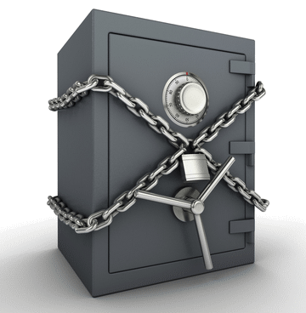
What's Not Covered
Loss or damage caused by depreciation or wear and tear.
Consequential losses.
Loss or damage to property by pollution or contamination.
War and nuclear perils.

Slide 39
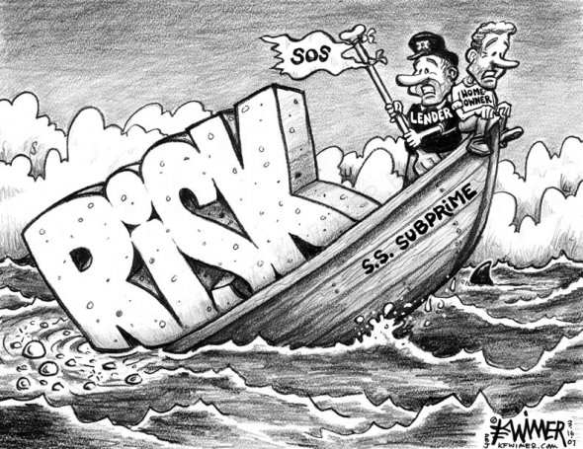
Underwriting Guidelines

Slide 40
The basic criteria for acceptance are
1. The construction type of shop should be Class A (Brick wall in RCC framework) and no kutcha
construction is allowed.
2. This policy is designed mainly for shops covering building and /or Contents of shop only. Any
separate storage not in the premises of shop but belonging to shop owner / Proposer to be
referred to local / zonal underwriter for approval.
3. Shop should not be situated in basement.
4. No manufacturing / Repair work should be carried out in the shop premises.
5. Shop should not be silent (closed) in nature.
6. Shop should not be situated in low laying area and having past flood loss history.
7. Proposal form with clear and complete details such as coverage, sum insured limits and duly
signed by Proposer / Shopkeeper.
8. Burglary sum insured should be identical to total sum insured of content under section I and
first loss limit to be clearly mentioned in customized proposals.
9. Minimum 3 sections to be opted and out of that Fire and Burglary section is compulsory.
10.No short period policy proposals shall be accepted.
11.Equipment age under Electrical and Mechanical appliance and electronic appliances section
shall not be more than 7 years.

Slide 41
Decline List
Shopkeeper Proposal should not be accepted in following cases
1. Shop selling solely fire works, Nitrocellulose based product, Paints and Varnishes, Flammable
chemicals.
2. Shops situated in basement.
3. Shops which are closed and no selling activity.
4. Shops dealing in Art Works / Painting.
5. Jeweler’s Shop.
6. Xerox Shop.
7. Shops selling seasonal items.
Following will not be covered in shopkeeper policy.
1. Valuables / Jewellery under any section of policy.
2. Cash other than Money section.
3. Commission Agents / Sales Person on the fields are not covered under fidelity section.
4. Photocopier / Image Processing machines

Slide 42
Underwriting Approval Required
If the shop premises had previous loss / claim history under any section.
Rent for alternate accommodation extension under Section I.
Tenants fire legal liability extension under section I.
If there is business interruption coverage required.
If there is proposal exceeding predefined limits under one or more section as below.
If any terms and conditions not defined or not within the shopkeeper underwriting guidelines.
If discount exceeds 40% on tariff covers.

Slide 43
Cover Limits
Section | Covers | Limits
I | Fire and Special Perils
 | Building and Contents | Up to 3 Crs. (Building and Contents value shall be shown separately and both put together should not exceed Rs. 3 Crs. Contents sum insured is mandatory and sum insured can be up to Rs. 3 Crs if building cover is not opted. Sum insured value of building; FFF should be on reinstatement basis. Contents (stocks) should be on Market Value basis.
 | Rent for alternate accommodation | Refer to Local / Zonal Underwriter
 | Tenant fire legal liability | Refer to Local / Zonal Underwriter
II | Burglary and / or Housekeeping | Up to 3 Crs. Burglary sum insured should be equal to sum insured of contents under section I of policy. Sum Insured should be on Market Value basis for contents (Stocks)
III | Electrical and Mechanical Appliances (Machinery Breakdown) | Max limit up to 20% of sum insured under fire section. Per Equipment sum insured limit to 5,00,000. Each equipment age should not be more than 7 years. Sum Insured should be on Reinstatement Basis.
IV | Electronic Equipment | Max sum insured up to 20% of sum insured under fire section. Per Equipment sum insured limit to 200,000. Each equipment age should not be more than 7 years. Insured should be on Reinstatement Basis. Should not be more than 10% of content sum insured
V | Money Insurance
 | Money in Transit | Max per carrying limit 10 Lacs
 | Money in Safe | Max Limit for money in Safe is 5 Lacs
 | Money in Counter | Max Limit for money in counter is 1 Lacs

Slide 44
Cover Limits
Section | Covers | Limits
VI | Infidelity / Dishonesty of Employee | Max Limit per employee is 50,000. Total sum Insured Limit AOA:AOY: 2 Lacs. Applicable for the only employees on the books of shop
VII | Fixed Plate Glass | 20% of sum insured under section I subject to max up to 5 Lacs.
VIII | Neon Sign / Glow Sign | Max Limit of total sum insured Rs.50,000
IX | Personal Accident (Death and PTD and TPD) | Coverage applicable for Owner and Employees in the books of shop. Owner Limit 10 Lacs, Employees: 2 Lacs (in multiples of Rs. 50,000)
X | Workmen Compensation | As per W.C.tariff guidelines
XI | Public Liability | Max Limit up to 50 Lacs
XII | Pedal Cycle | Max Limit up to 10,000. Per cycle Limits Rs.2,500
XIII | Baggage | Max Limit up to 50,000.
IVX | Business Interruption | Refer to Local / Zonal Underwriter
XV | Portable Equipments - Laptop | Max Limits up to 3 Lacs with per equipment not exceeding INR 50,000. Serial No/ Make/ YOM is mandatory. Max 4 Year of age.

Slide 45
Excess
Excess
Fire | 5% of claim amount subject to min of Rs.10,000/- for each and every claim
 | Terrorism - 0.5% of total sum insured subject to min of Rs.10,000/-
Burglary | 5% of claim amount subject to min of Rs.2500 for each and every claim.
Machinery Breakdown | 1% of sum insured subject to min of Rs.2,500/-
Electronic Appliances | Computers: 1% of claim amount subject to min of Rs.2,500/-
 | For all other equipments: 5% of claim amount subject to min of Rs.1,000/-
Money Insurance | Nil
Fidelity | 5% of claim amount subject to minimum of Rs.2500/-
Plate Glass | 5% of claim amount subject to minimum of Rs.2500/-
Sign Board | 5% of claim amount subject to minimum of Rs.2500/-
Personal Accident | Nil
Workmen Compensation | Nil
Public Liability | 0.5% of Any One Accident
Pedal Cycle | Nil
Baggage | Nil
All Risk | Laptops - 5% of Claim amount subject to minimum of Rs.2500/-

Slide 46
Discounts
Sectional Discounts
Section I and II is compulsory.
Discounts shall be allowed (on non tariff section) for opting higher section as under,
More than 2 Section and Up to 4 Section 5%
More than 5 section and less than 8 section 10%
More than 8 section and less than 11 section 15%
More than 11 section 20%
B. Discount on Tariff Covers
We can allow discount up to 40% on tariff covers

Slide 47
Details Required for Premium Quote
Section | Interest Insured
Fire and Special Perils with Earthquake | Building
 | Contents
 | Terrorism |  | No
 | Rent for Alternate Accommodation (IP 6 Months)
 | Tenants Legal Liability ( Fire Damage Only)
Burglary | Total Contents Sum Insured |  | Yes
 | First Loss Percentage
Electrical and Mechanical Appliances | Air Conditioner
 | Portable Generator Set upto 10 KVA
 | Electrical Equipments other than AC & DG Set
Electronic Appliances | Electronic Equipments
Money Insurance | Cash in Transit - Single Carrying Limit
 | Cash in Safe
 | Cash in Counter
Fidelity | Shop Employees
Plate Glass | Fixed Plate Glass Only
Sign Board | Neon Sign / Glow Sign
Personal Accident | Shop Owner
 | Employees Number/SI |  | 200000
Workmen Compensation | Number of Employees
 | Salary Per month
Public Liability | Third Party Liability
Pedal Cycle | Pedal Cycle - non motor
Baggage | Domestic Travel - Shop Owner
All Risk | Portable Computer

Slide 48


Slide 49

Making a claim
Our in-house claim settlement team processes your claims within 7 working days from the time we receive your claim intimation form along with required documentation.
In-house team of professionals who can give specialised advice.
Claim form – You can intimate your claim online or submit the form to your nearest branch or alternatively email it to us.
Complaint/feedback form – Should you have any complaints/feedback, you can fill in the form and submit it to the nearest branch or email us.
Grievance Redressal - procedure along with list of ombudsman addresses. In case you are not satisfied with the resolution to the complaint as provided by us, you may approach the Insurance Ombudsman for review.

Slide 50

Contact our Helpline
Call us on:
1800-220-233
1860-500-3333
022-67837800
Registered & Corporate Office
Future Generali India Insurance Co Ltd.,
Indiabulls Finance Centre, Tower 3, 6th Floor,
Senapati Bapat Marg, Elphinstone (W), Mumbai - 400 013.

