Slide 1

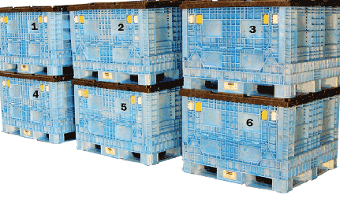
MARINE CARGO INSURANCE

Slide 2
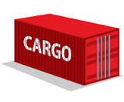
Agenda
Marine Insurance Introduction
INCOTERMS
Types of Policies
Coverage's
Underwriting Consideration
List of Non-preferred cargo
Selling points - FGI

Slide 3
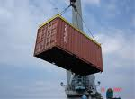

Marine Insurance-Introduction
Marine Insurance is oldest form of Insurance
Marine Insurance
Cargo Insurance
Hull Insurance
Liability Policy
Offshore Energy
Insurance of goods during transit from one location to another
Insurance of ship
and its machinery
Port Package Policy
Insurance of offshore
oil/gas exploration units

Slide 4

Marine Cargo Insurance
Does Marine Cargo Insurance cover only sea transit?
Although the word Marine may appear to be synonymous with ocean voyage, in modern day, Marine Insurance policies covering exports , import and inland transits by all modes of transportation as mentioned below
    Road
    Rail
    Inland/ Coastal Waterways
    Ocean
    Air
    Postal /Courier

Slide 5

Why is Marine Insurance Required?
To cover physical loss / damage to cargo whilst in transit.
Almost all carriers are able to limit their liability for loss /damage to cargo under various international conventions such as the Hague Visby Rule, Warsaw Convention etc.

Slide 6

Target segment for marine Insurance?
Importers
Exporters
Manufacturers
Traders
Contractors of Projects
Logistic operators
Bankers
C&F Agents

Slide 7

Who can effect the insurance?
Any movement of cargo involves mainly two agencies.
Seller and Buyer
Existence of insurable interest governed by the terms of sales contract- called INCOTERMS
INCOTERMS (International Commercial Terms) is a universally recognized set of definitions of international trade
It was developed by the International Chamber of Commerce in Paris, France. The purpose was to bring uniformity in interpretations of contract
Incoterms was first published in 1936 and it is revised periodically. The current set of Incoterms used are amended in 2010

Slide 8

INTERNATIONAL COMMERCIAL TERMS 2010
CAN BE USED FOR INLAND SHIPMENTS ALSO
  International Commercial Terms (‘Incoterms’) are internationally recognised standard trade terms used in sales contracts.
  They’re used to make sure buyer and seller know:
  who is responsible for the cost of transporting the goods, including insurance, taxes and duties
  where the goods should be picked up from and transported to
  who is responsible for the goods at each step during transportation
  INCOTERMS by themselves DO NOT:
  Constitute a contract;
  Supersede the law governing the contract;
  Define where title transfers;
  Address the price payable, currency or credit terms;
  Define the remedies for breach of contract;
  Apply to contract of service. Only apply to contract of goods.

Slide 9
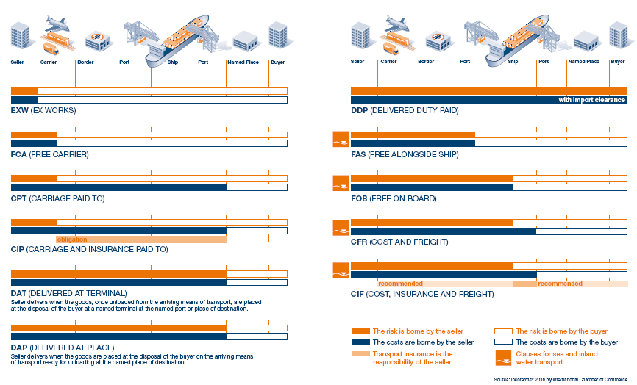
INTERNATIONAL COMMERCIAL TERMS 2010
CAN BE USED FOR INLAND SHIPMENTS ALSO

Slide 10

Types of Marine Policies
Cargo Insurance
Based on Voyage
Based on type of trade
Others
Based on Coverage
Click
Click
Click
Sales Turnover
Named perils
(ICC B,ICC C)
Export
Single Transit
Project related marine policy
All Risk Policy (ICC A, ITC A)
Import
Open Policy
Inland
Inland, Import and export policies can be further bifurcated as single transit and open policies for eg. Export Open Policy and Export Single Transit Policy

Slide 11

Based on Voyage
Depending on the requirement of insured, he can take policy to cover specific transit or an annual policy.
Single Transit Policy
  When insured needs insurance for a specific voyage or single transit, then single transit or specific transit policy is issued.
  This policy is useful for traders whose orders are inconsistent. Small size exporters also use single transit policies
Open Policy
  When insured is having multiple orders throughout the year, it is very time consuming and costly affair to arrange single transit policy for each and every transit. In such a scenario, he can take open policy.
  Open policy is a contract effected for a period of 12 months , whereby the insurance company agrees to provide insurance cover to all shipments coming within the scope of an open cover

Slide 12

Open Policy
Practice of Declaration
  In case of open policy, client takes an initial Sum Insured as per his need. As and when he does transit, he has to declare the details in defined format which includes information like Invoice No & Date, BL No. & Date, Transit from & To etc to insurance company. The sum insured will be debited from his original sum insured by the same amount. When sum insured falls below certain level, the insured can increase sum insured by passing endorsement.
  There is a condition in policy which states that the insured has to submit the declarations for all transits within stipulated period.
  In case client fails to provide declarations, the claim is not tenable under marine policy

Slide 13

Classification based on Trade
Import
  This policy is issued to Insured in India who imports cargo from anywhere in world to Insured’s premised in India.
Export
  This policy is issued to Insured in India who exports cargo from his premises in India to consignee residing in foreign country.
Inland
  In case of Inland policy, the transit is within India
All above policies can be further classified as Open Policy or Single transit Policy

Slide 14

Sales Turnover Policy
Rate is charged on estimated turnover & adjusted on actual turnover at the end of year
Single policy covers all movements of transit outside factory premises viz. Indigenous purchase, sales, Imports, Exports, Job works movement and inter-depot movements
No hassles of submitting monthly declarations for each transits.
Declaration is required only for consolidated sales figure at the agreed frequency.
Reduces operational cost of monitoring separate policies and providing declarations

Slide 15

Advantages of Sales Turnover Policy
Rate is charged on entire sum insured
Separate policies for purchase and sales to be monitored
Transit wise monthly declarations to be submitted for each transit
Non submission of declarations will jeopardize claims
Higher cost of monitoring different policies and providing monthly declarations
Declaration Policy
Sales Turn Over Policies
Rate is charged on annual turnover
Need to monitor a single Policy
No hassles of submitting declarations for each transit
Non submission of declarations will not jeopardize claims
Reduces Operational cost of monitoring different policies and submitting declarations
Sales Turnover Policy

Slide 16

Whom to offer & whom not to offer STOP
STOP should be offered to;
Company listed on recognized stock exchange in India.
Or
Company registered under Indian Companies Act 1956
Not to be offered to;
Companied dealing in bulk cargoes.
Traders & manufacturing of seasonal goods.
Newly established companies who are in process of building up inventories of finished goods.

Slide 17
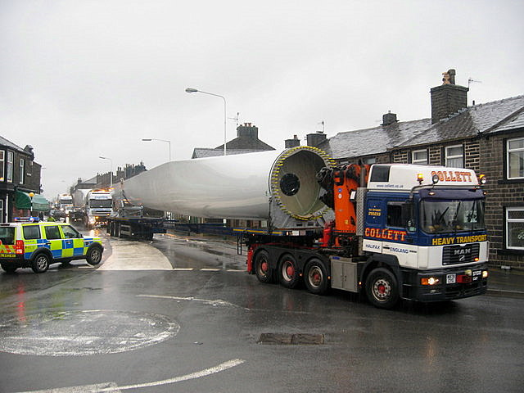
Project Cargo Insurance
Issued in conjunction with project related policies
Covers indigenous and import transits of project cargo till project site in anywhere in India/world
Policy period for marine cargo would be same as that of project insurance policy

Slide 18

Classification Based on Coverage
Export and Import Policies are governed by Institute Cargo Clauses
These clauses have been designed by the Institute of London Underwriters. The various clauses are as below:
  Institute Cargo Clauses (C) – ICC (C)
  Institute Cargo Clauses (B) – ICC (B)
  Institute Cargo Clauses (A) – ICC (A) also called as All risk Policy
  Institute War Clauses (Cargo)
  Institute Strike Clauses (Cargo)
ICC ‘A’ Clause offers all risk cover subject to only named exclusions which are mostly uninsurable.
ICC ‘C’ & ICC ‘B’ Clauses are “Named Peril” policy where scope of cover is limited.
ICC A, ICC B and ICC C clauses are used where mode of transit is sea
Named Peril Policy

Slide 19

Coverage: ICC B vs. ICC C
Perils | ICC – B | ICC - C
 | (Wider Risk Cover) | (Basic Risk Cover)
Fire or Explosion | Yes | Yes
Stranding, Grounding, Sinking or Capsizing of the vessel | Yes | Yes
Overturning or Derailment of Land Conveyance | Yes | Yes
Collision on or Contact of Ship, Craft or Conveyance with anything other than Ship or Craft (excludes Water but not Ice) | Yes | Yes
Discharge of Cargo at Port of Distress | Yes | Yes
General Average Sacrifice | Yes | Yes
Jettison | Yes | Yes
Loss over board during Loading / Discharge (total loss only) | Yes | No
Washing Overboard (deck cargo) | Yes | No
Seawater entering Ship, Craft, Hold Conveyance Container Lift Van or Place of Storage. | Yes | No
River or Lake Water entering same | Yes | No
Earthquake Volcanic Eruption or lightening | Yes | No

Slide 20
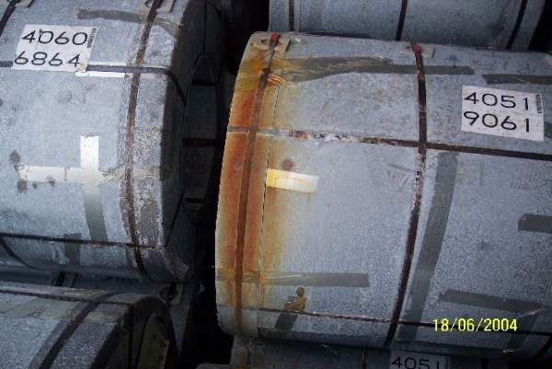
What are the additional perils covered under ICC A?
ICC A Clauses offers all risks cover subjected to named exclusions. It is the widest form of cover.
In comparison to ICC B, ICC A covers following additional perils
Partial losses during loading and discharge of cargo (ICC B covers only total loss during loading / discharge)
Theft
Pilferage
Non-delivery/ Shortage
Hijack
Piracy
Rain water damage
Malicious damage (This is excluded under general exclusions in case of ICC b AND ICC C)
Handling losses like (Hook, oil or mud damage)

Slide 21
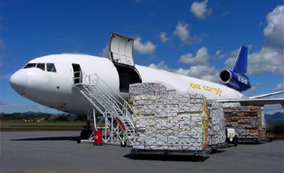
Institute Cargo Clauses (Air)
When mode of transit is Air, Institute Cargo Clauses (Air) are used
The coverage is similar to ICC A
The limited or named peril policy is not available under Air Cargo clauses
Along with Institute Cargo Clauses (Air), separate war clauses and strikes clauses are attached as below
  Institute War Clauses (Air)
  Institute Strikes Clauses (Air)

Slide 22

General Exclusions
Institute Cargo Clauses are subjected to general exclusions, which are as below
Willful misconduct of the assured
Ordinary leakage/loss in weight or volume
Insufficiency or unsuitability of packing
Inherent vice (for eg. Iron is likely to rust if exposed to external climate or humidity, coal has the property of spontaneous combustion)
Loss caused by delay
Insolvency or financial default of owner
Deliberated Damage by any person (This is not excluded in ICCA)
Losses due to War peril (It is available as an add on cover)

Slide 23
Duration clause 1982 vs. 2009
 | Duration clause 1982 | Duration clause 2009
The risk as attaching from the time | The goods leave the warehouse or other place of storage at the place named in the policy to commence transit; continues during the ordinary course of transit; and terminates in certain conditions. | The goods is first moved in the warehouse or at the place of storage for the purpose of the immediate loading or onto the carrying vehicle for commencement of transit; continues during the ordinary course of transit; and
Termination of Risk | Any one of the following events, that occur first, will terminate the risk - 1)Delivery to the consignee / his warehouse / place of storage at the destination named in the policy. 2)Delivery to a place of storage, which the assured intends to use for storage other than in the ordinary course of transit. or for allocation or distribution 3)Expiry of 60 days after discharge of cargo from the ship at the destination place/port. Normal period for termination of contract : 60 days – Voyage via SEA 30 days – Voyage via AIR 7 days – Voyage via LAND shipments | Any one of the following events, that occur first, will terminate the risk - 1)On completion of unloading from the carrying vehicle at final warehouse or place of storage at the destination named in the contract of insurance 2)On unloading from the carrying vehicle to a place of storage(whether prior to or at the destination named in the contract of insurance), which the assured intends to use other than in the ordinary course of transit or for allocation or distribution, or When assured or there employee elect to use the carrying vehicle or any container for storage other then in ordinary course of transit or 3)On expiry of 60 days after discharge of cargo from the ship at the destination place/port, whichever shall first occur. Normal period for termination of contract : 60 days – Voyage via SEA 30 days – Voyage via AIR 7 days – Voyage via LAND shipments

Slide 24

Add on Covers
War and SRCC (Strike, Riots and Civil Commotion)
  Standard Institute Cargo Clauses excludes War and SRCC perils
  This exclusion can be buy back by paying additional premium
  Institute War Clause and Institute Strike Clause are attached with the policy.
For Inland Policies
  SRCC is applicable
Custom Duty Cover/Policy along with Import Policy
Notes:
24

Slide 25

Inland Transit Clauses (Rail/Road)
Inland Insurance Policy is governed by Inland Transit Clauses (Rail/Road)
Coverage is inline with ICC clauses. The only difference is that the clauses are formulated keeping in view the rail and road transit. The various Inland Transit clauses are as follows:
  Inland transit clause (C) - ITC (C)
  Inland transit clause (B) - ITC (B)
  Inland transit clause (A) - ITC (A)
  Strike Riot Civil Commotion (SRCC) Clause –The wording is same as that of Institute Strike Clause. It covers terrorism as well
  Inland clauses do not offer cover against War perils
  ITC C covers fire and lightening perils only and is very rarely used

Slide 26

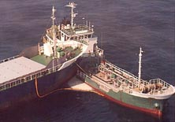

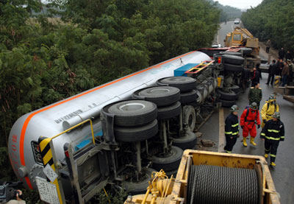
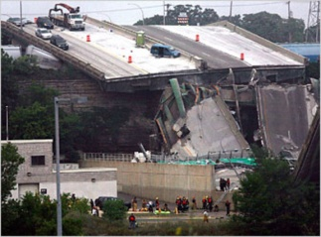
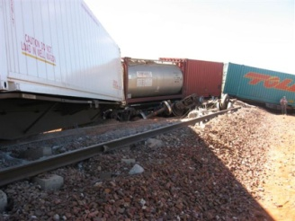
Inland Transit Clauses (B)
Perils
Covered
ITC B
Fire
Lightening
Breakage of
bridges
Derailment
Or Accident
Of carrying
Vehicle/
wagon
Overturning
of carrying
vehicle
Collision

Slide 27
Underwriting Consideration

Slide 28

What is underwriting?
Acceptance of risk
Deciding the term & conditions
Fixing of premium rates
Issuance of policy
Risk Management

Slide 29

Underwriting Considerations
Insured / consignee
Nature of cargo
Packing
Vessel / Conveyance
Voyage
Valuation
Season / Duration
Terms of cover
Previous Insurance / Claim Experience
Other terms & conditions like excess, franchise, warranties.

Slide 30

Details required for quotation
For Specific policy
1. Invoice copy or Performa invoice
For Open policy
Detail description of Cargo
Packing
Voyage to be covered
Sum Insured & Annual estimated insurable value
Per Sending Limit & Per Location Limit
Previous Insurance / Claim Experience

Slide 31

Premium calculation
Premium= Sum Insured x Rate
+
Service Tax= Add 15%
+
For domestic and air transit stamp duty chargeable is Re 1/-
For transit by sea, the stamp duty chargeable is 10 p for every Rs. 3000/- of sum insured only if the rates are more than 0.125% including war & SRCC

Slide 32
Premium calculation
Example:
  Sum Insured: Rs. 200 Cr
  Rate:0.03%
  Type of Policy: Export/Import/Inland
  Mode of conveyance: Sea/Air
Premium Calculation
  Premium= Sum Insured x Rate (2000,000,000*0.03/100)
      = 600,000
  Service Tax= Add 15% = 90,000/-
  Stamp Duty= 0.5 (If Mode of conveyance is Sea and rate is above 0.125%, then Stamp duty = Sum Insured/ 30,000)
  Total Premium= 600,000+90,000+0.5 = Rs. 6,90,000.5 = Rs.6,90,001/-

Slide 33

List of Non-preferred Cargo
Coal, Grains, fertilizer and other cargo in bulk
Heavy Machinery
Project cargo/ Over dimensional cargo
Liquid bulk cargo
Cotton
Fragile cargo
Paper

Slide 34

USP - FGI
Experienced underwriting & claims team at all major offices.
On-line facility for certificate issuance.
Adequate capacity for underwriting large risks.
Capability of providing customized solutions to cater to requirement of client.
Pan India network of competent surveyors.
Claim settlement TAT which is appreciated in industry.

Slide 35
Name : Madhusudan Lahoty
Email address: madhusudan.lahoty@futuregenerali.in
www.futuregenerali.in

