Slide 1

Future Generali India Insurance
Health Buzz Process and system

Slide 2
Health Buzz Process

Slide 3
List of Statuses/Buckets in Health Buzz
Code | Status | Remarks/Actionable
IN | INWARD | Proposal has been in warded & same needs to be processed further for Policy issuance
RS | RETURN TO SALES | Proposal has been Retuned To Sales
DS1 | DISCREPANCY | Proposal has been put into discrepancy due to incomplete/incorrect proposal and documents
PS | PROCESS SHEET | Proposal is created & QC is done at summarised level/ Proposal is declined or sent for Collection Tagging/Refer to UW by system
IP | IN PROCESS | Proposal has been inwarded & is in process and the same needs to be processed further for Policy issuance
DOP | DISCREPANCY-OPS | Proposal is in discrepancy & ops needs to resolve the discrepancy
UW | UNDERWRITING | Proposal is pending with UW for review & approval
UW1 | UNDERWRITING | Proposal is pending with UW for review & approval
UW2 | UNDERWRITING | Proposal is pending with UW for review & approval
UW3 | UNDERWRITING | Proposal is pending with UW for review & approval
ME | MEDICAL | Proposal has been moved for Medicals (Pre Policy)
DUW | DISCREPANCY-UW | Proposal has been put into discrepancy by UW

Slide 4
List of Statuses/Buckets in Health Buzz
Code | Status | Remarks/Actionable
NC | NO CASH | Insufficient Funds or 64 VB Violation
QC2 | QC | Proposal is created & Receipt needs to be tagged for policy issuance
IF | ISSUED | Policy is issued
IPE | IN PROCESS | Endt has been inwarded & is in process and the same needs to be processed further for endt issuance
QCE | QC | Endt is created & Receipt needs to be tagged for endt issuance
CH | ENDORSEMENT | Endorsement is issued
CN | CANCELLATION | Proposal has been cancelled
DL | DECLINED | Proposal has been declined due to non-compliance with UW guidelines/ by Underwriter
DE | DELETED | Proposal deleted by ops due to data entry error

Slide 5
Responsibilities
Scrutiny & Acceptance
Inward
Policy Issuance
Operations at all branch offices shall be responsible for

Slide 6
Process Flow - Scrutiny Of Documents
Branch ops to Scrutinise and Inward New Business, Roll Overs(Portability) and Renewal cases in the Health Buzz system.
Branch Ops shall physically scrutinize the documents and confirm the requisites before in warding.
Branch Operations will acknowledge the proposal with inward date stamp duly affixed on the proposal form.
PORTABILITY CASE
  Before the expiry of the policy, the sales team should ensure that they submit the duly filled Proposal form along with Portability form & last 4 years policy copies to the Ops team for processing.
  Portability excel sheet is now not required from the sales team.
  If proposal is received after the expiry of previous policy, then the same shall be declined by the system and it will not be allowed for policy issuance.

Slide 7
Process Flow - Scrutiny Of Documents
Post scrutiny of the proposal, branch operations shall classify the proposal into below categories
  Return To Sales (RTS)
  Proposals requiring Medicals
  Decline cases
  Proposal - STP (Straight Through Processing/ Non-Medical case)
Branch ops shall ensure that in any of the above scenarios, case shall be inwarded so that a Document Control Number (DCN) gets generated. This DCN shall act as the Inward No based on which we will be able to do any search or modification in the proposal.

Slide 8
Return to Sales
During scrutiny if found non adherence to below points, proposal to be marked as RTS in HB System and handed over to sales.
Proposal form outside underwriting guidelines.
Check if AML guidelines are adhered
Check if proposal form is complete e.g. Medical history details under Point No 18 of the proposal form is not filled
Client Creation
Client creation is required at branch
Only New & roll over business requires client creation
Inward in HB System
Case to be inwarded in HB System and DCN to be created.
Mark the case RTS with reason to be mentioned in HB System
Returning the Case
Proposal to be returned to sales.
A.1
A.3
A.2

Slide 9
Return to Sales and Discrepancy Resolution Points
RS Bucket – Sales resolves it and hand over to Ops
DS1 Bucket - Sales resolves it and hand over to Ops
DOP Bucket – Sales to resolve it and update in system
DUW Bucket - Underwriter to resolve it and update in system

Slide 10
Proposals Requiring Medicals – MTR Cases
Client Creation
New business and Roll Over cases need client creation at Branch level
In warding in HB
All cases including RTS too be in warded in HB and DCN to be generated
MTR Form
No need to fill separate MTR form
Scanning & Uploading
Proposal Entry
UW Bucket
Upload all the documents in OMINI docs as well as HB System
Done at branch.
Case to be moved to UW bucket to initiate medical
System will identify & refer to UW for medical
B.6
B.5
B.4
B.3
B.2
B.1
Cont……

Slide 11
Proposals Requiring Medicals – MTR Cases
PRE-POLICY MEDICAL TEST:
Based on the UW recommendations, Medical tests shall be scheduled for the client. The MIS of pre-policy medical test shall be available in the below specified path. https://webapps.fggeneral.in/HealthClaim/SitePages/Home.aspx
B.7
SMS & Email
  IMDs and Clients are regularly updated thru SMS and Email at each level of Medical underwriting i.e. pre policy medical, acceptance & decline of proposal. This is possible if we have correct mobile no & email ids.
  Soft copies of reports are sent to the client thru email and hard copies thru courier.
Rating letter
  Rating letters are sent to the client & IMDs thru emails.
  SM gets the rating letter, presently this is being done manually by tracking IMD mapping to the SM.
  Status of the medical proposal can be tracked at above mentioned intranet path. Important columns to be check to understand the pre-policy medical underwriting status in the excel MIS.
  Upon confirmation, you can download the rating letter from QC bucket.
Column | Status
E | Proposal No/ID
V | Show Status/Show date
AA | Rating Status
AI | Final U W remarks

Slide 12
Proposals Requiring Medicals – MTR Cases
Premium computation after loading
  Premium loading has to be applied on the basic premium (Excluding GST) and add GST thereafter
Health Total | Individual SI | Loading to be added only on the members needs to be loaded as per rating letter.
 | Floater SI
Health Suraksha | Individual SI | Loading to be added only on the members needs to be loaded as per rating letter.
 | Floater SI | Loading to be added on Family premium

Slide 13
Proposal Requiring Medical – MTR Cases
UW Decision
APPROVED CASES ( with loading or any other condition)
DECLINED CASES
DISCREPANCY CASES
Case moved to Decline Bucket
Rating letter sent to the customer & IMD
Cases available in Discrepancy bucket.
Discrepancy report is circulated as usual
Branch ops resolves in HB & push to next bucket.
Sales submits the cheque to ops for receipting
DCN number should be mentioned on back of the cheque
Outside Underwriting Guidelines
Underwriter declines post medical underwriting
B.8
Revoke option
Cont……

Slide 14
Proposal Requiring Medical – MTR Cases
B.10
RECEIPTING
On approval by UW case to be moved to QC Bucket.
Upon receiving the cheque ops to hand over the same to accounts for Receipting with DCN, Client Code & IMD Code mention on it
Receipting will be done in FG Connect
POLICY ISSUANCE
Upon receipting receipt to be tagged with the proposal in collection bucket and submit to issue
On issuance system will generate policy no.
B.9

Slide 15
STP (Straight Through Processing/Non Medical Cases)
Client Creation
New business and Roll Over cases need client creation at Branch level
Inwarding in HB
All cases including RTS too be inwarded in HB and DCN to be generated
Receipting
Ops hand over the case to Finance with DCN, Client Code & IMD code mentioned on it Finance mentions receipt no on checklist.
Scanning & Uploading
Upload all the documents in OMINI
Receipting to be done in FG Connect
Cases which are other than RTS or Medical shall fall under this category.
C.4
C.3
C.2
C.1
Cont…..

Slide 16
Decline cases (Outside UW guidelines)
Decline cases means cases which are outside Underwriting guidelines and cannot be accepted.
However if sales want to refer a particular declined case to UW, the proposal details should be entered in the system. The system will move such cases to the Decline bucket.
Now such cases can be referred to the UW by using the REVOKE OPTION.
Within underwriting guidelines
Within referral guidelines
Outside underwriting guidelines
Processed
Moves to UW bucket
Moves to Decline Bucket
Underwriter accepts and moves to QC2 bucket
Underwriter asks for Pre policy test – moves to ME Bucket
Underwriter declines – moves to DL Bucket
Proposal can be revoked if required by authorized sales person
Proposal moves to IP bucket.
Proposal In worded

Slide 17
Decline cases (Within UW guidelines)
Such Decline cases are within UW guidelines or could be referred to UW for decision, but could be declined by Underwriters after they are referred to them.
For such cases the UW may ask for Medical tests or may decline the same completely.
Once the case moves to the DECLINE bucket, the option of REVOKE remains which will once again refer to the case to UW or if approved, follows the usual process of receipting and issuance.
Within underwriting guidelines
Outside underwriting guidelines
Processed
Moves to UW bucket
Moves to Decline Bucket
Underwriter accepts and moves to QC2 bucket
Underwriter asks for Pre policy test – moves to ME Bucket
Underwriter declines – moves to DL Bucket
Proposal can be revoked if required by authorized sales person
Proposal moves to IP bucket.
Proposal Inworded
Within referral guidelines

Slide 18
Revoke option
  In exceptional cases Sales team can exercise revoke option.
  Wherever SM want to exercise revoke option, s/he will write a mail to the BM with reasons and justification to exercise revoke option.
  If acceptable to the BM, BM shall send recommendation mail to UW with copy to ops to revoke the proposal. Also BM’s approval should be saved in back papers against the respective DCN either in Health Buzz or Omnidocs. This will ensure quicker closure.
  While exercising revoke option mandatorily mention the DCN and Proposal no.
  If request to revoke is accepted by underwriter the proposal will move to either QC2 or DOP bucket as may be the requirements highlighted by the underwriter.

Slide 19
STP (Straight Through Processing/Non Medical Cases)
Proposal Entry
STP ACCEPTED CASES
UW REFERRAL CASE
DECLINED CASE
Case reflects in collection bucket for Receipt tagging.
UW reviews and decides if medical is required, if required – refer B.8
If approved, moves to collection bucket
If declined, moves to declined bucket
Case moves to declined bucket
C.5
Cont…..

Slide 20
STP (Straight Through Processing/Non Medical Cases)
C.7
Discrepancy
If case if found as discrepancy, it moves to Discrepancy bucket with update of the reason.
Ops resolves the discrepancy and moves the case to next bucket – HO(Ops/UW)
Policy Issuance
Receipt to be tagged with the proposal in Collection Tagging Bucket and submit for issuance.
If Receipt amount is less than premium case will move from Collection Tagging Bucket to NC Bucket
C.6

Slide 21
Discrepancies
DM32 MIS currently circulated by CORPORATE MIS has the details of the discrepancies
  Column “N” will reflect the status i.e. Inward, Return to Sales, Discrepancy, Medical, No Cash etc.
  Column “O” provides the reason for discrepancy.
Discrepancy resolution option is available in your system
Discrepancy to be resolved in the system by the sales and submit the documents to ops for uploading.
All discrepancies related to the proposal form to be resolved in one go, otherwise proposal remains in discrepancy bucket.
Any specific need for additional documents, sales need to hand over the documents to ops, they will do it.
Sometimes, Sales want to check the documents in Omni Doc to better understand the discrepancy. In the field of application no DCN no to be used with prefix of H

Slide 22
NC – No Cash Cases
These are cases where there is a short fall in premium or there is a 64 VB violation.
Sales kindly refer to ops to find out reasons

Slide 23
Mandates
Branch Ops creates the mandate in HB
Detaches the Mandate form and hands over to the Accounts for receipting in P-asia.
Post receipting Accounts dispatches the mandate form to HO-Ops.
Branch Ops moves to premium collection on HB and issue the policy.

Slide 24
Renewal Cases with CB
Health Total
  All the portability cases have details of the insurance history in the schedule i.e. no of years insured for, Sum Insured and CB etc pertaining to previous insurance. This helps in reducing ambiguity..
  Cumulative bonus is not transferred, however, insured has an option to accrue the CB and take higher sum insured with waiver of waiting periods equivalent to the SI+CB at the time of porting.
Health Suraksha
  In portability for the proposal upto the age of 45 yrs, CB is transferred and credited in policy. In such case we offer 2 slab above normal limit of 50%, In such cases continuous renewal with us get the insured CB up to 70%
  In case of portability cases above 45 yrs of age, Cumulative bonus is not transferred, however, insured has an option to accrue the CB and take higher sum insured with waiver of waiting periods equivalent to the SI+CB at the time of porting.

Slide 25
Documents to be submitted with Proposal form
NEW BUSINESS
Proposal Form completely filed with all details
ROLL OVER(PORTABILITY)
Proposal Form completely filed with all details
Portability Form completely filed with all details
Previous Years Policy copies
RENEWAL
Renewal Notice
Fresh Proposal form completely filed with all details in case of any change of terms and conditions.
Note – The relevant medical documents in all the above type of proposals, wherever medical declaration is filled in the proposal form must be submitted.

Slide 26
Frequently Asked Questions
1. What is the process for inwarding the Business
Proposal form and other documents as mentioned in slide 46 must be submitted to ops.
Portability cases -policies which are already expired are bound to get Declined. Hence it must be ensured that such cases are submitted before the expiry.
If the proposer is married and spouse is not being covered, it must be specifically mentioned on the proposal form that the spouse is covered elsewhere along with proof of being covered elsewhere. If the spouse is suffering from any serious illness and hence not opting for insurance, same must also be clearly mentioned on the proposal form. This can avoid unnecessary discrepancies.
Other docs like pan card also needs to be provided to avoid discrepancy.
2 . What is the process of receipting the premium
If the case is a medical / Non-STP case, premium should not be collected until the underwriter gives the decision.
If the case is an STP case premium should be submitted with the proposal form and submitted to ops.
In medical cases the premium amount must be submitted after the rating letter is received in any case not later than 15 days from the date of the rating letter.
In non-STP cases which have been referred to UW and UW decides to load the premium, the same can be known from the DM-32 MIS (Refer the column Proposal quote amount which shows the amount of premium charged before loading and the column named Gross Premium which shows the total premium including the loading)
3. Why are cases marked as Return to Sales (RTS)
  Some of the reasons why case can be returned to sales
  Quotation in case of personal accident policies is missing
  The premium cheque provided is a third party cheque, pan card is missing,
  There is a change a intermediary code and there is no approval zonal manager
  The proposal form is incomplete
4. What is discrepancy status?
Discrepancy can be raised in system by the ops or UW
Please refer DM 32 MIS circulated daily by FG Qlik support
You can also check your cases in the Health Buzz system
The different discrepancies status are DS1, DOP,NC and QC2

Slide 27
Frequently Asked Questions
5. How to resolve discrepancy?
  Review the MIS and see the Proposal Status .The Proposal status description has been shared in the Health Buzz process
  Case in Discrepancy – Solve the discrepancy and Close in system .if any documents are required to be submitted, please hand over to ops for scanning and upload into the system.
  Case in NC -please get the premium
  If the Case in QC2 – please check if there is any shortfall of premium to be remitted as mentioned in FAQ2 above. Policy to be issued by the branch subject to receipt being available.
  The process of closing the discrepancy is explained in detail the Health Buzz Process.
6. How to resolve discrepancy in the system?
  Go to Underwriting Tab, From the drop down list appearing on left side, select “ View/Manage Proposal Discrepancy OPS”
  Enter the DCN # or the Proposal No and search
  Click on Proceed option and view the Open Discrepancy. Click on Close option and a new Close discrepancy tab will appear.
  Click on Select button and also on Close and further enter the Discrepancy resolution details in the Remarks and Close Remarks Fields. And finally click on Close Discrepancy tab.
7. Why is a case referred to Underwriter?
  Case has certain medical declarations in Proposal Form.
  Declined cases are revoked by Ops team.
  Any deviation in Underwriting Guidelines.
8. When will the Medicals be triggered?
  Medicals will be triggered only once the PROPOSAL is in the UW bucket and there is no further Discrepancy raised by the UW.
  Incase there is any underwriting requirement for any documents or query about the proposal ,the case will be in Discrepancy again till it is further solved by the branch sales/branch ops.

Slide 28
Frequently Asked Questions
9. How is the Policy inception date calculated in the HBZ system?
Risk Inception date – Non-medical cases/STP
  If payment is received through NEFT/ QuickPay : Risk inception date is the date of payment received from the customer.
  If payment received through Cheque : Risk inception date is the date of Receipt or Inward date whichever is earlier
  If payment received through Cash : Risk inception date is the date of Receipting
Risk Inception date - Medical Referred case- Premium with UW Loading
  Risk inception date would be the underwriters approval date or premium received date ,whichever is later.
Risk Inception date: - Medical cases/non-stp cases
  Risk inception date is the date of proposal acceptance by the underwriter and subject to premium collection, whichever is later.
  However, While inwarding the proposal form the default Period of insurance desired has to be the date of proposal inwarding.
  Don’t collect the premium in advance, premium to be collected only after acceptance by the underwriter.
10. How to identify if additional loading has been levied by UW on the proposal?
  A Daily MIS ( DM-32) is circulated which displays the premium amount for the particular case under which there are two amounts.
  “Proposal Quote Amount “is the amount entered during inwarding of the proposal in HB system and the
  “Gross Premium Amount” is the amount which is inclusive of the loading levied by the UW after UW review.
11. Can policy be issued from AGF?
Though policy can be issued from the Agent Float Account , there is no 80 D certificate generated when the policy is issued from agent float account. So please avoid using this option as it may lead to Customer grievances.

Slide 29
Frequently Asked Questions
12. Can we renew the policy after the expiry of the policy ? What is a Grace Period?
FG Renewal
Conditions – Future Generali policy has come for renewal after the expiry of the policy and the product remains as same.
Action :
  Ideally policy should be renewed before expiry of the Policy.
  Incase of Expired policy opting for renewal up to 30 days from date of policy expiry ,shall be accepted with break in period. The insured shall not be covered during the break in period.
  Insured is eligible for Continuity benefit
  Insured is eligible for Cumulative Bonus
  Grace Period is the period post expiry of the policy till 30 days wherein the expired policy can be renewed with continuity of cover and Cumulative Bonus (if any).The insured shall not be covered for any claim due an illness or injury during the break in period post expiry till date of renewal of the policy.
  The Grace Period is applicable for Renewal of our own FG policies
13) Can we accept the proposal of Portability or Roll over after the expiry of the policy ?
Rollover case - From other Insurance Co /FG Other Health products to FG (STP Case)
Conditions:
  There is no Medical declaration in the Proposal
  There is no Medical Test required for the Insured as per the Product Underwriting Guidelines.
  The proposal should be inwarded in FG System before the Expiry Date of the previous insurance policy
  Action :
  Proposal shall be processed
Rollover Case -From other Insurance Co /FG Other Health products to FG ( Non STP Case)
Conditions:
  There is Medical declaration in the Proposal
  Medical Tests are required for the Insured as per the Product Underwriting Guidelines
  The proposal should be inwarded in FG System minimum 15 Days or Prior before the Expiry Date of the previous insurance policy
  Action :
  Proposal shall be processed

Slide 30
Daily Pending MIS– DM 32
Pending with Ops :
Includes cases that are at various stages like Inward, In process , Process Sheet and QC and needs to be processed by Ops )
Discrepancy Includes cases that are marked as Discrepant, Return To Sales & No cash –Insufficient Fund
Pending With Underwriting Includes cases that are pending with UW for review and approval and Medical cases
Pending Proposal Status Highlights cases that are pending at each stage of the proposal. Attached is the brief summary of the various stages and the action required at each stage )
Sample MIS published by HO-Ops

Slide 31
Daily Decline MIS– DM 37
Sample MIS
Sample MIS published by HO-Ops

Slide 32
Turn Around Time
STP case – NB and rollovers- issuance TAT is 3 days from the date of inward and 7 days for renewals.
Non-STP case requiring only UW approval and no medicals, the TAT is 1 working day from the time it is referred to UW so the over all TAT will be 4 days i.e. from inward to issuance. For medical cases, the TAT will be 1 working day after the medical tests are completed and the case is with UW for decision.
NOTE - Discrepancies raised by UW/ops under STP or non-STP cases will follow the usual process and the TAT will start from the discrepancy resolution date.

Slide 33
Policy Schedule/Health Card Printing and Dispatch
Policy Schedules
Policy printing shall remain the same as per the existing process with the option of vendor printing. Policy schedule along with Health card is emailed once the policy is issued. Policy schedule is also sent by whatsapp to the customer’s mobile no.
Policy Dispatch
Since the Outward module is not available to update the dispatch details, branch ops shall maintain the dispatch details in an excel file. Wherever the policy docket is handed over to the sales team, acknowledgement shall be taken and maintained with Branch ops.
Health Card Printing
Health card printing shall remain the same as per the existing process until further notifications.

Slide 34
Future Advantage Top-Up Product
User Manual

Slide 35
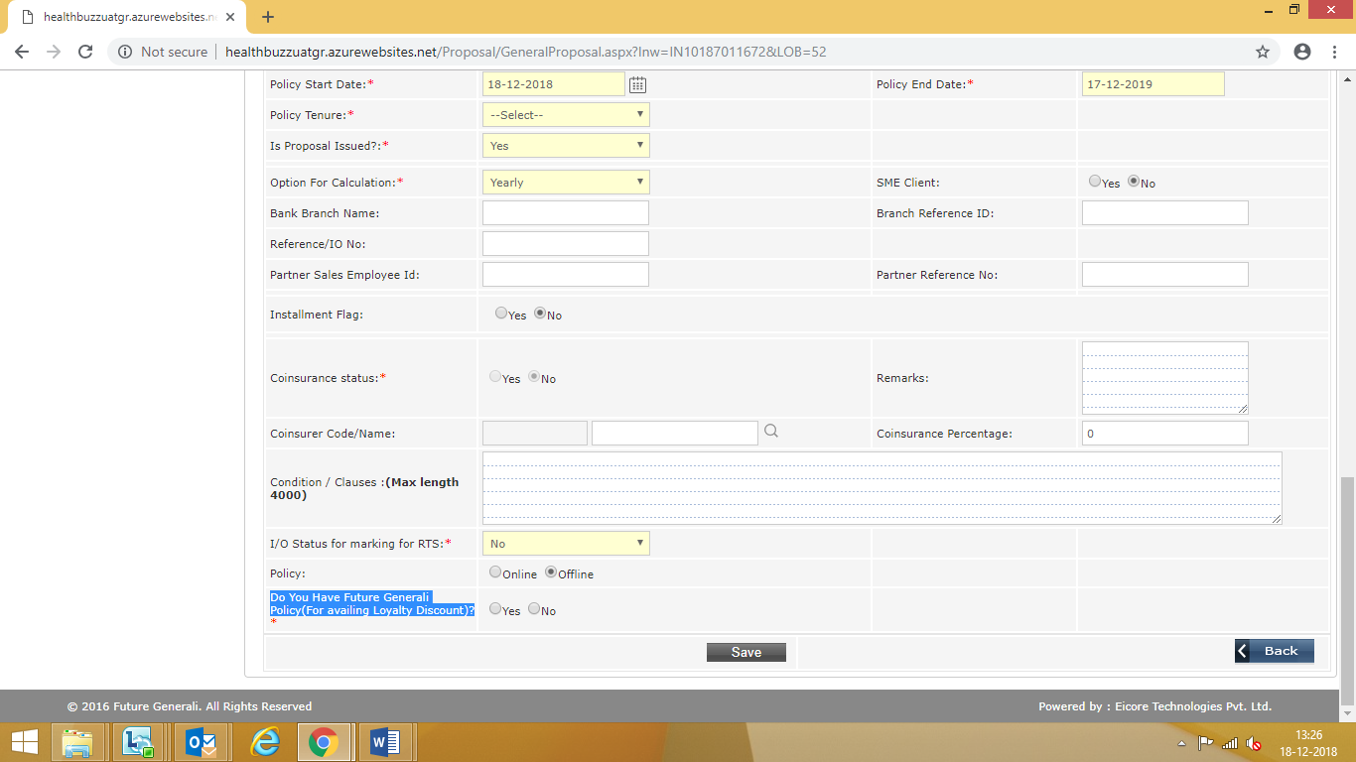
Advantage Top Up Health Insurance Product
“Future Advantage Top-Up” is a Deductible Health Insurance Product with high Sum Insured options to provide extra coverage at low premium.
PROCESS TO BE FOLLOWED
The below mentioned steps specifies the process of policy issuance under the product “Future Advantage Top-Up” in HealthBuzz System.
POLICY ISSUANCE PROCESS: -
Client Creation: - As per existing process.
DCN Creation: - As per existing process.
General Proposal: - As per existing process and one more field is introduced on the general proposal screen named as “Do You Have Future Generali Policy (For availing Loyalty Discount)?”

Slide 36
Advantage Top Up Health Insurance Product
Steps:
If User selects option as “Yes”, then the system will auto populate other Health policy number/s of the Insured, if any.
User needs to select the existing health policy no from the dropdown. After selecting the policy number system will auto populate the basic details of the policy (i.e. Product name, Policy Start/End date. Screen image attached.
User to verify active coverage of Insured under other Health Insurance Policy by verifying the policy copy (active coverage means, the name of the Insured should be on the other Health Insurance policy schedule and it should be a live policy as on date of Inception of Future Advantage Top up) and upload the other Health Insurance Policy copy on HealthBuzz/Omnidocs.
In case system does not auto populate the existing Health Insurance Policy details then User will have to select “other” option where in a text box will open for the User to manually mention the other Health Policy number of FGI of the Insured.
Further it is mandatory for the User to select the product name of that FGI policy number from the provided drop down options only: i.e.
  Future Health Suraksha
  Health Total
  Future HospiCash
  Future Criticare
  Future Health Surplus
  Future Vector Care (Retail)
  Sukshma HospiCash
  POS- Future Health Suraksha
  POS- Health Total.
User to verify active coverage of Insured under other Health Insurance Policy by verifying the policy copy (active coverage means, the name of the Insured should be on the other Health Insurance policy schedule and it should be a live policy as on date of Inception of Future Advantage Top up).
User to enter the Inception date and Expiry date of the other Health Policy on system.

Slide 37
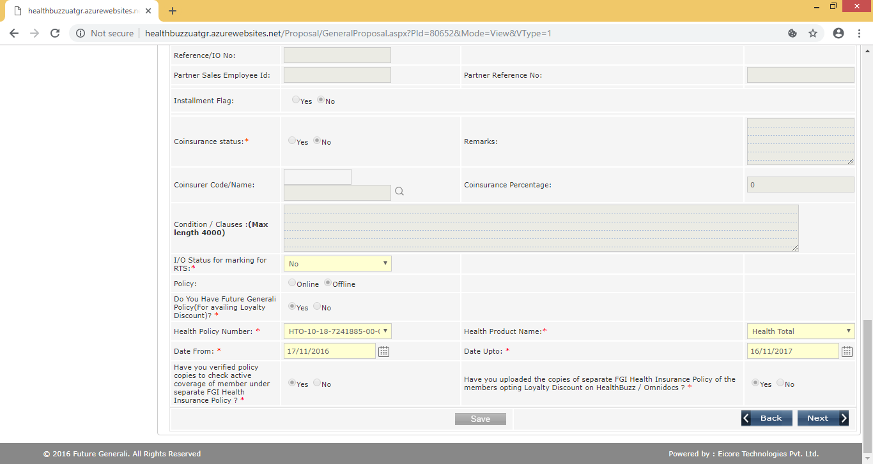
Advantage Top Up Health Insurance Product
User to give declaration by selecting “Yes”, confirming that the Policy copy of other Health Insurance product has been verified for active coverage of the insured.
User to upload the policy copy of other Health Insurance product that has been verified on HealthBuzz / Omnidocs and mark declaration as “Yes”.
0

Slide 38
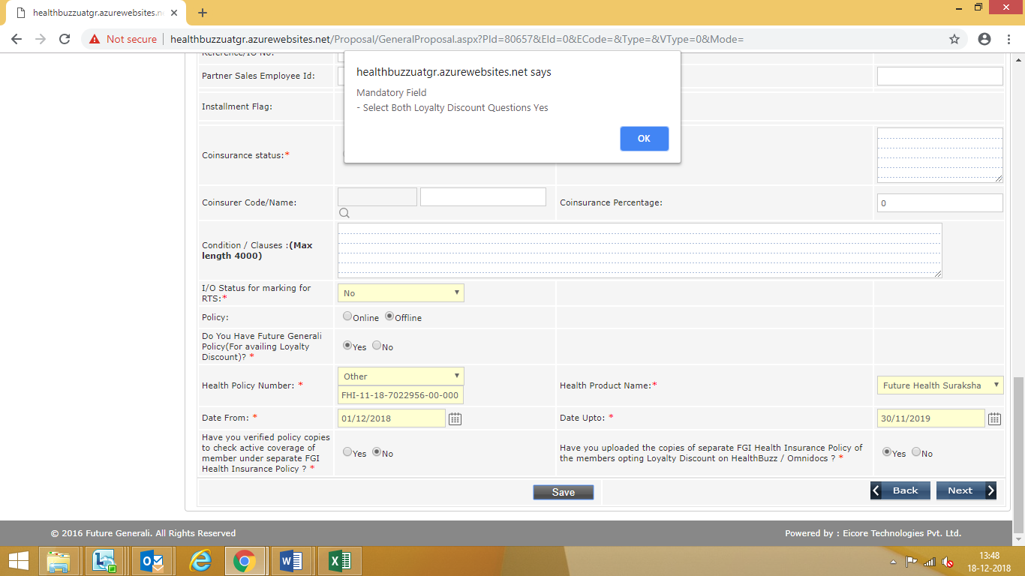
Advantage Top Up Health Insurance Product
If the user selects the option as “No” against these two User Declarations, then system will not allow to proceed further.

Slide 39
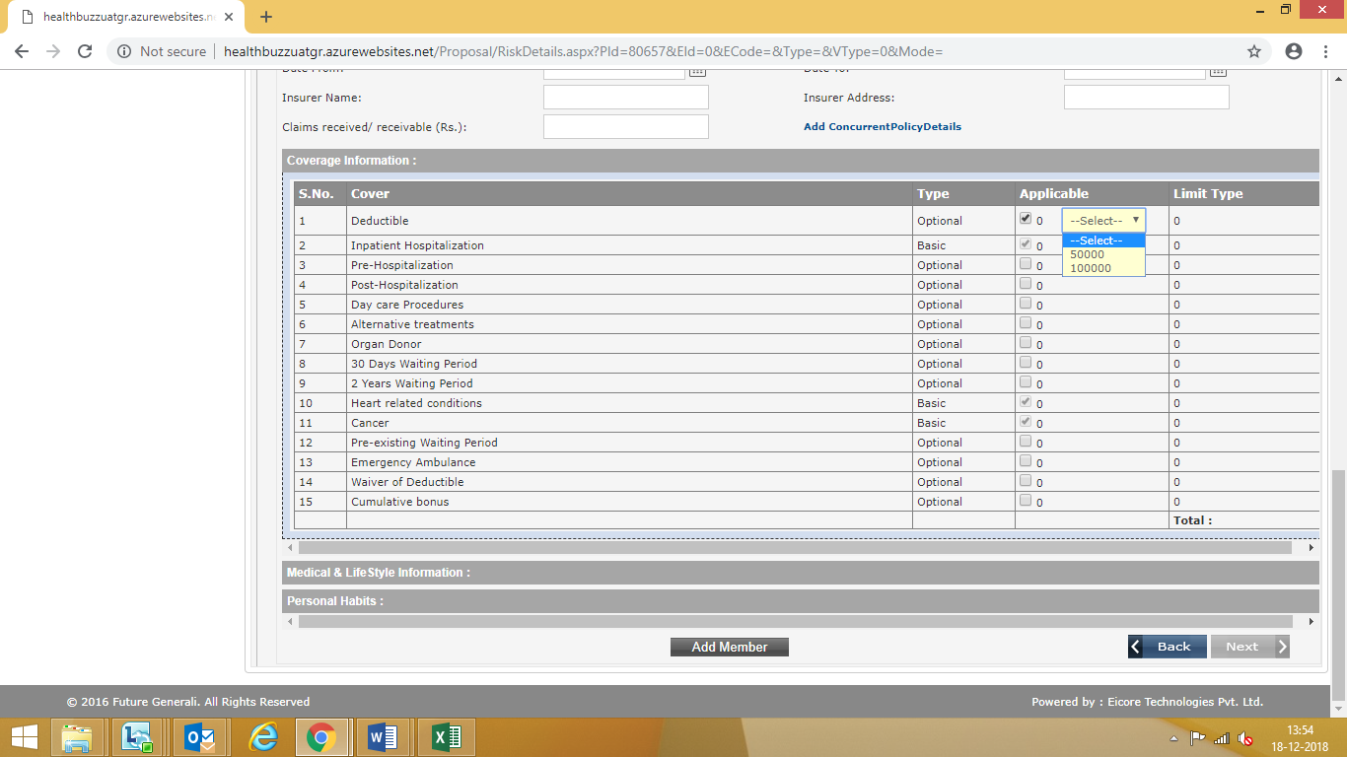
Advantage Top Up Health Insurance Product
System will show multiple options of the available deductibles in the product for a given sum insured. User to select the deductible as opted by the customer on the proposal form. Screen image attached.

Slide 40
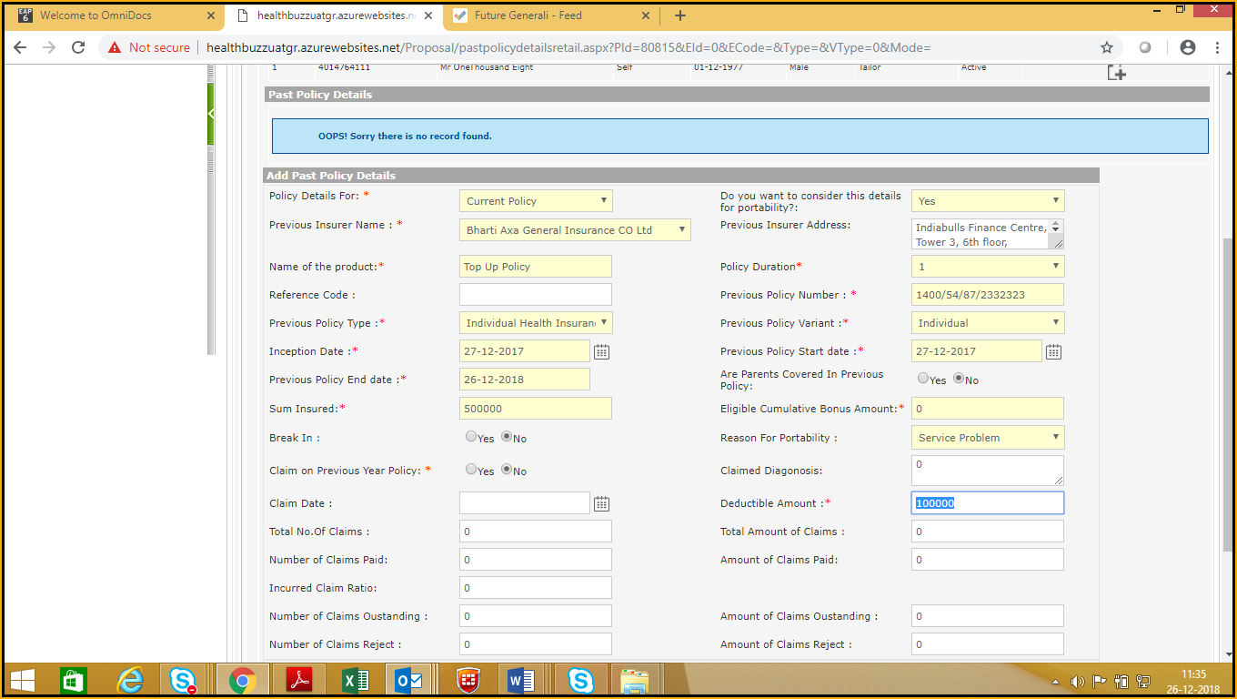
Advantage Top Up Health Insurance Product
In case of Roll Over, the past policy/s product should be a similar a Top Up product, i.e there will be with a high deductible along with the Sum insured on the past policy schedule/s. User to verify this before processing for Roll Over proposal under Future Advantage Top up.
Products other than Top Up are not allowed to port in Future Advantage Top up.
Remaining process for the policy issuance will be same as per the existing process.

