Slide 1
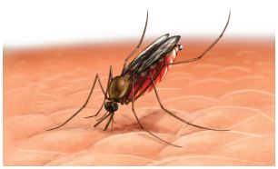
Future Vector Care
New Launch

Slide 2
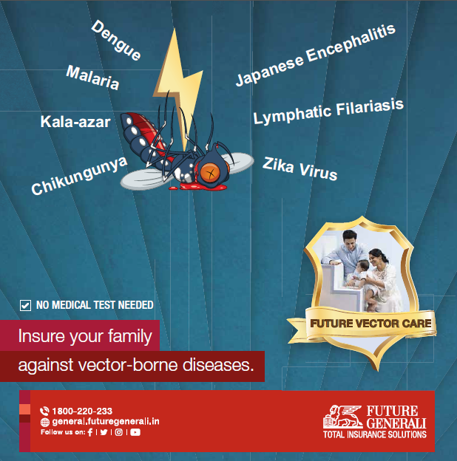
LAUNCHING

Slide 3
Salient Features
Future Vector Care
Lumpsum fixed benefit amount will be paid for named conditions
Cover for Dengue, Malaria, Chickengunya, Kala-azar, Japanese Encephalitis, Lymphatic Filariasis and Zika Virus.
Diagnosis and treatment (24 hours hospitalization) for any of named Vector borne diseases will trigger claim under this policy.
Diagnosis and treatment outside India. However, this exclusion shall not be applicable in the following countries/ cities: Canada, Dubai, Hong Kong, Japan, Malaysia, New Zealand, Singapore, Switzerland, USA, and countries of the European Union. The company may review the above list of accepted foreign countries from time to time. Claims documents from outside India are only acceptable in English language unless specifically agreed otherwise, and duly authenticated.
Initial waiting period of only 15 days, 60 days waiting in case customer suffered from any of 7 covered condition within last 2 months.
Self, Spouse, 3 dependent children and 2 parents may be covered under single policy.
4 sum insured options (10,000, 25,000, 50,000, and 75,000), very reasonable premium.
Entry age from day 1 to 65 years with lifelong renewability, Individual Sum Insured basis
Cover can be issued for 1 year, 2 years (5% discount) or 3 years (7.5% discount)
Cover is reinstated after claim payment by recovering prorated premium
Cooling period for relapse/ claims for same condition is 60 days.

Slide 4
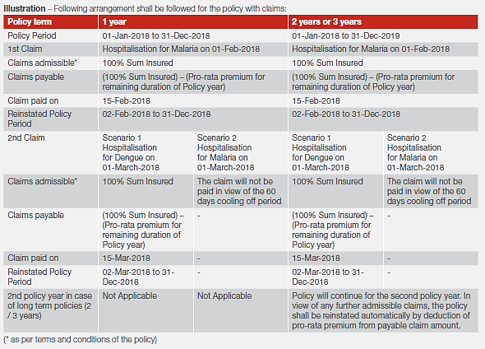
How it works
Future Vector Care
Understand cooling period and reinstatement of cover
Cooling
period
for next
Claim
is only
60 days.
Cover
is
reinstated
after
Claims
payment

Slide 5
Future Vector Care
Waiting periods
Initial waiting period of 15 days from the date of commencement of risk will be applicable.
The initial waiting period of 15 days will be increased to 60 days, if the insured is suffering or suffered within 60 days prior to the date of proposal, from any one of the listed condition except Lymphatic Filariasis at the time of taking the policy.
In case, if the insured is suffering or suffered within 60 days prior to the date of proposal, from Lymphatic Filariasis at the time of taking the policy, Lymphatic Filariasis will be excluded from the policy and the other listed conditions shall have an initial waiting period increased to 60 days.

Slide 6

Premium Chart
Future Vector Care
A discount of 15% in lieu of intermediary commissions if policy is taken directly from the insurer
and /or Online

Slide 7
Claims
Future Vector Care
Simple Claims Procedure and 30 day settlement
a) We must be informed of any event or occurrence that may give rise to a claim under this Policy within 48 hours of hospitalisation of the illness. You can intimate us through letter, email, fax or telephone.
b) You or someone claiming on Your behalf must promptly and in any event within 15 days of discharge from a Hospital give Us the necessary documents along with all original supporting documentation, including but not limited to the following, and other
information We ask for, to investigate the claim for Our obligation to make payment for it
i. Our claim form duly completed (along with captioned documents) and signed by/ on behalf of the Insured Person.
ii. Original Discharge Summary.
iii. Medical certificate confirming the diagnosis/treatment of Illness from Medical Practitioner.
iv. A precise diagnosis of the treatment for which a claim is made.
v. Treating doctor’s certificate regarding the duration of the illness & etiology.
vi. KYC documents.
vii. Laboratory reports.

Slide 8
Future Generali Health
Service
Communication Matrix
Exclusive Communication
Escalation Matrix
Primary contact details
1800-103-8889
1800-209-1017
fgh@futuregenerali.in
WhatsApp for Deficient Claim Documents
7755996994
IMD exclusive communication
E-mail
fgh.express@futuregenerali.in
Phone
020-67904509
First Level
vinayak.pankhade@futuregenerali.in
Second Level
ashish.saxena@futuregenerali.in
Third Level
bishwajit.nayak@futuregenerali.in
Final Level
shreeraj.deshpande@futuregenerali.in

Slide 9
Future Vector Care
Medical Conditions
1. Dengue fever
The applicant will be eligible for the benefit pay out in case of being diagnosed with Dengue confirmed by a Medical Practitioner.
Hospitalization must be absolutely necessary as advised by the Medical Practitioner and the Laboratory examination result countersigned by a
pathologist/ microbiologist must confirm the following:
• Decreasing platelet levels- less than 100,000 cells/mm3; and
• Immunoglobulins/PCR test showing positive results for Dengue
Indoor case papers should be mandatorily obtained and the diagnosis of admission should be Dengue in addition to the above two conditions.
Specific exclusions for this cover:
• Any Treatment other than for Dengue (as defined above)
• Hospitalization less than 24 hours
• Treatment outside India
• Any claim of Dengue fever during the waiting period

Slide 10
Future Vector Care
Medical Conditions
2. Malaria
Diagnosis of Malaria should be confirmed by a Medical Practitioner with confirmatory tests indicating presence of Plasmodium Falciparum/
Vivax/ Malariae in the patient's blood by laboratory examination countersigned by a pathologist/microbiologist in peripheral blood smear or
positive rapid diagnostic test (antigen detection test).
Continuous Hospitalization of 24 hours should be absolutely necessary along with high fever and shaking chills.
Indoor case papers should be mandatorily obtained and the diagnosis of admission should be malaria and its complications, if any.
Specific exclusions for this cover:
• Any Treatment other than for malaria and its complications
• Hospitalization less than 24 hours
• Treatment outside India
• Any claim of malaria fever during the waiting period

Slide 11
Future Vector Care
Medical Conditions
3. Lymphatic Filariasis
Commonly known as Elephantiasis, must be confirmed by a Medical Practitioner and the laboratory examination countersigned by a
pathologist must be documented with presence of microfilariae in a blood smear by microscopic examination and along with any two of the
following criteria:
• Lymphoedema, • Elephantiasis, • Scrotal swelling
Indoor case papers should be mandatorily obtained and the diagnosis of admission should be Filariasis in addition to the two of the above conditions.
Specific condition for this cover:
• Filariasis will be payable once in lifetime
Specific exclusions for this cover:
• Any Treatment other than for Filariasis and its complications (as defined above)
• Hospitalization less than 24 hours
• Treatment outside India
• Any claim or Filariasis during the waiting period

Slide 12
Future Vector Care
Medical Conditions
4. Kala-azar
Visceral leishmaniasis, also known as Kala-azar, is characterized by irregular bouts of fever, substantial weight loss, swelling of the spleen and liver, and anaemia.
The diagnosis must be confirmed by a Medical Practitioner and by parasite demonstration in bone marrow/spleen/lymph node aspiration or in
culture medium as the confirmatory diagnosis or positive serological tests for Kala-azar should clearly indicate the presence of this disease.
Indoor case papers should be mandatorily obtained and the diagnosis of admission should be Kala-azar.
Specific exclusions for this cover:
• Any Treatment other than for Kala-azar (as stated above)
• Hospitalization less than 24 hours
• Treatment outside India
• Any claim of Kala-azar during the waiting period

Slide 13
Future Vector Care
Medical Conditions
5. Chikungunya
Chikungunya is characterized by an abrupt onset of fever with Joint pain. Other common signs and symptoms include muscle pain, headache, nausea, fatigue and rash.
The diagnosis must be documented by a Medical Practitioner and by Serological tests, such as enzyme-linked immunosorbent assays (ELISA), confirming the presence of IgM and IgG anti-chikungunya antibodies.
Indoor case papers should be mandatorily obtained and the diagnosis of admission should be Chikungunya.
Specific exclusions for this cover:
• Any Treatment other than for Chikungunya
• Hospitalization less than 24 hours
• Treatment outside India
• Any claim of Chikungunya during the waiting period

Slide 14
Future Vector Care
Medical Conditions
6. Japanese Encephalitis
Characterized by rapid onset of high fever, headache, neck stiffness, disorientation, coma, seizures, spastic paralysis. To confirm Japanese Encephalitis (JE) infection and to rule out other causes of encephalitis requires a laboratory testing of serum or preferably cerebrospinal fluid.
The diagnosis must be confirmed by a Medical Practitioner and positive serological test for JE by immunoglobulin M (IgM) antibody capture ELISA (MAC ELISA) for serum and cerebrospinal fluid (CSF).
Indoor case papers should be mandatorily obtained and the diagnosis of admission should be Japanese Encephalitis.
Specific exclusions for this cover:
• Any treatment other than for Japanese Encephalitis (as stated above)
• Hospitalization less than 24 hours
• Treatment outside India
• Any claim of Japanese Encephalitis fever during the waiting period

Slide 15
Future Vector Care
Medical Conditions
7. Zika Virus
People with Zika virus disease can have symptoms like mild fever, skin rash, conjunctivitis, muscle and joint pain, malaise or headache.
A diagnosis of Zika virus infection should be confirmed by a Medical Practitioner and by plaque-reduction neutralization testing (PRNT). PRNT
is performed by CDC (Centers for Disease Control and Prevention) or a CDC-designated confirmatory testing laboratory to confirm presumed
positive, equivocal, or inconclusive IgM results.
Indoor case papers should be mandatorily obtained and the diagnosis of admission should be Zika virus.
Specific exclusions for this cover:
• Any treatment other than for Zika virus (as stated above)
• Hospitalization less than 24 hours
• Treatment outside India
• Any claim of Zika virus during the waiting period

Slide 16
Future Vector Care
Questions and Feedback

Slide 17
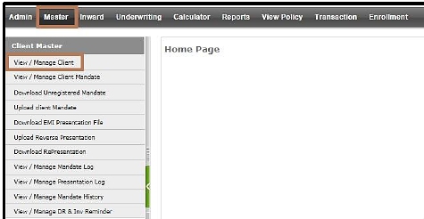
Future Vector Care
Operations Manual
Client ID Generation
Client Master
View / Manage Client
Add New
Click to Expand
“Home and Office Address” , “Mailing Address” , “Bank Details”
Note: Email ID and Contact number is compulsory
Update & Submit
Client ID Generated

Slide 18

Future Vector Care
Operations Manual
INWARD
Inward
View / Manage Inward
Add New
Submit Details
Document Control Number
is Generated; Next Step is DMS

Slide 19
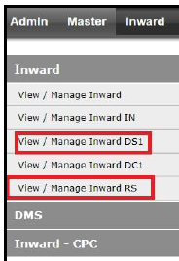
Future Vector Care
Operations Manual
RTS/ Discrepancy
If proposal status is in Discrepancy / RTS update the reason of same in remarks.
Once resolved Click “View / Manage Inward DS1 / View / Manage Inward RS”
Change the processed status as “IN” and update processed remarks and then proceed to DMS.

Slide 20
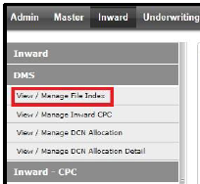
Future Vector Care
Operations Manual
DMS – Document Management System
Click on Inward on the homepage and then expand “DMS”.
Click on View/Manage File Index
To process the already created inward, Search the record through Document Control No. or Client code
Click on “Proceed for Proposal”
Upload the documents one by one and once done click on submit.

Slide 21
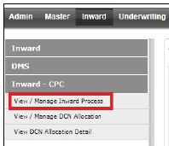
Future Vector Care
Operations Manual
INWARD- CPC
View/Manage Inward Process allows the user to add proposal information or view existing proposal information.
Click on Inward on the homepage and then expand ‘Inward-CPC'.
To process the already created inward, Search the record through Document Control No. or Client code
Click on Proceed for Proposal

Slide 22
Future Vector Care
Operations Manual
General Proposal
On Proceed, following screen will appear where user needs to enter all mandatory information / details.
After filling the details, Click on Save

Slide 23
Future Vector Care
Operations Manual
Co-insurace
If Co-insurance status is selected as Yes on General Proposal page, then fill the Co-insurance information,
Otherwise, Click on Next to proceed further.

Slide 24
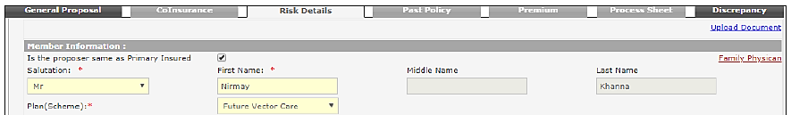
Future Vector Care
Operations Manual
Risk Details
Clicking on Next brings the page to “Risk detail”.
User have to enter all mandatory information of insured and other details .
Once details of all insured member updated click on Next.

Slide 25
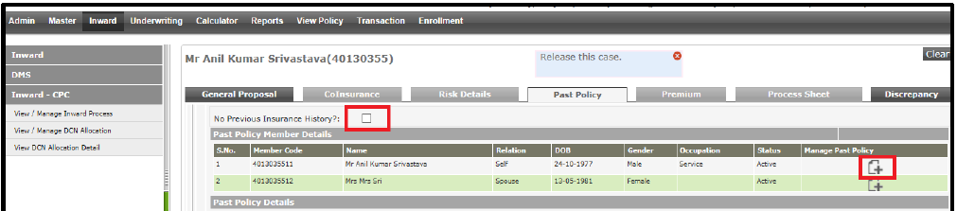
Future Vector Care
Operations Manual
Past Policy
Clicking on Next move the process to Past policy screen.
If Past policy details exists, then fill the Past Policy Information , otherwise click on checkbox “No Previous insurance history? .
Click on Next

Slide 26
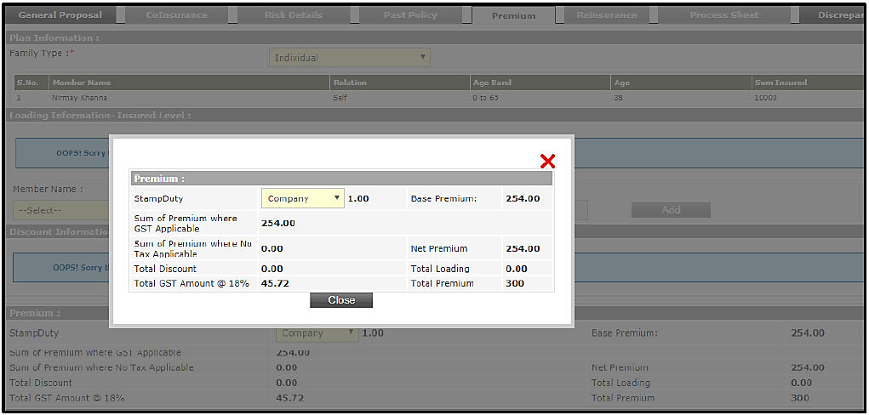
Future Vector Care
Operations Manual
Premium
After clicking on “Next” Button, Premium page will appear
Click on view premium and then close.
Click on Save Proposal and click ok on dialog box.

Slide 27
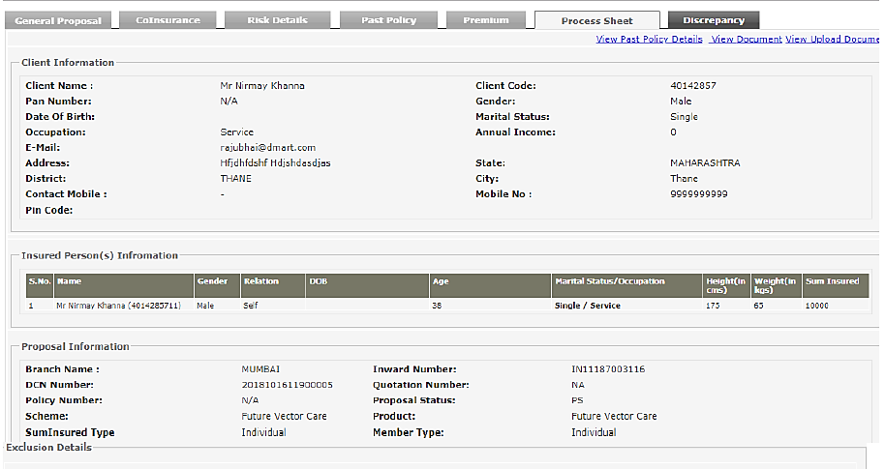
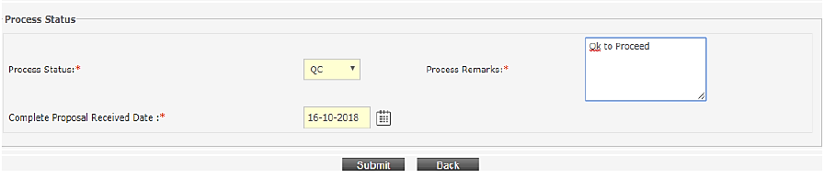
Future Vector Care
Operations Manual
Process Sheet

Slide 28
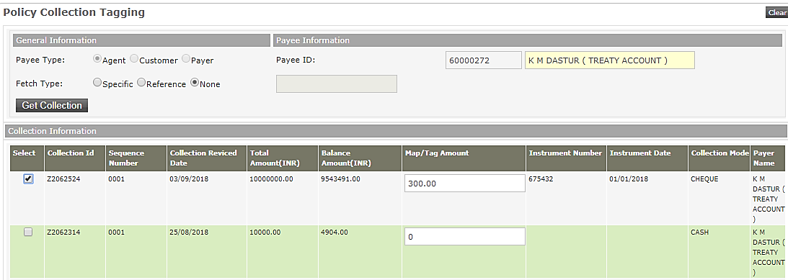
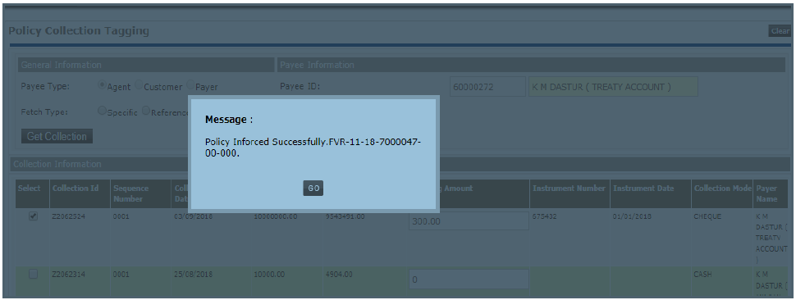
Future Vector Care
Operations Manual
Collection Tagging

Slide 29
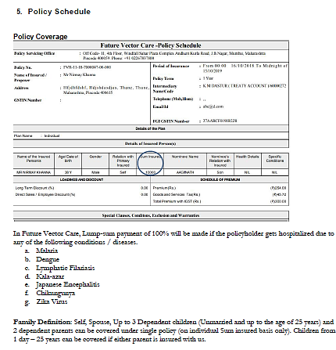
Future Vector Care
Operations Manual
Policy Schedule

Slide 30
www.futuregenerali.in

