Slide 1

LAUNCHING

Slide 2
Key Features
Inpatient care (minimum 24 hours)
Day care procedures
Pre Hospitalization expenses
Post Hospitalization expenses
Ambulance charges
Free medical check up (each year from 1st renewal)
Long term discount (2/3 year)
EMI option (2/3 year)
Family discount (Individual Sum Insured)
Medical Report discount
50% reimbursement of pre policy check up expenses
Up to 25% underwriting loading
Tax benefit under section 80D

Slide 3
Eligibility
Minimum Policy Term | 1 Year
Long Term Policy term | 2 / 3 Years (with discount for advance premium and EMI option)
Minimum Age at Entry | 60 Years
Maximum Age at Entry | Lifelong
Renewal | Lifelong
Instalment frequency Loading on standard premiums for 2 years and 3 years policy terms.
Monthly - 5%
Quarterly - 4%
Half-yearly - 3%
Discount for advance premium for 2 years and 3 years policy terms.
2 years - 5%
3 years - 10%
In case of instalment for policy terms of 2 years and 3 years, if monthly mode is opted, minimum 2 months premium needs to be collected for policy issuance.

Slide 4
Sum Insured Options
Sum Insured Options | 2 Lakh; 3 Lakh; 4 Lakh; 5 Lakh | 7.5 Lakh; 10 Lakh
SI Basis | Both Individual and Floater
Family Definition:
# For Individual Plan: - Family means – Self and Spouse; 10% discount is applicable where Self and Spouse are covered.
# For Family Floater Plan: - Family means – Self and Spouse (Spouse age may be less than 60 years)
Selection Guidelines:
Proposer to have the highest Sum Insured.
• In case married, spouse to be covered mandatorily. However in case the insured is covered in some other health
insurance product then copy of the policy is to be provided to allow selection of the insured.

Slide 5

Key Features
Illustration
Ambulance charges
1000/ claim
Medical expenses in registered hospital due to illness or injury for minimum 24 hours
60 days Pre
Hospitalization
90 days Post
Hospitalization
Day Care procedures (409)

Slide 6
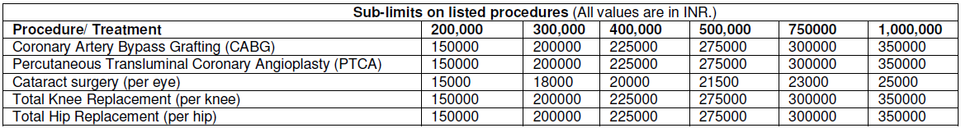
Key Features
Co-pay on PED and Other Claims
a) 50% co-payment is applicable on each and every claim related to Pre-existing disease, on the admissible
hospitalisation bill, excluding claim related to pre and post hospitalisation. The Insured will have No option to waive off this co-payment.
b) 25% co-payment is applicable on each and every claim for all other claims, on the admissible hospitalisation bill, excluding claim related to pre and post hospitalisation. However the Insured have an option to waive off this co-payment on payment of additional loading of 20% on the standard premium.
c) Both the above co-payments will be applicable lifelong
Sub-limits on listed procedures
Co-payments will not be applicable in case there is a claim for the listed procedures mentioned in the Sub-limits table.

Slide 7
Discounts
Family discount – 10% Family discount in case of more than one insured covered under the same policy on individual sum insured basis.
b) Long-term discount – Applicable in case of single premium payment for policy term of more than one year
2 years - 5%
3 years - 10%
c) Medical Report Discount– 10% discount on the individual member’s premium, if the insured produces the latest medical reports within 15 days of the tests done (2 D Echo, Blood Pressure report, Glycosylated hemoglobin, blood urea & serum creatinine) along with the proposal form and the proposal is accepted. This is available for Sum Insured options of ₹ 2L, 3L, 4L and 5L. This discount will not be applicable for further renewals.
d) Direct Sales Discount – A discount of 15% in lieu of intermediary commissions if policy is taken directly from the insurer and /or Online

Slide 8
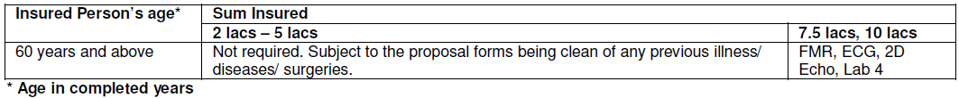
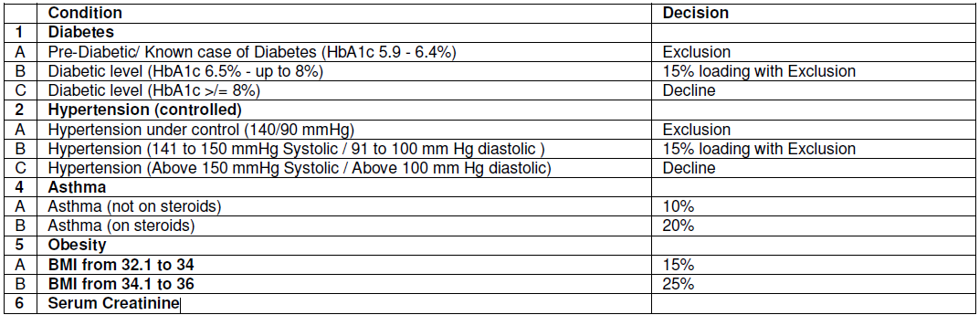
Medical underwriting
50% of the cost of any pre-insurance medical examination conducted at our empanelled DC, once the Proposal is accepted and the Policy is issued

Slide 9
Waiting periods
PED cover after just 1 Year waiting
a) 12 months for Pre existing conditions declared and/or accepted at the time of proposing the Policy for the first time.
b) 24 months waiting period for following conditions, irrespective of whether it falls under
pre-existing diseases: Cataract, Glaucoma, Diseases of the anterior and posterior segment of the eyes, surgery on ears, Diseases related to Thyroid, Varicose veins and ulcers, all diseases of Prostate, Stricture Urethra, all types of Hernia, Varicocele, Hydrocele, Fistula / Fissure in ano, Hemorrhoids, Pilonidal Sinus and Fistula, Rectal Prolapse, Stress Incontinence and Congenital Internal disease / defect, Gall bladder and Pancreatic diseases, Gastric and duodenal ulcers and all treatments related to Hepato-pancreato-biliary disease including Gall bladder and Pancreatic calculi. All types of management for Kidney and Genito-urinary tract calculi. All treatments related to all diseases of Uterus, Fallopian tubes, Cervix and Ovaries, Dysfunctional Uterine bleeding, Pelvic inflammatory diseases, Conservative, operative treatment and all types of intervention for diseases related to Tendon, Ligament, Fascia, Bones and Joint [other than caused by accident], Degenerative disc and Vertebral diseases including replacement of Bones and Joints, Prolapse of intervertebral disc (other than caused by accident), Degenerative diseases of the Musculo-skeletal system, all internal or external tumors/ cysts/ nodules/ polyps of any kind including breast lumps with exception of malignant tumour or growth
e) 48 months for any mental Illness or psychiatric Illness
f) 48 months for treatment for AIDS (Acquired Immune Deficiency Syndrome) and/ or infection with HIV (Human Immunodeficiency Virus)
g) 30 days from policy inception of Your first Policy with Us, except claims arising due to an accident.

Slide 10
Exclusions
Refreshed with more features and plan options
Medical Exclusions
(i) Vaccination/ inoculation (except as post bite treatment), cosmetic treatments, plastic Surgery other than as may be necessitated due to an Accident or as a part of any Illness, refractive error corrective procedures, Unproven/Experimental treatment, investigational or unproven procedures or treatments, devices and pharmacological regimens of any description.
(ii) Charges incurred in connection with cost of spectacles and contact lenses, hearing aids, durable medical equipment
(iii) Dental treatment or Surgery of any kind unless requiring Hospitalisation as a result of accidental Bodily Injury.
(iv) The treatment of obesity (including morbid obesity)
(v) Expenses incurred towards treatment of Illness/ disease/ condition arising out of alcohol use/ misuse or abuse of alcohol, substance or drugs (whether prescribed or not).
(vi) Convalescence, general debility or rest cure, venereal /Sexually Transmitted disease other than HIV/AIDS, intentional self-Injury.
(vii) Maternity expenses however, this exclusion will not apply to Ectopic Pregnancy
(viii) Congenital External Illness/ disease/ defect anomaly.
(ix) Costs incurred on all methods of treatment including AYUSH treatments except Allopathic.
(x) Charges incurred at Hospital or Nursing Home primarily for diagnostic, X-ray or laboratory examinations not consistent with or incidental to the diagnosis and treatment of the positive existence or presence of any ailment, sickness or Injury.
(xi) Outpatient Diagnostic, Domiciliary hospitalization, Treatment outside India.

Slide 11
Sum Insured enhancement
Conditions for Sum Insured Enhancement:
The enhancement should be proportionate throughout the policy i.e. for all family members without selection.
1. The proposal form should be clean
2. No claim in the expiring policy – In case of a claim referral to be made to Retail Health Underwriting Team for further advise
3. For every Sum insured enhancement the following wording to appear on the face of the policy “For the enhanced SI the waiting periods will apply afresh”.
4. The enhancement will be allowed maximum up to 2 steps higher only.
a) In case the revised sum insured is less than or equal to ₹ 5 L, free health annual check-up will be taken into account for enhancement of Sum insured unless there is any other test advised by the underwriter
b) In case of revised sum insured is above ₹ 5 L (i.e. 7.5 or 10 L) then pre-policy check-up will be required as per table above.

Slide 12
Multiple Policies
a) If two or more policies are taken by an insured during a period from one or more insurers to indemnify treatment costs, the policyholder shall have the right to require a settlement of his/her claim in terms of any of his/her policies.
b) In all such cases the insurer who has issued the chosen policy shall be obliged to settle the claim as long as the claim is within the limits of and according to the terms of the chosen policy.
c) The policyholder having multiple policies shall also have the right to prefer claims from other policy/ policies for the amounts disallowed under the earlier chosen policy/ policies, even if the sum insured is not exhausted. Then the Insurer(s) shall settle the claim subject to the terms and conditions of the other policy / policies so chosen.
d) If the amount to be claimed exceeds the sum insured under a single policy after considering the deductibles or co-pay, the policyholder shall have the right to choose insurers from whom he/she wants to claim the balance amount.
e) Where an insured has policies from more than one insurer to cover the same risk on indemnity basis, the insured shall only be indemnified the hospitalization costs in accordance with the terms and conditions of the chosen policy.
f) This section is not applicable to the Hospital Cash benefit payable in case of Platinum Plan and Ruby Plan.

Slide 13
Claims Service
For availing cashless at a Network Provider,
We must be called at Our call centre and a request for pre-authorisation must be made by way of the written form prescribed by Us.
(Cashless TAT currently is 90 minutes)
If treatment is taken in a Hospital which is Non-Network or
If You do not wish to avail cashless facility or
If pre-authorisation (for cashless)is denied by Us, then:
Claim Intimation – within 48 hours
Document Submission – within 15 days of Discharge
Settlement – within 30 days of the receipt of the last necessary documents. (30 days is as per PPI regulation however settlement is done within 8 days)

Slide 14
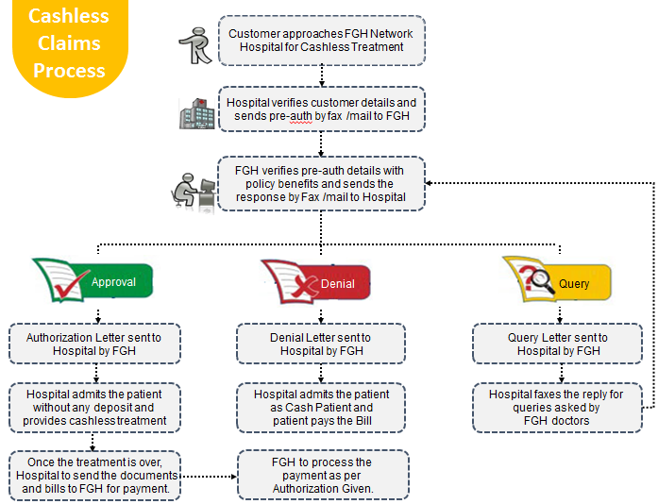
Time to ‘Deliver on the Promise
Health Claims at Future Generali India

Slide 15
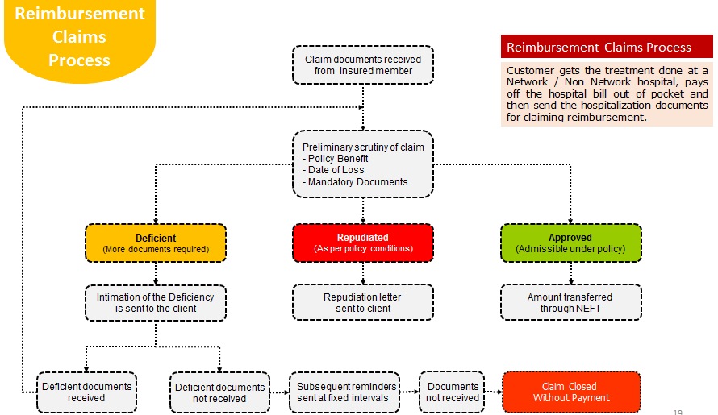
Health Claims at Future Generali India
Time to ‘Deliver on the Promise

Slide 16
Future Generali Health
Claims Service
Communication Matrix
Exclusive Communication
Escalation Matrix
Primary contact details
1800-103-8889
1800-209-1017
fgh@futuregenerali.in
WhatsApp for Deficient Claim Documents
7755996994
IMD exclusive communication
E-mail
fgh.express@futuregenerali.in
Phone
020-67904509
First Level
vinayak.pankhade@futuregenerali.in
Second Level
ashish.saxena@futuregenerali.in
Third Level
bishwajit.nayak@futuregenerali.in
Final Level
shreeraj.deshpande@futuregenerali.in

Slide 17
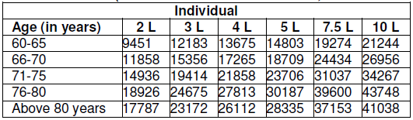
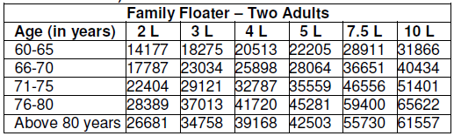
Premium
(Premium in ₹, without Goods and Services Tax)
**Age in completed years
*** For Family Floater, premium would be applicable as per the age of the eldest member in the family. In case the spouse is of age less than 60 years, she/ he can still
opt under Family Floater option, provided the age of Self is 60 years and above. In case of medical loading for spouse of age less than 60 years, the loading shall be
applied on the individual premium for age of 60 years.

Slide 18
Key Features- Revision
Inpatient care (minimum 24 hours)
Day care procedures
Pre Hospitalization expenses
Post Hospitalization expenses
Ambulance charges
Free medical check up (each year from 1st renewal)
Long term discount (2/3 year)
EMI option (2/3 year)
Family discount (Individual Sum Insured)
Medical Report discount
50% reimbursement of pre policy check up expenses
Up to 25% underwriting loading
Tax benefit under section 80D

Slide 19
Market comparison
Feature | FG Varistha up to 10 Lac | Bajaj Silver up to 5 Lac | New India Senior up to 1.5Lac
PED cover | After 1 year | After 1 year | After 1.5 years
PED Claim | 50% co-pay | 50% co-pay | 10% co-pay
Joint replacement | After 2 years | After 4 years | After 4 years
Pre and Post Hosp | 2% combined | 3% combined | 5% and 10%
Free Health Check | Each year (from 1st Renewal) | After 4 Claim free years | After 4 Claim free years
Sub-limits (defined limits) | For 5 named conditions; 25% co-pay (waived with loading) | 20% co-pay for Non network claim (waived with loading) | Room 1%, ICU 2%, Dr. 25%, Others 50%
Named conditions waiting | 2 years | 1 year | 1.5 years
Family discount | 10% | 5% | 10%
Cumulative bonus | NA | 10%; max 50% | 5%; max 30%

Slide 20
Future Generali India Insurance Company Limited
IRDAI Registration No.: 132
CIN: U66030MH2006PLC165287
Registered and Corporate Office:
Indiabulls Finance Centre, Tower 3, 6th Floor,
Senapati Bapat Marg, Elphinstone (W),
Mumbai – 400013
Contact No: 022 – 4097 6666
Fax: 022 – 4097 6900
Email: fgcare@futuregenerali.in.
Insurance is the subject matter of solicitation

