Slide 1



Future Hospicash
A plan that pays a fixed benefit for each day of your hospitalization.

Slide 2

Do We Need Hospital Cash Plan?
Normal indemnity plans can take care of your hospitalization expenses.
However, incidental expenses during hospitalisation can be significant.
It is also important to plan for loss of income during hospitalisation period.
Ideal situation would warrant a combo solution to take care financial losses in every possible way

Slide 3

Presenting A Hospital Cash Cover
To Make Up For Financial Loss
In The Event Of Hospitalisation!
What Is Hospicash?
Future Hospicash is a cover that provides cash benefit in case
an insured gets hospitalised.
It is specifically designed to take care of the incidental expenses in case of hospitalization.
Future Hospicash policy guards you and your family against
the trauma you face because of increased financial burden during
hospitalization.
Future Hospicash provides you with fixed benefit for each day
of hospitalization irrespective of the actual medical cost. Thus,
provides you with additional protection at all times.

Slide 4
Hospi Cash – Hospitalisation Daily Allowance
Entry till 65 years and continuity for life.
No need for original bills submission.
Low premium based on plan opted (Daily benefit amount and benefit period).
Unique feature of paying triple the daily allowance for outstation ICU admissions
Pays double the daily allowance for ICU admissions
No time excess, pays from day 1
Unique feature of paying Convalescence benefit (5000) for 10+ days LOS
Cover for pre existing after 4 years
Group option available for employer employee groups.
Claim servicing through Future Generali Health- ISO certified In house division for end to end servicing of Health Insurance clients.
Dedicated Cashless Empanelment (4300 + Hospitals) , Enrollment, Pre policy, Underwriting, Claims, Analysis and Contact center setup since 2010.
Industry leading turn around time for enrollment (7 days), cashless approvals (2 hours), and reimbursements (14 days)

Slide 5

Policy Coverage
In the event of hospitalization, this policy pays,
  Fixed benefit for each continuous and completed period of 24 hrs of hospitalization for maximum of 30/ 60/ 90/ 180 days as per the plan chosen.
  Two times of the benefit chosen in case of hospitalization in ICU in your own Home City* for maximum 10 days for each hospitalization and 20 days during policy period.

Slide 6
Policy Coverage
  Three times of the benefit chosen in case of hospitalization in ICU in other than your Home City* for maximum 10 days for each hospitalization and 20 days during policy period.
  Fixed amount for Convalescence for hospitalization beyond 10 consecutive days for maximum once per hospitalization period.
  *Home City means the city of residence as specified on the proposal form

Slide 7

Plan Benefits
Benefits | Plans
 | A (in Rs ) | B (in Rs ) | C (in Rs ) | D (in Rs )
Daily Hospitalization benefit due to accident and sickness | 500 | 1000 | 2000 | 3000
ICU benefit in home city of residence. (max. 10 days per hospitalization and max. 20 days per policy period) | 1000 | 2000 | 4000 | 6000
ICU benefit in other than home city of residence (max. 10 days per hospitalization and max. 20 days per policy period) | 1500 | 3000 | 6000 | 9000
Convalescence benefit for hospitalization exceeding consecutive 10 days | 5000

Slide 8

Salient Features
The policy can be on individual Sum Insured basis or on family floater basis, covering Self, Spouse, and two dependent children ( upto 25 yrs).
For Individual as well as Family floater plan only one hospitalization benefit plan across all members needs to be selected.
Continuity would be offered from similar Hospital cash policy with the same per day benefit amount.
Continuity would be offered from similar Hospital cash policy with the same per day benefit amount from our Group Hospital cash policy to our individual Hospicash policy.
Premium paid is exempt under the section 80 D of Income Tax.

Slide 9
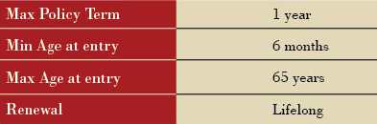

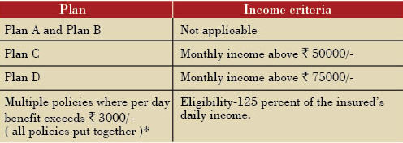
Eligibility Limits
*Maximum benefit available for an individual is Rs 6000/- per day.
A person can buy Hospital Cash policies, wherein the per day benefit will not exceed Rs 6000/- per day under a single or multiple Hospital cash policies. If the per day benefits put together for all these policies exceed Rs 6000/- he will not be eligible to buy any additional policy.

Slide 10

Underwriting Guidelines
Completely filled Proposal form is mandatory.
No medical tests required for clean proposal except for Plan C and D where insured is above 55yrs of age.
Pre Acceptance Tests Applicable as below:
30/ 60/ 90/ 180 days | 0- 35 years | 36- 45 years | 46- 55 years | 56- 60 years | 61- 65 years
Plan A | NA | NA | NA | NA | NA
Plan B | NA | NA | NA | NA | NA
Plan C | NA | NA | NA | FMR, ECG, LAB 1 | FMR, ECG, LAB 1
Plan D | NA | NA | NA | FMR, ECG, LAB 1 | FMR, ECG, LAB 1
FMR: Full Medical report by MD Physician, ECG: Electrocardiogram report by MD Physician
Lab 1: includes Fasting Blood sugar, Post-Prandial Blood Sugar, Complete Blood Count (incl Diff), Serum Cholesterol, Serum Creatinine, Urinalysis (chemical &microscopic)
In case of Pre-policy check, it has to be done in our empanelled diagnostic centre and 50% cost of medical tests will be reimbursed to you if the Proposal is accepted by us and subject to realization of cheque.
The test reports would be valid for 1 month.

Slide 11
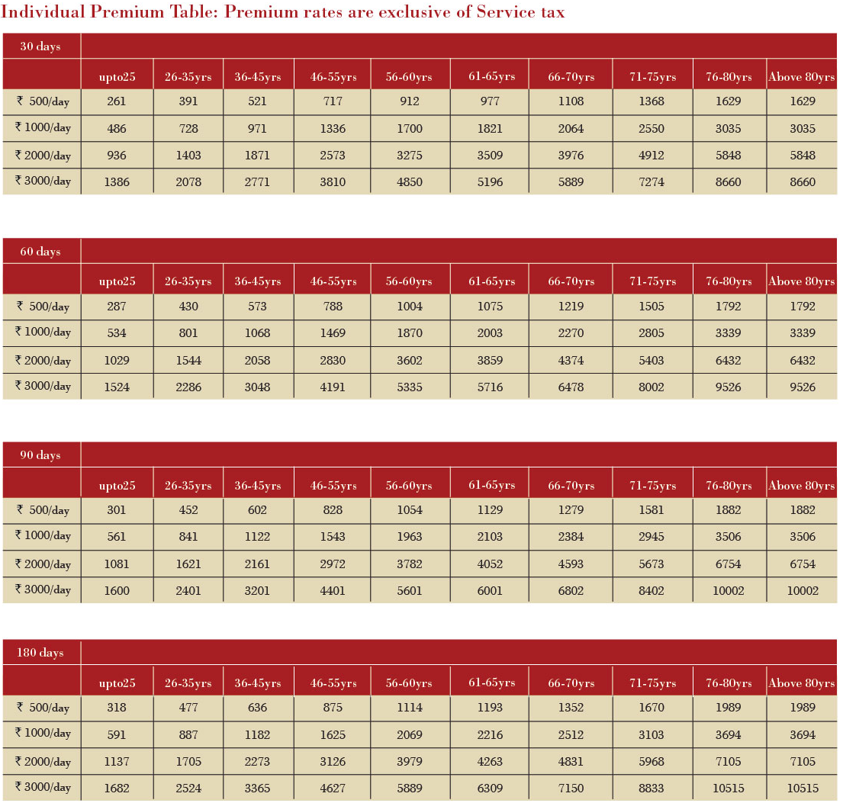

Premium Calculation
Premium Chart- Individual

Slide 12

Premium Calculation
For calculation purpose the eldest member of the family will be considered as the primary insured.
Premium of Spouse – 50 % of Self premium.
Premium of Child -25 % of Self premium.

Slide 13
IRDA Health Regulations 2013
Free Look Period
a) The insured will be allowed a period of at least 15 days from the date of receipt of the Policy to review the terms and conditions of the Policy and to return the same if not acceptable.
b) If the insured has not made any claim during the free look period, the insured shall be entitled to-
i. A refund of the premium paid less any expenses incurred by the Insurer on medical examination of the insured persons and the stamp duty charges or;
ii. where the risk has already commenced and the option of return of the Policy is exercised by the Policyholder, a deduction towards the proportionate risk premium for period on cover or;
iii. Where only a part of the risk has commenced, such proportionate risk premium commensurate with the risk covered during such period.

Slide 14
IRDA Health Regulations 2013
No Adverse claim loading.
Standard Definitions.
Revision of contribution clause.
List of non payable items.
Policy wordings with IRDA approval number.

Slide 15

Mazor Exclusions
Pre-existing diseases will be covered after a waiting period of 48 months.
Waiting period of 24 months for certain diseases like benign prostatic hypertrophy, hernia of all types, hydrocele etc.
Hospitalisation for cosmetic treatments, plastic surgery, refractive error corrective procedures, experimental, investigational or unproven procedures or treatments.
Hospitalisation for General debility, ‘Run-down’ condition or rest cure, sexually transmitted disease, intentional self-injury.
Hospitalisation for Pregnancy and fertility related treatments.
Non-Allopathic Treatment / Hospitalisation.
Hospitalisation for any mental illness or psychiatric illness.
Any hospitalisation outside India.
* Please read policy documents for complete list of exclusions.

Slide 16

Claims Procedure
Claim must be informed in writing immediately, and in any event within 48 hours of the Illness or Bodily Injury.
Within 30 days of discharge from a Hospital, documentation (written details of the quantum of any claim along with certified copies of discharge card, hospital bill and receipt.) should be submitted.
Mandatory documents required to process claim are
Completely filled Future Hospi-Cash Claim form ( original )
Discharge certificate/ card from Hospital (photocopy)
Final Hospital bill with receipt (photocopy)
Decision will be taken in 30 days.

Slide 17
Claims Assistance
Claims Department
Future Generali Health (FGH)
Future Generali India Insurance Company Ltd.
Office No. 3, 3 Floor, Building A, G - O Square,
Sr. No. 249 + 250, Near Mankar Chowk,
Aundh Hinjewadi Link Road, Wakad, Pune - 411 057, Maharashtra.
Toll free number: 1800 103 8889
Fax number: 1800 103 9998
Email: fgh@futuregenerali.in

Slide 18

Thank You
Happy Selling

