Slide 1

Future Health Surplus
A Top Up Plan For Your Basic Health insurance
At Very Low Premiums

Slide 2

What Is Future Health Surplus?
Future Health Surplus is a high deductible health insurance plan which can also act as a top up plan to your existing health insurance cover.
This policy covers medical expenses incurred during hospitalization due to accident or illness.
Future Health Surplus can be taken over and above an existing base plan to provide additional safety net with better health cover at fraction of a cost of a base health insurance plan.

Slide 3

Coverage
This Policy will cover hospitalization expenses in excess of the deductible per hospitalization incurred by Insured but not exceeding the sum insured during the period stated in the Policy Schedule.
Hospitalization cover: Expenses incurred for in-patient hospitalization
(minimum period of 24 hrs) are covered. These include Room, Board & Nursing Expenses as provided by the hospital/nursing home including
registration and service charges.

Slide 4
Coverage
Expenses for Surgeon, Anesthetist, Medical Practitioner, Consultants, Specialists Fees, Anesthesia, Blood, Oxygen, Operation Theatre Charges,
Surgical Appliances, Medicines & Drugs, Diagnostic Materials and X-ray,
Cost of Pacemaker, prosthesis/ internal implants and any medical expenses incurred which is integral part of the operation.
Pre–Hospitalisation expenses incurred within 60 days prior to Hospitalisation on illness/ injury sustained.
Post–Hospitalisation expenses incurred within 90 days after the date of discharge from the hospital.

Slide 5


Sum Assured Options
The limit of indemnity/ Sum Insured is the maximum liability above
the deductible.
For example- if the Sum Insured is 10 lakhs and deductible is 5 lakhs, our liability for a claim of 15 lakhs would be 10 lakhs (which is over and above the deductible).
Deductible would apply afresh on every claim in a policy period. In case of our own renewals also, deductible would apply afresh every year except in case of a relapse within 45 days for which a claim has been made, wherein such relapse shall be deemed to be part of the same claim.

Slide 6
Salient Features
• This product is available on Individual Sum Insured basis as well as Floater Sum Insured basis.
• Family floater is available with coverage for Spouse and 2 children.
• There is no Medical examination up to the age of 55 years subject to the proposal form having no adverse medical declarations.
• Pre-policy check up if advised has to be done in our empanelled diagnostic center. Up to 50% cost of the diagnostic tests charges would be reimbursed by Us, for accepted cases wherein policy has been issued. The test reports would be valid for 1 month.

Slide 7
Salient Features
• For all proposal forms with any health declaration (any sum inured and age) should be referred to Retail Health Underwriting.
• Medical screening process routed through FGH.
• 50% cost of medical examination would be reimbursed upon cheque realization and policy acceptance subject to submission of original itemized bills.
• Affordably low premium rates inclusive of Service tax.
• Premium paid is exempt under the section 80 D of Income Tax Act.

Slide 8

Eligibility
• Members covered under Medical expenses (Hospitalization) policy. This policy covers the medical expenses in excess of the specified deductible amount.
• Members who do not have any Health policy can also opt for this policy; the expenses up to the deductible limit (per hospitalization) have to be borne by the member.

Slide 9
Eligibility
• What is the eligible age?
– Age of entry: 3 Months – 65 Years. Renewable lifelong
– Children from 3 Months – 5 years can be covered if both the parents are insured with us
– Children from 6 years to 18 years can be covered if either of the parents are covered with us.
– Children from 18 years to 25 years can be covered as self proposer or as dependents.

Slide 10
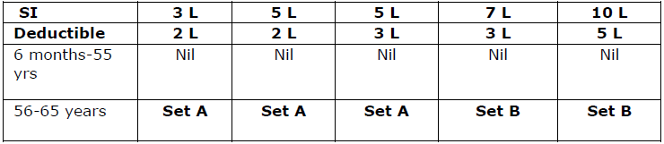
Underwriting
Guidelines
• Completely filled Proposal form is mandatory.
• No tests would be conducted in case of proposer/ insured less than 55yrs and subject to clean proposal form.
• Pre Acceptance Tests Applicable as below:
Set A- FMR, SMA- 12, ECG, Urinalysis, CBC, HbA1c, HBsAg, HIV I & I
Set B- FMR, SMA- 12, TMT, X- ray chest, Urinalysis, CBC, HbA1c, HBsAg, HIV I & II
In case of Pre-policy check it has to be done in our empanelled diagnostic center and up 50% cost of the diagnostic tests would be borne by Us for accepted cases wherein premium has been receipted.
The test reports would be valid for 1 month.

Slide 11
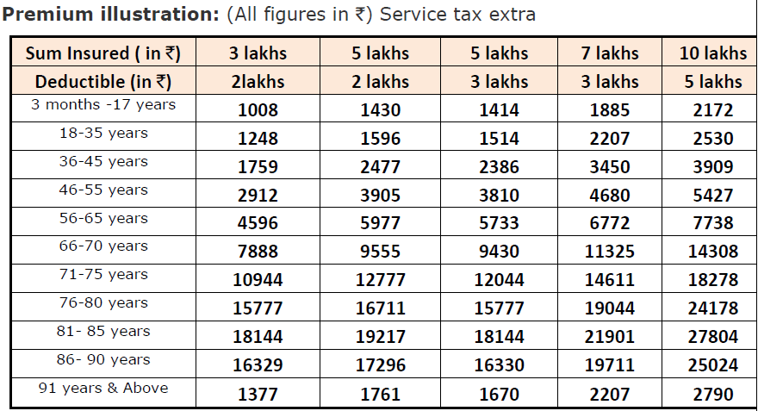

Individual Premium

Slide 12

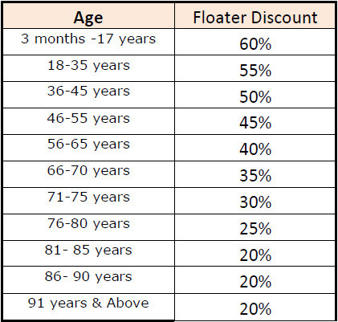
Floater Discounts
For calculation purpose the eldest member of the family will be considered as the primary insured. Age of the Premium for the primary insured remains as per table. For remaining members discounts applicable as table below.

Slide 13

Premium Calculation
Name | Age | SI Required | Ind. Premium | Applicable Floater Discount | Floater Premium
Ramesh | 38 | 1000000 / 5 lacs ded. | 3909 | 50% | 1954.5
Rama ( Wife) | 33 | 1000000 / 5 lacs ded. | 2530 | 55% | 1138.5
Son | 3 | 1000000 / 5 lacs ded. | 2172 | 60% | 868.8
Daughter | 6 | 1000000 / 5 lacs ded. | 2172 | 60% | 868.8
Total Premium | Service tax of 15% has to be added to this total premium |  |  |  | 4830.6

Slide 14

Role Plays
Mr. Ram is 35 year old CA.
His family comprises of wife and 1 child.
Earns about 65,000/- pm and is very careful when it comes to financial planning.
He feels since he already has standalone health cover, he need not go for any other health products.
Let’s sell Health Surplus to Mr. Ram.

Slide 15
Role Plays
Mrs. Rani, an IT employee, is not ready to buy a Top-Up cover since she has been provided with 5 lacs of GMC by her company.
She is 33 with 2 children of 7 and 3 yrs. Her husband also works for an IT company who is covered for 5 lacs of GMC.
Help Rani understand the importance of buying a Top-Up plan apart from having GMC cover, keeping in their scenario
See if you can pitch a 10 lac plan with 5 lacs deductible.

Slide 16
IRDA Health Regulations 2013
Free Look Period
a) The insured will be allowed a period of at least 15 days from the date of receipt of the Policy to review the terms and conditions of the Policy and to return the same if not acceptable.
b) If the insured has not made any claim during the free look period, the insured
shall be entitled to-
i. A refund of the premium paid less any expenses incurred by the Insurer on
medical examination of the insured persons and the stamp duty charges or;
ii. where the risk has already commenced and the option of return of the Policy is
exercised by the Policyholder, a deduction towards the proportionate risk premium
for period on cover or;
iii. Where only a part of the risk has commenced, such proportionate risk premium
commensurate with the risk covered during such period.

Slide 17
IRDA Health Regulations 2013
• No Adverse claim loading.
• Standard Definitions.
• Revision of contribution clause.
• List of non payable items.
• Policy wordings with IRDA approval number.

Slide 18

Exclusions
• Any condition, ailment, injury or related condition(s) for which you have been diagnosed, received medical treatment, had signs and/ or symptoms, prior to the inception of your first policy until 48 months from the date of inception
• Any disease contracted during the first 30 days from the commencement
of the policy
• Non-allopathic treatment
• Congenital diseases
• All expenses related to AIDS and related diseases
• Joint replacement surgery shall be covered after a waiting period of 3
years, unless required due to an accident
• Use of intoxicating drugs or alcohol
* Please read policy documents for complete list of exclusions.

Slide 19

Claims Assistance
• In house claims servicing is through Future Generali Health (FGH )
– Cashless facility is offered through our network of hospitals.
– Cashless facility is subject to mandatory pre-authorization by Future Generali Health
Team and is also subject to policy conditions.
– Cashless facility can be availed on producing the FGH - Health Id card along with photo
identification proof.
– In case cashless facility is not availed, the claim documents can be submitted directly to
the below mentioned address for reimbursement:

Slide 20
Claims Assistance
Claims Department
Future Generali Health (FGH)
Future Generali India Insurance Company Ltd.
Office No. 3, 3 Floor, Building A, G - O Square,
Sr. No. 249 + 250, Near Mankar Chowk,
Aundh Hinjewadi Link Road, Wakad, Pune - 411 057, Maharashtra.
Toll free number: 1800 103 8889
Fax number: 1800 103 9998
Email: fgh@futuregenerali.in

Slide 21

Thank You
Happy Selling

