Slide 1


Slide 2
Key Features
Refreshed with more features and plan options
Inpatient care (minimum 24 hours)
Day care procedures
Pre Hospitalization expenses
Post Hospitalization expenses
Ambulance charges
Cover for Organ Donor (harvesting expenses)
Recharge benefit (for Sum Insured 3 Lac and more)
Accompanying person benefit
Hospital Cash
Patient care benefit
Accidental hospitalization – 25% auto increase in sum insured
Cumulative bonus – 10% for each claim free year (max. 50%)
Free medical check up (after 4 claim free year)
Loyalty discount (2.5%)
Long term discount (2/3 year)
EMI option (2/3 year)
Family discount (Individual Sum Insured)
100% reimbursement of pre policy check up expenses
Up to 15% underwriting loading
Plan options a. Gold/ Platinum (without sub limits) b. Ruby/Topaz (with sub limits and Co pay)
Premium based on Zone (place of residence)
Tax benefit under section 80D

Slide 3
Eligibility
Minimum Policy Term | 1 Year
Long Term Policy term | 2 / 3 Years (with discount for advance premium and EMI option)
Minimum Age at Entry | 90 Days
Maximum Age at Entry | 70 Years
Renewal | Lifelong
Instalment frequency Loading on standard premiums for 2 years and 3 years policy terms.
Monthly - 5%
Quarterly - 4%
Half-yearly - 3%
Discount for advance premium for 2 years and 3 years policy terms.
2 years - 5%
3 years - 10%
In case of instalment for policy terms of 2 years and 3 years, if monthly mode is opted, minimum 2 months premium needs to be collected for policy issuance.

Slide 4
Plans and Sum Insured Options
Plan | Gold |  |  | Platinum | Topaz |  | Ruby
Sum Insured Options | 50,000; 1 Lakh; 1.5 Lakh | 2 Lakh; 2.5 Lakh | 3 Lakh; 3.5 Lakh; 4 Lakh; 4.5 Lakh; 5 Lakh | 6 Lakh; 7.5 Lakh; 8 Lakh; 9 Lakh; 10 Lakh | 1 Lakh | 2 Lakh; 3 Lakh; 4 Lakh; 5 Lakh | 6 Lakh; 7.5 Lakh; 10 Lakh
SI Basis | Individual | Both Individual and Floater |  |  | Individual | Both Individual and Floater
Family Definition:
# For Individual Plan: - Family means – Self, Spouse, Your 4 dependent Children (unmarried and up to the age of 25 years) and dependent Parents. 10% discount is applicable where two or more family members are covered.
# For Family Floater Plan: - Family means – Self, Spouse, Your 3 dependent Children (unmarried and up to the age of 25 years).
Note –
Sum insured of ₹ 50000, 100000, 150000 from Zone A / B / C will be applicable only for Children up to age of 25 years.
b) Sum insured of ₹ 100000, 150000 from Zone C will be applicable for Rural Areas only.

Slide 5
Key Features
Refreshed with more features and plan options
Ambulance charges
Medical expenses in registered hospital due to illness or injury for minimum 24 hours
Pre
Hospitalization
Post
Hospitalization
Day Care procedures (409)
Gold & Platinum Plan
Individual and Floater option
Without Sub limits
Topaz & Ruby Plan
Individual and Floater option
With Sub limits & Co payment

Slide 6
Key Features
Refreshed with more features and plan options
2000/ claim in G&P plan
750 / claim in T&R plan (max 1500)
Actuals in G&P plan
____________________
Room charges up to 1% in T&R plan
60 days
in G& P plan
90 days
in G& P plan
1 % of sum
Insured in
T& R Plan
1 % of sum
Insured in
T& R Plan
Day Care procedures (409)
G- Gold (2- 5 Lac sum insured)
P- Platinum (6- 10 Lac sum insured)
T- Topaz (2- 5 Lac sum insured)
R- Ruby (6- 10 Lac sum insured)
Note –
Sum insured of ₹ 50000, 100000, 150000 from Zone A / B / C
will be applicable only for Children up to age of 25 years.
b) Sum insured of ₹ 100000, 150000 from Zone C will be applicable
for Rural Areas only.

Slide 7
Key Features
Refreshed with more features and plan options
Room rent, Board & Nursing Expenses as provided by the Hospital/ Nursing Home
Gold (for Sums Insured ₹ 50000/-, ₹ 1 lakh and ₹ 1.5 lakhs) - up to 1% of the Sum Insured (excluding Cumulative Bonus) per day for non-ICU room. If admitted into Intensive Care Unit (ICU) up to 2% of the Sum Insured per day. All admissible hospitalization claims during the Policy year, shall be payable maximum up to 35% of the Sum Insured per claim.
Surgeon, Anaesthetist, Medical Practitioner, Consultants, Specialists Fees, shall be payable maximum up to 35% of the Sum Insured per claim.
Anaesthesia, Blood, Oxygen, Operation Theatre Charges, Surgical Appliances, etc, shall be payable maximum up to 40% of the Sum Insured per claim.
1.1. Gold (for Sums Insured ₹ 2 -5 lakhs) – As per actuals.
1.2. Platinum (for Sums Insured ₹ 6 -10 lakhs) – As per actuals.
Claims related to Surgery for cataracts (Only one condition with sub limit)
For Gold and Platinum plans, we will make payment for Surgery for cataracts (after the expiry of the 2 year waiting period, shall be restricted to 10% of the Sum Insured for each eye, subject to a minimum of Rs 15000 (or the actual incurred amount whichever is lower) and maximum of Rs 50,000/- per eye.

Slide 8
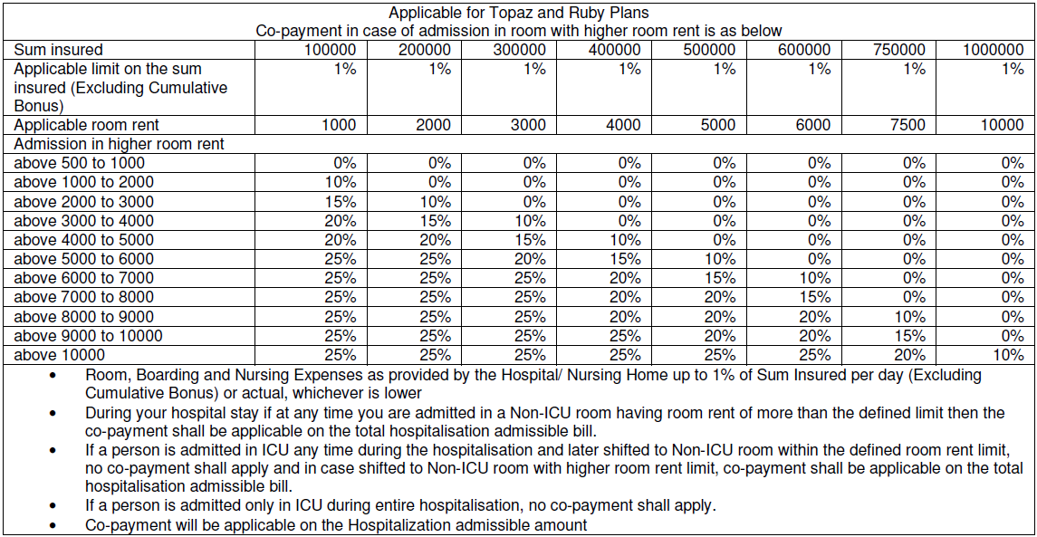
Key Features
Refreshed with more features and plan options
1.3. Room rent, Board & Nursing Expenses as provided by the Hospital/ Nursing Home
Topaz and Ruby Plans – up to 1% of the Sum Insured (excluding Cumulative Bonus) per day for non-ICU room.

Slide 9
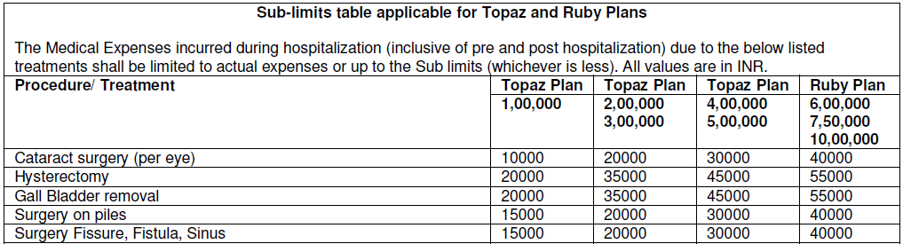
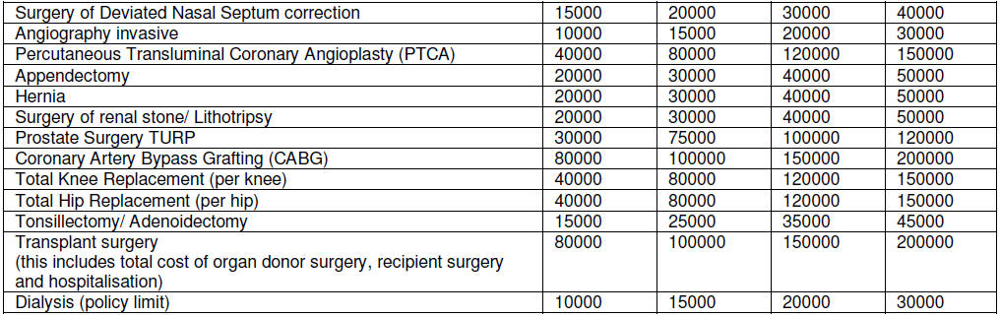
Disease wise limits in Topaz and Ruby

Slide 10
Key Features
Refreshed with more features and plan options
Patient Care – Available for persons above 60 years, We shall provide payment for the nursing charges by a qualified nurse immediately after discharge from the Hospital, up to a maximum of 10 days per Hospitalisation subject to maximum of 30 days during the Policy Year.
Up to 350 per day in Topaz and Ruby Plan
Up t0 500 per day in Gold and Platinum Plan
Accompanying Person -.We shall make payment of ₹ 500/- for each completed day of Hospitalisation for the Accompanying Person of an Insured Person provided that the Insured Person is a Dependent Child of age up to 10 years and is undergoing Medically Necessary Hospitalisation due to an Injury or Illness that occurred during the Policy Period. We will not make payment under this Benefit in respect of an Insured Person for more than 30 days in any Policy Year.
Hospital Cash– We shall make payments of ₹ 500/- for each completed day of Hospitalisation subject to maximum of 60 days during the Policy Year. This benefit is applicable for Platinum plan and Ruby plan with Sum Insured ₹ 6 lakhs and above.
These benefits are over and above the Hospitalisation sum insured.

Slide 11
Key Features
Refreshed with more features and plan options
Accidental Hospitalisation – In case of Hospitalisation following an Accident, the limits under the Policy shall increase by 25% of the balance Sum Insured available subject to maximum of ₹ 1 Lakh irrespective of number of claims in a Policy Year.
Free medical check-up - At the end of every continuous period of 4 years during which You have held Our Future Health Suraksha Policy without making a claim, You may apply to Us for a free medical check-up (Physician’s Consultation, ECG, Complete Blood Count, Urine Routine, Fasting blood Sugar, Post Prandial Blood Sugar, Lipid Profile, Sr. Creatinine, SGOT, SGPT, GGTP) at Our Diagnostic Center, the location of which We will specify at the time of Your application. For the avoidance of doubt, We shall not be liable for any other ancillary or peripheral costs or expenses (including but not limited to those for transportation, accommodation or sustenance).
i. In case of Individual policy, the benefit will be available for all insured persons who were already covered under the Policy.
ii. In case of family floater policy, the benefit will be available for two of the insured persons covered under the Policy.
e.g. Basic sum insured is 3 Lac
Claim 1 is paid for Disease – 1 Lakh
Claim 2 for Accident can be paid up to 2.5 Lakh
(i.e. Available basic SI is 2 Lakh + 25% (50000))

Slide 12
Key Features
Refreshed with more features and plan options
Organ Donor Expenses – We will pay the Reasonable and Customary Charges incurred for an organ donor’s treatment for the harvesting of the organ donated provided that:
a. The organ donor is any person whose organ has been made available in accordance and in compliance with THE TRANSPLANTATION OF HUMAN ORGANS (AMENDMENT) BILL, 2011 and the organ donated is for the use of the Insured Person, and
b. We will not pay the donor’s screening expenses or pre and post hospitalisation expenses or for any other medical treatment for the donor consequent on the harvesting
c. We have accepted claim under hospitalisation for the Insured Person and the Insured Person has been Medically Advised to undergo an organ transplant;
d. Costs directly or indirectly associated with the acquisition of the donor’s organ will not be covered.
e. These expenses shall be covered under the recipient’s policy.

Slide 13
Key Features
Refreshed with more features and plan options
Recharge of Sum Insured
Recharge benefit is applicable for all plans, where the basic Sum Insured opted is 3 Lakhs and above. If the Basic Sum Insured and Cumulative Bonus (if any) is exhausted due to claims made and paid during the Policy Year, then We will automatically re-instate the Sum Insured up to 100%, once in a policy, subject to conditions specified below:
a. A claim will be admissible under this Benefit only if the claim is admissible under In-patient Hospitalization or Day Care Treatment.
b. The recharge shall be utilised only after the Sum Insured, Cumulative Bonus has been completely exhausted in that Policy Year.
c. The recharge shall be available only for all future claims for that Insured Person during that Policy Year. (Irrespective of whether the claim is for the same ailment for which he/she has claimed).
e.g. Basic Sum Insured- 3 Lac sum insured
Sum of Claim 1 and 2 is 3.25 Lakh (SI exhausted) with 25000 out of pocket expense
Recharge sum insured made available/ is used for Claim 3 and Claim 4

Slide 14
Key Features
Refreshed with more features and plan options
Cumulative Bonus
a) We will provide cumulative bonus for every claim free year. We shall increase in the Sum Insured by 10% towards Cumulative Bonus for every claim free year on the basic Sum Insured up to the maximum of 50% of the sum insured.
b) In case of a claim in the Policy, the Cumulative Bonus will get reduced by 10% for each claim year. Increase/ Reduction in cumulative bonus will depend on the claims in the previous year, but the base Sum Insured (excluding cumulative bonus amount if any) of the Policy issued by Us shall be preserved.

Slide 15
Discounts
Family discount – 10% Family discount in case of more than one insured covered under the same policy on individual sum insured basis.
b) Long-term discount – Applicable in case of single premium payment for policy term of more than one year
2 years - 5%
3 years - 10%
c) Loyalty Discount –
• 2.5% loyalty discount in case the client already have a separate health insurance policy (other than Future Health Suraksha/ Personal Accident/Travel) from Future Generali India Insurance Co. Ltd.
• The loyalty discount shall continue only if the insured maintains the separate health insurance policy with Us.
• Policy copy will be required to avail the loyalty discount. In case the policy copy is not submitted, the discount shall not be allowed.
d) Direct Sales Discount – A discount of 15% in lieu of intermediary commissions if policy is taken directly from the insurer and /or Online

Slide 16
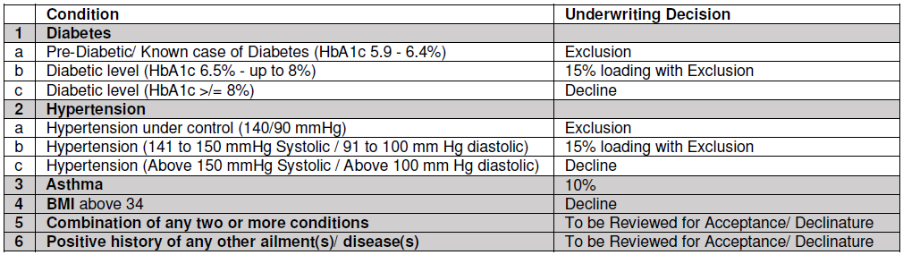
Medical underwriting
Pre-insurance medical examination is not required for any proposer, up to the age of 50 years, irrespective of the sums insured subject to the proposal form is clean (without health declaration).
If any of the member is of the age up to 55 years with sum insured up to ₹ 3 lakhs then no pre-acceptance medical test is required.
In case the policy is issued for that particular client, the client is eligible for 100% of reimbursement of pre-insurance medical tests charges.

Slide 17
Waiting periods
Refreshed with more features and plan options
Waiting Periods
a) 48 months for Pre existing conditions declared and/or accepted at the time of proposing the Policy for the first time.
b) 36 months for Organ transplant, Joint replacement Surgery due to Degenerative condition, Age related Osteoarthritis and Osteoporosis unless such joint replacement
Surgery is necessitated by accidental Bodily Injury.
c) 24 months for Cataracts, Benign Prostatic Hypertrophy, Hernia of all types, Hydrocele, Para nasal sinuses, Deviated Nasal Septum, Fistulae, Hemorrhoids, Fissure in ano, Dysfunctional Uterine Bleeding, Fibromyoma, Endometriosis, Hysterectomy, all internal or external tumors/ cysts/ nodules/ polyps of any kind including breast lumps with exception of malignant tumor or growth, Surgery for prolapsed inter vertebral disc unless arising from Accident, Surgery of Varicose Veins, Varicose Ulcers and Congenital Internal Illness/ disease/ defect anomaly.
d) 12 months for any types of gastric or duodenal Ulcers, stones in the Urinary and Biliary systems, Surgery on ears/ tonsils/ adenoids.
e) 48 months for any mental Illness or psychiatric Illness
f) 48 months for treatment for AIDS (Acquired Immune Deficiency Syndrome) and/ or infection with HIV (Human Immunodeficiency Virus)
g) 30 days from policy inception of Your first Policy with Us, except claims arising due to an accident.

Slide 18
Exclusions
Refreshed with more features and plan options
Medical Exclusions
(i) Vaccination/ inoculation (except as post bite treatment), cosmetic treatments, plastic Surgery other than as may be necessitated due to an Accident or as a part of any Illness, refractive error corrective procedures, Unproven/Experimental treatment, investigational or unproven procedures or treatments, devices and pharmacological regimens of any description.
(ii) Charges incurred in connection with cost of spectacles and contact lenses, hearing aids, durable medical equipment
(iii) Dental treatment or Surgery of any kind unless requiring Hospitalisation as a result of accidental Bodily Injury.
(iv) The treatment of obesity (including morbid obesity)
(v) Expenses incurred towards treatment of Illness/ disease/ condition arising out of alcohol use/ misuse or abuse of alcohol, substance or drugs (whether prescribed or not).
(vi) Convalescence, general debility or rest cure, venereal /Sexually Transmitted disease other than HIV/AIDS, intentional self-Injury.
(vii) Maternity expenses however, this exclusion will not apply to Ectopic Pregnancy
(viii) Congenital External Illness/ disease/ defect anomaly.
(ix) Costs incurred on all methods of treatment including AYUSH treatments except Allopathic.
(x) Charges incurred at Hospital or Nursing Home primarily for diagnostic, X-ray or laboratory examinations not consistent with or incidental to the diagnosis and treatment of the positive existence or presence of any ailment, sickness or Injury.
(xi) Outpatient Diagnostic, Domiciliary hospitalization, Treatment outside India.

Slide 19
Multiple Policies
a) If two or more policies are taken by an insured during a period from one or more insurers to indemnify treatment costs, the policyholder shall have the right to require a settlement of his/her claim in terms of any of his/her policies.
b) In all such cases the insurer who has issued the chosen policy shall be obliged to settle the claim as long as the claim is within the limits of and according to the terms of the chosen policy.
c) The policyholder having multiple policies shall also have the right to prefer claims from other policy/ policies for the amounts disallowed under the earlier chosen policy/ policies, even if the sum insured is not exhausted. Then the Insurer(s) shall settle the claim subject to the terms and conditions of the other policy / policies so chosen.
d) If the amount to be claimed exceeds the sum insured under a single policy after considering the deductibles or co-pay, the policyholder shall have the right to choose insurers from whom he/she wants to claim the balance amount.
e) Where an insured has policies from more than one insurer to cover the same risk on indemnity basis, the insured shall only be indemnified the hospitalization costs in accordance with the terms and conditions of the chosen policy.
f) This section is not applicable to the Hospital Cash benefit payable in case of Platinum Plan and Ruby Plan.

Slide 20
Claims Service
For availing cashless at a Network Provider,
We must be called at Our call centre and a request for pre-authorisation must be made by way of the written form prescribed by Us.
(Cashless TAT currently is 90 minutes)
If treatment is taken in a Hospital which is Non-Network or
If You do not wish to avail cashless facility or
If pre-authorisation (for cashless)is denied by Us, then:
Claim Intimation – within 48 hours
Document Submission – within 15 days of Discharge
Settlement – within 30 days of the receipt of the last necessary documents. (30 days is as per PPI regulation however settlement is done within 8 days)

Slide 21
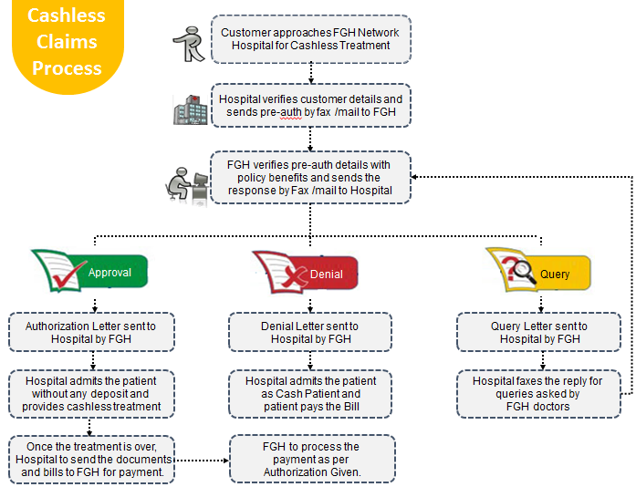
Time to ‘Deliver on the Promise
Health Claims at Future Generali India

Slide 22
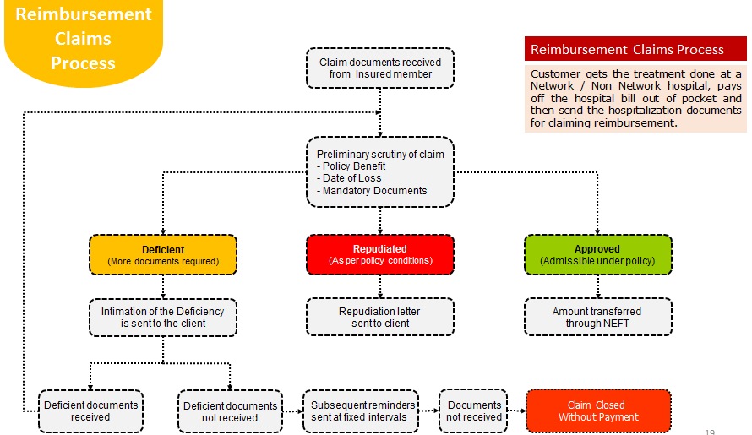
Health Claims at Future Generali India
Time to ‘Deliver on the Promise

Slide 23
Future Generali Health
Claims Service
Communication Matrix
Exclusive Communication
Escalation Matrix
Primary contact details
1800-103-8889
1800-209-1017
fgh@futuregenerali.in
WhatsApp for Deficient Claim Documents
7755996994
IMD exclusive communication
E-mail
fgh.express@futuregenerali.in
Phone
020-67904509
First Level
vinayak.pankhade@futuregenerali.in
Second Level
ashish.saxena@futuregenerali.in
Third Level
bishwajit.nayak@futuregenerali.in
Final Level
shreeraj.deshpande@futuregenerali.in

Slide 24
Premium factors
1. Zone as per pin code of residence
Zone Classification | Areas covered
Zone A | Mumbai ,Navi Mumbai ,Thane ,Panvel, Delhi & NCR, Gujarat, Bangalore, Kolkata, Chennai, Hyderabad, Pune
Zone B | Nagpur, Chandigarh, Lucknow, Ludhiana , Jalandhar, Jaipur, Bhopal, Indore, Comibatore, Mangalore, Mysore
Zone C | Rest of Location
Family Definition
3. Individual / Floater
4. Plan opted (Gold/ Platinum/ Topaz/ Ruby)
5. Sum Insured (2- 10 Lakhs)
6. Medical /UW loading
7. Long term discount/ Loading for EMI
8. GST @ 18%

Slide 25
Premium
PREMIUM CALCULATOR
Future Health Suraksha Please note instalment facility is currently available for policy terms of 2 years and 3 years only
Plan Option | Floater Sum Insured basis
Please enter data in blue cells only
Zone | Zone A - Mumbai ,Navi Mumbai ,Thane ,Panvel, Delhi & NCR, Gujarat, Bangalore, Kolkata, Chennai, Hyderabad, Pune
Family Definition | Two Adults + Two Children
Plan Option | Gold Plan
Sum Insured | 500000
Member | Age Band (years) | Medical Loading | Premium
Primary Member | 41-45 | 0% | 16772
Spouse | 41-45 | 0%
Dependant Child | 0-17 | 0%
Dependant Child | 0-17 | 0%
Dependant Child
Total Base Premium (in ₹) |  |  | 16772
Loyalty Discount applicable (in ₹) NOTE: A loyalty discount will be applicable if the insured already has a separate Retail health insurance policy (other than Future Health Suraksha/ PA/ Travel) from Future Generali India Insurance Co. Ltd., the loyalty discount shall continue only if the insured maintains the separate health insurance policy with us. Please provide the policy copy to avail the discount. |  | No | 0.00
Premium after Loyalty discount (in ₹) |  |  | 16772.00
Direct Sales Discount or Employee Discount (in ₹) |  | No | 0.00
Premium after Direct Sales Discount or Employee Discount, Family discount (in ₹) |  |  | 16772.00
Policy Term |  | Three | 50316.00
Discount for policy term 2 and 3 years (in ₹) |  |  | 0.00
Premium after long term discount (in ₹) |  |  | 50316.00
Premium payment option |  | Monthly | 52831.80
Number of Instalments |  |  | 36.00
Instalment amount (in ₹) |  |  | 1467.55
GST applicable (in ₹) |  |  | 264.16
Final Premium with GST (in ₹) |  |  | 1,732

Slide 26
Premium
PREMIUM CALCULATOR
Future Health Suraksha Please note instalment facility is currently available for policy terms of 2 years and 3 years only
Plan Option | Floater Sum Insured basis
Please enter data in blue cells only
Zone | Zone A - Mumbai ,Navi Mumbai ,Thane ,Panvel, Delhi & NCR, Gujarat, Bangalore, Kolkata, Chennai, Hyderabad, Pune
Family Definition | Two Adults + Two Children
Plan Option | Topaz Plan
Sum Insured | 500000
Member | Age Band (years) | Medical Loading | Premium
Primary Member | 41-45 | 0% | 14759
Spouse | 41-45 | 0%
Dependant Child | 0-17 | 0%
Dependant Child | 0-17 | 0%
Dependant Child
Total Base Premium (in ₹) |  |  | 14759
Loyalty Discount applicable (in ₹) NOTE: A loyalty discount will be applicable if the insured already has a separate Retail health insurance policy (other than Future Health Suraksha/ PA/ Travel) from Future Generali India Insurance Co. Ltd., the loyalty discount shall continue only if the insured maintains the separate health insurance policy with us. Please provide the policy copy to avail the discount. |  | No | 0.00
Premium after Loyalty discount (in ₹) |  |  | 14759.00
Direct Sales Discount or Employee Discount (in ₹) |  | No | 0.00
Premium after Direct Sales Discount or Employee Discount, Family discount (in ₹) |  |  | 14759.00
Policy Term |  | Three | 44277.00
Discount for policy term 2 and 3 years (in ₹) |  |  | 0.00
Premium after long term discount (in ₹) |  |  | 44277.00
Premium payment option |  | Monthly | 46490.85
Number of Instalments |  |  | 36.00
Instalment amount (in ₹) |  |  | 1291.41
GST applicable (in ₹) |  |  | 232.45
Final Premium with GST (in ₹) |  |  | 1,524

Slide 27
Key Features- Revision
Refreshed with more features and plan options
Inpatient care (minimum 24 hours)
Day care procedures
Pre Hospitalization expenses
Post Hospitalization expenses
Ambulance charges
Cover for Organ Donor (harvesting expenses)
Recharge benefit (for Sum Insured 3 Lac and more)
Accompanying person benefit
Hospital Cash
Patient care benefit
Accidental hospitalization – 25% auto increase in sum insured
Cumulative bonus – 10% for each claim free year (max. 50%)
Free medical check up (4 claim free year)
Loyalty discount (2.5%)
Long term discount (2/3 year)
EMI option (2/3 year)
Family discount (Individual Sum Insured)
100% reimbursement of pre policy check up expenses
Up to 15% underwriting loading
Plan options a. Gold/ Platinum (without sub limits) b. Ruby/Topaz (with sub limits and Co pay)
Premium based on Zone (place of residence)
Tax benefit under section 80D
Note: Only new product will be available in system for new sourcing from 1st march 2019 onwards.
Renewal customers will have option to continue with old product/ premium for 90 days as per regulations.
Teams must educate renewal customers to opt for new product/premium by highlighting new features and benefits.

Slide 28
Comparison with earlier product
Sr. | Earlier | Now
1 | Basic/Silver/Gold plan premiums with co pay for opting treatment in higher zone. | Basic/Silver/Gold is now Gold plan and there is no co pay in Gold plan. Ruby and Topaz plans are available with sub limits and co pay.
2 | Recharge benefit- Not available | Recharge benefit- Available
3 | Organ Donor expenses- Not covered | Organ Donor expenses- Covered
4 | Long term policy- Not available | Long term policy- Available with EMI option/ Discount for advance premium
5 | Group plan available | Group Plan – Not available
6 | Ambulance charges- 1500/ claim | Ambulance charges- 2000/ claim in Gold and Platinum; 750/ claim in Ruby and Topaz plan
7 | Patient care – 350/ day | Patient care – 500/ day in Gold and Platinum; 350/day in Ruby and Topaz plan
8 | Day care procedures- 130 listed | Day care procedures - 409 listed
9 | Loyalty discount – Not applicable | Loyalty discount – 2.5 % discount Applicable
10 | Reimbursement of pre policy check up cost- 50% | Reimbursement of pre policy check up cost- 100%

Slide 29
Future Generali India Insurance Company Limited
IRDAI Registration No.: 132
CIN: U66030MH2006PLC165287
Registered and Corporate Office:
Indiabulls Finance Centre, Tower 3, 6th Floor,
Senapati Bapat Marg, Elphinstone (W),
Mumbai – 400013
Contact No: 022 – 4097 6666
Fax: 022 – 4097 6900
Email: fgcare@futuregenerali.in.
Insurance is the subject matter of solicitation

