Slide 1


Slide 2

Key Features
Inpatient care (minimum 24 hours)
Day care procedures
Pre Hospitalization expenses
Post Hospitalization expenses
3 Plan options
Long term discount (2/3 year)
EMI option (2/3 year)
Family discount (Individual Sum Insured)
50% reimbursement of pre policy check up expenses
Up to 25% underwriting loading
Tax benefit under section 80D

Slide 3
Key Features
Combined limit of pre & post hospitalization / claim is 2% of Sum Insured
60 days
Room charges up to 1% of Sum Insured / Day
90 days
Day Care procedures (409)

Slide 4
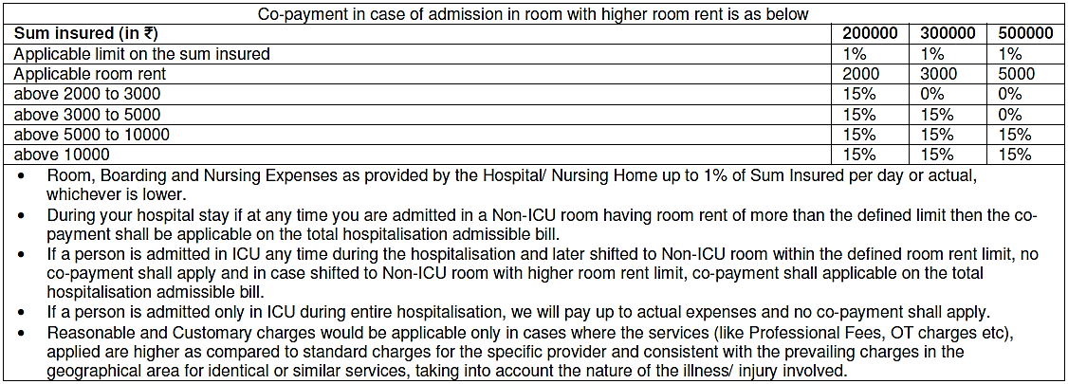
Key Features
Room rent, Board & Nursing Expenses as provided by the Hospital/ Nursing Home
Up to 1% of the Sum Insured per day for non-ICU room In case You or insured person opts for a room with rent higher than the entitled room limit, the following co-payment will be applicable on the admissible hospitalisation claim amount

Slide 5
Discounts
Family discount – 5% Family discount in case of more than one insured covered under the same policy on individual sum insured basis.
b) Long-term discount – Applicable in case of single premium payment for policy term of more than one year
2 years - 5%
3 years - 10%
c) Direct Sales Discount – A discount of 15% in lieu of intermediary commissions if policy is taken directly from the insurer and /or Online

Slide 6
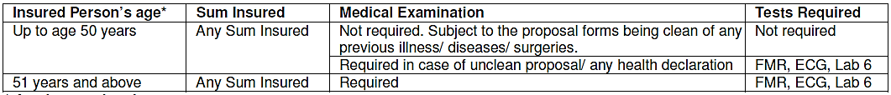
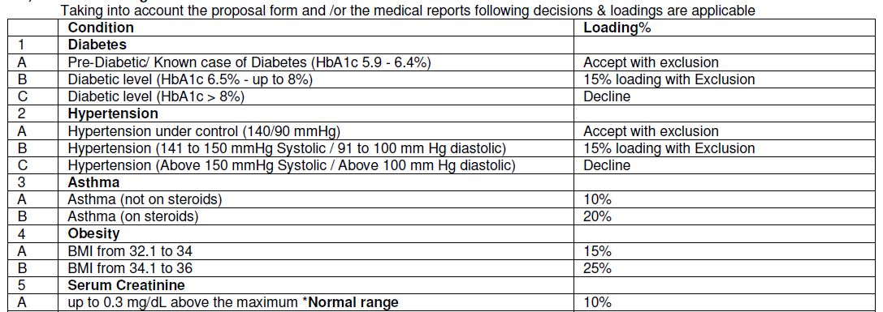
Medical underwriting

Slide 7
Eligibility
Minimum Policy Term | 1 Year
Long Term Policy term | 2 / 3 Years (with discount for advance premium and EMI option)
Minimum Age at Entry | 1 Days
Maximum Age at Entry | 70 Years
Renewal | Lifelong
Instalment frequency Loading on standard premiums for 2 years and 3 years policy terms.
Monthly - 5%
Quarterly - 4%
Half-yearly - 3%
Discount for advance premium for 2 years and 3 years policy terms.
2 years - 5%
3 years - 10%
Notes:
In case of instalment for policy terms of 2 years and 3 years, if monthly mode is opted, minimum 2 months premium needs to be collected for policy issuance.

Slide 8
Plans and Sum Insured Options
Plan | A | B | C
Sum Insured Options | 2/ 3/ 5 Lac | 2/ 3/ 5 Lac | 2 /3 /5 Lac
Co-payment | 10% | 10% + 20% | 10% + 30%
SI Basis | Individual or Floater
Family Definition:
# For Individual Plan: - Family means – Self, Spouse, Your 4 dependent Children (unmarried and up to the age of 25 years) and dependent Parents. 5% discount is applicable where two or more family members are covered.
# For Family Floater Plan: - Family means – Self, Spouse, Your 3 dependent Children (unmarried and up to the age of 25 years).

Slide 9
Waiting periods
After 30 days
Cover available for Illness
After 24 months
Cover available for Cataract, Piles, etc
RID
Cover available for Accident

Slide 10
Waiting periods
After 48 months
Cover available for Pre existing conditions
RID
Cover available for Accident
After 48 months
Cover available for Mental Illness, HIV

Slide 11
Exclusions
Maternity and related expenses
Vaccination
Dental t/t
Cosmetic t/t
Rest Cure
Diagnostic and
Evaluation only
Consumables
Ext. Congenital
Alcohol/ Drugs
Use/ Abuse
Self Injury
OPD Expenses

Slide 12
Multiple Policies
a) If two or more policies are taken by an insured during a period from one or more insurers to indemnify treatment costs, the policyholder shall have the right to require a settlement of his/her claim in terms of any of his/her policies.
b) In all such cases the insurer who has issued the chosen policy shall be obliged to settle the claim as long as the claim is within the limits of and according to the terms of the chosen policy.
c) The policyholder having multiple policies shall also have the right to prefer claims from other policy/ policies for the amounts disallowed under the earlier chosen policy/ policies, even if the sum insured is not exhausted. Then the Insurer(s) shall settle the claim subject to the terms and conditions of the other policy / policies so chosen.
d) If the amount to be claimed exceeds the sum insured under a single policy after considering the deductibles or co-pay, the policyholder shall have the right to choose insurers from whom he/she wants to claim the balance amount.

Slide 13
Claims Service
For availing cashless at a Network Provider,
We must be called at Our call centre and a request for pre-authorisation must be made by way of the written form prescribed by Us.
(Cashless TAT currently is 120 minutes)
If treatment is taken in a Hospital which is Non-Network or
If You do not wish to avail cashless facility or
If pre-authorisation (for cashless)is denied by Us, then:
Claim Intimation – within 48 hours
Document Submission – within 15 days of Discharge
Settlement – within 30 days of the receipt of the last necessary documents. (30 days is as per PPI regulation however settlement is done within 10 days)

Slide 14
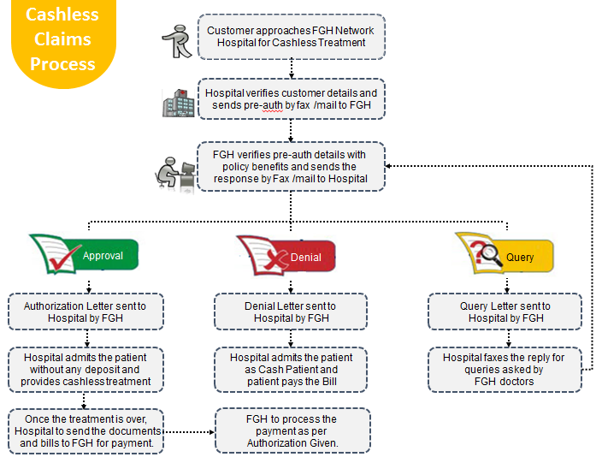
Time to ‘Deliver on the Promise
Health Claims at Future Generali India

Slide 15
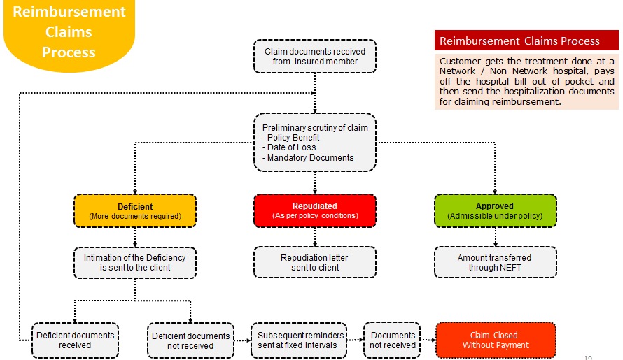
Health Claims at Future Generali India
Time to ‘Deliver on the Promise

Slide 16
Future Generali Health
Primary contact details
Exclusive Communication Avenues
24/7 Phone lines
1800-103-8889
1800-209-1017
Email
fgh@futuregenerali.in
WhatsApp for Deficient Claim Documents
7755996994
For Underwriting related queries
E-mail Queryhealthunderwriting@futuregenerali.in
Phone
8451962421
For Claims related queries
E-mail
fgh.express@futuregenerali.in
Phone
020-67904509

Slide 17
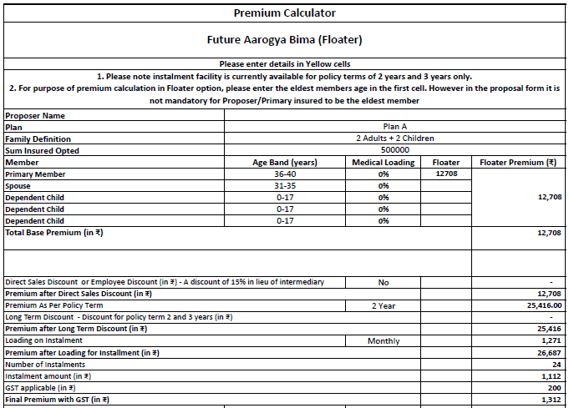
Premium

Slide 18
Future Generali India Insurance Company Limited
IRDAI Registration No.: 132
CIN: U66030MH2006PLC165287
Registered and Corporate Office:
Indiabulls Finance Centre, Tower 3, 6th Floor,
Senapati Bapat Marg, Elphinstone (W),
Mumbai – 400013
Contact No: 022 – 4097 6666
Fax: 022 – 4097 6900
Email: fgcare@futuregenerali.in.
Insurance is the subject matter of solicitation

