Slide 1
New Launch - Advantage Top Up
Aggregate Deductible Health Plan

Slide 2
Advantage Top Up
New Launch
Plan Features
1. In-patient treatment – No Sub-limits
a) Room rent, Board & Nursing Expenses as provided by the Hospital/ Nursing Home.
b) Surgeon, Anaesthetist, Medical Practitioner, Consultants, Specialists Fees.
c) Anaesthesia, Blood, Oxygen, Operation Theatre Charges, Surgical Appliances
d) Medicines & Drugs
e) Diagnostic Materials and X-ray
f) Cost of Pacemaker, prosthesis/internal implants and any Medical expenses incurred which is integral part of the operation.
2. Day Care expenses – 409 Procedures listed
3. Pre-Hospitalisation Medical expenses – 60 days
4. Post-Hospitalisation Medical expenses – 90 days
5. Alternative treatment – after 2 years waiting period
6. Organ Donor Expenses – after 2 years waiting period
7. Emergency Ambulance – up to 2000 per hospitalization claim
8. Cumulative Bonus – 10% for each claim free year (max 50%)

Slide 3
Advantage Top Up
New Launch
Aggregate Deductible
Our liability to make payment for claims shall be in excess of the Deductible as stated in the Schedule (50,000- 40 Lac) which shall apply in aggregate to all admissible claims arising under the Policy in respect to Hospitalisation(s) of Insured Person (on Individual basis in case of Individual Policy and on Family Floater basis in case of Family Floater Policy) in a Policy Year.
Our maximum, total and cumulative liability for any and all claims in respect of all Insured Persons shall not exceed the Sum Insured (50,000- 1 Cr.)
It is clarified that for the purpose of calculation of the Deductible, the Medical Expenses incurred on Room Rent, nursing expenses, ICU Charges, surgeon’s, anaesthetist’s, Medical Practitioner’s, consultant’s and specialist’s fees, anaesthesia, blood, oxygen, operation theatre
charges, surgical appliances, medicines and drugs, diagnostic materials and X-ray, cost of pacemaker and similar expenses, Pre-hospitalisation Medical Expenses, Post-hospitalisation Medical Expenses and Ambulance charges will be taken into account.
Further, the non-payable items are not considered for the calculation of the Deductible.
For the purpose of calculation of claim amount we will consider eligible Medical Expenses incurred less the Deductible amount.

Slide 4
Advantage Top Up
New Launch
Aggregate Deductible
Answer the following;
Year 1- Admissible Claim of 2 Lac we pay ________ ?
Year 1- Non Admissible Claim of 2 Lac, we pay ______ ?
Year 2- Admissible Claim of 6 Lac, we pay ________ ?
Year 3- Admissible Claim of 1 Lac, we pay _______ ?
Year 3- Admissible Claim of 1 Lac, we pay _______ ?
Year 4- Admissible Claim of 2.5 Lac, we pay ______ ?
Sum
Insured
e.g. 5 Lac
Deductible
e.g. 1 Lac

Slide 5
Advantage Top Up
New Launch
Plan options
a) Supreme Plan (Just like Mediclaim)
The Supreme Plan includes cover for all ailments including Heart related conditions and Cancer.
The deductible under this plan shall include the claims related to all ailments including Heart related conditions and Cancer.
b) Elite Plan (30% discount on premium) (Just like Critical Illness)
The Elite Plan includes cover for Cancer and ailments related to Heart, as defined below. A discount of 30% shall be available on the premium payable for the Insured Person.
The deductible under this plan shall include the claims related to Cancer and ailments related to Heart only.
Heart related ailments include following diseases/ conditions:
i. Acute rheumatic heart diseases ii. Chronic rheumatic heart diseases iii. Hypertensive diseases iv. Ischaemic Heart Diseases
v. Pulmonary heart disease and diseases of pulmonary circulation vi. Diseases of arteries, arterioles and capillaries
Cancer means a malignant tumor characterized by the uncontrolled growth and spread of malignant cells with invasion and destruction of
normal tissues. This diagnosis must be supported by histological evidence of malignancy. The term cancer includes leukemia, lymphoma and sarcoma.
The following are also included:
i. All tumours which are histologically described as carcinoma in situ, benign, pre-malignant, borderline malignant, low malignant
potential, neoplasm of unknown behavior, or non-invasive, including but not limited to: Carcinoma in situ of breasts, Cervical
dysplasia CIN-1, CIN - 2 and CIN-3.
ii. Any non-melanoma skin carcinoma. iii. Malignant melanoma. iv. All tumours of the prostate. v. All Thyroid cancers.
vi. Chronic lymphocytic leukaemia. vii. Non-invasive papillary cancer of the bladder. viii. All Gastro-Intestinal Stromal Tumours.

Slide 6
Advantage Top Up
New Launch
Waiting Periods
All Illnesses and treatments shall be covered subject to the waiting periods specified below:
1. Pre-Existing Disease
A waiting period of 24 months from inception of Your first Policy with Us, shall apply to any medical expenses in connection with all Preexisting conditions declared and/or accepted at the time of proposing the Policy for the first time.
2. Waiting Period for specified diseases/ ailments/ conditions
A waiting period of 24 months from inception of Your first Policy with Us, shall apply to any medical expenses in connection with Internal Congenital Anomalies, Benign Prostatic Hypertrophy, Dysfunctional Uterine Bleeding, Fibromyoma, Endometriosis, Hysterectomy, all internal or external tumors/ cysts/ nodules/ polyps of any kind including breast lumps with exception of malignant tumor or growth, Surgery for Prolapsed Inter Vertebral Disc unless arising from Accident, any types of gastric or duodenal ulcers, stones in the Urinary and Biliary systems, Surgery on ears, Organ transplant, Rheumatoid Arthritis, Gout, Joint replacement Surgery due to Degenerative condition, Age related Osteoarthritis and Osteoporosis unless such joint replacement Surgery is necessitated by accidental Bodily Injury.

Slide 7
Advantage Top Up
New Launch
Waiting Periods
3. Alternative Treatment
a) The waiting period of 24 months from inception of Your first Health Policy with Us, shall apply to any medical expenses in connection with Alternative treatments.
b) Any Alternative Treatment other than Ayurveda, Unani, Siddha or Homeopathy are excluded.
4. 30 days waiting period
We are not liable for any claim arising for any illness diagnosed or diagnosable within 30 days from inception of Your first Policy with Us, except claims arising due to an accident.
5. Mental Illness or Psychiatric Illness waiting period
A waiting period of 48 months from inception of Your first Policy with Us, shall apply to any medical expenses in connection with treatment for any mental Illness or psychiatric Illness
6. HIV/AIDS waiting period
A waiting period of 48 months from inception of Your first Policy with Us, shall apply to any hospitalisation expenses in connection with treatment for AIDS (Acquired Immune Deficiency Syndrome) and/ or infection with HIV (Human Immunodeficiency Virus)

Slide 8
Advantage Top Up
New Launch
Exclusions
Outpatient Diagnostic, Medical and Surgical Procedures or OPD treatments, non-prescribed drugs and medical supplies
Dental treatment or Surgery of any kind unless requiring Hospitalisation as a result of accidental Bodily Injury.
Charges incurred at Hospital or Nursing Home primarily for diagnostic, X-ray or laboratory examinations not consistent with or incidental to the diagnosis and treatment
Medical Practitioner’s home visit charges during pre and post Hospitalisation period, Attendant Nursing charges.
Charges incurred in connection with cost of spectacles and contact lenses, hearing aids, durable medical equipment The treatment of obesity (including morbid obesity) and other weight control programs, services and supplies.
Expenses incurred towards treatment of Illness/ disease/ condition arising out of alcohol use/ misuse or abuse of alcohol, substance or drugs (whether prescribed or not).
Convalescence, general debility, or rest cure, intentional self-Injury, venereal/ Sexually Transmitted disease other than HIV/ AIDS.
Maternity expenses for treatment
Congenital External Illness/ disease/ defect/ anomaly.
Domiciliary hospitalisation or treatment.,Treatment abroad.

Slide 9
Advantage Top Up
New Launch
Eligibility and Family Definition
Minimum Age at entry – 1 day
Maximum Age at Entry - Any age
Maximum Age at Renewal – Lifelong
Individual Plan – Self; Spouse; 2 dependent parents and Up to 5 Children
Floater Plan where Self and Spouse are Insured – Self+ Spouse+ 1/2/3/5 Children
Floater Plan where only Self is Insured – Self (Proposer) + 1/2/3 Children (Child Age - Min 6 years)
It is not compulsory (however strongly advised) to Insure all family members

Slide 10
Advantage Top Up
New Launch
Discounts and Income Tax benefits
Discounts
Family Discount – 10% for 2 or more family members covered under same policy on Individual sum insured basis
Long-term Discount – 5% for 2 years and 10% for 3 years premium paid in advance
Loyalty Discount – 2.5% discount to existing retail health policy holders of Future Generali India
Direct Sales Discount – 15% discount when taken directly from Insurer
Plan Discount – 30% discount if insured opts for Elite Pan (Heart and Cancer)
Tax Benefits
Insured can claim benefit under section 80 D of Income tax Act

Slide 11
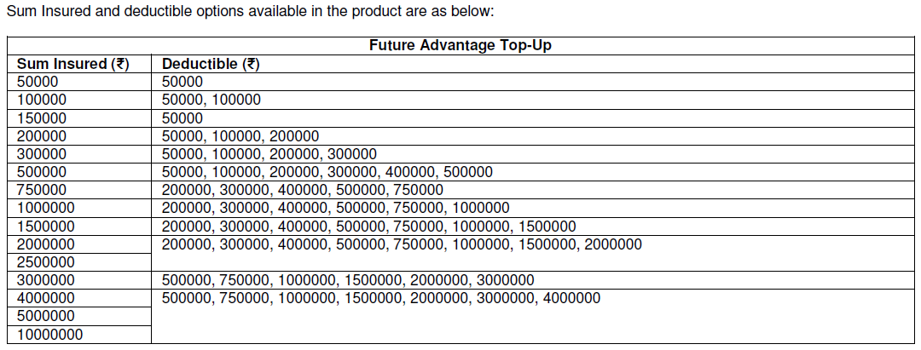
Advantage Top Up
New Launch
Sum Insured and Policy Term
Policy can be issued for tenure of 1 year, 2 years and 3 years.
Premium may be paid in advance (discount of 5% for 2 year and 10% for 3 year term) or
Installment basis (loading of 3% for half yearly, 4% for quarterly and 5% for monthly ECS option)

Slide 12
Advantage Top Up
New Launch
Pre Policy Check up
ADVANTAGE | Sum Insured | Deductible | Test
18-50 | 30 L, 40 L, 50 L, 100 L | 5L, 7.5L, 10L | Series 9
51-55 | 15 L, 20 L, 25 L | 2 L, 3 L | Series 10
 | 30 L, 40 L, 50 L, 100 L | 5 L, 7.5 L, 10 L | Series 9
56-60 | 50000, 1 L, 1.5 L, 2 L, 3 L, 5 L, 7.5 L, 10 L, 15 L | 50000, 1 L, 2 L, 3 L | Series 9
 | 15 L, 20 L, 25 L | 2 L, 3 L | Series 10
 | 30 L, 40 L, 50 L, 100 L | 5 L, 7.5 L, 10 L | Series 9
61 and above | 50000, 1 L, 1.5 L, 2 L, 3 L, 5 L, 7.5 L, 10 L | 50000, 1L, 2L, 3L | Series 9
 | 5 L, 7.5 L, 10 L, 15 L, 20 L, 25 L | 4 L, 5 L, 7.5 L, 10 L | Series 11
 | 15 L, 20 L, 25 L | 2 L, 3 L | Series 10
 | 15 L, 20 L, 25 L, 30 L, 40 L, 50 L, 100 L | 15 L, 20 L, 30 L, 40 L | Series 9
 | 30 L, 40 L, 50 L, 100 L | 5 L, 7.5 L, 10 L | Series 12
For Age 1 day to 17 completed years - No medical tests irrespective of any sum insured , any deductible. Subject to clean proposals.
Cost of pre-insurance medical examination
We will reimburse 100% of the cost of any pre-insurance medical examination conducted at our empanelled diagnostic center, once the Proposal is accepted and the Policy is issued for that Insured Person.

Slide 13
Advantage Top Up
New Launch
Underwriting loading
Condition Loading%
1. Diabetes
A. Pre-Diabetic/ Known case of Diabetes (HbA1c 5.9 - 6.4%) Issue with Exclusion
B. Diabetic level (HbA1c 6.5% - up to 8%) Issue with 10% loading with Exclusion
C. Diabetic level (HbA1c >/= 8%) Decline
2. Hypertension
A . Hypertension under control (140/90mmHg) Issue with Exclusion
B. Hypertension (141 to 150 mmHg Systolic / 91 to 100 mm Hg diastolic ) Issue with 10% loading with Exclusion
C. Hypertension (Above 150 mmHg Systolic / Above 100 mm Hg diastolic) Decline
3. Combination of any two or more conditions To be Reviewed for Acceptance/ Declinature
4. Positive history of any other ailment(s)/ disease(s) To be Reviewed for Acceptance/ Declinature

Slide 14
Advantage Top Up
New Launch
Multiple Policies
a) If two or more policies are taken by an insured during a period from one or more insurers to indemnify treatment costs, the policyholder shall have the right to require a settlement of his/her claim in terms of any of his/her policies.
b) In all such cases the insurer who has issued the chosen policy shall be obliged to settle the claim as long as the claim is within the limits of and according to the terms of the chosen policy.
c) The policyholder having multiple policies shall also have the right to prefer claims from other policy/ policies for the amounts disallowed under the earlier chosen policy/ policies, even if the sum insured is not exhausted. Then the Insurer(s) shall settle the claim subject to the terms and conditions of the other policy / policies so chosen.
d) If the amount to be claimed exceeds the sum insured under a single policy after considering the deductibles or co-pay, the policyholder shall have the right to choose insurers from whom he/she wants to claim the balance amount.
e) Where an insured has policies from more than one insurer to cover the same risk on indemnity basis, the insured shall only be indemnified the hospitalization costs in accordance with the terms and conditions of the chosen policy.

Slide 15
Advantage Top Up
New Launch
Alignment of Policy periods
a) Ii is strongly advised to align the policy period of Top up policy with that of base policy in the interest of Insured.
If policy period is aligned i.e. both policies start on say 1st April then there will be no issues for admissible claims.
i.e. Aggregate Claim exceeding 1 Lac will be paid from Top up SI
If policy period is not aligned i.e. Base policy starts on say 1st Jan & Top up policy starts on 1st Apr then there may be issues even for admissible claims.
i.e. If claim 1 for 1 Lac is in Feb and Claim 2 for say 1 Lac is in May because Deductible will be calculated considering the policy period of Top up.
SI 5 Lac
Deductible
1 Lac

Slide 16
Advantage Top Up
New Launch
Waiver/ Reduction in Deductible
Waiver of Deductible
We will offer the Insured Person an option to waive the Deductible and to opt for any indemnity health insurance Policy (without any Deductible) offered by Us for same Sum Insured without re-evaluation of health status or any pre policy check, at the time of renewal, provided that
the Insured Person has been insured with Us for first time under this Policy before the age of 50 years and the completed age is within the age group of 54-60 years.
Condition for All Insured
Reduction in deductible amount is allowed at the time of renewal only, provided that the policy has completed a continuous period of 3 years with same deductible amount, however, the decrease in the Deductible amount shall be allowed maximum up to 3 steps below.
Increase or Decrease in Sum Insured/ Deductible has to be proportionate for all members covered under
the same policy

Slide 17
Advantage Top Up
New Launch
PREMIUM CALCULATOR
FUTURE ADVANTAGE TOP UP (Floater) Please note instalment facility is currently available for policy terms of 2 years and 3 years only.
Please enter details in blue cells
Family Definition | Two Adults + Two Children
Plan Option | Supreme Plan
Sum Insured (₹) | SI_1500000
Deductible (₹) | 500000
Member |  |  | Age Band (years) |  |  | Medical Loading | Premium (₹)
Primary Member |  |  | 36-40 |  |  | 0% | 4,671
Spouse |  |  | 26-30 |  |  | 0%
Dependent Child 1 |  |  | 0 - 17 |  |  | 0%
Dependent Child 2 |  |  | 0 - 17 |  |  | 0%
Dependent Child 3 |  |  | 0 - 17 |  |  | 0%
Dependent Child 4 |  |  | 0 - 17 |  |  | 0%
Dependent Child 5 |  |  | 0 - 17 |  |  | 0%
Total Base Premium (in ₹) |  |  |  |  |  |  | 4,671
Loyalty Discount applicable (in ₹) NOTE: A loyalty discount will be applicable if the insured already has a separate Retail health insurance policy (other than Future Advantage Top-Up/ PA/ Travel) from Future Generali India Insurance Co. Ltd., the loyalty discount shall continue only if the insured maintains the separate health insurance policy with us. Please provide the policy copy to avail the discount. |  |  |  |  | No |  | -
Premium after Loyalty discount (in ₹) |  |  |  |  |  |  | 4,671
Direct Sales Discount or Employee Discount (in ₹) |  |  |  |  | No |  | -
Premium after Direct Sales Discount or Employee Discount, Family discount (in ₹) |  |  |  |  |  |  | 4,671
Policy Term |  |  |  |  | 1 |  | 4,671
Discount for policy term 2 and 3 years (in ₹) |  |  |  |  |  |  | -
Premium after long term discount (in ₹) |  |  |  |  |  |  | 4,671
Premium payment option |  |  |  |  | Single (no instalment) |  | 4,671
Number of Instalments |  |  |  |  |  |  | 1
Instalment amount (in ₹) |  |  |  |  |  |  | 4,671
GST applicable (in ₹) |  |  |  |  |  |  | 841
Final Premium with GST (in ₹) |  |  |  |  |  |  | 5,512

Slide 18
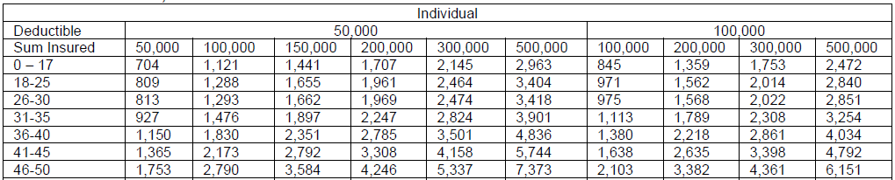
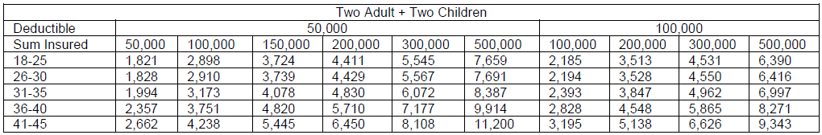
Advantage Top Up
New Launch
Premium (GST @18% extra)

Slide 19
Future Generali India Insurance Company Limited
IRDAI Registration No.: 132
CIN: U66030MH2006PLC165287
Registered and Corporate Office:
Indiabulls Finance Centre, Tower 3, 6th Floor,
Senapati Bapat Marg, Elphinstone (W),
Mumbai – 400013
Contact No: 022 – 4097 6666
Fax: 022 – 4097 6900
Email: fgcare@futuregenerali.in.
Insurance is the subject matter of solicitation

