Slide 1

Engineering Line of Business
Product Presentation
Date

Slide 2

Engineering LOB Premium over the years
Section 00
Premium in Cr. | 2013-14 | 2014-15 | 2015-16 | 2016-17 (till Aug)
Industry Total | 2476 | 2336 | 2372 | 974.72
Future Generali India | 38.06 | 37.93 | 37.21
Industry premium is flat over past couple of years due to intense competition.
As Indian economy recovers engineering insurance premium may grow substantially in near future.
Date
Engineering LOB

Slide 3

Section 01
Project Insurance
Contractors All Risk
Date
Engineering LOB

Slide 4

Basic Understanding : Contractors All Risk Insurance Policy
Section 01
Standard Policy Form
General Exclusions
Period of Cover
General Conditions
Section 1 –Material Damage
Exclusions to Section 1
Provisions applying to Section -1
Memo 1- Sum Insured
Memo 2- Premium Adjustment
Memo 3- Reinstatement of Sum Insured
Memo 4- Basis of Loss Settlement
Memo 5- Extension of Cover
Memo 6- Construction Plant & Machinery
Memo 7- Surrounding Property
Memo 8- Major Perils/ AOG Perils
Memo 9- Reinstatement of Indemnity Limit
Memo 10- Third Party Liability
Section 2- Third Party Liability
Exclusions to Section -2
Conditions applying to Section -2
CAR Tariff
  General Rules and Regulations
  Standard Policy Form
  Proposal
  Rating Schedule (Group 1-4)
  Declined Risk
  Excess
  Escalation Provision
  Option to Insure under MB/ EEI
  Additional Rates
  Endorsements
Date
Engineering LOB

Slide 5

Basic Understanding Contractors All Risk Insurance Policy
Section 01
  General Exclusions
  War perils
  Nuclear perils
  Willful act or Willful negligence of the Insured or his responsible representatives
  Cessation of work whether total or partial
  Burden of proof is on the Insured if the company disclaims liability
Standard Policy Form
Date
Engineering LOB

Slide 6
Basic Understanding Contractors All Risk Insurance Policy
Section 01
  Period of Cover Construction period
Standard Policy Form
Start
Policy Start Date or
Unloading of Material
Put to Use
Liability ceases for parts of insured property put to use
End
Policy expiry or
Extended date
Date
Engineering LOB

Slide 7
Basic Understanding Contractors All Risk Insurance Policy
Section 01
  General Conditions
  Due observance and fulfillment of terms of this policy
  Insured to take all reasonable precautions and comply with reasonable recommendations to prevent loss/ damage
  A. Right of Entry
  B. Immediate notice of Material Change in Risk
  A. Immediately notify any occurrence which may lead to claim under this policy
  B. Take all steps to minimize the extent of loss/ damage
  4. C. Preserve affected parts and make them available for inspection
  D. Furnish all such information and documentary evidence as the company may require
  4. E. Inform police in case of loss due to theft or burglary
  Company shall not be liable for any loss/ damage, in case no notice has been received by the company within 14 days of its occurrence.
Standard Policy Form
Date
Engineering LOB

Slide 8

Basic Understanding Contractors All Risk Insurance Policy
Section 01
  General Conditions
  5. Subrogation
  6. Arbitration
  7. Claim considered abandoned after 3 months of rejection, in case no suit is filed
  8. Condition of Contribution (Multiple Insurance)
  9. Appropriate refund on termination at request of Insured (LR of less than 60% and Minimum 3 months unexpired period)
  10. Rate able refund if cancelled by the underwriters by giving 15 days notice
Standard Policy Form
Date
Engineering LOB

Slide 9

Basic Understanding Contractors All Risk Insurance Policy
Section 01
  Section-1 Material Damage
  Company will indemnify the insured subject to exclusions and conditions that if, Insured property of any part thereof is LOST, DAMAGED or DESTROYED by ANY CAUSE, other than those specifically excluded.
  In a manner necessitating replacement or repair ,
  The company will pay or make good all such loss or damage up to an amount not exceeding in respect of each of the items specified in the schedule the sum set opposite thereto and not exceeding in whole the total sum insured
  The company will also reimburse the insured for the cost of clearance and removal of debris following an event giving rise to an admissible claim under the policy , but not exceeding the sum (if any) mentioned in the schedule.
Standard Policy Form
Date
Engineering LOB

Slide 10

Basic Understanding Contractors All Risk Insurance Policy
Section 01
  Section-1: Exclusions
  Policy excess
  Loss discovered only at the time of taking inventory
  Normal wear and tear , gradual deterioration
  Loss or damage due to faulty design
  Cost of repair, rectification, or replacement of defective material and workmanship , but this exclusion shall be limited to items immediately affected
  Cost necessary for rectification or correction of any error
  Loss or damage to files, folders, currency, notes, securities, packing material
  Damage or penalty du to insured’s non fulfillment of terms of delivery or completion of contract
  Loss or damage to vehicle licensed for general road use or water borne machinery / equipment
Standard Policy Form
Date
Engineering LOB

Slide 11
Basic Understanding Contractors All Risk Insurance Policy
Section 01
Standard Policy Form
Section 1- Provisions
Memo 1- Underinsurance
Memo 2- Adjustment of premium on completion of project (increase or decrease in prime cost of material is not to be considered)
Memo 3- Reinstatement of sum insured after loss (by paying pro rata extra for balance period)
Memo 4- Basis of loss settlement (in case of repairable loss- cost of repair less salvage; in case of total loss – actual cost of the property less salvage)
Memo 5- Extra charges like overtime, holiday wages, express freight are not covered by this policy, unless agreed
Memo 6- Construction Plant and Machinery (Loss or damage due to Its own explosion or breakdown is excluded)
Mem0 7- Surrounding property (In care custody control of Principal or Contractor )
Memo 8- Major Perils/ AOG Perils (EQ, Landslide, Rockslide, Subsidence, Flood, Inundation, Storm , Tempest, Hurricane, Cyclone, Lightning, other Atmospheric disturbances and Collapse); Water damage for wet risks
Memo 9- Reinstatement of limit of indemnity for extensions is allowed however TPL can be reinstated only up to 1 crore during entire policy period.
Memo 10- Third party liability cover cannot be granted during extended maintenance
Date
Engineering LOB

Slide 12

Basic Understanding Contractors All Risk Insurance Policy
Section 01
Standard Policy Form
Section 2- Third Party Liability
Legal liability for accidental loss or damage caused to property of other persons including property held in trust by or under custody of the insured for which he is responsible excluding property used in connection with construction.
Legal liability (liability under contract excepted) for fatal or non fatal injury to any person other than insured’s employees, workmen, or employees of owner of the works or premises or any firm connected with project, or members of insured family
In respect of claim for compensation to which indemnity applies, company will in addition indemnify the insured against-
All cost and expenses of litigation recovered by any claimant from the insured
All cost and expenses incurred with written consent of the company
Date
Engineering LOB

Slide 13

Basic Understanding Contractors All Risk Insurance Policy
Section 01
Standard Policy Form
Exclusions- Third Party Liability
Excess for TPPD claims
Expenditure for doing, redoing, making good, repairing or replacing anything covered or coverable under section 1
Liability consequent upon bodily injury to or illness of any employees of contractor, principal or any other firm connected with the project or members of their families
Loss of or damage to property belonging to or held in care, custody, control of contractor, principal, or any firm connected with the project, or an employee or workmen of the aforementioned
Liability consequent upon any accident caused by vehicle licensed for general road use or waterborne vessels or aircraft
Any contractual agreement to pay any sum by way of indemnity unless such liability would have attached even in absence of such agreement
Date
Engineering LOB

Slide 14

Basic Understanding Contractors All Risk Insurance Policy
Section 01
Standard Policy Form
Conditions- Third Party Liability
1. No admission, offer, promise, payment or indemnity shall be made or given by or on behalf of the Insured without the written consent of the Company who shall be entitled if they so desire, to take over and conduct in the name of the Insured the defence or settlement of any claim or to prosecute for their own benefit in the name of the Insured any claim for indemnity or damage or otherwise and shall have full discretion in the conduct of any proceedings or in the settlement of any claim and the Insured shall give all such information and assistance as the Company may require.
2. The Company may, so far as any accident is concerned, pay to the Insured the limit of indemnity for any one accident, any one period, but deducting therefrom in such case any sum/s already paid as compensation in respect thereof or any lesser sum for which the claim or claims arising from such accident can be settled and the company shall thereafter be under no further liability in respect of such accident under this section.
Date
Engineering LOB

Slide 15
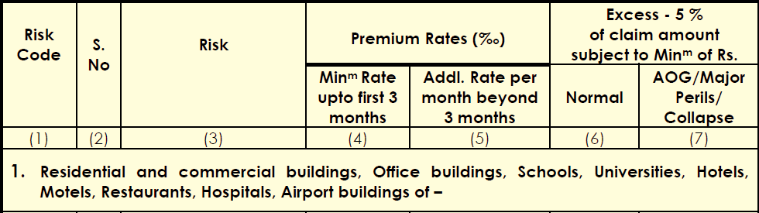

Project Insurance Contractors All Risk Insurance
Section 01
Rate Schedule e.g.
Date
Engineering LOB

Slide 16

Project Insurance Contractors All Risk Insurance
Section 01
Rating method for projects above 100 Cr. Under CAR/ EAR
Compute basic rate as per EAR/SCE/CAR tariffs without application of discounts.
2. Apply Volume discount on the basic rate as per prescribed Scale
3. Apply Voluntary Excess Discount on the net rate arrived as in (2) above, as per the prescribed scale
4. Adjust the net rate as arrived in (3) above, by addition/subtraction of the following additional extras/reductions corresponding to various additional covers listed in the Annexure - 2 to arrive at the overall net rate.
Date
Engineering LOB

Slide 17
Basic Understanding : Contractors All Risk Insurance Policy
Section 01
General Regulations
Jurisdiction
Scope
Sum Insured
Marine/ Transit Risks
Sub contracts forming part of a Project
Computation of Premium
Storage rate at fabricators premises/ workshop
Additional rates for Earthquake
Mid term increase in sum insured
Excess for claims ‘AOG perils’
Discount for Higher Excess & Volume Discount
Clearance and removal of debris
Third party liability cover
Surrounding property of the insured
Escalation provision
Additional rate for express freight (excl. Air), holiday, overtime rates
Additional rate for Airfreight only
Additional customs duty
Construction machinery plant and equipment
Extension rates
Claims discount/ loading on Extension rates
Maintenance visit and extended maintenance cover
Refund on early completion of project
CAR Tariff
  General Rules and Regulations
  Standard Policy Form
  Proposal
  Rating Schedule (Group 1-4)
  Declined Risk
  Excess
  Escalation Provision
  Option to Insure under MB/ EEI
  Additional Rates
  Endorsements
Date
Engineering LOB

Slide 18

Basic Understanding : Contractors All Risk Insurance Policy
Section 01
General Regulations Jurisdiction
  Tariff applies to all risks located in India with sum insured up to 1500 Cr
  CAR tariff applies to all risks for which the value of civil works involved is more than 50% of the total contract value
Date
Engineering LOB

Slide 19

Basic Understanding : Contractors All Risk Insurance Policy
Section 01
General Regulations Sum Insured
  Sums Insured on the following items are to be taken into account for arriving at total sum insured for CAR Insurance
  Marine (Imports) landed cost at site
  Marine (Indigenous) landed cost at site
  Cost of construction
  Permanent civil engineering works
  Half the escalated amount, if escalation is opted for
  Preoperative expenses
Date
Engineering LOB

Slide 20

Basic Understanding : Contractors All Risk Insurance Policy
Section 01
General Regulations Marine/ Transit Risks
  Marine transit connected to CAR insurance of any project in India may be placed simultaneously or later on in one combined policy or separate policies.
  The loss due to breakage of glass can however be covered by payments of additional premium
  CAR rates to be loaded by 25%
  Excess on glass items shall be 10% of aggregate sum insured on all glass items
Date
Engineering LOB

Slide 21

Basic Understanding : Contractors All Risk Insurance Policy
Section 01
General Regulations Subcontracts forming part of project
  Irrespective of whether the project value has been broken into sections and orders/ contracts are placed with different suppliers, contractors or sub contractors or insured carry out work themselves departmentally , the insurances for all such sub contracts are subject to these regulations
Date
Engineering LOB

Slide 22

Basic Understanding : Contractors All Risk Insurance Policy
Section 01
General Regulations Computation of premium
  Premium shall be computed for the total period commencing from
  Commencement of work or
  Date of arrival of first consignment at the project site
  Whichever is earlier
Date
Engineering LOB

Slide 23

Basic Understanding : Contractors All Risk Insurance Policy
Section 01
General Regulations Storage rate at fabricators premises/ workshop
  Can be covered as an extension to CAR policy
  Rate charged – 0.30 per mille per annum
  Excess – INR 1500 per claim
Date
Engineering LOB

Slide 24
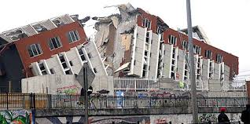
Basic Understanding : Contractors All Risk Insurance Policy
Section 01
General Regulations Additional rates for Earthquake
  Irrespective of sum insured for CAR, additional rates for Earthquake are to be charged according to the earthquake zone as per Fire tariff
Date
Engineering LOB

Slide 25

Basic Understanding : Contractors All Risk Insurance Policy
Section 01
General Regulations Mid term increase in sum insured
  Where sum insured under CAR policy is increased midterm , premium on additional sum insured at applicable CAR rate is charged
  It is not permissible to charge pro rated premium on additional sum insured
  Mid term increase in sum insured shall be affected only after the same has been recorded in the policy by the company before occurrence of any claim.
Date
Engineering LOB

Slide 26

Basic Understanding : Contractors All Risk Insurance Policy
Section 01
General Regulations Excess for claims ‘AOG perils’
  Rate schedule prescribes minimum excess for collapse claims and claims arising out of act of god perils
  Minimum rate for AOG in project insurance is 0.15 per mille
  Minimum excess will be 5X minimum excess as per tariff
Date
Engineering LOB

Slide 27
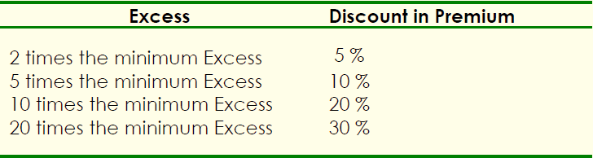
Basic Understanding : Contractors All Risk Insurance Policy
Section 01
General Regulations Discount for Higher Excess
  All rates are subject to minimum excess per claim and excess is prescribed separately for Normal and AOG/ collapse claims.
  Discount for opting higher excess (Normal& AOG) can be allowed in CAR rate as under
Date
Engineering LOB

Slide 28
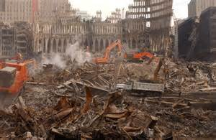
Basic Understanding : Contractors All Risk Insurance Policy
Section 01
General Regulations Clearance and removal of debris
  Rate applicable to CAR policy will be charged on the limit of sum insured fixed for Clearance and removal of debris
  The policy excesses should apply to Clearance and removal of debris claims
Date
Engineering LOB

Slide 29

Basic Understanding : Contractors All Risk Insurance Policy
Section 01
General Regulations Third party liability cover
  Rate applicable to CAR policy will be charged on the limit of sum insured fixed for Third party liability cover up to the following limits
  For policies with SI up to 10 Cr : TPL SI up to 1 Cr
  For policies with SI above 10 Cr : TPL SI up to 10 Cr or 10% of total erected value of project , whichever is less
Date
Engineering LOB

Slide 30
Basic Understanding : Contractors All Risk Insurance Policy
Section 01
General Regulations Surrounding property cover
  50% of rate applicable to CAR policy will be charged on the limit of sum insured fixed for Surrounding property
  The policy excesses should apply to Surrounding property claims
Date
Engineering LOB

Slide 31

Basic Understanding : Contractors All Risk Insurance Policy
Section 01
General Regulations Escalation provision
  Escalation benefit shall be limited to 50% of Sum insured for CAR (the limit may be expressed in either percentage or in amount) and will be permitted only once at the time of inception of policy.
  Rate charged for escalation will be CAR policy rate but applied on 50% of escalation limit selected
Date
Engineering LOB

Slide 32

Basic Understanding : Contractors All Risk Insurance Policy
Section 01
General Regulations Additional rate for express freight (excl. Air), holiday, overtime rates
  Rate charged for additional rate for express freight will be Basic CAR policy rate (excluding extras for earthquake, etc.) and applied on limit selected
Date
Engineering LOB

Slide 33
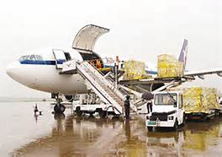
Basic Understanding : Contractors All Risk Insurance Policy
Section 01
General Regulations Additional rate for Air freight only
  Rate charged for additional rate for Air freight will be as under
Date
Engineering LOB

Slide 34
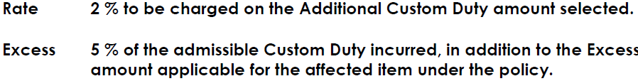

Basic Understanding : Contractors All Risk Insurance Policy
Section 01
General Regulations Additional customs duty
  Rate charged for additional rate for Air freight will be as under
  Cover will be on first loss basis and can be expressed as either percentage or amount
  The amount can be reinstated in the event of loss
Date
Engineering LOB

Slide 35
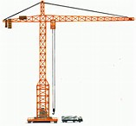
Basic Understanding : Contractors All Risk Insurance Policy
Section 01
General Regulations Construction machinery plant and equipment
  Separate sum insured is fixed for CPM equipment used for CAR projects
  Where such Sum Insured does not exceed 5% of CAR sum insured or 25 Lac (whichever is lower), the same can be covered under CAR policy at CAR policy rates and excesses
  Where such sum insured exceeds 5% of CAR sum insured or 25 Lac , the same should be insured seperately under CPM policy.
Date
Engineering LOB

Slide 36
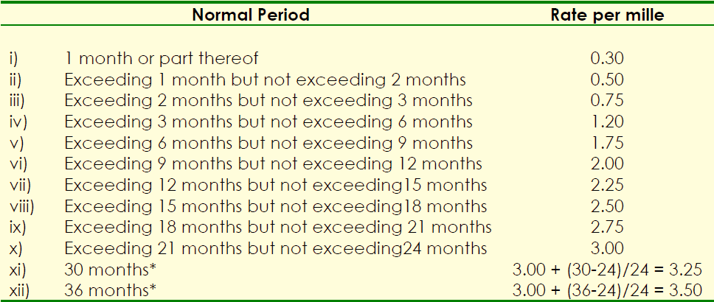
Basic Understanding : Contractors All Risk Insurance Policy
Section 01
General Regulations Extension rates (for extension of insurance beyond policy period)
Date
Engineering LOB

Slide 37
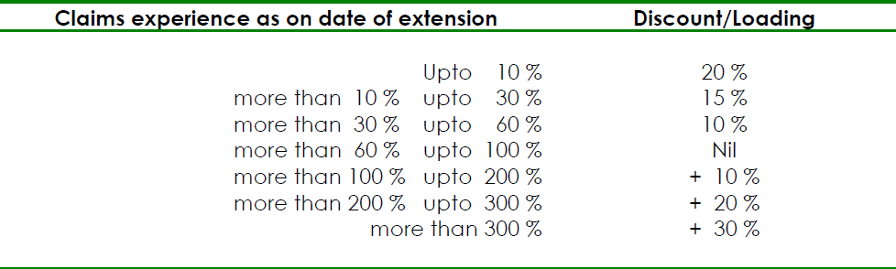
Basic Understanding : Contractors All Risk Insurance Policy
Section 01
General Regulations Claims discount/ loading on Extension rates
  Discounts/ loading is applicable to proposals above 100 Cr, and shall apply on extension rates as under
  Maximum discount applicable is 60% and final rate after applying all discounts should not be less than 40% of basic CAR rate
Date
Engineering LOB

Slide 38
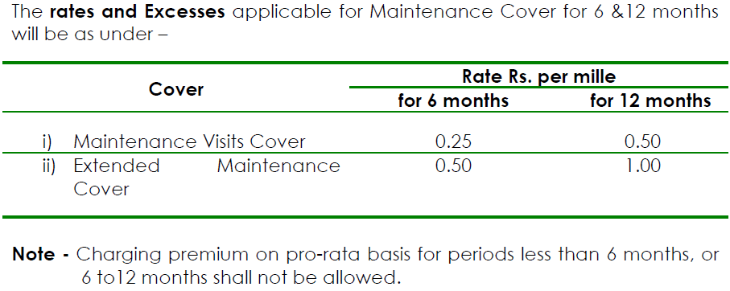
Basic Understanding : Contractors All Risk Insurance Policy
Section 01
General Regulations Maintenance visit and extended maintenance cover
  Extended maintenance can be given for any period exceeding 12 months as required under the contract
  In case of deletion of Maintenance visit and extended maintenance cover availed at inception of policy before attachment of risk , refund may be given by retaining 25% of premium under this extension.
  No refund if risk is attached
Date
Engineering LOB

Slide 39

Basic Understanding : Contractors All Risk Insurance Policy
Section 01
General Regulations Refund on early completion of project
  Refund of premium, arising out of cancellation of policy due to abandonment, double insurance or early completion of project can be allowed subject to following conditions
  Period of insurance is 18 months or higher
  Notice of early completion is given in advance to the insurer before completion
  Claims experience is less than 60%
  The original policy period is not exceeding the contract period as per contractual clause
  The minimum period for which refund can be claimed is 3 months
Date
Engineering LOB

Slide 40
Basic Understanding : Contractors All Risk Insurance Policy
Section 01
CAR Tariff
  General Rules and Regulations
  Standard Policy Form
  Proposal
  Rating Schedule (Group 1-4)
  Declined Risk
  Excess
  Escalation Provision
  Option to Insure under MB/ EEI
  Additional Rates
  Endorsements
Endorsements
Pipeline construction
Exclusion of loss of stabilizing fluid
Road construction
Piling construction
Abandonment of shafts
Crops, forests, cultivated areas
Existing underground cables
Contract works time schedule
Temporary access roads
Special conditions concerning construction of dam and water reservoir
Special conditions concerning safety measures with respect to precipitation, flood and inundation
Special conditions concerning removal of debris from landslide
Endorsement for escalation provision
Date
Engineering LOB

Slide 41

Section 02
Project Insurance
Erection All Risk
Date
Engineering LOB

Slide 42
Basic Understanding : Erection All Risk Insurance Policy
Section 02
EAR Tariff
  General Rules and Regulations
  Schedule
  Standard Policy Form
  Proposal
  Rating Schedule
  Endorsements
Standard Policy Form
General Exclusions
Period of Cover
General Conditions
Section 1 –Material Damage
Exclusions to Section 1
Provisions applying to Section -1
Memo 1- Sum Insured
Memo 2- Premium Adjustment
Memo 3- Reinstatement of Sum Insured
Memo 4- Basis of Loss Settlement
Memo 5- Extension of Cover
Memo 6- Construction Plant & Machinery
Memo 7- Surrounding Property
Memo 8- Major Perils/ AOG Perils
Section 2- Third Party Liability
Exclusions to Section -2
Conditions applying to Section -2
Date
Engineering LOB

Slide 43
Basic Understanding Erection All Risk Insurance Policy
Section 02
  General Exclusions
  War perils
  Nuclear perils
  Willful act or Willful negligence of the Insured or his responsible representatives
  Cessation of work whether total or partial
  Burden of proof is on the Insured if the company disclaims liability
Standard Policy Form
Date
Engineering LOB

Slide 44
Basic Understanding Erection All Risk Insurance Policy
Section 02
  Period of Cover Erection period
Standard Policy Form
Start
Policy Start Date or
Unloading of Material
Put to Use
Liability ceases for parts of plant or machinery which are put to use
End
1st test operation or test loading is concluded
Extended date
In case after the expiry of four weeks of trial running, approval of the plant is not given by the concerned Authorities the cover for the extended period of further trial running can be covered at extra premium to be arranged before hand.
In the case of second-hand/used property, the insurance hereunder shall however, cease immediately on the commencement of the testing.
Date
Engineering LOB

Slide 45
Basic Understanding Erection All Risk Insurance Policy
Section 02
  General Conditions
  Due observance and fulfillment of terms of this policy
  Insured to take all reasonable precautions and comply with reasonable recommendations to prevent loss/ damage
  A. Right of Entry
  B. Immediate notice of Material Change in Risk
  A. Immediately notify any occurrence which may lead to claim under this policy
  B. Take all steps to minimize the extent of loss/ damage
  4. C. Preserve affected parts and make them available for inspection
  D. Furnish all such information and documentary evidence as the company may require
  4. E. Inform police in case of loss due to theft or burglary
  Company shall not be liable for any loss/ damage, in case no notice has been received by the company within 14 days of its occurrence.
Standard Policy Form
Date
Engineering LOB

Slide 46
Basic Understanding Erection All Risk Insurance Policy
Section 02
  General Conditions
  5. Subrogation
  6. Arbitration
  7. Claim considered abandoned after 3 months of rejection, in case no suit is filed
  8. Condition of Contribution (Multiple Insurance)
  9. Appropriate refund on termination at request of Insured (LR of less than 60% and Minimum 3 months unexpired period)
  10. Rate able refund if cancelled by the underwriters by giving 15 days notice
Standard Policy Form
Date
Engineering LOB

Slide 47
Basic Understanding Erection All Risk Insurance Policy
Section 02
  Section-1 Material Damage
  Company will indemnify the insured subject to exclusions and conditions that if, Insured property of any part thereof is LOST, DAMAGED or DESTROYED by ANY CAUSE, other than those specifically excluded.
  In a manner necessitating replacement or repair ,
  The company will pay or make good all such loss or damage up to an amount not exceeding in respect of each of the items specified in the schedule the sum set opposite thereto and not exceeding in whole the total sum insured
  The company will also reimburse the insured for the cost of clearance and removal of debris following an event giving rise to an admissible claim under the policy , but not exceeding the sum (if any) mentioned in the schedule.
Standard Policy Form
Date
Engineering LOB

Slide 48
Basic Understanding Erection All Risk Insurance Policy
Section 02
  Section-1: Exclusions
  Policy excess
  Loss discovered only at the time of taking inventory
  Normal wear and tear , gradual deterioration
  Loss or damage due to faulty design, defective material or casting, bad workmanship other than faults in erection
  This exclusion shall be limited to the items immediately affected and shall not be deemed to exclude loss or damage to other insured items resulting from such excluded perils
  5. Cost necessary for rectification or correction of any error
  6. Loss or damage to files, folders, currency, notes, securities, packing material
  7. Damage or penalty du to insured’s non fulfillment of terms of delivery or completion of contract
Standard Policy Form
Date
Engineering LOB

Slide 49

Basic Understanding Erection All Risk Insurance Policy
Section 02
Standard Policy Form
Section 1- Provisions
Memo 1- Underinsurance
Memo 2- Adjustment of premium on completion of project (increase or decrease in prime cost of material is not to be considered)
Memo 3- Basis of loss settlement (in case of repairable loss- cost of repair less salvage; in case of total loss – actual cost of the property less salvage)
Memo 4- Construction Plant and Machinery (Loss or damage due to Its own explosion or breakdown is excluded)
Memo 5- Surrounding property (In care custody control of Principal or Contractor )
6. Memo 6- Major Perils/ AOG Perils (EQ, Landslide, Rockslide, Subsidence, Flood, Inundation, Storm , tempest, Hurricane, Cyclone, Lightning, other Atmospheric disturbances)
Date
Engineering LOB

Slide 50
Basic Understanding Erection All Risk Insurance Policy
Section 02
Standard Policy Form
Section 2- Third Party Liability
Legal liability for accidental loss or damage caused to property of other persons including property held in trust by or under custody of the insured for which he is responsible excluding property used in connection with construction.
Legal liability (liability under contract excepted) for fatal or non fatal injury to any person other than insured’s employees, workmen, or employees of owner of the works or premises or any firm connected with project, or members of insured family
In respect of claim for compensation to which indemnity applies, company will in addition indemnify the insured against-
All cost and expenses of litigation recovered by any claimant from the insured
All cost and expenses incurred with written consent of the company
Date
Engineering LOB

Slide 51
Basic Understanding Erection All Risk Insurance Policy
Section 02
Standard Policy Form
Exclusions- Third Party Liability
Excess for TPPD claims
Expenditure for doing, redoing, making good, repairing or replacing anything covered or coverable under section 1
Liability consequent upon bodily injury to or illness of any employees of contractor, principal or any other firm connected with the project or members of their families
Loss of or damage to property belonging to or held in care, custody, control of contractor, principal, or any firm connected with the project, or an employee or workmen of the aforementioned
Liability consequent upon any accident caused by vehicle licensed for general road use or waterborne vessels or aircraft
Any contractual agreement to pay any sum by way of indemnity unless such liability would have attached even in absence of such agreement
Date
Engineering LOB

Slide 52
Basic Understanding Erection All Risk Insurance Policy
Section 02
Standard Policy Form
Conditions- Third Party Liability
1. No admission, offer, promise, payment or indemnity shall be made or given by or on behalf of the Insured without the written consent of the Company who shall be entitled if they so desire, to take over and conduct in the name of the Insured the defence or settlement of any claim or to prosecute for their own benefit in the name of the Insured any claim for indemnity or damage or otherwise and shall have full discretion in the conduct of any proceedings or in the settlement of any claim and the Insured shall give all such information and assistance as the Company may require.
2. The Company may, so far as any accident is concerned, pay to the Insured the limit of indemnity for any one accident, any one period, but deducting therefrom in such case any sum/s already paid as compensation in respect thereof or any lesser sum for which the claim or claims arising from such accident can be settled and the company shall thereafter be under no further liability in respect of such accident under this section.
Date
Engineering LOB

Slide 53
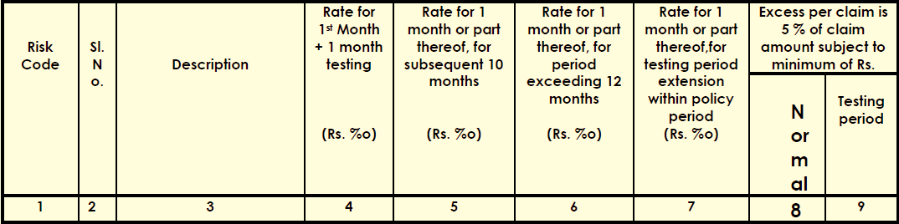
Project Insurance Erection All Risk Insurance
Section 02
Rate Schedule e.g.
Date
Engineering LOB

Slide 54
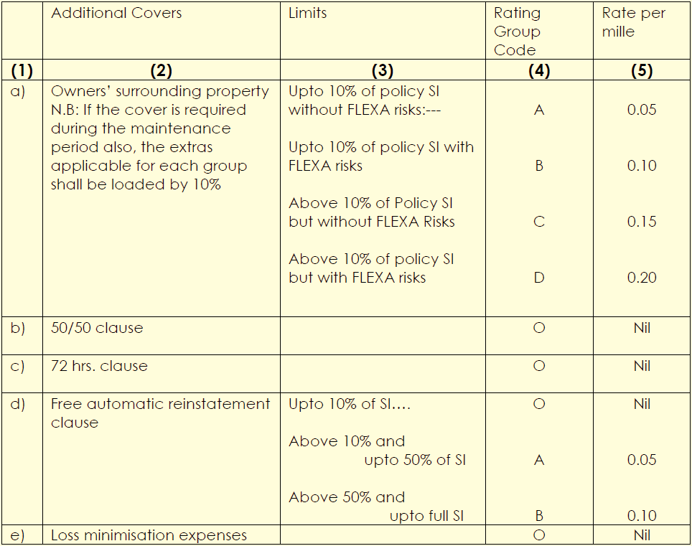
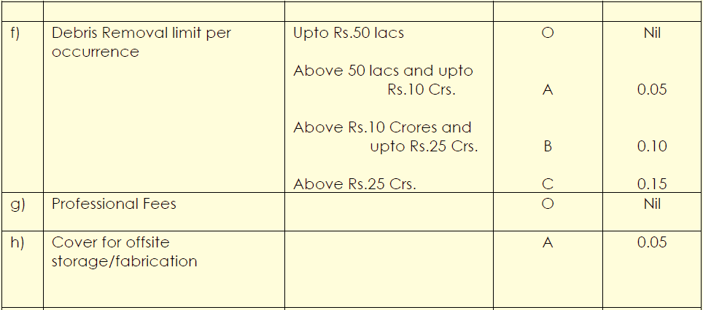
Project Insurance Erection All Risk Insurance
Section 02
Additional covers
Date
Engineering LOB

Slide 55
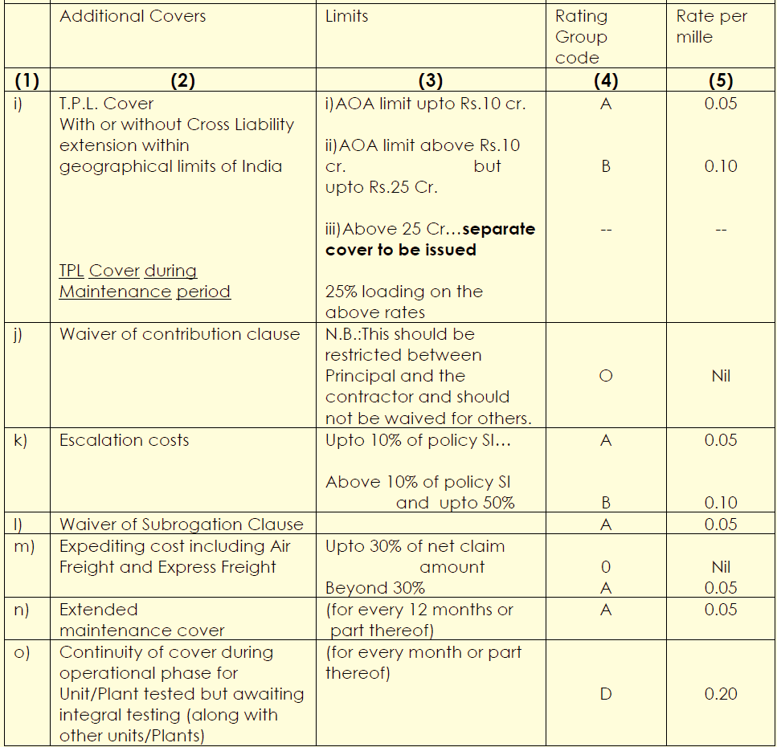
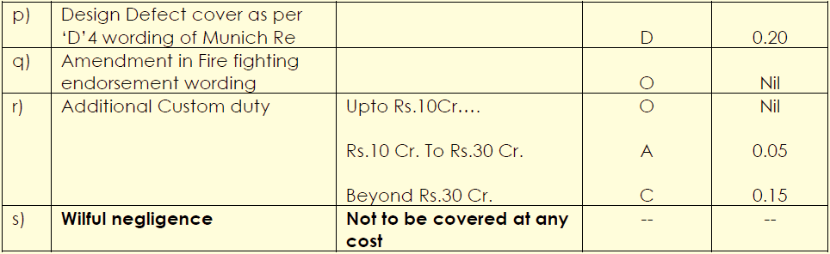
Project Insurance Erection All Risk Insurance
Section 02
Additional covers
Date
Engineering LOB

Slide 56
Project Insurance Erection All Risk Insurance
Section 02
Rating method for projects above 100 Cr. Under CAR/ EAR
Compute basic rate as per EAR/SCE/CAR tariffs without application of discounts.
2. Apply Volume discount on the basic rate as per prescribed Scale
3. Apply Voluntary Excess Discount on the net rate arrived as in (2) above, as per the prescribed scale
4. Adjust the net rate as arrived in (3) above, by addition/subtraction of the following additional extras/reductions corresponding to various additional covers listed in the Annexure - 2 to arrive at the overall net rate.
Date
Engineering LOB

Slide 57
Basic Understanding : Erection All Risk Insurance Policy
Section 02
General Regulations
Jurisdiction
Scope
Marine/ Transit Risks
Sub contracts forming part of a Project
Sum Insured
Storage rate at fabricators premises/ workshop
Erection All risk rates
Volume discount
Additional rate for dismantling cover
Additional rates for Earthquake
Excess for claims arising out of major perils / AOG
Rules for fire protection
Higher excess discount
Clearance and removal of debris
Third party liability cover/ Cross liability cover
Terrorism cover
Civil works
Cost of erection
EAR Tariff
  General Rules and Regulations
  Standard Policy Form
  Proposal
  Rating Schedule
  Declined Risk
  Excess
  Escalation Provision
  Option to Insure under MB/ EEI
  Additional Rates
  Endorsements
Date
Engineering LOB

Slide 58
Basic Understanding : Erection All Risk Insurance Policy
Section 02
General Regulations
Surrounding property
Escalation provision
Mid term increase in sum insured
Additional rate for express freight (Air excl.), overtime
Additional rate for Airfreight only
Additional customs duty
Construction Plant and Machinery
Rates for extension
Claim discount/ loading on extension rates
Rates for testing period extension
Mantainance visit cover and extended maintenance cover
Test run definition (Thermal power plants)
Testing period for plants (other than Thermal power)
Suspension of testing period
Combined cycle power plants
Cover for catalyst (fertilizer and chemical plant)
Refund of premium for early completion
Refund of premium for cancellation
Gross rates
Issue for fire policy during testing period
EAR Tariff
  General Rules and Regulations
  Standard Policy Form
  Proposal
  Rating Schedule
  Declined Risk
  Excess
  Escalation Provision
  Option to Insure under MB/ EEI
  Additional Rates
  Endorsements
Date
Engineering LOB

Slide 59
Basic Understanding : Erection All Risk Insurance Policy
Section 02
General Regulations Marine/ Transit Risks
Where Marine/Transit Insurance connected with Erection All Risks Insurances of any project is placed in India simultaneously or later on in one combined or under separate Policies in one department or in different departments, the matter relating to Erection All Risks/Storage-Cum-Erection Cover is required to be underwritten, subject to these General Regulations.
Date
Engineering LOB

Slide 60
Basic Understanding : Erection All Risk Insurance Policy
Section 02
General Regulations Subcontracts forming part of project
  Irrespective of whether the project value has been broken into sections and orders/ contracts are placed with different suppliers, contractors or sub contractors or insured carry out work themselves departmentally , the insurances for all such sub contracts are subject to these regulations
Date
Engineering LOB

Slide 61
Basic Understanding : Erection All Risk Insurance Policy
Section 02
General Regulations Sum Insured
  Sums Insured on the following items are to be taken into account for arriving at total sum insured for EAR Insurance
  a) Marine (Imports) -landed cost at site
  b) Marine (Indigenous) -landed cost at site
  c) Cost of Erection (exclusive of preoperative expenses but inclusive of cost of visits of specialists and supervision charges).
  d) Permanent Civil Engineering Works
  e) Half the escalated value, if escalation is opted for.
  DUTY IN CASE OF OVERSEAS CONSIGNMENTS –
  In respect of overseas consignments certain additional valuation on account of the following will get added to the CIF value, after the goods are cleared at the docks
  i) Custom Duty paid on clearance and
  ii) Clearing & forwarding charges to the agents concerned.
  In such cases the `Duty' can be covered at full rate applicable for Marine (imports).
Date
Engineering LOB

Slide 62
Basic Understanding : Erection All Risk Insurance Policy
Section 02
General Regulations Storage rate at fabricators premises/ workshop
  The Storage Risks at the Fabricator‟s Premises/Workshop can be covered as an extension to the EAR/SCE policies and for such storage the Rate and Excess are as under –
  Storage Rate Rs. 0.30 per mille per month or part thereof
  Excess Rs. 5000 per claim during storage
  10 % claim amount subject to minimum of testing period excess per AOG/Fire/Explosion claim.
Date
Engineering LOB

Slide 63
Basic Understanding : Erection All Risk Insurance Policy
Section 02
General Regulations Erection All Risk rates
  1) Column No.4 of Rate Schedule- Prescribes rate for first two months of the project period (first month plus one month‟s testing), the same rate will apply for EAR Insurances for a period of two months even where the testing cover is not required.
  Similarly, the rate prescribed under column No.4 will apply for EAR Insurances where the policy period (including testing period) is two months or less and the testing period is one month or less.
  2) EAR/SCE period -
  The EAR/SCE period has to commence from the date of arrival of first consignment at the site of erection. However, it may happen that in a few cases the Insured may take EAR/SCE insurance at a much later date. In all such cases irrespective of the date of commencement of the insurance, the SCE rate has to be computed for the total period commencing from the date of arrival of the first consignment at the site of erection.
  In all such cases the Insurers should clearly
  stipulate that any damages which have taken place
  prior to commencement of the insurance, are
  not covered by the policy.
Date
Engineering LOB

Slide 64
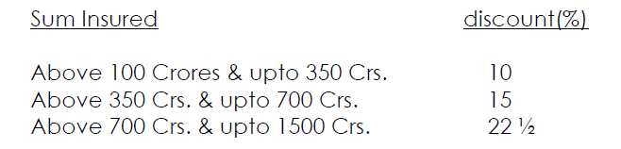

Basic Understanding : Erection All Risk Insurance Policy
Section 02
General Regulations Volume Discount
  For projects with Sum Insured above Rs. 100 Crores and upto Rs. 1500 Crores, the applicable Volume Discount shall be as per „Annexure I‟.
  ii) Volume Discount will not be applicable for the following extensions:
  a) Additional Rate for risks situated in Earthquake zone I & II
  b) Additional Rate for testing of second hand machinery
  c) Policy Extension Rates
  d) Maintenance Period Rate
  e) Air freight
  f) Additional Custom Duty
  g) Fabricators premises extension
  h) Intermediate Storage
  Note: No volume discount is applicable on this additional rate for testing of second hand machinery.
Date
Engineering LOB

Slide 65
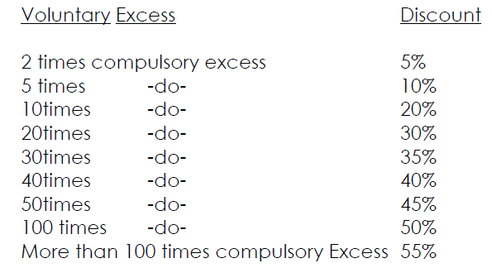

Basic Understanding : Erection All Risk Insurance Policy
Section 02
General Regulations Voluntary Excess
  Note: Net discounted EAR/ SCE/ CAR rate shall not be
  less than 30% of basic rate
Date
Engineering LOB

Slide 66
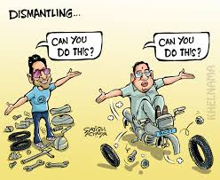
Basic Understanding : Erection All Risk Insurance Policy
Section 02
General Regulations Additional rate for dismantling cover
  The Additional Rates for Dismantling Cover will be 60 % of the total SCE Rate irrespective of the period for Dismantling.
  The Dismantling Extra of 60 % should be applied on the total EAR/SCE Rate excluding additional `Testing' and `Earthquake' Extras.
Date
Engineering LOB

Slide 67
Basic Understanding : Erection All Risk Insurance Policy
Section 02
General Regulations Additional rates for Earthquake
  Irrespective of sum insured for EAR, additional rates for Earthquake are to be charged according to the earthquake zone as per Fire tariff
  Earthquake cover on first loss basis - Earthquake cover could be granted on first loss basis with Sum Insured limits of 20% (OR 10%) of the total Sum Insured at the rates of 50 % (OR 40 %) of the tariff rate calculated on the total sum insured.
Date
Engineering LOB

Slide 68
Basic Understanding : Erection All Risk Insurance Policy
Section 02
General Regulations Excess for claims ‘AOG perils’
  Minimum rate for AOG in project insurance is 0.15 per mille
  Excess: 10 % of the claim amount subject to a minimum of the Testing Period Excess with an upper limit of Rs. 5 Crores.
  Minimum excess will be 5X minimum excess as per tariff
Date
Engineering LOB

Slide 69

Basic Understanding : Erection All Risk Insurance Policy
Section 02
General Regulations Rules for Fire Protection
  For unprotected construction/erection sites of risks having Sum Insured less than Rs. 50 Crores excess applicable shall be 10% of claim amount subject to minimum of testing period excess with an upper limit of Rs. 2 Crores.
  In respect of Risks with Sum Insured of Rs. 50 Crores and above, the excess applicable shall be 20% of claim amount subject to minimum of testing period excess with an upper limit of Rs. 3 Crores.
  Insurers may reduce the excess to 10% of claim amount subject to minimum of testing period excess, with upper limit of Rs. 2 Crores wherever requirements under Rule 11A(I) below are complied with within first 25% of the project period OR 12 months whichever is less.
  Insurers may also grant 2.5% discount on EAR/SCE premium rates and reduce the excess for fire/explosion claims to 5 % of claim amount subject to minimum of testing period excess with an upper limit of Rs. 2 Crores in respect of proposals which comply with the relevant regulations under Rule 11 A(I) & (II) within first 25 % of the project period OR 12 months whichever is less.
Date
Engineering LOB

Slide 70
Basic Understanding : Erection All Risk Insurance Policy
Section 02
General Regulations Rules for Fire Protection
A - Rules for Fire Protection –
  I) Minimum Compulsory Requirements applicable to all risks irrespective of Sum Insured -
  i) One portable fire extinguisher of Soda Acid or Water type for every 300 sq. m of storage/erection site area or small bore hose reels as per Relevant Section of Fire Protection Manual of TAC shall be provided. The location of fire extinguishers shall be conspicuously marked by clearly visible signs. Checking and maintenances at regular intervals shall be recorded.
  ii) Trained fire fighting squad shall be maintained for the site.
  iii) Watch and Ward facility shall be provided round the clock at the site/premises.
  iv) One fire engine of 400 GPM x 100 PSI shall always be stationed at site.
  Note - Not applicable to policy with Sum Insured upto Rs. 50 crores
  v) Materials and equipments stored in buildings (sheds) or in open area shall be divided into sub-units with the value, which shall not exceed 10% of the sum insured or Rs. 50 Crores whichever is less. Wherever value of single equipment stored exceeds this limit, its value shall be taken as the limit. The sub-units in open area shall be separated from each other by a distance of atleast 15 m. In case of storage buildings, firewalls of 9" thickness carried upto roof shall be erected without any wall openings between the sub-units.
  vi) Packing materials, scaffolding etc. combustible materials and liquids and explosive substances should be stored at a 30 M safe distance from other buildings, plants and stores.
  vii) Utmost attention should be paid to good housekeeping
Date
Engineering LOB

Slide 71
Basic Understanding : Erection All Risk Insurance Policy
Section 02
General Regulations Rules for Fire Protection
A - Rules for Fire Protection –
  I) Minimum Compulsory Requirements applicable to all risks irrespective of Sum Insured -
  vii) Utmost attention should be paid to good housekeeping such as -
  • Orderly storage;
  • Periodic removal of combustible packing material, either by burning on site at a safe distance of 100 M or removal from the site;
  • Clean-up of site atleast once a week;
  viii) Open flame work (welding, cutting etc.) requires utmost caution. All combustible materials lying around must be removed or covered.
  ix) Grass and/or any other vegetation in and around the site are regularly removed.
  x) "No smoking" rules must be enforced in areas exposed to fire (stores etc.) and in the vicinity of hazardous operations.
  xi) Living quarters should be well separated (100 M away) from construction site.
  xii) In addition to above, the following fire prevention measures are recommended:
  a) The site be secured by properly constructed fence.
  b) Temporary buildings (offices, rest rooms, material stores etc.) be made of non - combustible materials. Safe distances of 15 M be kept between temporary buildings (this applies in particular to material stores).
Date
Engineering LOB

Slide 72
Basic Understanding : Erection All Risk Insurance Policy
Section 02
General Regulations Rules for Fire Protection
A - Rules for Fire Protection –
  II) Additional Fire Protection Requirements for earning Discount on EAR/SCE Premium–
  i) One fire engine or two trailer pumps of 400 GPM x 100 PSI shall be provided for every 10,000 Sq-m of largest storage site with maximum of two Fire Engines or 4 trailer pumps. In case of Trailer pumps, vehicular arrangements shall be available for towing them. (in lieu of item iv above)
  ii) Static water tanks of atleast 10,000 gallons capacity shall be provided, which shall be so placed that no part of storage/erection site lies beyond 100 M of atleast 2 tanks (50 M in case of storeyed structures).
  OR
  Alternatively a temporary hydrant system with atleast 4" dia. hydrant mains shall be laid which shall always be pressurised to 1.0 KSC from where fire engines/Trailer pumps can draw their supply from a double hydrant (DH). Each DH may be taken as equivalent to a static water tank described above. Pumping capacity of the general water supply shall be in excess of 1,00,000 litres.
  iii) 36 hoses, 15 M long and 18 nozzles shall be provided to ensure that all parts of the contract works can be reached with water.
  iv) Trained fire fighting squad consisting of atleast 8 persons per shift shall be maintained at the site. (in lieu of Item A I(ii) above)
Date
Engineering LOB

Slide 73
Basic Understanding : Erection All Risk Insurance Policy
Section 02
General Regulations Clearance and removal of debris
  The rate applicable for Storage-cum Erection cover is to be charged on the limit of Sum Insured fixed for `Clearance and Removal of Debris.'
  Where the Project is a mix of both old and new machinery, the EAR/SCE Rate as applicable for the new machinery is to be charged on the limit of sum insured selected for Clearance and Removal of Debris.
  The policy excesses should apply to Clearance and removal of debris claims
Date
Engineering LOB

Slide 74
Basic Understanding : Erection All Risk Insurance Policy
Section 02
General Regulations Third party liability cover
  Rate applicable to CAR policy will be charged on the limit of sum insured fixed for Third party liability cover up to the following limits
  For policies with SI up to 10 Cr : TPL SI up to 1 Cr
  For policies with SI above 10 Cr : TPL SI up to 10 Cr or 10% of total erected value of project , whichever is less
  CROSS LIABILITY COVER
  The Third Party Liability Cover can be modified to offer cover to the insured parties named in the Policy schedule as if a separate policy has been issued to each party. The additional premium for this purpose shall be 50 % of the premium applicable for TPL cover as in (A) above.
Date
Engineering LOB

Slide 75
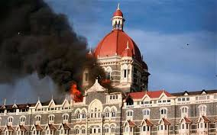
Basic Understanding : Erection All Risk Insurance Policy
Section 02
General Regulations Terrorism Cover
  Pool rate for Industrial risk is applied to projects as well
  Rate for projects with sum insured up to 500 Cr is Re. 0.23 per mille
  For Sum insured higher than 500 Cr and up to 1500 Cr,
  Rate for first 500 Cr is Re. 0.23 per mille and
  Rate is Re. 0.20 on sum insured in excess of 500 Cr
  Excess for terrorism claim will be 5% of claim amount
  subject to minimum of INR 1,00,000 and maximum 2.5 Cr.
Date
Engineering LOB

Slide 76

Basic Understanding : Erection All Risk Insurance Policy
Section 02
General Regulations Civil works / Cost of Erection
  CIVIL WORKS -
  The civil works related to machinery foundations should necessarily be covered along with the machinery under EAR/SCE Policies.
  The rate as applicable for EAR/SCE cover is to be charged on the limit of Sum Insured fixed for civil works.
  The policy excess (Normal/Testing period) should apply for Civil Works also.
  COST OF ERECTION -
  The rate applicable to Cost of Erection would be the EAR/SCE rate.
Date
Engineering LOB

Slide 77
Basic Understanding : Erection All Risk Insurance Policy
Section 02
General Regulations Surrounding property cover
  For covering the specified surrounding property of the Insured the rate applicable will be 50 % of the EAR/SCE rate and should be charged on the limit of sum Insured selected for surrounding property.
  Where the project is a mix of both old and new machinery 50 % of the EAR/SCE Rate as applicable for new machinery is be charged on the limit of sum insured selected for surrounding property.
  The policy excesses (Normal/Testing period) should apply for surrounding property also.
  Reinstatement of the indemnity limit on payment of additional premium after occurrence of claim can be allowed for this extension.
Date
Engineering LOB

Slide 78
Basic Understanding : Erection All Risk Insurance Policy
Section 02
General Regulations Escalation provision
  Whenever additional Sum Insured is required for Escalation in the values, the Escalation Benefit will be limited to a maximum of 50 % of the sum insured for EAR/SCE (the escalation limit shall be expressed in percentage) and will be permitted only once at the time of inception of the EAR/SCE Policy.
  Additional Premium should be charged for 'Escalation Provision‟ at the rates prescribed for EAR /SCE), but on the 50 % of the amount of escalation.
Date
Engineering LOB

Slide 79
Basic Understanding : Erection All Risk Insurance Policy
Section 02
General Regulations Mid term increase in sum insured
  If the Sum Insured for EAR/SCE is required to be increased during the Policy period the premium should be collected on the additional Sum Insured at applicable EAR/SCE rate. It is not permissible to charge pro-rata premium on such increased Sum Insured.
  Mid-term increase in Sum Insured shall be affected only after the same has been recorded in the policy by the Company, before the occurrence of any claim.
  In such cases, no additional volume discount shall be applicable.
Date
Engineering LOB

Slide 80
Basic Understanding : Erection All Risk Insurance Policy
Section 02
General Regulations Additional rate for express freight (excl. Air), holiday, overtime rates
  The additional premium for covering Express Freight (Air Freight excluded) Holiday and Overtime Rate of Wages will be at the basic SCE Rate (excluding extras for Earthquake, Dismantling etc.) to be applied on the limit selected.
  Reinstatement of the indemnity limit on payment of additional premium after occurrence of claim can be allowed for this extension.
Date
Engineering LOB

Slide 81
Basic Understanding : Erection All Risk Insurance Policy
Section 02
General Regulations Additional rate for Air freight only
  The Rate and Excess as under shall be charged exclusively for items of Air Freight only and subject to the limit selected by the Insured for Indemnity against Air Freight only
  Rate 5 % on the amount of indemnity selected
  Excess 5 % of the Air Freight incurred per claim, in addition to policy Excess.
  Reinstatement of the indemnity limit on payment of additional premium after occurrence of claim can be allowed for this extension.
  Air Freight cover applies to both Marine and SCE portion of a MCE Policy.
Date
Engineering LOB

Slide 82
Basic Understanding : Erection All Risk Insurance Policy
Section 02
General Regulations Additional customs duty
  The cover for Additional Customs Duty will be subject to the following rates, terms and conditions -
  a) The cover for Additional Customs Duty will be on first Loss Basis.
  b) The specific amount for Additional Customs Duty has to be selected by the insured at the inception of the policy and cannot be reinstated in the event of loss.
  c) The rate and excess will be as under –
  Rate 2 % to be charged on the Additional Customs Duty amount selected.
  Excess 5 % of the Additional Custom Duty incurred, in addition to the excess amount applicable for the affected item under the policy.
  Note -This extension can also be made available to projects in respect of which the original imports are exempted by the Govt. of India from payment of Custom Duty but the Custom Duty is payable on replacement items. In such cases the basic duty component taken into account in arriving at the sum insured shall be considered as ZERO.
Date
Engineering LOB

Slide 83
Basic Understanding : Erection All Risk Insurance Policy
Section 02
General Regulations Construction machinery plant and equipment
  Separate sum insured is fixed for CPM equipment used for EAR projects
  Where such Sum Insured does not exceed 5% of EAR sum insured or 25 Lac (whichever is lower), the same can be covered under EAR policy at EAR policy rates and excesses
  Where such sum insured exceeds 5% of EAR sum insured or 25 Lac , the same should be insured separately under CPM policy.
Date
Engineering LOB

Slide 84
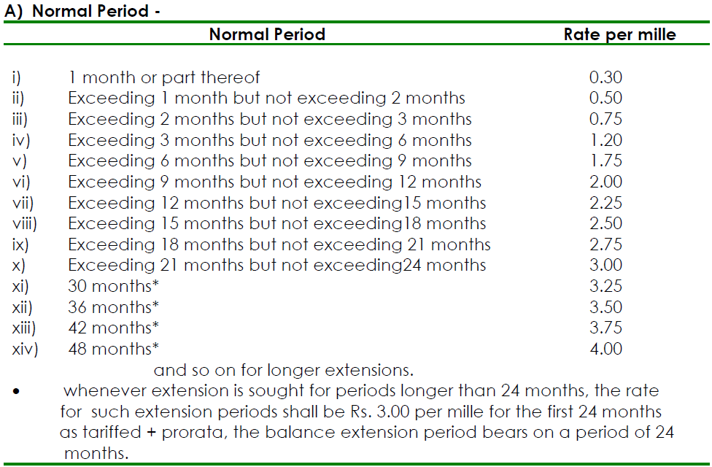
Basic Understanding : Erection All Risk Insurance Policy
Section 02
General Regulations Extension rates (for extension of insurance beyond policy period)
Date
Engineering LOB

Slide 85

Basic Understanding : Erection All Risk Insurance Policy
Section 02
General Regulations Extension rates (for extension of insurance beyond policy period)
  Extension rates shall apply on the value on the remaining part of the project, which is yet to be completed (i.e. which have not gone out of EAR/SCE Cover).
  Volume Discount is not applicable but higher excess discount is permitted on the extension rate.
  Excess will be as per original policy. (ie Higher Excess Discount shall be allowed on the extension rate, if the original policy carried Higher Excess Provision)
  Irrespective of the number of extensions availed of by the Insured the above extension rates will apply for each extension.
  For the risks located in Earthquake Zones Pro-rata extra of the additional rates for Earthquake will also apply for Extension Periods beyond Policy period, in addition to the Normal extension Rates for EAR/SCE Cover pre scribed above.
Date
Engineering LOB

Slide 86
Basic Understanding : Erections All Risk Insurance Policy
Section 02
General Regulations Claims discount/ loading on Extension rates
  Discounts/ loading is applicable to proposals above 100 Cr, and shall apply on extension rates as under
  Maximum discount applicable is 60% and final rate after applying all discounts should not be less than 40% of basic EAR rate
Date
Engineering LOB

Slide 87

Basic Understanding : Erection All Risk Insurance Policy
Section 02
General Regulations Extension rates (for testing period extension)
  For Petrochemical Plants, Fertilizer Plants, Petroleum Refineries, Power Plant and Gas Turbine/Combined Gas Cycle Plant, the following rates apply for extension of testing period beyond one month – Extension within Policy period 0.50 per mille per month or part thereof
  Extension beyond Policy period : 0.70 per mille per month or part thereof
Date
Engineering LOB

Slide 88
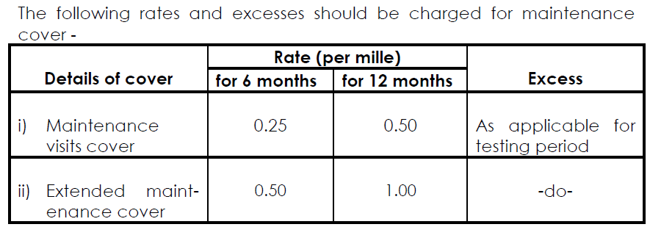
Basic Understanding : Erection All Risk Insurance Policy
Section 02
General Regulations Maintenance visit and extended maintenance cover
  This cover should be granted at the inception of the policy only. It cannot be granted just prior to commencement of maintenance period.
  Notes –
  a) Charging premium on pro-rata basis for periods less than 6 months, or 6 to12 months shall not be allowed.
  b) These covers could be granted for periods exceeding 12 months, as required under the contract at the rate of Rs1.00per mille per annum.
  c) In case of deletion of maintenance visit/extended maintenance cover (availed at inception of policy) before attachment of risk, refund of premium may be given by retaining 25 % of the premium under this extension.
  d) In case the risk is attached, no refund shall be allowed for deletion of maintenance visit/extended maintenance cover.
Date
Engineering LOB

Slide 89
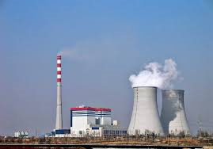
Basic Understanding : Erection All Risk Insurance Policy
Section 02
General Regulations Test run definition (thermal power plant)
  The entire Power Station machinery are deemed to have commenced their first test operation or test loading from the date of synchronisation of the Turbo Generator set with the grid system/bus bar provided the date of synchronisation is within 72 hours from the date of introduction of steam into turbine and shall continue till the Turbo Generator Set is operated at full load for a continuous period of 72 hours or until expiry of testing period granted under the policy whichever is earlier. If, however, the date of synchronisation exceeds 72 hours from the date of introduction of steam of the first trial operation test loading is deemed to have commenced from the date of introduction of steam into the turbine of the Turbo Generator set.
Date
Engineering LOB

Slide 90
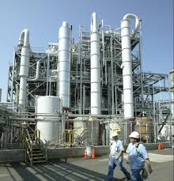
Basic Understanding : Erection All Risk Insurance Policy
Section 02
General Regulations Test run definition (other than thermal power plant)
  Testing period available under the policy shall cease to operate with the commencement of the commercial production or with the handing over of the plant to the principal whichever is earlier. In no case, the duration of the testing period shall exceed 12 months.
Date
Engineering LOB

Slide 91

Basic Understanding : Erection All Risk Insurance Policy
Section 02
General Regulations Suspension of testing period
  If testing is suspended after commencement of test run and if such period during which no testing activity is carried on exceeds 7 days in duration, it can be treated as erection period, provided
  i) it is within the policy period,
  ii) it does not fall within testing extension period.
  iii) it is due to fortuitous accident happening anywhere at site and
  iv) situation is beyond the control of insured
  In consideration of this, the testing period shall remain reduced by number of days the testing was carried out in the initial test run.
Date
Engineering LOB

Slide 92
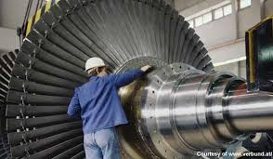
Basic Understanding : Erection All Risk Insurance Policy
Section 02
General Regulations Combined cycle power plants
  In those cases, where both GT's & ST's are covered under the same EAR/SCE policy for a common period of insurance, the policy can be extended to cover OPEN CYCLE Mode of GT's at following rates -
  ▪ Within policy period - Re. 1.00 per mille per month or part thereof
  Note – Gas Turbines, which are covered under separate policies have to be considered operational and the EAR/SCE covers can not be extended to cover such GTs during OPEN CYCLE modes.
Date
Engineering LOB

Slide 93

Basic Understanding : Erection All Risk Insurance Policy
Section 02
General Regulations Cover for Catalyst (Fertilizer & Chemical Plants)
  a) The Catalyst is automatically covered for storage and Erection risks at the normal EAR/SCE rate if the value of Catalyst is included under the sum insured.
  b) For covering the catalyst during hot testing period the additional rate applicable is Rs. 20/- per mille (to be charged on the value of the catalyst) with an Excess of 5 % of the value of the catalyst subject to a minimum of Rs. 2,50.000/- over and above the excess as applicable under the policy.
  c) If both equipments and catalysts are damaged, the respective excesses on equipments and catalyst shall be applicable separately.
Date
Engineering LOB

Slide 94
Basic Understanding : Erection All Risk Insurance Policy
Section 02
General Regulations Refund on early completion of project
  Refund of premium for completion of the project earlier than the period mentioned in the policy schedule for any project (including the testing period) may be allowed subject to the undernoted conditions being complied with –
  a) The period of insurance is 18 months and above.
  b) Notice for early completion being given in advance to the insurer i.e. before commencement of testing or in any case not later than 7 days after commencement of testing.
  c) Claims Experience under the policy being less than 60 %.
  d) The minimum period for which refund can be claimed shall be 3 months.
  e) The refund of premium would be allowed only after re-working of the premium on reduced policy period.
Date
Engineering LOB

Slide 95

Basic Understanding : Erection All Risk Insurance Policy
Section 02
General Regulations Issue of fire policy during testing period
  No Fire Policy can be issued during „Testing Period‟ for items covered under EAR/SCE policy.
Date
Engineering LOB

Slide 96
Basic Understanding : Erection All Risk Insurance Policy
Section 02
EAR Tariff
  General Rules and Regulations
  Standard Policy Form
  Proposal
  Rating Schedule
  Declined Risk
  Excess
  Escalation Provision
  Option to Insure under MB/ EEI
  Additional Rates
  Endorsements
Endorsements
Civil engineering works
Fire/ explosion claims and fire fighting
Cross liability cover
Escalation
Air freight
Additional customs duty
Test run definition in respect of thermal power station
Test run definition in respect of gas turbines in respect of combined cycle power plant
Hydrocarbon endorsement for testing and commissioning
Storage endorsement
Safety measures
Damage to crops, forests etc.
Maintenance visit and extended maintenance
Underground cables and pipes
Open trenches during laying of pipelines ducts and cables
Leak search cost while laying pipelines
Date
Engineering LOB

Slide 97
Thanks
www.futuregenerali.in
Date

