Slide 1

Future Criticare
Standalone Critical Illness Cover
Protecting you and Your Family From Critical Illnesses

Slide 2

What Is Future Criticare?
Unlike a Health Insurance Plan, Critical illness cover pays out a cash sum if you meet the definition of any of the critical illnesses covered by your policy.
You can use the money as per your wish.
Ex: Pay off your expenses that would not be paid by your indemnity health insurance.

Slide 3
Do We Need Critical Illness Plan?
Normal indemnity plans can take care of your hospitalization expenses.
However, the financial losses in case of critical illnesses can be huge and can put both earning members out of work.
It is important to plan for financial sustenance during recovery period.
Ideal situation would warrant both indemnity plan for hospital expenses and a benefit plan for financial safety during recovery period.

Slide 4

Let Us Go Through Some Statistics!
Source Is A Research Paper published in III
In India Coronary Heart Disease (“CHD”) is more prevalent than cancer whereas in UK the trend is reverse.
2. In the next ten years, CHD is expected to increase many folds in rural as well as in Urban India. The range may vary from 13% to 80% at different ages. The major increase is expected in the younger ages than older ages. 3. In India both males and females have higher incidence rates of CHD than corresponding rates in UK.

Slide 5
Let Us Go Through Some Statistics!
4. In India females have higher heart attack rates than males, whereas in UK, the trend is opposite.
5. The incidence rates of strokes in India are very low as compared to UK.
6. Both in India and UK the incidence rates of cancer of females are heavier than males between the ages 20 to 60 years. 7. The cancer incidence rates in males and females in India are heavier up to age 60, after that, UK rates become heavier.

Slide 6
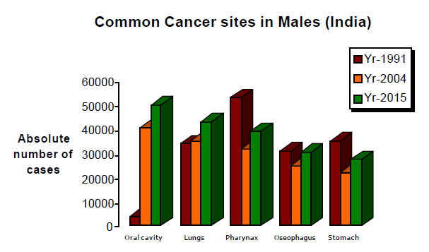
Let Us Go Through Some Statistics!

Slide 7

Coverage Offered
Presenting A Critical Health Cover
To Secure Family’s Financial future
In The Event Of Critical Illness!
Cancer ( Cancer Of Specified Severity )
First Heart Attack (Myocardial Infraction) of specified severity
Open chest CABG Coronary Artery Bypass Graft
Kidney Failure Requiring Regular Dialysis
Major Organ / Bone marrow Transplant
Stroke resulting in permanent symptoms

Slide 8
Coverage Offered
Multiple Sclerosis with persisting symptoms
Aorta Graft Surgery
Primary Pulmonary Arterial Hypertension
Coma of specified severity
Total Blindness
Liver Failure

Slide 9

Key Features
• 100% payout on the first occurrence of the covered event.
• Can be used over and above the existing Medical insurance coverage.
• Original medical documents will be returned back to the Customer.
• Available in wide range of Sum Insured's from 1 Lakh to 50 Lakhs.
• Product offered to age groups of 6 years to 65 years.
• Lifelong renewals
• No pre policy medical check up for age up to 45 years and SI- 5 Lakhs.

Slide 10
Key Features
• For all proposal forms with any health declaration (any sum inured and age) should be referred to Retail Health Underwriting.
• Medical screening process routed through FGH.
• 50% cost of medical examination would be reimbursed upon cheque realization and policy acceptance subject to submission of original itemized bills.
• Affordably low premium rates inclusive of Service tax.
• Premium paid is exempt under the section 80 D of Income Tax Act.

Slide 11

Conditions
• Waiting period of 90 days.
• Pre- existing illness excluded from coverage.
• Survival Period: At any point of time during the term of the Policy, any benefit shall be payable only if the Insured is alive for a period of more than or equal to 28 days from the date of the first diagnosis of the Critical illness / Undergoing for the first time of the Surgical Procedures / for the first time of occurrence of medical events.
• For details on Exclusions refer to Policy wordings.

Slide 12
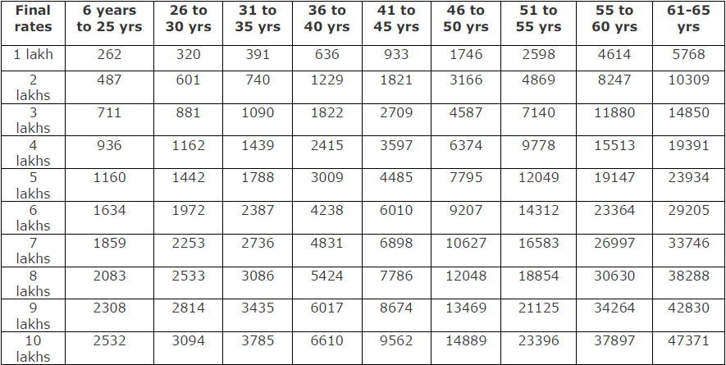

Premium Illustrations

Slide 13
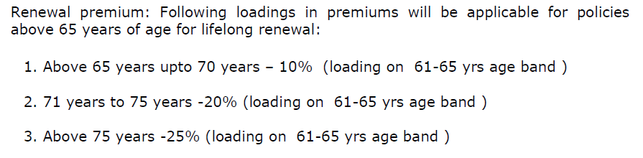
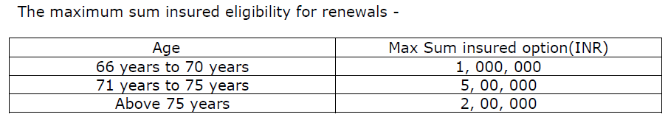
Premium Calculation

Slide 14
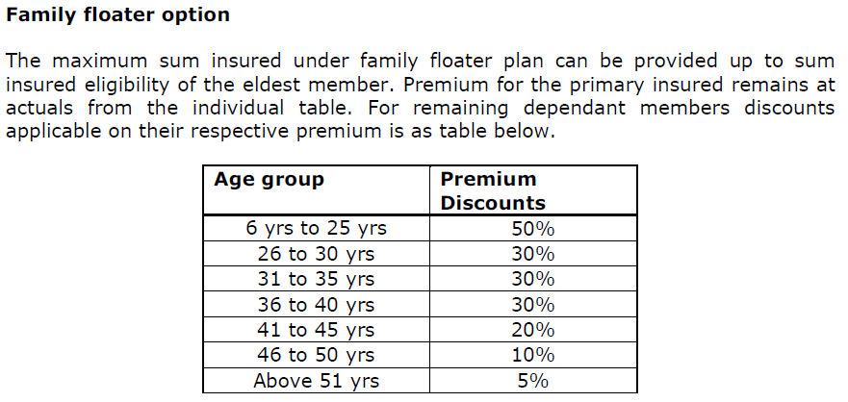
Floater Calculation
Family Definition: Self ,Spouse,2 children,2 dependent parents.

Slide 15

Premium Calculation
Name | Age | SI Required | Ind. Premium | Applicable Floater Discount | Floater Premium
Ramesh | 38 | 1000000 | 6610 | 30% | 4627
Rama ( Wife) | 33 | 1000000 | 3785 | 30% | 2649.5
Rajesh ( Father ) | 60 | 1000000 | 37897 | 5% | 36002.15
Jaya ( Mother ) | 55 | 1000000 | 23396 | 5% | 22226.2
Total Premium | Service tax of 15% has to be added to this total premium |  |  |  | 65504.85

Slide 16

Role Plays
Mr. Mukul is 40 years and working in a private firm.
His family comprises of wife and 2 children.
He is fond of travelling and food.
Earns about 70,000/- pm and wants his children to study well.
He goes for a vacation once every year.
He feels since he already has standalone health cover along with corporate cover, he need not go for any other health products.
Let’s sell Criticare to Mr. Rajesh.

Slide 17
Role Plays
Mr. Rakshit is ready to buy a Critical illness cover and an agent from competition has already visited him.
He is 42 with a wife of 38 yrs and 3 children of 9, 7 and 3 yrs.
He want to know what is special in Criticare.
He is looking for a SI of 10 lacs.

Slide 18

Underwriting Guidelines
• Requirements:
– Proposal Form
– Age proof
• Non Medical Limits:
– 6 years to 45 years up to SI- 5 Lakhs
• The maximum cover allowed per person for Future Criti- Care should not exceed Rs. 50 Lakhs
• For pre-existing adversities medical underwriting to be done on individual basis.

Slide 19
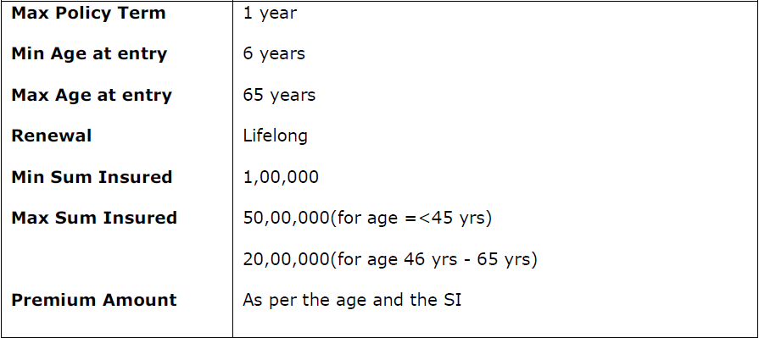
Underwriting Guidelines

Slide 20

General Exclusions 1
1. Benefits will not be available for Any Pre- Existing conditions or related condition(s) for which You have been diagnosed, received medical treatment, had signs and / or symptoms, prior to inception of Your first Policy, unless such a condition is stated in the proposal form and specifically accepted by the Company and endorsed thereon.
2. The Company shall not be liable to make any payment under this Policy in connection with or in respect of any Insured Event, as stated in this Section, occurred or suffered before the commencement of Period of Insurance or arising within the first 90 days of the commencement of the Period of Insurance.
3. Any medical procedure or treatment, which is not medically necessary or not performed by a Doctor.
4. Any treatment relating to birth defects and external or internal congenital Illnesses.
5. Birth control procedures and hormone replacement therapy.

Slide 21
General Exclusions 2
6. Any treatment/surgery for change of sex or any cosmetic surgery or treatment/surgery /complications/illness arising as a consequence thereof.
7. Treatment by a family member and self-medication or any treatment that is NOT scientifically recognized.
8. Ayurvedic, Homeopathy, Unani, naturopathy, reflexology, acupuncture, bone-setting, herbalist treatment, hypnotism, rolfing, massage therapy, aroma therapy or any other treatments including Alternative treatments other than Allopathy / western medicines.
9. Attempted suicide (whether sane or insane) or intentionally self inflicted Injury or Illness, or sexually transmitted conditions, mental or nervous disorder, anxiety, stress or depression, Acquired Immune Deficiency Syndrome (AIDS), Human Immune deficiency Virus (HIV) infection.

Slide 22
General Exclusions 3
10. Being under the influence of drugs, alcohol, or other intoxicants or hallucinogens unless properly prescribed by a Physician and taken as prescribed.
11. War, civil War, invasion, insurrection, revolution, act of foreign enemy, hostilities (whether War be declared or not), rebellion, mutiny, use of military power or usurpation of government or military power.
12. Participation in winter sports, skydiving/parachuting, hang gliding, bungee jumping, scuba diving, mountain climbing (where ropes or guides are customarily used), riding or driving in races or rallies using a motorized vehicle or bicycle, caving or pot-holing, hunting or equestrian activities, skin diving or other underwater activity, rafting or canoeing involving white water rapids, yachting or boating outside coastal waters (2 miles), participation in any Professional Sports, any bodily contact sport or any other hazardous or potentially dangerous sport for which You are untrained.

Slide 23
General Exclusions 4
12. Participation in winter sports, skydiving/parachuting, hang gliding, bungee jumping, scuba diving, mountain climbing (where ropes or guides are customarily used), riding or driving in races or rallies using a motorized vehicle or bicycle, caving or pot-holing, hunting or equestrian activities, skin diving or other underwater activity, rafting or canoeing involving white water rapids, yachting or boating outside coastal waters (2 miles), participation in any Professional Sports, any bodily contact sport or any other hazardous or potentially dangerous sport for which You are untrained.
13. Loss caused directly or indirectly, wholly or partly by infections (except pyogenic infections which shall occur through an Accidental cut or wound) or any other kind of Disease.
14. Diagnosis outside India; unless reaffirmed by Physician in Indian and subject to presentation of all Claim documents in English.

Slide 24
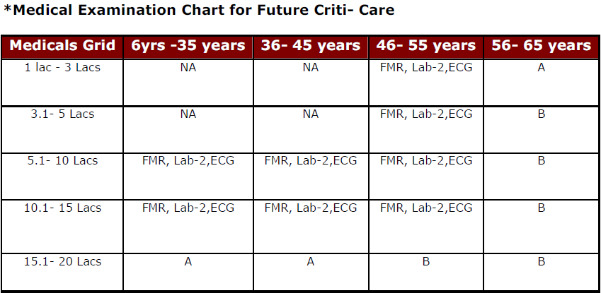
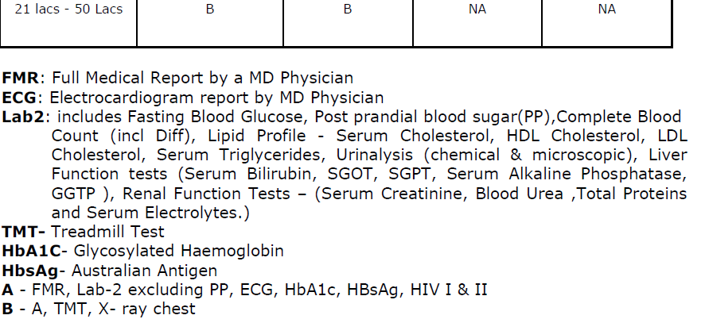
Underwriting Guidelines

Slide 25

Claims Procedure
Notification of Claim should be made in writing immediately, and in any event within 60 days of the aforesaid Illness/ condition/ surgical event but after the survival period of 28 days.
In the event of the death of the insured person post the survival period, someone claiming on his behalf must inform Us in writing immediately and send Us a copy of the post mortem report (if any) within 14 days.
We will scrutinize the claims and flag the claim as settled/ Rejected/ Pending within the period of 30 days of the receipt of the last „necessary‟ documents.

Slide 26
Claim Documents
• Discharge certificate/card from the Hospital.
• Attending Doctor’s / Consultant’s / Specialist’s/ Anesthetist’s certificate regarding diagnosis.
• Surgeon’s certificate stating nature of operation performed and Surgeon’s bill and receipt.
• Indoor case papers from the Hospital.
• Investigation reports confirming the diagnosis.

Slide 27

Thank You
Happy Selling

